Slide 1
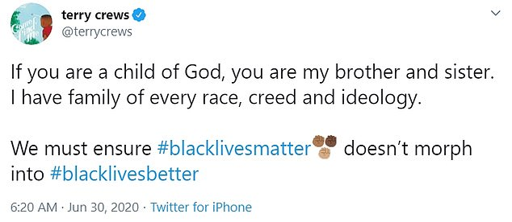
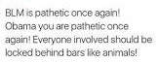
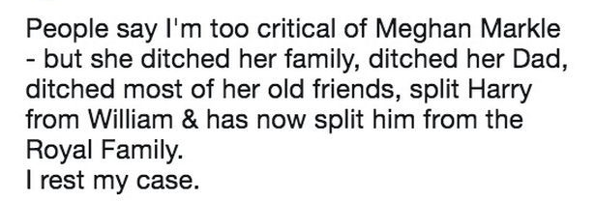
Week 4 / Lesson Four: DNA
1. How have these people voiced their opinions? Do you think they have done this correctly?
2. What do you think the writer's intentions were when writing their tweets?
Challenge: What other ways could these writer's voice their opinions and views? Is there a more effective way to do this?
Choose a character from AIC and write a tweet about society
@MrBirling
You can lead a horse to water, but you can't force it to drink...just like you can show your children how to act, but they still act like peasants. #Idiots #Disrespectful #ShouldBeSeenAndNotHeard
Notes:
context

Slide 2
Focus for the week:
Priestley's intentions
C/W Date
Lesson Title: Writer's intentions
Lesson Focus: make informed connections between texts that are different in time, culture and tradition
AO3:
Show an understanding of the relationship between texts and the context in which they’re written

Slide 3
Week focus: Priestley’s intentions
Word Consciousness – Please record on the back page of your exercise books
Word and definition | Your definition or synonyms
Apartheid (in South Africa) a policy or system of segregation or discrimination on grounds of race. segregation on grounds other than race. "gender apartheid"
Intentions Noun - a thing intended: an aim or plan

Slide 4
Learning Journey
Week focus: Priestley’s intentions
Last lesssson we examined the Inspector's presence in the play and how he affects other characters.
Today we will be reading the poem Nothing's Changed and comparing it with the Inspector's final speech
We will be writing a comparison paragraph about the two texts explaining the writer's intentions

Slide 5
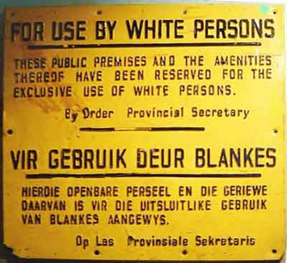
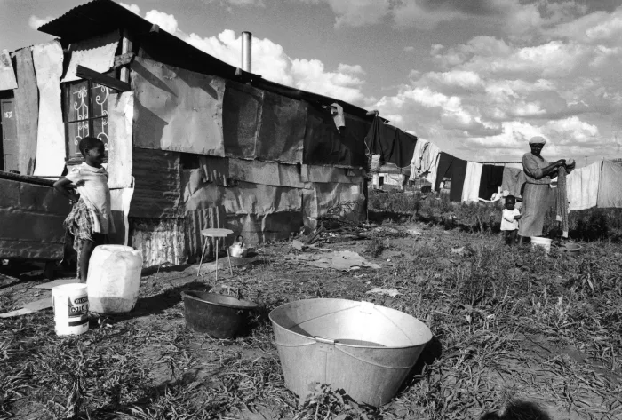
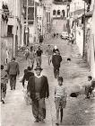
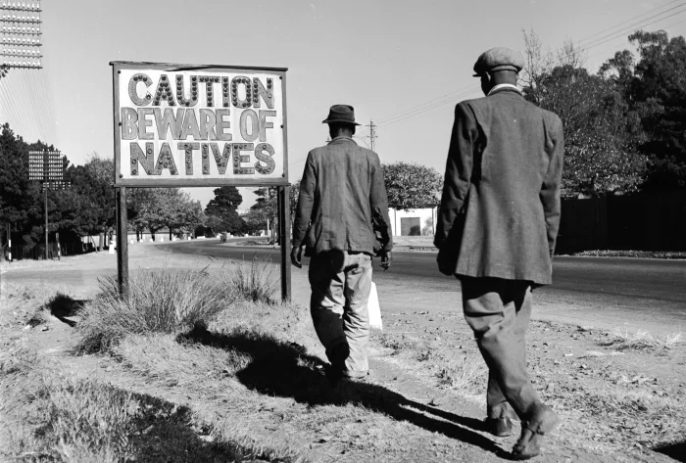
How are these pictures connected?
In 1948, Apartheid was introduced to South Africa. The county established laws that separated whites from black South Africans causing segregation and conflict for years.
The poem, Nothing's Changed, by Tatumkhulu Afrika, talks about the rampant apartheid system in District Six near Cape Town in South Africa, and explores the racism. ... It reveals the experience of Afrika returning to South Africa in 1994, after the system of racial separation, called Apartheid, had been upturned. Afrika discovered that nothing had changed.
Week focus: Priestley’s intentions

Slide 6
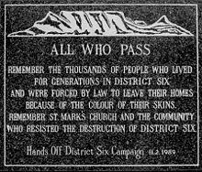
Nothing's Changed – Contiguous Read
Week focus: Priestley’s intentions
Follow the poem whilst listening it to being read out
https://www.youtube.com/watch?v=J9E1ry1q3pw
1. What were Afrika's intentions?
2. What message did he want to portray to his audience?
Think about:
Who? What? When? Why? How?

