Slide 1
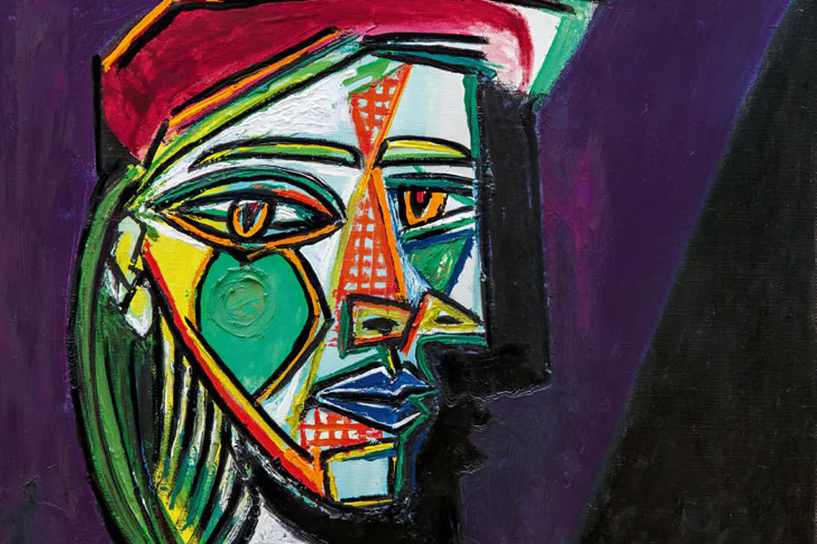
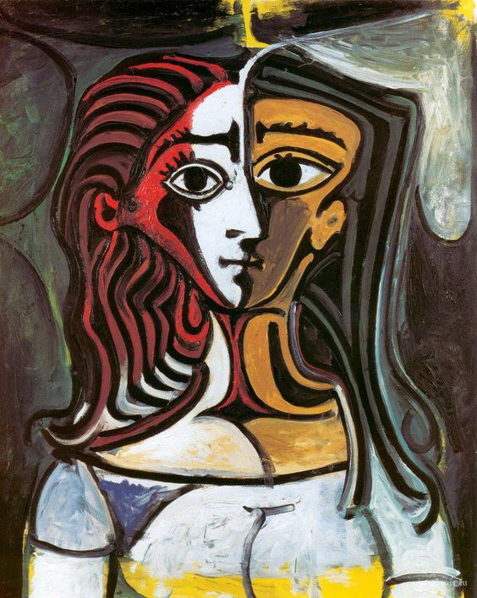
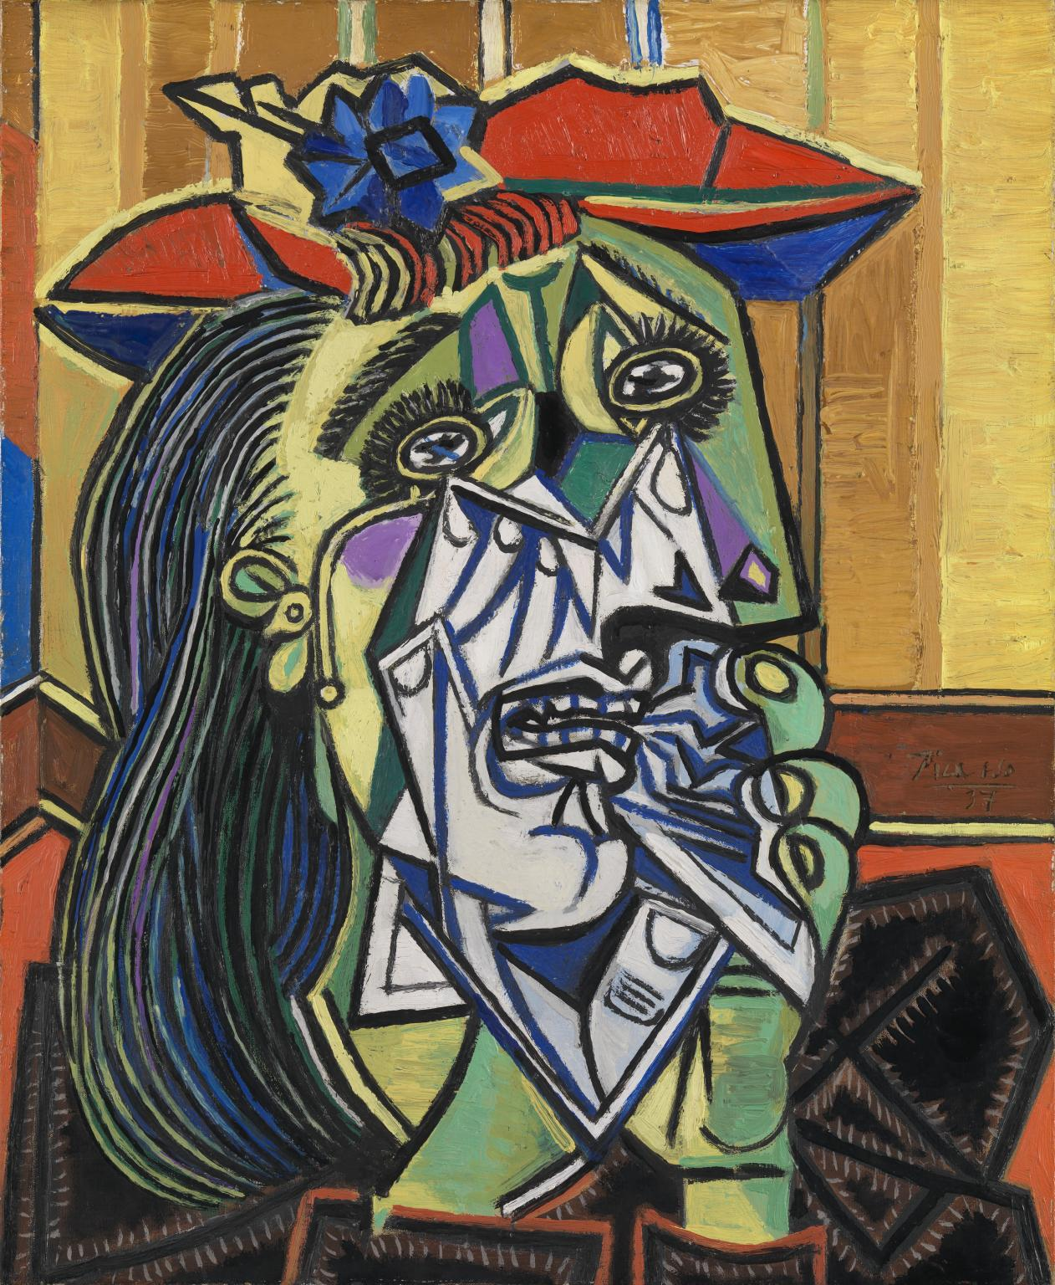
Task 6:
Example of his portraits
Picasso Research/Reference Page
Using this link gather information about Pablo Picasso to be able to create a reference page.
https://www.tate.org.uk/art/artists/pablo-picasso-1767
On the page you need
information about him,
his style of work,
where he lived,
what media does he do his paintings in
Images (either printed out or copy one of his works
Describe the images you have glued down or drawn

Slide 2
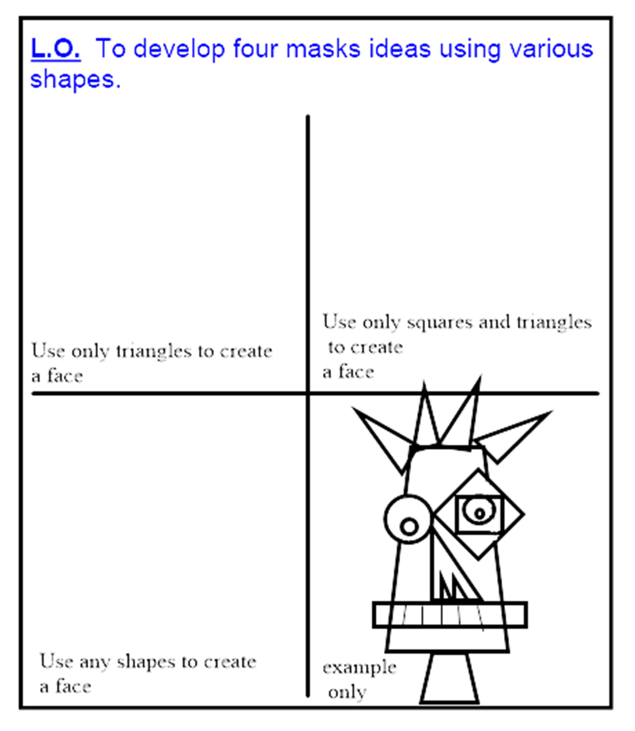
Task 7:
Pablo Picasso style portrait
Using the sheet on the next slide (if you can print) or design your own similar sheet and complete the boxes to create your own Picasso style shapes face
Once you have created 3 different shape faces – add colour - like Picasso – bright and bold but not the obvious colours you would expect for a face

Slide 3
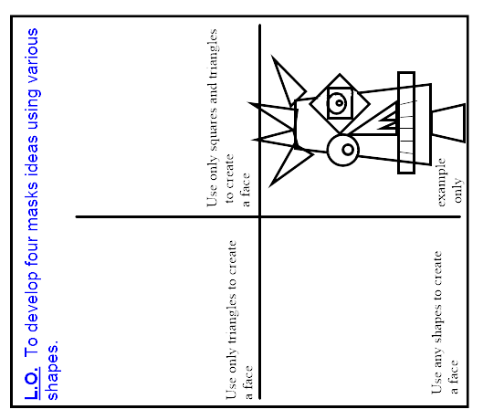
Help sheet – please print or create your own on paper – split your paper in to quarters and design faces made up of shapes

Slide 4
Task 8:
Enlarge your best idea from Task 7 – to A4 size
Add colour using your knowledge of colour blending – or shading if you have no colours

Slide 5
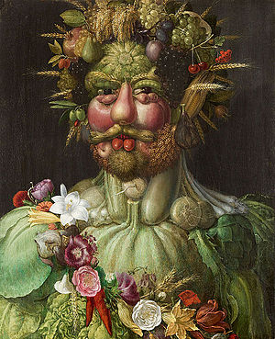
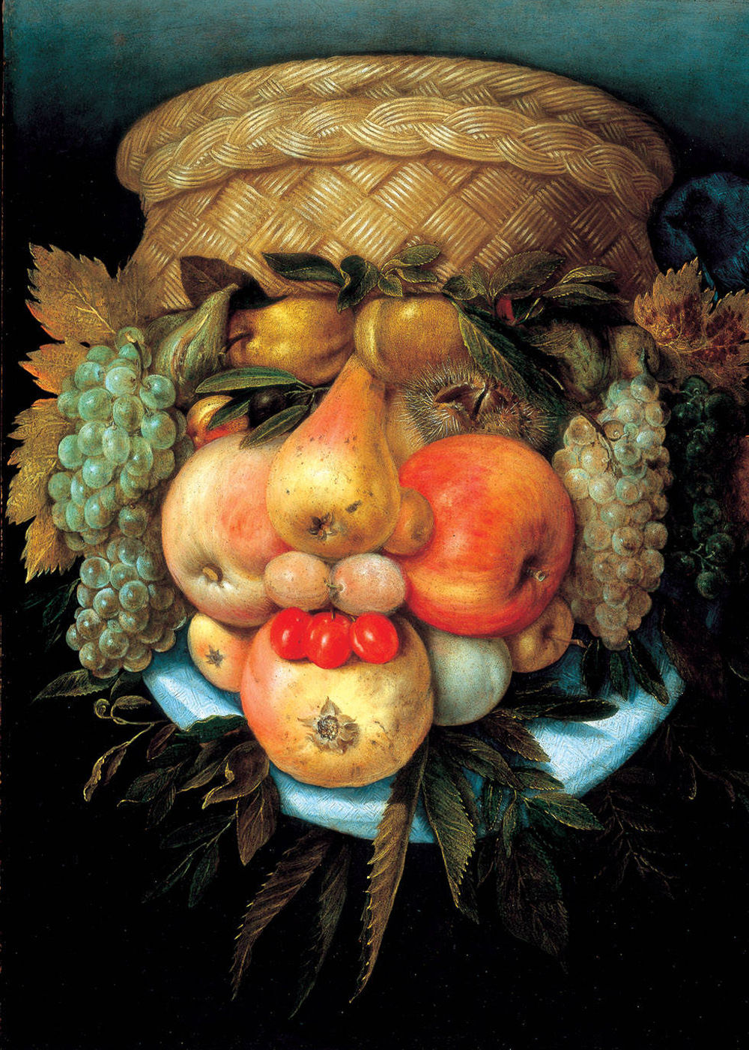
Task 9:
Example of his portraits
Arcimboldo Research/Reference Page
Using this link gather information about Pablo Picasso to be able to create a reference page.
https://www.giuseppe-arcimboldo.org/
On the page you need
information about him,
his style of work,
where he lived,
what media does he do his paintings in
Images (either printed out or copy one of his works
Describe the images you have glued down or drawn

Slide 6
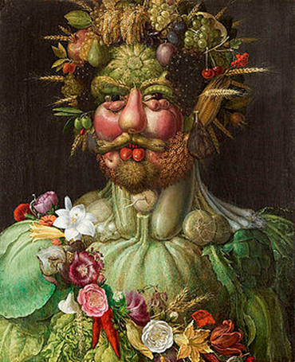
Task 10:
Create your own Giuseppe Arcimboldo style portrait.
You can choose any of the ways below to create your Arcimboldo portrait:-
Draw your objects to create a face
Create a sculpture and photograph it
Possible ideas you could think of:-
Using school equipment to create the face – for example a ruler for the mouth, small coloured crayons for eyebrows etc
You can use any equipment or objects you can find around the house to create your face to draw from or to take a photo of once you have created your portrait

