Slide 1
IDENTIFY the 4 components of blood (4)
Identify 2 long term effects on the CV system and explain how it helps
EXPLAIN the structure of each blood vessel
Identify 2 short term effects on the CV system and explain how it helps
DNA
Challenge – Explain what a balanced diet is

Slide 2
IDENTIFY the 4 components of blood (4)
Identify 2 long term effects on the CV system and explain how it helps
EXPLAIN the structure of each blood vessel
Identify 2 short term effects on the CV system and explain how it helps
DNA
Challenge – Explain what a balanced diet is

Slide 3
IDENTIFY the 4 components of blood (4)
Identify 2 long term effects on the CV system and explain how it helps
HR increases to get more blood to the working muscles
CO increase
BP increase
Blood shunts to working muscles
Body regulates temperature – red faced
Increase sweat releases salt and water through pores
Digestive system is bypassed
Red Blood Cells
White Blood Cells
Platelets
Plasma
EXPLAIN the structure of each blood vessel
Identify 2 short term effects on the CV system and explain how it helps
HR increases
CO increase
BP increase
Blood shunts to working muscles
Body regulates temperature – red faced
Increase sweat releases salt and water through pores
Digestive system is bypassed
DNA
Challenge – Explain

Slide 4
Role
Date: 10 February, 2020
Job
Functions of the Cardiovascular system
 | Good | Outstanding
Group 1: | TBAT explain how vascular shunting occurs and the mechanisms required to support this. | TBAT predict how the circulatory adapts to cope with a change in exercise intensity.
Group 2: | TBAT describe how the circulatory system regulates your body temperature | TBAT explain how vascular shunting occurs and the mechanisms required to support this.
Group 3: | TBAT identify the functions of the circulatory system | TBAT describe how the circulatory system regulates your body temperature
Notes:
Teachers explicitly share the purpose of the lesson/s with their students so that the students are in no doubt as to what is expected of them during the lesson. The teacher will:
Make the content, skills and thinking explicit
State clearly what the students will have learned by the end of the lesson
Share the criteria against which the learning will be assessed.

Slide 5
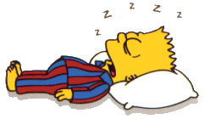
TASK: Where do you think the blood is going in each of these pictures?
1
2

Slide 6
Recap:
Veins
Arteries
Capillaries
Add info (to where you need to in your books) if needed
Title: Video task
NEW LEARNING:
LIST

Slide 7
Blood (vascular) Shunting:
Blood is shunted to where it is needed.
When you start exercising the blood vessel constrict (vasoconstict) so more blood goes to the muscles where the blood vessels dilate (vasodilate)
When you do not exercise blood is shunted back
Extension = Draw

Slide 8
Blood distribution
Task: Write the results of this in your on the Simpsons hand-out – in the correct location
Remember you target grade!

Slide 9
So where is their blood going?
Add MORE in green pen
2
1

Slide 10
Control of body temperature
The amount of blood flowing through the skin capillaries is altered by vasoconstriction and vasodilation.
Write this in NOTE FORM in your own words – lots can be cut shorter
One of the major functions of the circulatory is to control your body temperature.
Your body does not like change and normally your body is 37 Degrees Celsius.
If you get too hot during exercise or lose too much water in sweat (blood is 50% water) something needs to happen!
A lack of water leads to dehydration which makes you weak and dizzy.
Hypothermia is when you get too cold and you cant think straight which could kill you.
EXTENSION: = List things that happen to you when you’re…
Cold
Warm

Slide 11
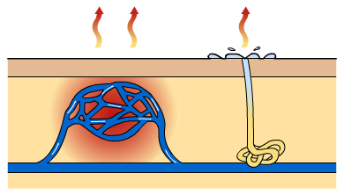
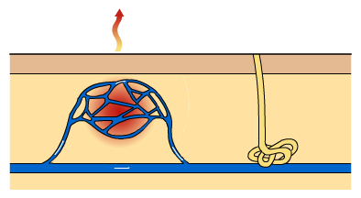
Hot
Cold
You’ve 5 minutes to write as many notes using the information mats.

Slide 12
Blood flow and body temperature
The circulatory system plays an important role in regulating body temperature.
Capillaries
Sweat gland
If the body gets too hot, capillaries near the surface of the skin widen. Blood is diverted to the skin where the heat can easily radiate away.
Therefore heat is lost by radiation. This is called vasodilation.
Secondly, sweat glands make more sweat which is mainly water which is then excreted as sweat to cool the body. As the water evaporates to help cool you down.
What happens if you lose a lot of sweat and you are unable to cool down?

Slide 13
Blood flow and body temperature
Capillaries
Sweat gland
If the body gets too cold, you need to maintain heat and stop it from getting cooler.
You stop sweating.
Blood vessels (capillaries) near the surface of the skin get narrower (contract). Blood is diverted away from the skin to limit heat loss. This is called vasoconstriction.
Muscles start to shiver which produces heat.
What happens if you get too cold? How does this impact on sports performance?

Slide 14
How does the circulatory system regulate temperature?

Slide 15
Name:
Name:
How does the circulatory system regulate temperature?
Name:
Name:

Slide 16
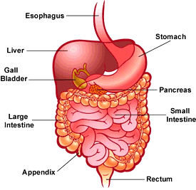
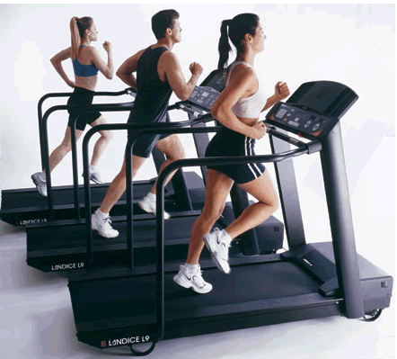
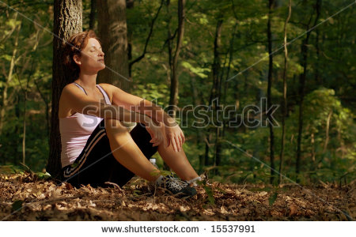
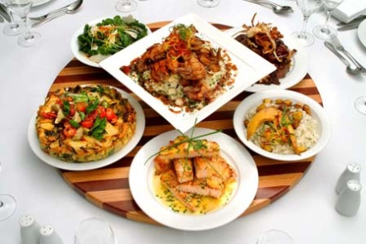
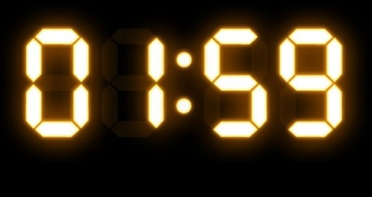
Question:
Timing of your dietary intake:
TASK –
number the order
Arrow the picture and statements
Using the pictures below to help LINK and ORDER why you should consider the timing of your dietary intake in relation to the need for oxygen in around body. (5 marks)
Examiner hint: Explain the need for oxygen/blood to move around your body at different points before, during and after eating/exercise
Notes:
Students are participating in a task or tasks that will allow them to demonstrate their developing understanding of the content that was presented. During this time teachers and students may be involved in assessing and evaluating the outcomes of the students’ learning. Over time there should be a variety of techniques and methods used to determine the levels of achievement

Slide 17
Our digestive system needs strong blood supply in order to work and digest our food. When at rest there is a greater blow flow to the digestive system, so that food can be digested properly
1
The working muscles need this increased blood supply to provide additional oxygen in order to produce the necessary energy to perform.
3
We should therefore wait a couple of hours before exercising after eating a large meal. This is the optimum time to eat and then perform.
5
2
When you exercise there is a reduction in blood flow to the digestive system in favour of the working muscles.
This means that we should not eat immediately before exercise, otherwise there will not be sufficient blood available to digest our food.
4
Notes:
Reviewing is a critical element in the process of teaching and learning as it is at this point that teachers can challenge the students to make their learning explicit. Although Review is the last of the elements of the cycle to be described, it should not be seen as coming only at the end of a lesson. It is useful to include different review opportunities throughout every lesson so that teachers and students can identify challenges and supports, and strengths and weaknesses. Review is a significant part of developing metacognitive awareness.

Slide 18
Timing of your dietary intake:
1) Our digestive system needs strong blood supply in order to work and digest our food. When at rest there is a greater blow flow to the digestive system, so that food can be digested properly.
2) When you exercise there is a reduction in blood flow to the digestive system in favour of the working muscles.
3) The working muscles need this increased blood supply to provide additional oxygen in order to produce the necessary energy to perform.
4) This means that we should not eat immediately before exercise, otherwise there will not be sufficient blood available to digest our food.
5) We should therefore wait a couple of hours before exercising after eating a large meal. This is the optimum time to eat and then perform.
Notes:
Reviewing is a critical element in the process of teaching and learning as it is at this point that teachers can challenge the students to make their learning explicit. Although Review is the last of the elements of the cycle to be described, it should not be seen as coming only at the end of a lesson. It is useful to include different review opportunities throughout every lesson so that teachers and students can identify challenges and supports, and strengths and weaknesses. Review is a significant part of developing metacognitive awareness.

Slide 19
Demonstrate:
Blood can be redistributed around the body to meet the demands of physical activity.
a) Identify TWO areas of the body that would experience a increase in blood flow when swimming.
1)
2)
(2 marks)
b) Explain your choices.
(3 marks)

Slide 20
Demonstrate:
Blood can be redistributed around the body to meet the demands of physical activity.
a) Identify TWO areas of the body that would experience a increase in blood flow when swimming.
1)
2)
(2 marks)
b) Explain your choices.
(3 marks)

Slide 21
Our digestive system needs strong blood supply in order to work and digest our food. When at rest there is a greater blow flow to the digestive system, so that food can be digested properly
Our digestive system needs strong blood supply in order to work and digest our food. When at rest there is a greater blow flow to the digestive system, so that food can be digested properly
The working muscles need this increased blood supply to provide additional oxygen in order to produce the necessary energy to perform.
The working muscles need this increased blood supply to provide additional oxygen in order to produce the necessary energy to perform.
We should therefore wait a couple of hours before exercising after eating a large meal. This is the optimum time to eat and then perform.
We should therefore wait a couple of hours before exercising after eating a large meal. This is the optimum time to eat and then perform.
When you exercise there is a reduction in blood flow to the digestive system in favour of the working muscles.
When you exercise there is a reduction in blood flow to the digestive system in favour of the working muscles.
This means that we should not eat immediately before exercise, otherwise there will not be sufficient blood available to digest our food.
This means that we should not eat immediately before exercise, otherwise there will not be sufficient blood available to digest our food.
Notes:
Reviewing is a critical element in the process of teaching and learning as it is at this point that teachers can challenge the students to make their learning explicit. Although Review is the last of the elements of the cycle to be described, it should not be seen as coming only at the end of a lesson. It is useful to include different review opportunities throughout every lesson so that teachers and students can identify challenges and supports, and strengths and weaknesses. Review is a significant part of developing metacognitive awareness.

