Slide 1
Health and Performance
Exam preparation

Slide 2
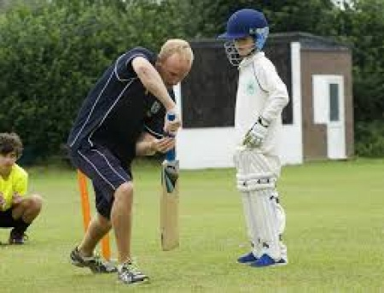
DNA: Independently answer with timer
4 minutes to share with partner
Lastly GFG
Give an example of an open & closed skill: ___________________________________________________________________________
Give an example of a basic skill and a complex skill: ____________________________________________________________________
Name 4 types of practice: _______________ _______________ _______________ _______________
What do S.M.A.R.T targets stand for? S_________ M_________ A_________ R_________ T__________
Look at the picture & answer the following
questions.
What type of guidance is being used: ___________
Give one advantage and one disadvantage of this type
of guidance: _______________________________
________________________________________ ________________________________________
What is the difference between low and high organisation skills? (2) _________________________________________
_________________________________________
Give an example of each: ____________________ (2)
Compare intrinsic and extrinsic feedback:
______________________________
______________________________ ______________________________
______________________________
______________________________
______________________________
Explain what is meant by ‘mental rehearsal’?
__________________________________________________________________________________________________________________________________________________________________________________________________________________
Explain why goal setting is important?
__________________________________________________________________________________________________________________________________________________________________________________________________________________
CHALLENGE QUESTION: Evaluate the use of visual and verbal guidance when working with a group of beginner badminton players (9 marks).

Slide 3
GFG
Give an example of an open & closed skill: ___________________________________________________________________________
Give an example of a basic skill and a complex skill: ____________________________________________________________________
Name 4 types of practice: _______________ _______________ _______________ _______________
What do S.M.A.R.T targets stand for? S_________ M_________ A_________ R_________ T__________
OPEN SKILL=
CLOSED SKILL=
Basic skill=
Complex Skill=
4 types of practice=
Massed:
Distributed:
Fixed:
Variable:
S
M
A
R
T

Slide 4
Guidance=
One advantage=
One disadvantage=
Low organisational skill=
High organisational=

Slide 5
Compare intrinsic and extrinsic feedback:
Explain what is meant by ‘mental rehearsal’?
________________________________________________________________________________________________________________________________________________________________________________________________________________________________________________________________________________________________________________________________________________________________________________________________________________________________________________________________________________________________________________________
Explain why goal setting is important?
_______________________________________________________________________________________________________________________________________________________________________________________________________________________________________________________________________________________________________________________________________________________________________________________________________________________________________________________________________________________
________________________________________________________________________________________________________________________________________________________________________________________________________________________________________________________________________________________________________________________________________________________________________________________________________________________________________________________________

Slide 6
Having goals is a smart thing
Recall what each letter stands for
Explain the principle that ‘S’ represents (3).
‘measurable’ is one of the principles-of goal setting, explain how this principle can be used to improve sports performance. (3)
Answer

Slide 7
Multiple choice Questions
Which of the following helps to maintain strong bones and teeth?
A Minerals
B Fibre
C Fats
D Carbohydrates
What are the roles of:
Fibre
Fats
Carbohydrates
Protein
Vitamins:

Slide 8
Which is classified as an open skill?
A Serve practise in badminton
B Layup in basketball training session
C Netball shot in a league game
D A trampolinist demonstrating a somersault.
Can you remember the other types of skill?

Slide 9
Practice structures
Massed:
Distributed:
Fixed:
Variable:
Which one of the following is a practice structure
A Massed
B Open
C Directed
D Interval

Slide 10
Explain the most effective type of feedback for this Olympic athlete.

Slide 11
Physical, Emotional, Social well-being
Regular Exercise benefits all of the above: state two benefits of regular participation for Physical, emotional and Social well-being
Physical=
Emotional=
Social=
Challenge: State how each benefit is achieved

Slide 12
Define a sedentary lifestyle
Challenge: Explain reasons why some people fall in to a sedentary lifestyle
_____________________________________________________________________________________________________________________________________________________________________________________________
What are the consequence of a sedentary lifestyle?

Slide 13
How does your socio-economic group affect your choice in sport?

Slide 14
Media
Communication
Written & electronic
Like to exaggerate and dramatize
Appeal to audience
Can you think of ways how media can affect sport?

Slide 15
Deviance
Consequences of deviance in elite sport. Note down some consequences.
At an elite level note down some reasons for deviance

