Slide 1
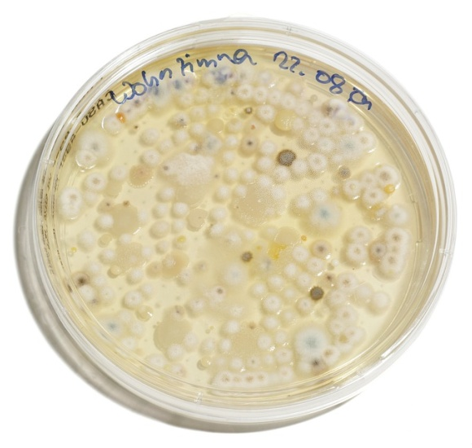
Growing bacteria
Do now activity:
How do bacteria and viruses differ from on another?
Identify some precautions you might use when handling bacteria cultures.
Describe how you might control the spread of bacteria

Slide 2
Progress indicators
GOOD PROGRESS:
Understand why cultures of bacteria are kept at lower temperatures in schools compared to industry
Describe how to grow an uncontaminated culture of bacteria in the lab
OUTSTANDING PROGRESS:
Calculate the number of bacteria in a population

Slide 3
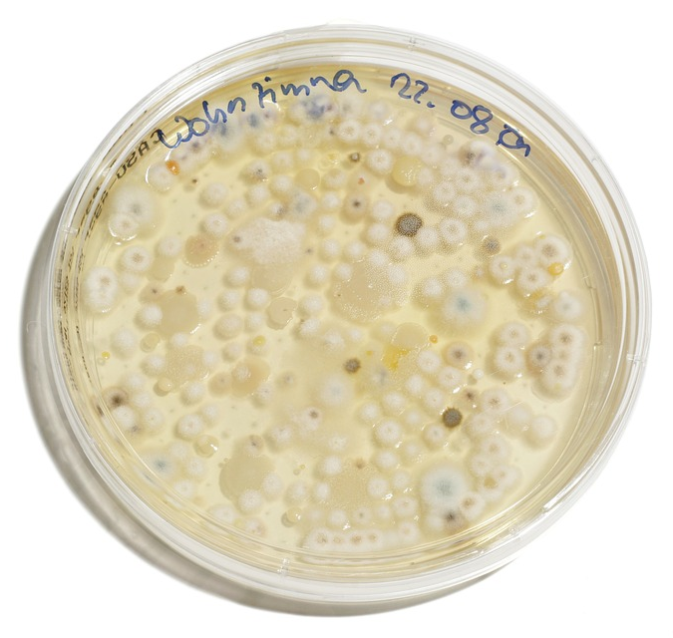
In order to find out more about microorganisms, scientists need to culture them.
This means they are grown in very large numbers so that scientists can see all of the bacteria (the colony) as a whole.
Separate colonies of bacteria

Slide 4
Task: Watch the video and answer the following questions:
If bacteria are kept in a suitable medium, at what rate can they multiply?
What is this simple process of division called?
For what purposes might scientists want to produce cultures of bacteria?
What useful substances are found in the agar jelly? These substances help bacteria to grow.
What do you need to do before using the inoculating loop to spread the bacteria onto the agar plate? Why is this process important?
Why is the Petri dish loosely taped shut?
What is the temperature at which bacteria cultures are kept in a school lab? Why is this?
https://www.youtube.com/watch?v=Uf8a7cCVjM4

Slide 5
Self-assessment:
Every 20 minutes
Binary fission
To test the effects of disinfectants or antibiotics on the growth/survival of bacteria
Carbohydrates, proteins, vitamins an minerals are all found in agar jelly. The bacteria need these substances in order to thrive, grow and reproduce.
Firstly the inoculating loop is sterilised using a Bunsen burner flame. This stops any unwanted bacteria from contaminating the culture.
The Petri dish is taped shut in order to prevent the bacteria culture from being contaminated
School labs keep bacteria cultures at 25⁰C, compared to industries which keep cultures at 37 ⁰C, as it is safer at a lower temperature. This means that the bacteria will not grow uncontrollably and develop into harmful pathogens which are bad for our health.

Slide 6
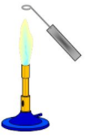
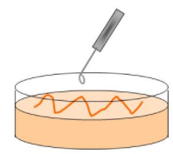
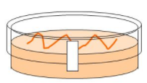
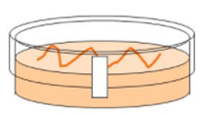
Growing useful microorganisms
Step 1: Sterilise the inoculating loop by passing it through a Bunsen burner flame until it is red hot. Let it cool, do not put the loop down or blow on it to cool it
Step 2: Dip the sterilised loop into the suspension of bacteria you would like to grow, use the loop to make zigzag streaks across the surface of the agar. Replace the lid on the dish as quickly as possible to avoid contamination.
Step 3: Fix the lid of the Petri dish with tape to prevent microorganisms from the air contaminating the culture – or microbes from the culture escaping. Do not seal all the way around the edge as oxygen will still need to enter so that bacteria can respire and grow.
Step 4: The Petri dish should be labelled and stored upside down to stop condensation falling on the agar surface. The dish should be kept in an incubator set at 25⁰C.

Slide 7
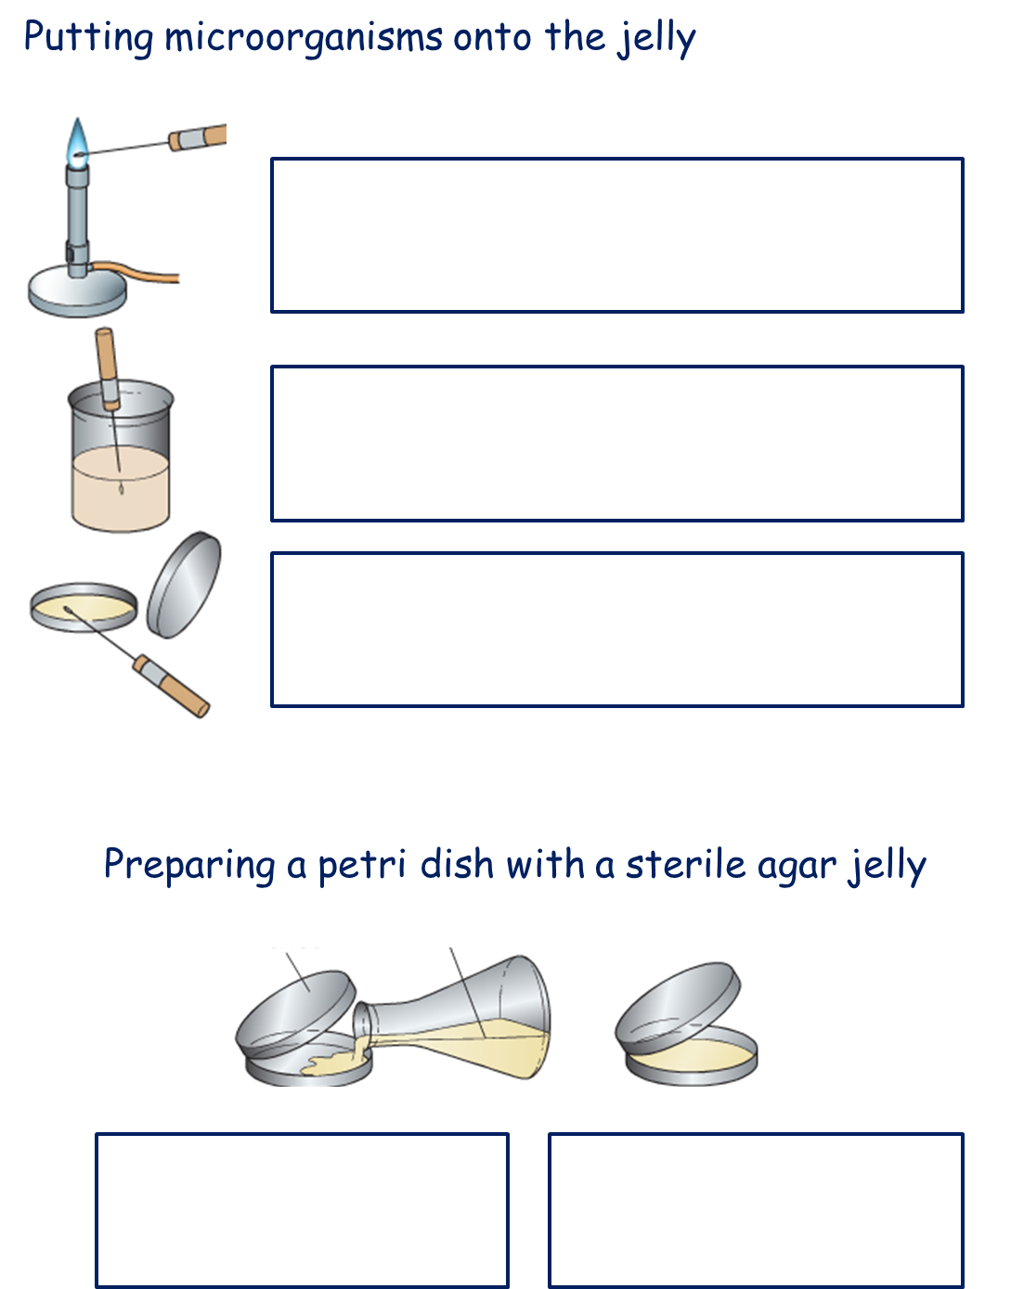
Task: Using the key words below, complete the boxes to show the stages by which microorganisms are grown on agar plates
Key word bank
Sterilisation
Inoculating loop
Bunsen burner
Beaker
Nutrient broth (contains bacteria)
Agar plate

Slide 8
Self-assessment:
Sterilise the inoculating loop by passing it through a Bunsen burner flame until it is red hot. Let it cool, do not put the loop down or blow on it to cool it as this will recontaminate it
Dip the sterilised inoculating loop into the beaker of nutrient broth containing the bacteria you would like to grow
Use the inoculating loop to make zigzag streaks across the surface of the agar. Replace the lid on the dish as quickly as possible and fix with tape (but do not seal all the way around) so that bacteria can respire and grow.

Slide 9
Task: Complete the exam-style question

Slide 10
Self-assess your work
a) Any two from:
Method of sterilisation (e.g. use of autoclave / boiling water)
Sterilisation to kill microorganisms
Pass flask / innoculating loop through bunsen burner flamer
Make sure all work is carried out near to a flame
Minimise the time the bacteria is exposed to air (opening of flask / test-tube / petri dish) (2)
b) Any two from:
Temperature
Type of nutrient
Volume of solution
Amount of bacteria added
Concentration of nutrients (2)

Slide 11
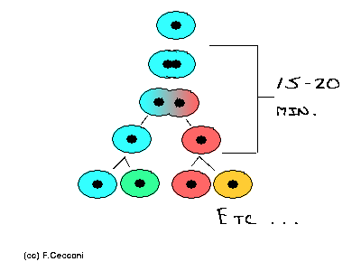
Calculating bacterial growth
Task: Watch the video, pausing when instructed, to carry out calculations related to the growth of bacteria on a Petri dish.
https://www.youtube.com/watch?v=R6Uv__WJlmM
Notes:
By f.cecconi (Own work) [CC BY-SA 3.0 (https://creativecommons.org/licenses/by-sa/3.0)], via Wikimedia Commons

Slide 12
Calculating the number of bacteria in a population
Worked example: The mean division time of bacteria is 30 minutes. Calculate how many bacteria will result from each individual bacterium after 8 hours.
How many times will the bacteria divide in 8 hours?
Calculate the number of bacteria in the population
If bacteria divide very 20 minutes they will divide 60/30 or twice every hour.
If the colony grows for 9 hours, each of the initial bacteria will divide 8 x 2 or 16 times
Every time the bacteria divides, the population doubles, so we can find the number of bacteria using the following equation:
Bacteria at the end of the growth period
=
Bacteria at the beginning of the growth period
2^{number of divisions}
x
Therefore, 1 x 2¹⁶ = 1 x 65536 = 65 536 bacteria

Slide 13
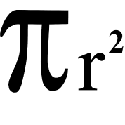
Measuring the impact of chemicals on bacteria growth
Task: Using the calculation below, copy and complete this table to show the area of the clear zones.
Radius = D/2
Area of a circle =
Chemical | Measured diameter (D) of clear circle (mm) | Calculated radius of cleared circle (mm) | Calculated surface area of clear circle (mm²)
None | 0.0
Disinfectant 1 | 7.0
Disinfectant 2 | 4.0
Disinfectant 3 | 12.0

Slide 14
Self-assessment:
Chemical | Measured diameter (D) of clear circle (mm) | Calculated radius of cleared circle (mm) | Calculated surface area of clear circle (mm²)
None | 0.0 | 0.0 | 0.0
Disinfectant 1 | 7.0 | 3.5 | 38.5
Disinfectant 2 | 4.0 | 2.0 | 12.6
Disinfectant 3 | 12.0 | 6.0 | 113.1

Slide 15
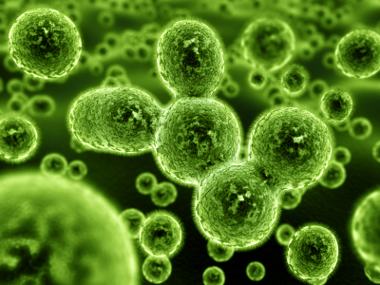
Plenary:
What have you learnt this lesson?
Summarise what you have learnt in 3 sentences!

Slide 16
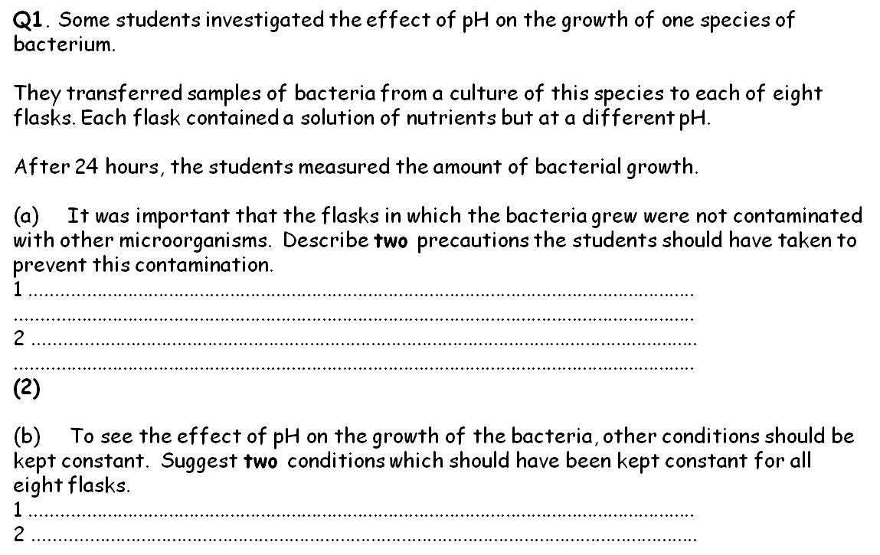

Slide 17
