Slide 1
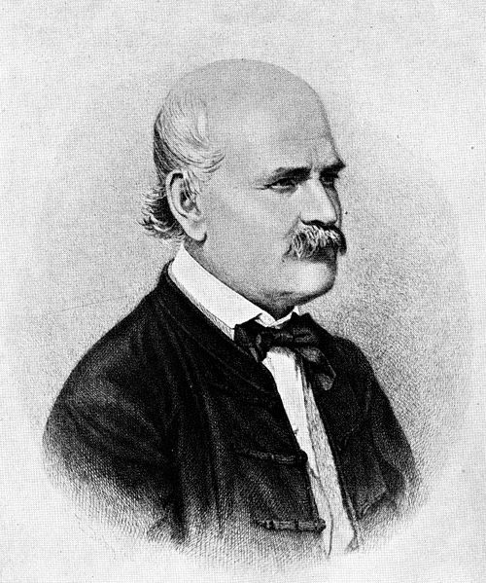
Preventing Infections
Do now activity:
How can communicable diseases spread from person to person?
Compare the structure of bacteria and viruses
Compare the mechanisms by which bacteria and viruses spread disease
Keywords
Pathogen
Bacteria
Virus
Fungi
Communicable

Slide 2
Progress indicators
GOOD PROGRESS:
Outline the work of Ignaz Semmelweis and other scientists in the development of methods to reduce the spread of infections
OUTSTANDING PROGRESS:
Describe the methods by which we can prevent the spread of communicable diseases

Slide 3
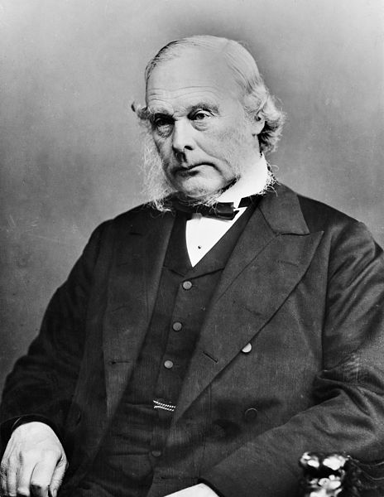
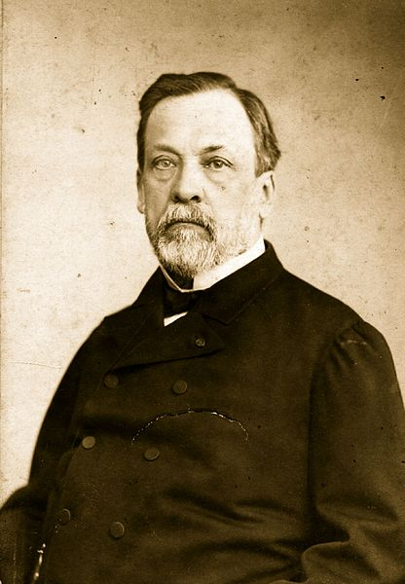
The work of pioneering doctors and scientists has helped the modern understanding of pathogens
Ignaz Semmelweis
Louis Pasteur
Joseph Lister
Notes:
Joseph Lister: See page for author [CC BY 4.0 (http://creativecommons.org/licenses/by/4.0)], via Wikimedia Commons
Semmelweis: By Eugen Doby (1834-1907[1]) [Public domain], via Wikimedia Commons
Pasteur: By unattributed (Hulton Archive) [Public domain], via Wikimedia Commons

Slide 4
Task: Watch the video on Ignaz Semmelwies
https://www.youtube.com/watch?v=OU8MsykzAKQ
Copy these sentence starters and complete the sentence whilst watching the video:
Semmelwies noticed that women …
Semmelwies identified a link…
However, some Scientists disagreed…
In hospitals now …

Slide 5
Task: Share information to complete the table
Prevention Method | How does this method reduce or prevent the spread of infection?
Hygiene
Isolating infected individuals
Destroying/ controlling vectors
Vaccination

Slide 6
Self assessment
Prevention Method | How does this method reduce or prevent the spread of infection?
Hygiene | Washing hands = prevents pathogen from spreading to surfaces Covering your mouth if you cough/sneeze = prevents pathogen from becoming airborne and others breathing it in Antiseptic disinfectants = kill pathogens on surfaces Cleaning agricultural machinery = stops the spread of plant pathogens
Isolating infected individuals | Isolation makes it less likely that pathogens will be passed on from one person to another
Destroying/ controlling vectors | Reducing the number of vectors means that pathogens cannot spread as quickly
Vaccination | Triggers your immune system to produce antibodies to destroy this pathogen so you will not get the disease

Slide 7
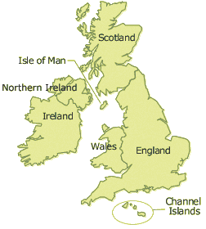
Plenary: Pandemics and Epidemics
Pandemic Swine Flu
Epidemic = outbreak of a disease within a community
Pandemic = outbreak of a disease over a whole country or the world
Task: Using the diagram and the information given, explain the difference between a Pandemic and an Epidemic.
Epidemic of Swine Flu in London

Slide 8
RESOURCES

Slide 9
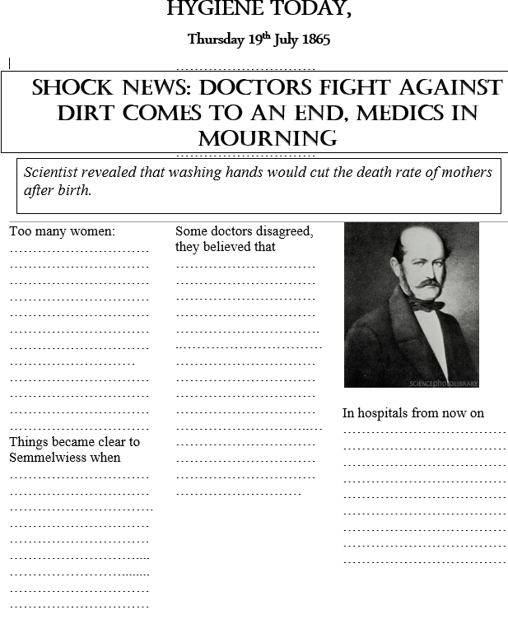

Slide 10
Hygiene
Simple hygiene measures as one of the most effective ways to stop the spread of pathogens. By implementing the following methods:
Washing hands, especially if you have been in contact with somebody with an infection, with food or with animals
Ensure you cover your mouth with a tissue or handkerchief if you cough/sneeze
Use disinfectant to wipe surfaces, killing pathogens
Maintain the hygiene of people and agricultural machinery to stop the spread of plant pathogens
Isolating infected individuals
If somebody with Ebola has an infected disease, especially a serious disease, they need to be kept isolation. This will make it less likely that the pathogen will be passed on.
Destroying/controlling vectors
Some infectious diseases can be passed on by vectors, e.g. mosquitoes carry a range of diseases such as malaria & dengue fever. Houseflies can carry over 100 human diseases. By controlling the numbers of spread of vectors, the spread of infections can also be controlled.
Vaccination
During vaccination doctors introduce a small amount of a harmless form of a specific pathogen or antigens into your body. This triggers your immune system to producing antibodies to destroy this pathogen so if you come up against it again you will be prepared.

