Slide 1
Lesson 7:
Dramatic Performance

Slide 2
DNA
Watch the video
Play close attention to:
Their intention (message to the audience)
The use of music to support emotive reactions in the audience

Slide 3
DNA
What is your dramatic intention?
Summarise in 1 sentence the impact you wish to have on anyone who watches your performance.

Slide 4
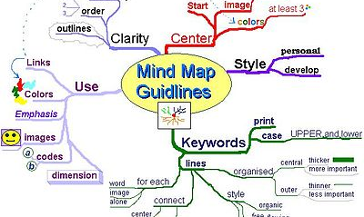
Create a mind map to develop your script ideas…
Ensure you have the key headings on your mind map;
1. Character’s-Protagonist, Antagonist
How old are they? What is their occupation? What are their social circumstances? What is their background? Do they have any Privilege?
2. Setting
Where will your script be set? (multiple locations?)
3. Plot
Record any ideas for your narrative, How many scene’s will you have? What plot structure will you use? (Chronological, Linear, montage).
4. Audience
Who is your target audience? (Young people in schools? The older generation?).
This Photo by Unknown Author is licensed under CC BY-SA

Slide 5
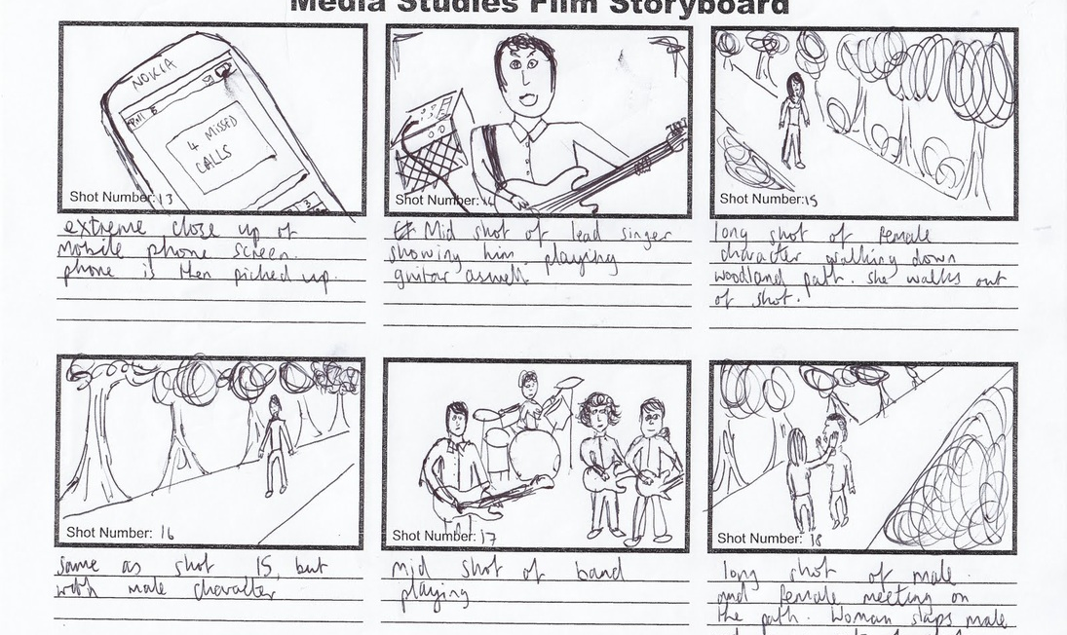
Task 3
Develop your story board.
Now you have your ideas for your script . Create a storyboard to plan your performance.
Imagine each box represents a camera shot that tells a story.
For example; In your performance if your protagonist is receiving racist insults by text you might want the first shot to be of a notification coming through on the phone.
The second shot might be the character answering the phone and the audience seeing their reaction.
This Photo by Unknown Author is licensed under CC BY-SA-NC

Slide 6
Progress Indicators
Good Progress
You have created a clear dramatic intention that relates to one of the key issues we have studied.
You have created clear character’s, setting and plot that are related to your dramatic intention.
Outstanding Progress
Your dramatic intention includes a variety of key issues studied.
You have created clearly defined character’s that represent the effect privilege has on individuals in society.
3. You have considered how you want the audience to think or feel. Your plot and character choices support this.

Slide 7
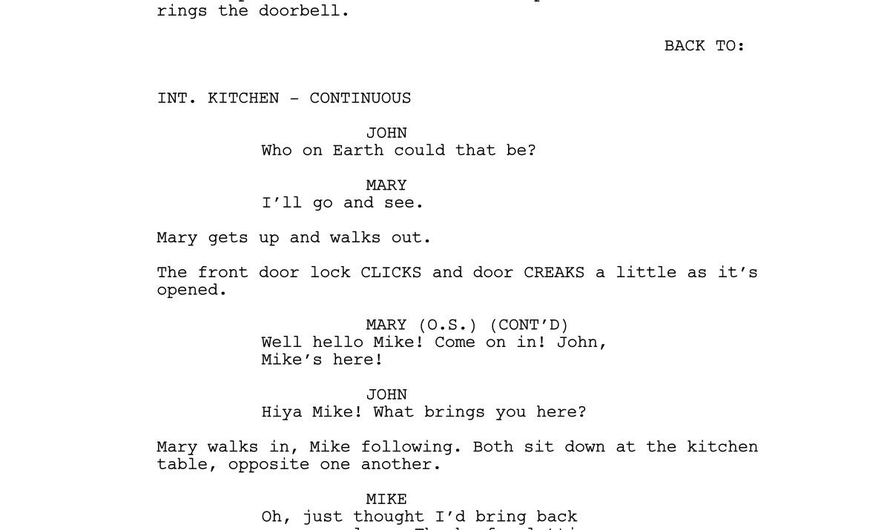
Extension
Start to write your
Script.
Ensure you use a standard script layout and stage directions.
This Photo by Unknown Author is licensed under CC BY-SA

