Slide 1
Title: Aerobic vs Anaerobic
LO: To recap the different role of Respiratory system in the body
DNA
Watch the video, decide whether the movement is aerobic or anaerobic movements
Progress Indicators
Good Progress | Outstanding Progress
Be able to explain the systems and how the differe | Link the content in terms of gaseous exchange to energy systems in an exam question
https://www.youtube.com/watch?v=eX3U4fcLb8Q

Slide 2
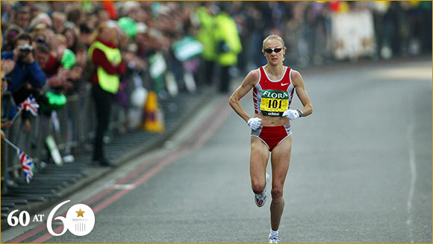
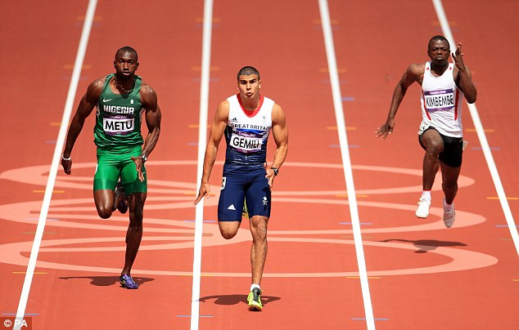
Aerobic exercise
Anaerobic exercise
No oxygen is used in its initial release, energy is produced from the supplies already in the body.
Maximum bursts of energy
Time it takes to do is very short
Aerobic exercise need a sufficient supply of oxygen to the tissues.
Work for a long time
Moderate – hard work
Periods of more then 60s
Extension task Explain how a games player would use both aerobic and anaerobic systems
(4 marks)
Glucose
Glucose + Oxygen
CO2 + water + Energy
Energy + Lactic acid

Slide 3
Aerobic exercise
Anaerobic exercise
No oxygen is used in its initial release, energy is produced from the supplies already in the body.
Maximum bursts of energy
Time it takes to do is very short
Aerobic exercise need a sufficient supply of oxygen to the tissues.
Work for a long time
Moderate – hard work
Periods of more then 60s
Extension task Explain how a games player would use both aerobic and anaerobic systems
(4 marks)
Glucose
Glucose + Oxygen
CO2 + water + Energy
Energy + Lactic acid

Slide 4
Energy
The muscles and liver store glucose (main source of energy from food)
Aerobic Respiration -
Glucose + oxygen -----Energy + CO2 + water
Is toxic!, causes muscle ache, cramps eventually stopping them from working!
Anaerobic Respiration -
Glucose -----Energy + lactic acid
The muscles and liver store glucose (main source of energy from food)
Fats:
Fuel source for aerobic activity
Carbohydrates:
Fuel source for anaerobic and aerobic activity

Slide 5
Oxygen debt
Oxygen debt is….
Oxygen debt is…
The amount of oxygen needed at the end of a physical activity to break down lactic acid. Often after a 400m race lactic acid builds up as the oxygen stores have run out. Oxygen is repaid through deep gasping breaths at the end of exercise.
Anaerobic Respiration -
Glucose -----Energy + lactic acid

Slide 6
Explain how the Cardiovascular system and the respiratory system work together (6)?
State
define
knowledge and understanding of a topic
describe
Identify
Explain how
Explain why
Apply knowledge and understanding
Give examples to back up your point
assess
discuss
Justify why
Analyse and evaluate
evaluate
analyse

Slide 7
Increased breathing rate
Oxygen debt
(take on enough oxygen until it is paid off)
Lactic acid build up (during anaerobic exercise) –
known as lactate accumulation
Muscle fatigue (because of the build up of lactic acid)
Respiratory
Increase cardiac output
Muscular
Cardiovascular
Increased tidal volume
Oxygen debt as a result of anaerobic exercise
Increase heart rate
Increase in blood pressure (diastolic & systolic)
Increase in stroke volume

Slide 8
Long term effects
Respiratory
Muscular-Skeletal
Cardiovascular
Increased lung capacity / volume
Increased vital capacity
Diaphragm and intercostal muscles get stronger
Number of alveoli increases
Increase strength
Increase size (hypertrophy)
Increase bone density
Increased strength of ligaments
Increase strength of tendons
More capillaries in the muscles
Increased cardiac output
Increased Stroke volume
Decreased resting HR
Faster recovery
Healthy Veins and arteries
Lower blood pressure
More red blood cells
All means you have a quicker recovery rate

Slide 9
Task
Functions of the cardiovascular system
Muscle fibres
Structures of arteries, capillaries and veins
Give a sporting example of the anaerobic system & aerobic system working together (explain how)
Make any form of revision tool in your homework book on the content on the left (all 4 bullet points)
“If you do what you’ve always done…you get what you’ve always got!”

