Slide 1
Task 5 – Observational Drawing – Packet/box of biscuits
Place a box or packet of biscuits in front of you on the table.
Observe the shape, form, sizes of the objects, draw what you see. ONLY DRAW WHAT YOU CAN SEE.
Add shading to make your drawing look 3D or colour if you have crayons – make it look photorealistic
Look at the examples on this page

Slide 2
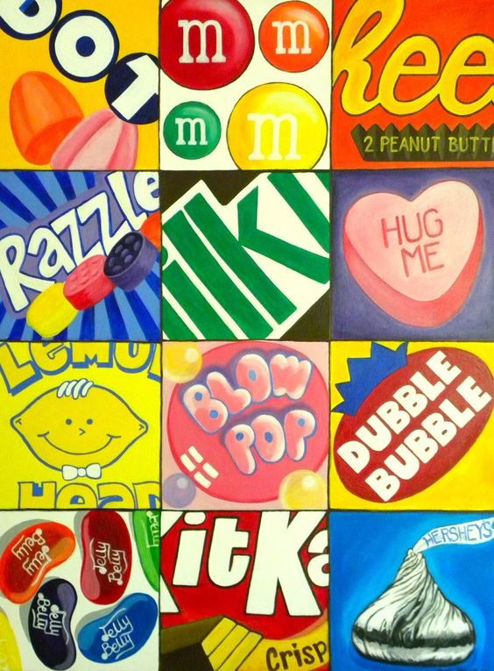
Task 6 – Brand Logo’s
Research brand logos for several sweets, chocolates etc.
Choose at least 6 (more if possible) and recreate them on an A4 page
Split the page like the example in the corner
Zoom in on the logo to make sure it fills the square

Slide 3
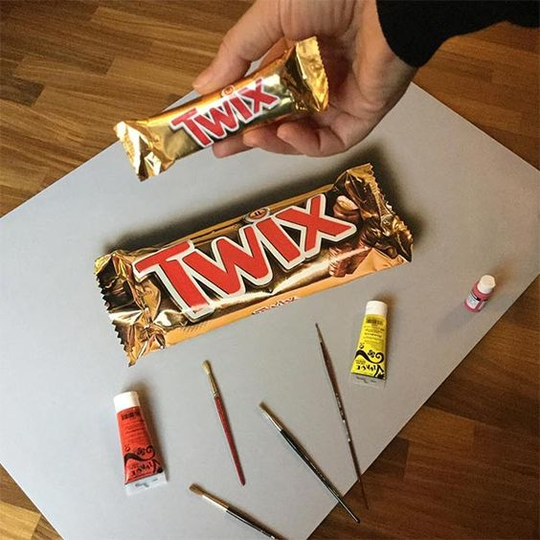
Task 7 – Create your own chocolate bar
Create your own chocolate bar or sweet – you need to think of a name for your chocolate bar/sweet (like Dairy Milk) and also a brand (like Cadburys).
Draw the wrapper with your own brand logo and name of the chocolate/wrapper
Think about the colour theme (Cadburys = Purple)
Your drawing needs to be large to show the detail – colour if possible or shade if you do not have colours and label your drawing with your choice of colours

Slide 4
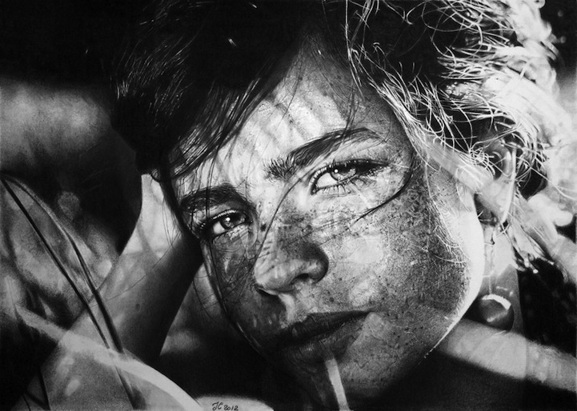
Task 8 – Photo Realism Reference page
Research what ‘photo realism’ is – create a reference page based on PHOTOREALISM
The page should include:-
Information about photorealism – what is it? When did it start? Any other interesting facts
Images to represent photorealism drawing/painting ( minimum of 5)
Minimum of 5 photo realistic artists and information about them ( you can not include Sarah Graham – please find others )

Slide 5
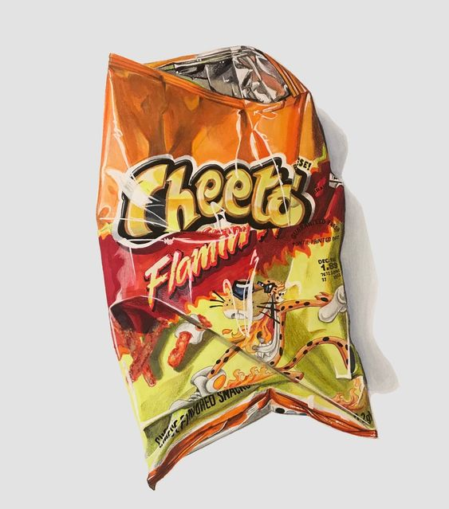
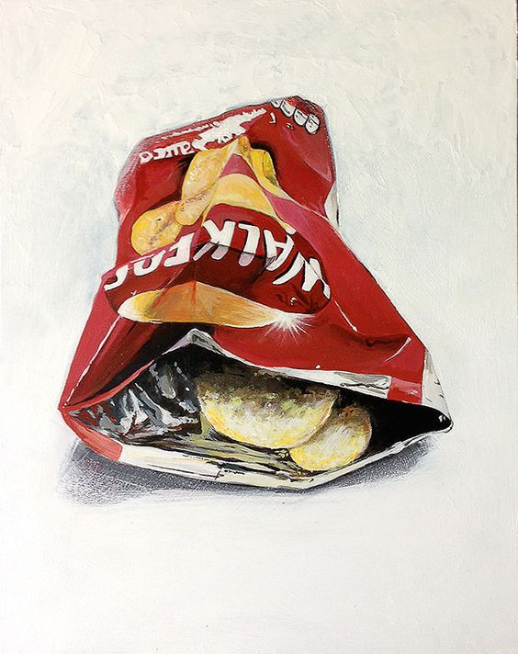
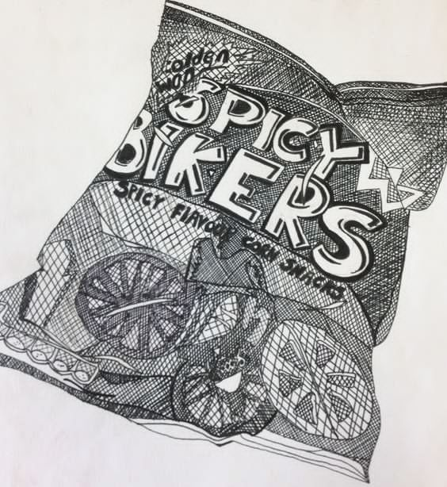
Task 9 – Observational Drawing – Crisp wrapper
Place a crisp packet (it can be full or empty) in front of you on the table.
Observe the shape, form, sizes of the object, draw what you see. ONLY DRAW WHAT YOU CAN SEE.
Add shading to make your drawing look 3D or colour if you have crayons – make it look photorealistic
Look at the examples on this page

Slide 6
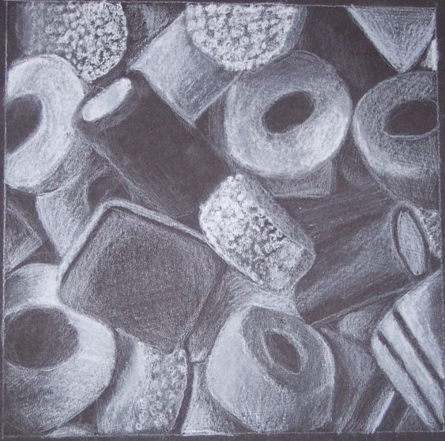
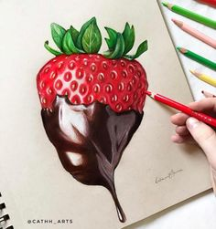
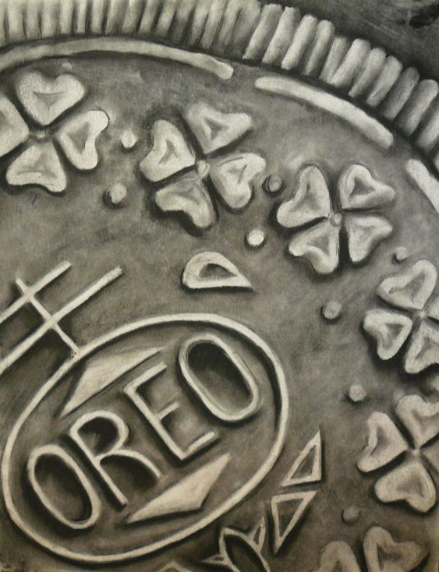
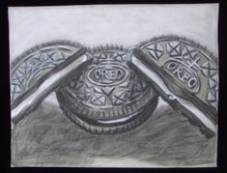
Task 10 – Observational Drawing – Actual sweets/biscuits NOT wrappers
Place some sweets/chocolate in front of you on the table. Group them together like the examples in the images below
Observe the shape, form, sizes of the objects, draw what you see. ONLY DRAW WHAT YOU CAN SEE.
Add shading to make your drawing look 3D or colour if you have crayons – make it look photorealistic
Look at the examples on this page

