Slide 1
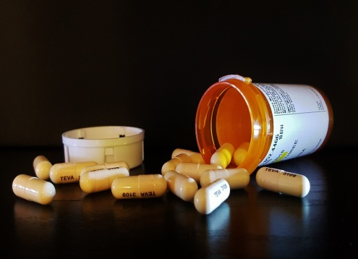
Antibiotic resistant bacteria
Progress indicators
Good progress: Identify the part played by mutations in the development of antibiotic resistance Describe the impact of antibiotic resistance.
Outstanding progress: Explain what we should do to slow down the rate of development of resistant strains of bacteria.
Do now activity:
What is meant by the term ‘mutation’?
Describe the different effects a mutation can have on the health of a population
Why do you think bacteria are able to develop antibiotic resistance so rapidly? What might a solution to this problem be?

Slide 2
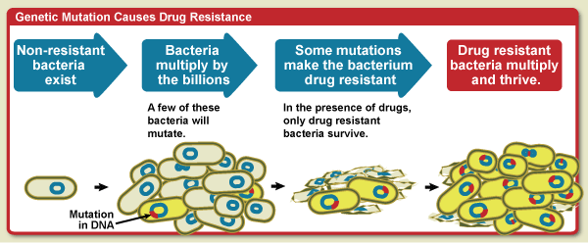
Antibiotic resistant bacteria
If you are given an antibiotic and use it properly the bacteria that have made you ill will be killed off. However, some bacteria develop resistance to bacteria due to random mutations and natural selection. Bacteria evolve rapidly as they reproduce at a faster rate.
Notes:
Image by NIAID [Public domain], via Wikimedia Commons

Slide 3
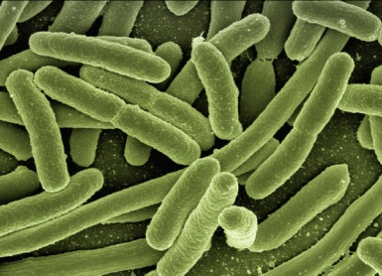
Task: Watch the video and answer the following questions:
Which types of areas do bacteria inhabit?
What effect do antibiotics have on bacteria cells?
Describe how antibiotic resistance can arise in a population of bacteria
How can the resistant genes be passed on within a population?
What is MRSA resistant to?
How are scientists trying to tackle the problem of antibiotic resistance?
https://www.youtube.com/watch?v=znnp-Ivj2ek

Slide 4
Self-assessment:
Bacteria can inhabit the ground, work surfaces, in water, your skin, inside your body.
Antibiotics can destroy bacteria cells by preventing the synthesis of a bacteria cell wall and also stopping bacteria from synthesising proteins.
Bacteria undergo mutations like all over cells, every once and a while a bacterial mutation will give that cell resistance against a certain antibiotic. If someone is treated with this antibiotic, it will kill the majority of the bacteria. However, those with the mutation for resistance will stay alive and breed with each other, passing on the resistant gene to many more bacteria cells.
Some bacteria can give their DNA up upon death and pass this on to a living bacteria cell, others can use a method called conjugation where bacteria connect their pili to share genes.
MRSA is resistant to methicillin, penicillin and oxycillin.
Scientists are trying to combat the plague of antibiotic resistant bacteria by developing novel treatments. One example is phage therapy or using vaccines to stop infections. An everyday way to combat this problem is stopping the unnecessary use of antibiotics or ensuring a patient finishes their course of treatment.

Slide 5
Task: Complete the following cartoon strip to demonstrate how antibiotic resistance can occur in a population of bacteria:
Key Words: antibiotic, mutation, resistance, multiply, pass, DNA, genes, bacteria, population

Slide 6
Preventing antibiotic resistance
Task: Read through the cards of information on how to prevent the development of resistant strains of bacteria and complete the following table:
Method | Explanation
Prevent overuse of antibiotics
Finish the course of antibiotics
Restrict the use of antibiotics in agriculture

Slide 7
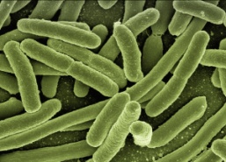
MRSA
Hospitals use a lot of antibiotics to treat infections, as a result some of the bacteria found in hospitals can be resistant to many antibiotics. This is what happened to MRSA, the bacterium methicillin-resistant Staphylococcus aureus.
Task: Read through the newspaper articles and answer the following questions:
Where is the bacterium Staphlococcus aureus naturally found in the body?
How does MRSA spread from person to person?
Describe the ways in which hospital staff and visitors can prevent the spread of MRSA.

Slide 8
Self-assessment:
Staphylococcus aureus is usually found on the skin or in the nose of a person.
MRSA can spread from person to person by skin-to-skin contact or someone who is infected or is a carrier, by contaminated wound dressings or bed sheets.
Hospital staff can ensure a reduction in the spread of MRSA by ensuring very strict hygiene and hand-washing protocols amongst hospital staff, visitors and patients. Patients should be regularly screened for the bacteria and isolated if they are infected. Try and limit transfer of patients between hospitals, especially if infected with MRSA.

Slide 9
Exam-style question
What is a pathogen (1)
Antibiotic-resistant strains of bacteria are causing a problem in many hospitals.
Explain, in detail, why there has been a large increase in the number of antibiotic resistant bacteria. (4)
3. How can doctors reduce the numbers of bacteria which are becoming resistant to antibiotics (2)
8 marks = 8 minutes

Slide 10
Self-assessment:
A bacteria/virus/fungus/microorganism which causes disease
Any four from: overuse of antibiotics; the bacteria mutate; antibiotic kill of non-resistant strains of bacteria; reduced competition for resistant strains of bacteria; resistant bacteria are able to reproduce
Reduce use of antibiotics for non-serious/mild infection
Ensure a patients finished their course of treatment

Slide 11
Plenary ~ Come up with three quiz questions to test your classmates knowledge of the lesson today

Slide 12
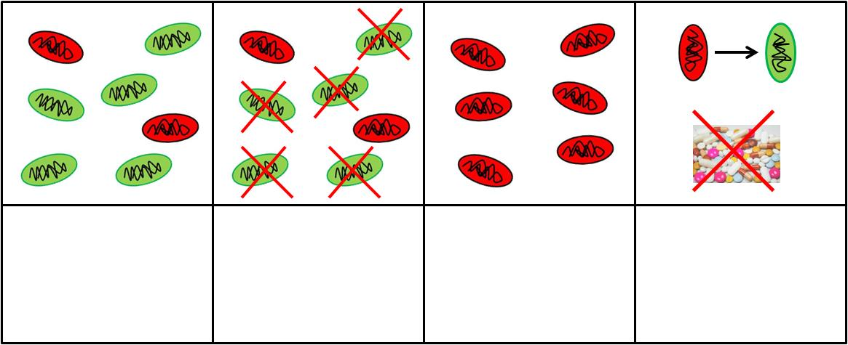

Slide 13
Doctors should not overuse antibiotics, they especially should not be prescribing antibiotics to treat non-serious infections such as mild throat or ear infections. Antibiotics don’t effect viruses so although you may have the symptoms of a bacterial infections, you may very well have a viral infection which antibiotics will not be able to treat. Overuse of antibiotics gives bacteria more chance to mutate and form an antibiotic resistant strain, the next time you try to use the antibiotic to treat an infection it won’t work.
The use of antibiotics in agriculture are often for growth promoters and to treat and prevent infection. However, antibiotic resistant strains can often arise in animal pathogens which can then be transferred to human pathogens, therefore restrictions need to be in place to prevent this from happening. In the UK we already have many restrictions in place, but in the USA 70% of human antibiotics are used on farm animals. This could speed up the evolution of resistant strains of human pathogens which would make treating infections in humans much more difficult.
Patients need to ensure that they finish the course of antibiotics every time they are given a prescription. This is to ensure that all bacteria are killed by the antibiotic, therefore none survive to mutate and form resistant strains.

Slide 14
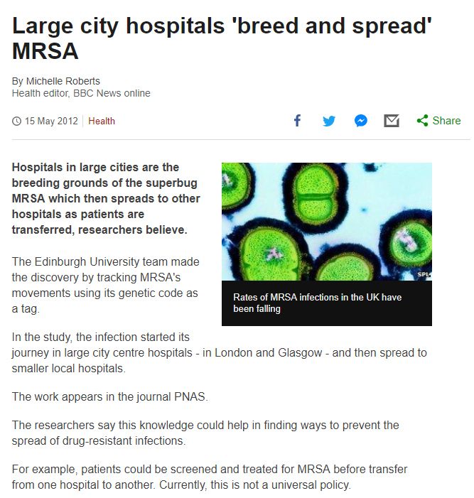
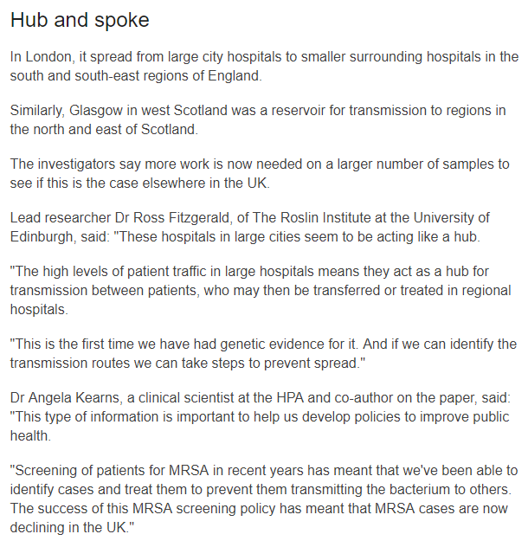
Source: http://www.bbc.co.uk/news/health-18062877

Slide 15
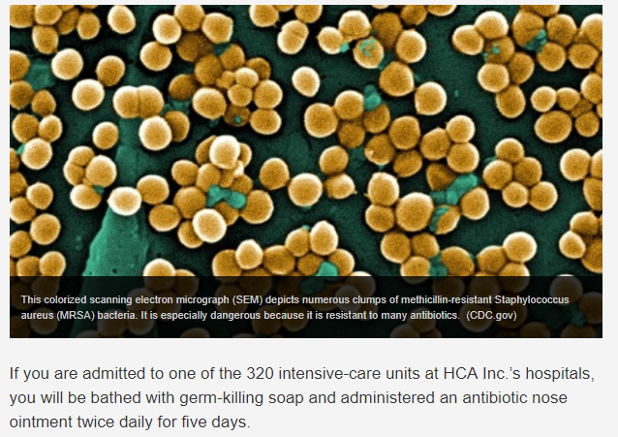
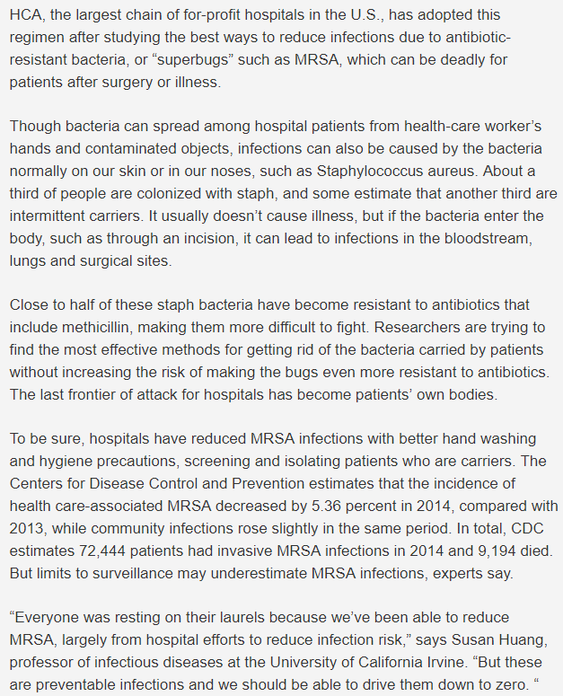
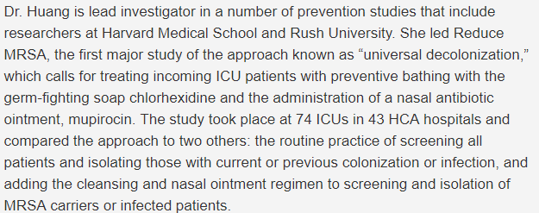
Source: http://www.foxnews.com/health/2016/09/13/ultimate-battle-against-mrsa.html

Slide 16
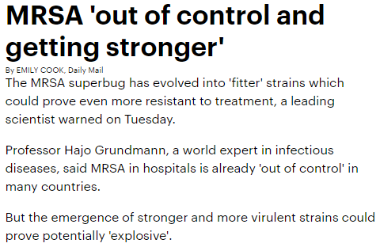
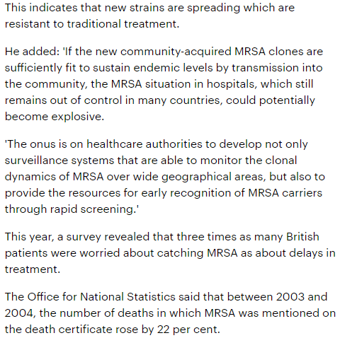
Source: http://www.dailymail.co.uk/news/article-391634/MRSA-control-getting-stronger.html

