Slide 1
Do Now: complete the table below filling in the solutions to the barriers
User Group | Provision | Targeted Promotion | Cost
Retired people/over 50
Unemployed/economically disadvantaged
Working singles/couples
Disabled people

Slide 2
Do Now: complete the table below filling in the solutions to the barriers
User Group | Provision | Targeted Promotion | Cost
Retired people/over 50 | Activities for elderly e.g., walking netball, football, senior only sessions, chair based activities. | Campaigns aimed at older people and the sports they could enjoy. | Subsidised rates for retired.
Unemployed/economically disadvantaged | Offer schemes to the unemployed, concessions, free tasters. | Better promotion of available/subsidised activities | Offer free subsidised activities, offer free/discounted equipment.
Working singles/couples | Provision of singles ‘clubs’ Twilight out of work sessions | Better promotion of available activities OUTSIDE normal working hours. | Subsidised membership through work or medical schemes
Disabled people | Transport, separate sessions, specialist equipment. | Promotion of disabled only events. Media coverage of disabled sport | Subsidised equipment, subsidised sessions

Slide 3
Progress Indicators:
Monday 28th September 2020
The Impact upon the popularity of sport in the UK
 | Good | Outstanding
Pass | To identify some factors that impact popularity | To identify and begin to explain how some of the factors impact popularity
Merit | To identify and explain most factors that impact popularity | To explain and describe most factors that impact popularity

Slide 4
Read and make notes on the following slide

Slide 5
The factors which can impact upon the popularity of sport in the UK
Provision
e.g. tennis lacks easily accessible courts impacting on base level participation, there are only 6 indoor velodromes for cycling in the UK
Participation
e.g. football has widespread mass participation due to strong infrastructure being in place, emerging sports are deemed to be new sports that have increased participation such as parkour, ultimate frisbee and handball.
Role models
e.g. lack of role models for particular groups in particular sports, such as British Asian footballers, woman and those with a disability
Spectatorship:
e.g. live professional rugby matches readily accessible, media coverage increases participation levels.
Environment/climate:
e.g. regular involvement in snow sports as participant or spectator either requires frequent trips abroad or the use of artificial slopes as most parts of UK do not have appropriate terrain/ weather
Success:
For both teams and individuals e.g. Sir Chris Hoy’s success at the Olympics has increased participation in cycling, netball success at the commonwealth games increased participation
Media Coverage :
e.g. BBC1 has sole coverage of Wimbledon, therefore, avid tennis fans will watch this, The Ashes not on free to air TV
Acceptability
e.g. boxing still has vocal opposition from those who feel that the aim of the sport is to ‘hurt the opponent’ and that it is, therefore, not appropriate, especially for younger people, opposition to horse racing due to perceived animal cruelty by use of whip, heading in football due to research that suggests potential brain injury.

Slide 6
Question Time:
Provision
Success:
Environment/climate
Spectatorship:
Participation
Acceptability
Media Coverage
Role models
Pick any factor from above.
In your own words explain how the factor impacts popularity using examples
Repeat
Example: The success of England ladies netball team in the commonwealth games has seen an increase in participation in this activity, matches are now aired on sky sports and BBC, this allows more spectatorship which has evidently been shown to increase participation levels (50,000 more participating in 2018-2019 compared to the year before.
 | Good | Outstanding
Pass | To identify some factors that impact popularity | To identify and begin to explain how some of the factors impact popularity
Merit | To identify and explain most factors that impact popularity | To explain and describe most factors that impact popularity

Slide 7
Test it:

Slide 9
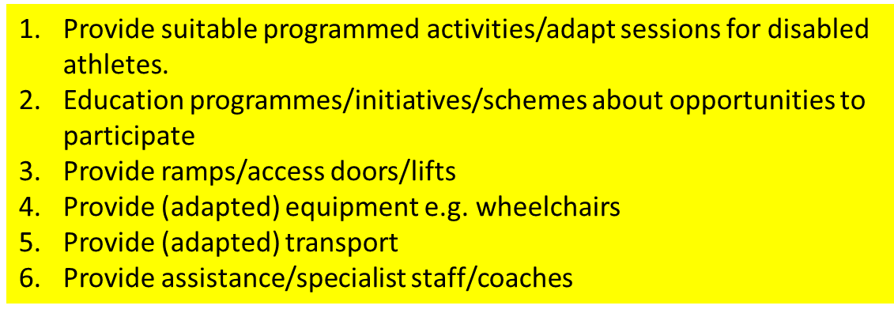

Slide 10
‘Explain’ means that you need to develop your point made with an example
‘Socially unacceptable’ means inappropriate behaviours
Can you think of some sports that may be seen by some people has unacceptable?

