Slide 1
Lesson Nineteen
C/W Date
Lesson Title: Stapleton and the policeman, Lestrade
Lesson Focus: - Use inference and deduction to recognise implicit meaning at sentence and text level

Slide 2
DNA
Summarise Chapter 9 and Chapter 10 in 20 words... it is harder than you think!
That's only 10 words for each Chapter.

Slide 3
Task - Word Consciousness
1) Please copy this out. If you are using your exercise book, this should be in the back.
2) Please complete this column by putting the definitions into your own words AND coming up with synonyms*. You saw and copied an example of how to do this in lesson 1.
*synonym means alternative words
Word and definition | Your definition or synonyms
Scotland Yard (Noun) (officially New Scotland Yard) is the headquarters of the Metropolitan Police responsible for policing all 32 boroughs of London.
Perceived (verb) 1) become aware or conscious of (something); come to realise or understand 2) interpret or regard (someone or something) in a particular way
Traits (Noun) a distinguishing quality or characteristic, belonging to a person.

Slide 4
Learning Journey
In previous lessons we have used inference and deduction in ‘Hound of the Baskervilles’ to work out key clues.
Today we are going to apply these skills to predict what might happen at the police interview
This will help us in all areas of English to assist creativity.

Slide 5
Task force
You need to decide what you think is going to happen next between Stapleton and the newly arrived Police Officer from Scotland Yard, Lestrade.
Task
Create two mind maps:
One for Stapleton
One on Lestrade
Use the information on the next slides to create your mindmaps.

Slide 6
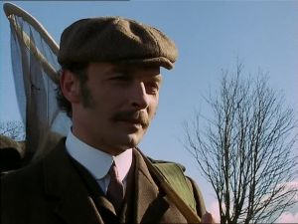
Task Force – Stapleton investigation
Think about the following for Stapleton and add it to your mind map –
-What do you know about Stapleton so far ?
-His character traits
-What adjectives could you use to
describe him?
-What do others think of him?
-How is he perceived?

Slide 7
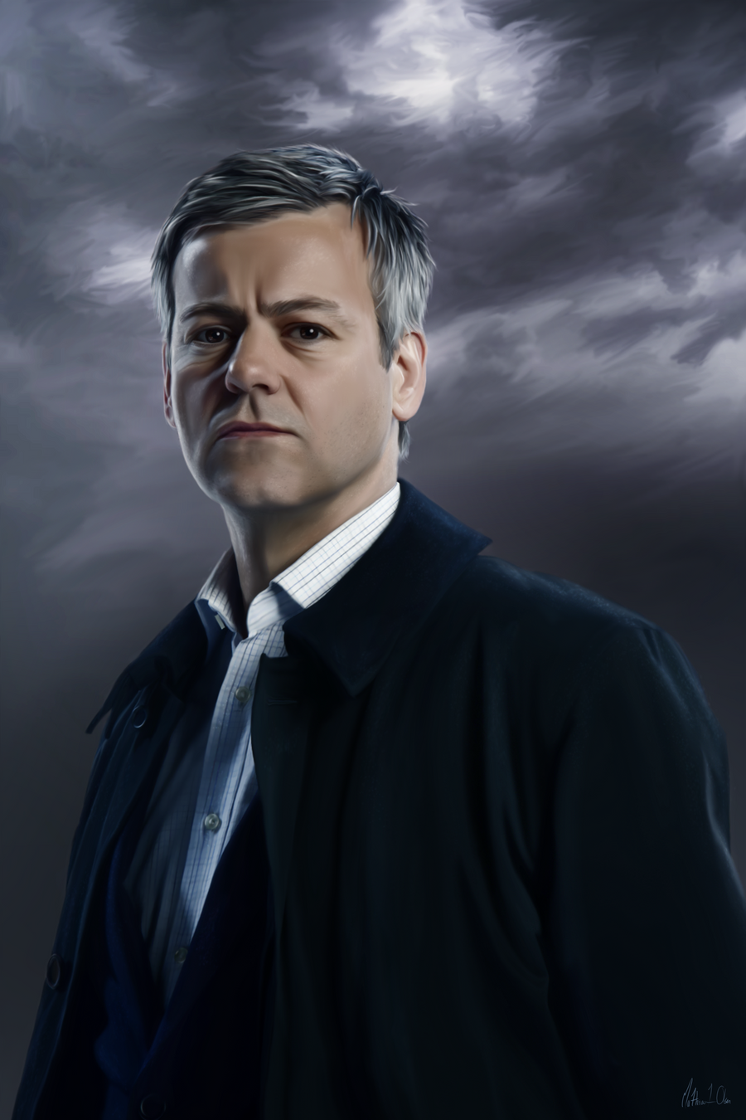
TASK force – Lestrade INVESTIGATON
You do not know much about Lestrade at the moment – he has only just stepped off the train! What we do know is that he is a police officer from Scotland Yard. Mind map your ideas of what you expect from Lestrade
-What do we expect a police officer to be like?
-What would we expect from a police officer?
-What qualities would he have?
-What adjectives would you use to describe a man
of the law?

Slide 8
Scrpit
Think outside the box – make the role play exciting!
Task
Your next task is to use your mind map information to write a script. You are going to predict what happens next between Stapleton and Lestrade.
For more information go to the next slide.

Slide 9
Some ideas to get you started
Think about if you want Stapleton to admit or deny any part of the existence of the Hound?
Lestrade is a policeman but is he good at his job or terrible? Maybe he would team up with Stapleton to help him kill people?
Is there an arrest? Or an interview? Or a police chase?
Or your script could be something completely different that nobody expects!

Slide 10
Help and ideas
So Stapleton asks “Did you hear anything?”. You might ask him why he wanted to know. Pg112
Stapleton says “I would agree”. Why would he agree? He wasn’t there for long! Pg 113
Holmes say that Stapleton recovered quickly from the shock… is this normal? Pg114
Sir Henry says that Mr Stapleton asked him to go to Merripit House. You might want to know why. Pg116
Laura Lyons has been used by Stapleton – he lied to her about not having a wife, you might want to ask him all about this.

Slide 11
Tell me what you think
WHAT MAKES A GOOD QUALITY AUDIENCE?
LIST 3 THINGS.

