Slide 1
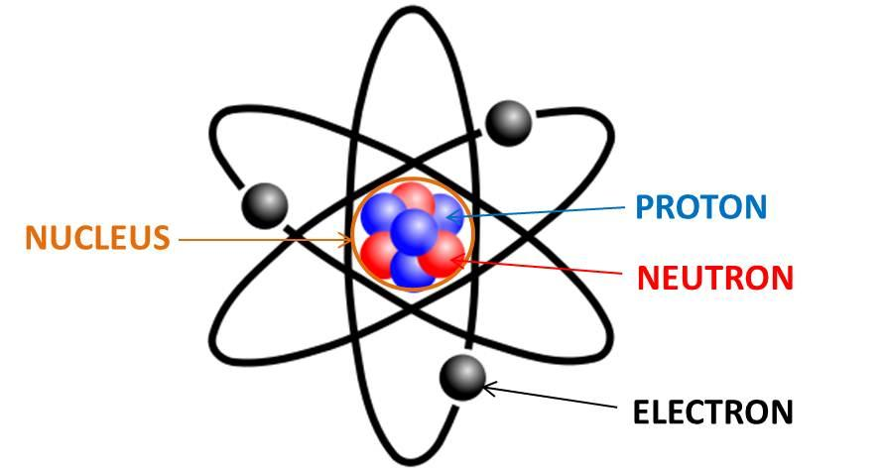
Atoms and Radiation
Last Lesson:
This Lesson:
Atoms & Radiation
Next Lesson:
Discovery of the Nucleus
Do now activity:
Label the 4 parts of this atom?
What charge is given by the blue particle?
What mass is given to the black particle?
What is the overall charge given to particles in the orange circle?
Notes:
Nucleus
Proton
Neutron
Electron
2. 0
3. 1/2000
4. +1

Slide 2
Progress indicators
GOOD PROGRESS:
Name the three sub-atomic particles found in an atom and identify the three types of nuclear radiation.
Describe the relative penetrating powers of the three types of nuclear radiation
OUTSTANDING PROGRESS:
Describe why a shadow forms on photographic paper between an object and radioactive source.

Slide 3
Recall - Atoms
What do we already know, draw the table below and complete?
What is the mass of these particles?
What is the charge of these particles?
How we represent this.
Subatomic Particle | Atomic Mass | Atomic Charge
Proton | 1 | +1
Neutron | 1 | 0
Electron | 1/2000 | -1

Slide 4
Radioactivity
How do elements become radioactive?
Some elements have an un-stable atomic structure.
The un-stable atom nuclei will emit radioactive radiation until it achieves a stable atomic structure.
The timing of this decay of the atom nuclei emitting radioactive radiation is completely random.(Half Life)

Slide 5
Radioactivity – Unstable Atom
e
e
n
p
p
n
n
n
p
p
p
n
n
p
n
p
n
n
p
p
p
p
e
p
n
n
n
n
n
p
p
p
p
n
n
n
n
p
p
p
p
n
n
e
e

Slide 6
Radioactivity
What do Radioactive sources emit? Key Information – Make a note.
n
p
Alpha Radiation
Symbol: α
Helium Nucleus – 2 protons, 2 neutrons
p
n
Gamma Radiation
Symbol: γ
Electromagnetic Radiation (High Energy Photon)
Beta Radiation
Symbol: β
High Energy Electron
e

Slide 7
Radioactivity
Stopping Radiation?
n
e
p
p
n
Gamma Radiation
Stopped by centimetres of high density metal
Alpha Radiation
Stopped by Paper
Beta Radiation
Stopped by millimetres of metal

Slide 8
Radioactivity
What part of the atom has to achieve a stable structure and when does it happen if becomes un-stable?
Green Pen
The nuclei of an atom and the decay is completely random, if it is un-stable
What are the three types of radioactivity and what can block the radioactivity?
Alpha radiation, stopped by paper
Beta radiation, stopped by millimetres metal
Gamma radiation, stopped by centimetres of high density metal

Slide 9
Radioactivity
Background radiation is the radiation level that is around us every day when not standing next to or near a radiation source.
The Earth is made up in part of radioactive rocks that emit radiation.
The Sun and other stars emit radiation.
Human activity through development of nuclear technology emits, accounts for a small amount of background radiation.

Slide 10
Radioactivity
How might we reduce our exposure to background radiation? Discuss…

Slide 11
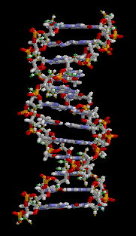
Radioactivity
The alpha, beta and gamma particles are emitted with a very high energy level and velocity.
When the particles hit another atom they ionise (rip off electrons) from the atom. When this happens to atoms in DNA that is part of living cells it damages the DNA structure.
The damaged structure when it replicates, then replicates incorrectly which results in a cancerous cell (mutations).

Slide 12
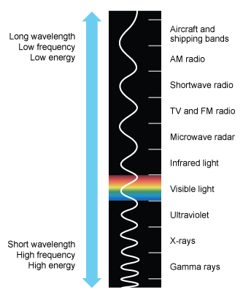
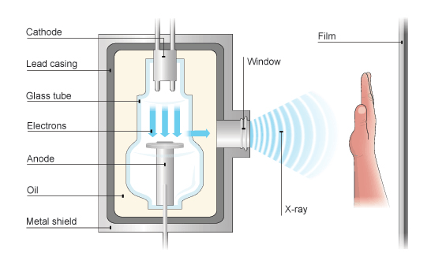
Radioactivity
X-Rays

Slide 13
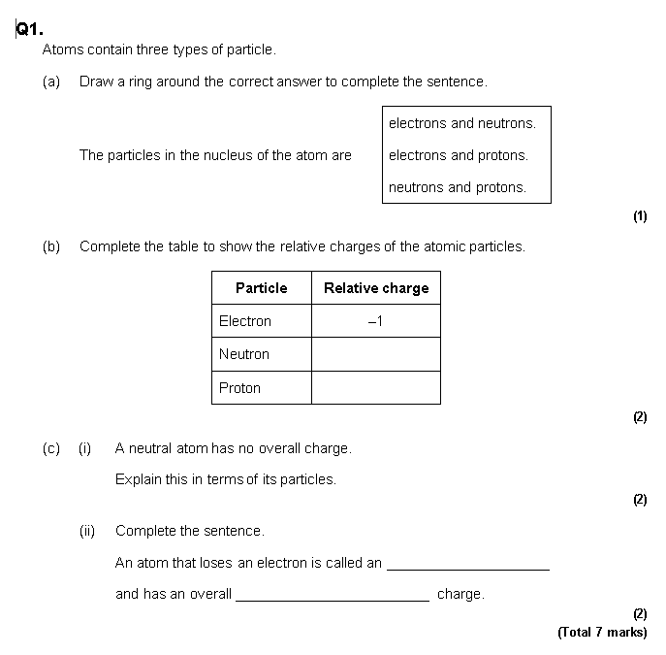
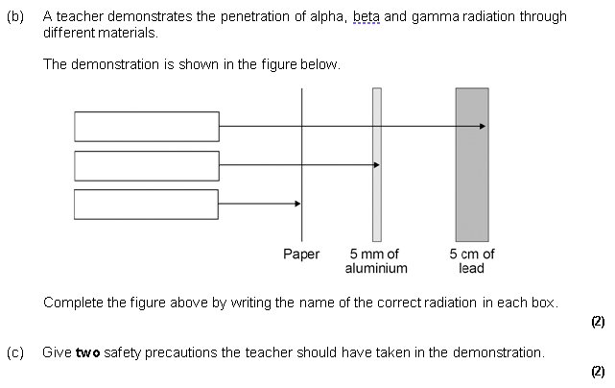
Radioactivity
Answer the Exam Style questions:

Slide 14
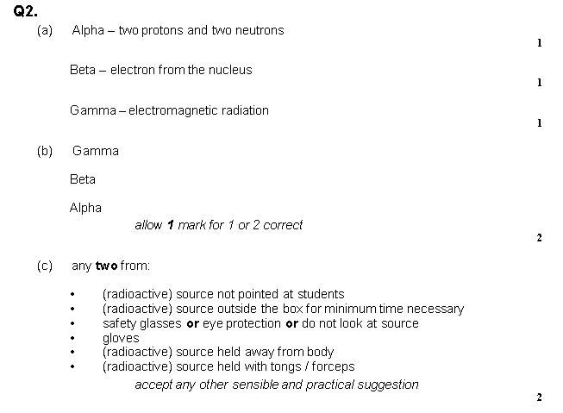
Radioactivity
SELF ASSESS
Green Pen

