Slide 1
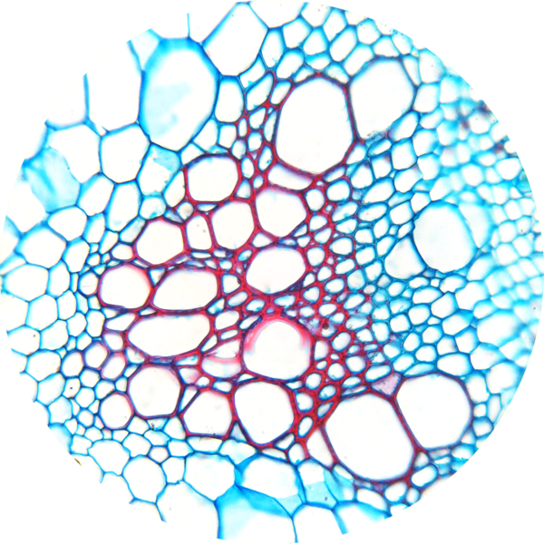
Transport Systems in Plants
Do Now activity:
Name the three main plant organs
Name the types of tissue you would expect see within a leaf of a plant?
Describe the role of the xylem and the phloem tissue
Notes:
Image by Kelvinsong (Own work) [CC BY 3.0 (http://creativecommons.org/licenses/by/3.0)], via Wikimedia Commons

Slide 2
Progress indicators
GOOD PROGRESS:
- Identify the substances transported in plants
- Describe the function of the xylem and phloem in relation to the substances they carry
OUTSTANDING PROGRESS:
- Explain why transport in plants is essential to life by relating each substance to its job within the plant

Slide 3
Xylem and phloem vessels are similar in that they both transport materials around the plant. But they have many differences.
Transports water & sugars (food)
Think > Pair > Share
Look at the diagram to the right, can you identify any similarities and differences between the xylem and phloem vessel?
Cheat sheet available!
Transports water & mineral ions
Xylem vessel
Phloem vessel

Slide 4
Task: Copy and complete the following sentences:
Xylem vessels are needed to transport _____ and _______ from the roots to the ______.
Phloem vessels are needed to transport ______ from the ______ to the rest of the plant.
Keywords: sugar water minerals leaves
water
minerals
shoots
sugars
leaves

Slide 5
https://www.youtube.com/watch?v=QXdujo4PZ7c
Task: Watch the video and answer the following questions:
How does water move up through the xylem vessels?
How do sugars move around the plant in the phloem vessels?
Glucose is made during which process?
What does glucose change into before it is transported in the phloem?
What are the names of the two types of cells needed to make the phloem tissue?

Slide 6
Self-assessment:
Water moves up through the xylem due to the transpiration pull of the transpiration stream
The process by which sugars move through a plant is called translocation
Glucose in the leaves during photosynthesis
Glucose is firstly changed into sucrose before it enters the phloem
Sieve tube cells and companion cells are the two cells that work together within the phloem tissue

Slide 7
Task: 1. Write the following headings into your book:
Xylem Phloem
2. Sort these statements into the correct columns:
Transports sugars, e.g. sucrose
Moves substances in one direction (from the roots to the leaves)
Is made up of living cells
Moves substances from the leaves to other parts of the plant
Transports minerals & water
Is made of dead cells
Ask for a cheat sheet if you are stuck!
Extra challenge: Complete a labelled diagram of a xylem and a phloem tissue

Slide 8
Xylem Phloem
Moves substances in one direction (from the roots to the leaves)
Transports sugars, e.g. sucrose
Is made up of living cells
Moves substances from the leaves to other parts of the plant
Is made of dead cells
Transports minerals & water

Slide 9
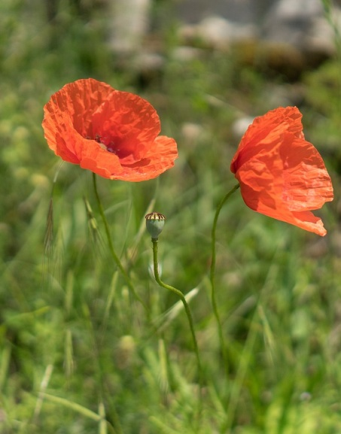
Why is transport so important?
It to a plants survival that dissolved sugars, water and mineral ions are moved around the plant.
Discuss in pairs what you think the importance of the following substances are to the plant:
Sugars ~
Mineral ions ~
Water ~
Cells need sugars for respiration as well for providing materials for growth
Mineral ions are needed for the production of proteins and other molecules in the cell
Water is needed for photosynthesis, it is also needed to ensure that the plant can hold itself upright

Slide 10
Exam-style question:
1. Plants transport many substances between their leaves and roots.
Describe how ions, water and sugar are obtained and transported through plants
(6 marks)

Slide 11
Self-assessment:
Points that could be included (must ensure at least one point is made for each substance):
Ions: are taken up by diffusion or active transport, from an area of high to low conc. (diffusion) or an area of low to high conc. (active transport), ions travel up in the xylem from the roots to the leaves (in one direction only)
Water: is taken up by osmosis from the soil by the roots, from an area of low to high concentration, water travels in the xylem from the roots to the leaves, water is pulled up through the plant by the transpiration stream
Sugar: this substance is made in the leaves during photosynthesis, sugar travels in the phloem, it is moved to other parts of the plant to be used in respiration or to be stored in storage organs.
(6 marks)

Slide 12
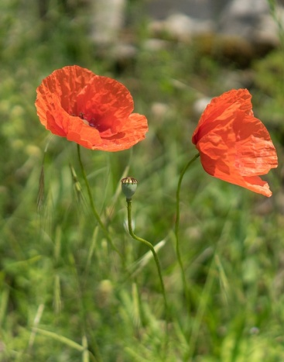
Plenary – Summarise what you have learnt today in 5 sentences, try and use the key words below.
Keywords: Xylem, phloem, mineral ions, transpiration, translocation, glucose, sucrose, water, respiration, photosynthesis, sieve tube cells, companion cells

Slide 13
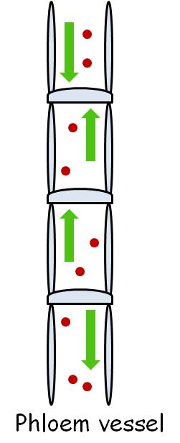
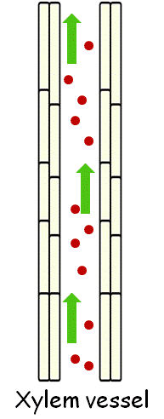
Cheat Sheet!
Cheat Sheet!
Phloem – Moving food
Phloem – Moving food
The phloem tissue transports sugars made from the leaves to the rest of the plant. Food is also transported to storage organs.
Phloem is a living tissue, phloem cells are alive. The movement of dissolved sugars from the leaves to the rest of the plant is called translocation.
The phloem tissue transports sugars made from the leaves to the rest of the plant. Food is also transported to storage organs.
Phloem is a living tissue, phloem cells are alive. The movement of dissolved sugars from the leaves to the rest of the plant is called translocation.
Xylem – Moving water and mineral ions
Xylem – Moving water and mineral ions
The xylem tissue carries water and mineral ions from the soil up to the stem and the leaves.
The mineral ions and water only travels in one direction.
Xylem cells are dead.
The xylem tissue carries water and mineral ions from the soil up to the stem and the leaves.
The mineral ions and water only travels in one direction.
Xylem cells are dead.

Slide 14
How does water move up through the xylem vessels?
How do sugars move around the plant in the phloem vessels?
Glucose is made during which process?
What does glucose change into before it is transported in the phloem?
What are the names of the two types of cells needed to make the phloem tissue?
How does water move up through the xylem vessels?
How do sugars move around the plant in the phloem vessels?
Glucose is made during which process?
What does glucose change into before it is transported in the phloem?
What are the names of the two types of cells needed to make the phloem tissue?

