Slide 1
Music Distribution
Distance Learning
Lesson 1 of 2

Slide 2
1.What do you think is meant by the term DISTRIBUTION?
DNA
2.What do you think are the two different types of MUSIC DISTRIBUTION?
Answer these questions in full sentences!

Slide 3
Progress Indicators
Key Terms | Good | Outstanding
Distribution Consumer | To identify what music distribution is and what a consumer is. To describe the difference between physical and digital distribution. | To describe the importance of music distribution and how it can impact on the consumer. To analyse the different types of distribution and provide an opinion on which appears to be most effective.

Slide 4
L/O How does the finished music product get to the consumer?
On the next couple of slides, you will find some information – read through it CAREFULLY and make some notes! Merits will be awarded for the most presentable notes!

Slide 5
1
A Record Company will pay for the costs of producing a musical product.
2
Distribution Companies sign deals with Record Labels which give them the right to sell that label's products..
3
The Distributor takes a cut of income from each unit sold and then pays the label the remaining balance and the artist/band or songwriter their ROYALTIES.

Slide 6
Distribution is the way that recorded music gets into the hands of consumers.
Companies that are responsible for making music available to consumers are called DISTRIBUTION COMPANIES.
Online Retailer
Record Company
Distribution Company
Consumer
Physical Retailer
Consumer

Slide 7
The Distribution Chain
Digital distribution
Distribution Company
iTunes/Spotify/
Amazon/Youtube
Consumer
Physical distribution
Tesco /Amazon/
HMV/ASDA
Consumer

Slide 8
Two Types of Distribution:
Physical Music Distribution
The more traditional method of distribution; this is how albums get into shops. A music distribution company signs deals with record labels or artists which then gives them the right to sell their music to shops. . Put simply, the distributing company act as a middleman between the artist/record label and the store.
Digital distribution
Digital Music Distribution
Digital music distribution works much the same, just on a different platform. Instead of transporting albums to a physical store, the distribution company will distribute music in digital format (usually mp3 or .wav). The music is sent to online music platforms such as iTunes, Spotify and AmazonMP3.
Physical distribution

Slide 9
The Distribution Chain
Digital distribution
Distribution Company
iTunes/Spotify/
Amazon/Youtube
Consumer
Physical distribution
Tesco /Amazon/
HMV/ASDA
Consumer
It is then the distributor’s job to ensure that royalties for the use of the music are passed back to the artists and song writers.

Slide 10
30 Second thinking time:
Hard Copy vs Digital Sales
Q: Is it easy to get rich selling your music? What do think makes more money – selling CDs/Vinyl or streaming and downloads?

Slide 11
Platform | £stream/view | Amount for £1000
YouTube
Spotify
Apple Music
Amazon Music
Google Play
0.0006
1,666,666
0.0030
333,333
Q: How many times do you think your music has to be viewed on YouTube to make £1000?
0.0057
175,438
0.0032
312,500
0.0054
185,185
Q: How many times do you think your music has to be streamed on Spotify to make £1000?

Slide 12
So, selling CDs and Vinyl is more profitable?
*Average CD selling price £9.99
Artist
Producer
Songwriters
Distributor
Manufacturing
Retailer
Record label
(6.6%)
(2.2%)
(4.5%)
(22%)
(5%)
(30%)
(30%)
(66p)
(22p)
(45p)
(£2.19)
(49p)
(£2.99)
(£2.99)
Q: As an artist, how many CDs will you have to sell to make £1000 profit?

Slide 13
WORD CONSCIOUSNESS
KEYWORD | YOUR DEFINITION
Distribution
Consumer
Ensure you read through the slides ands write your definitions down!

Slide 14
Read the worksheet titled
‘Is Streaming good for music?’
1. What are the advantages and disadvantages of streaming music from the point of view of a musician/artist/band?
2. Is streaming good for music? Write a paragraph in your books that explains your opinion, give reasons for your answer.
A copy of this sheet has been uploaded onto teams!

Slide 15
Platform vs Audience
Lesson 2 of 2

Slide 16
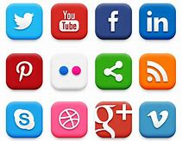
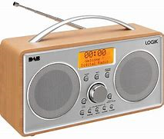
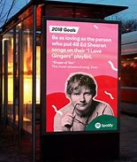
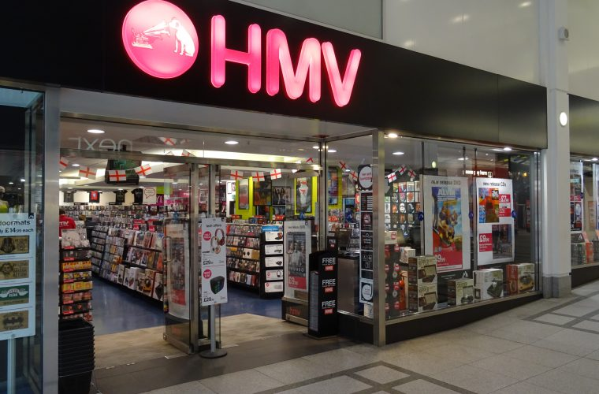
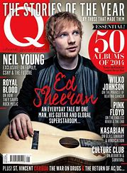
DNA
What do all of these have in common? Write ONE sente4nce with your answer.
CLUE: Think about business…

Slide 17
L/O How is music consumed? Who listens to which platform?

Slide 18
Progress Indicators:
Key Terms | Good | Outstanding
Consume/Consumption Platforms Target Audience Target Market | Identify a range of different platforms where music can be consumed. Make basic conclusions from listening data. | Describe a range of different music platforms where music can be consumed and suggest a suitable target audience for each one.

Slide 19
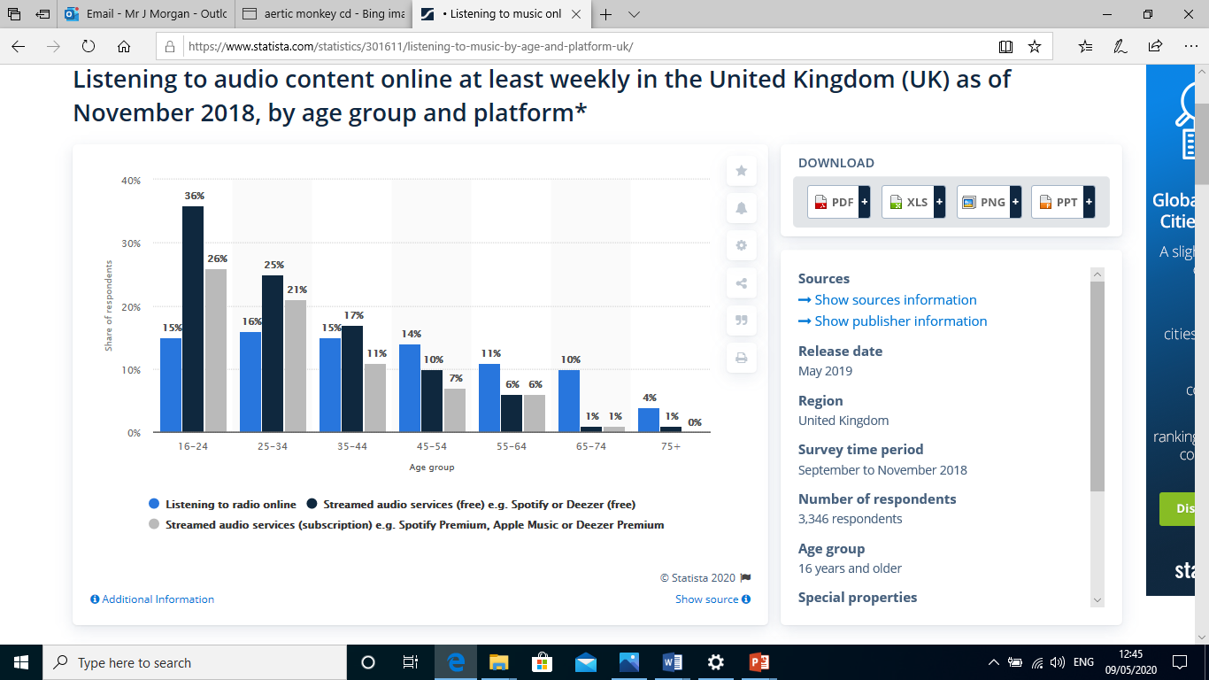

Slide 20
TASK
Task: write a paragraph about the information in the graph. What conclusions can you draw about the way different age groups consume music online?

Slide 22
TASK
Write a paragraph about what has happened to CD sales since they were invented around 1983.
EXTENSION: Why do you think that sales of CDs started to fall significantly after 2005?

Slide 23
CDs sales increased sharply between the 90’s-2000
CDs sales peaked around 2000
CD sales started to decline in then early-mid 2000s, this is w hen online music started to become more popular
Task: Why are there as many CDs still being sold now as there were in 1983? Write your answer in full sentences!

