Slide 1
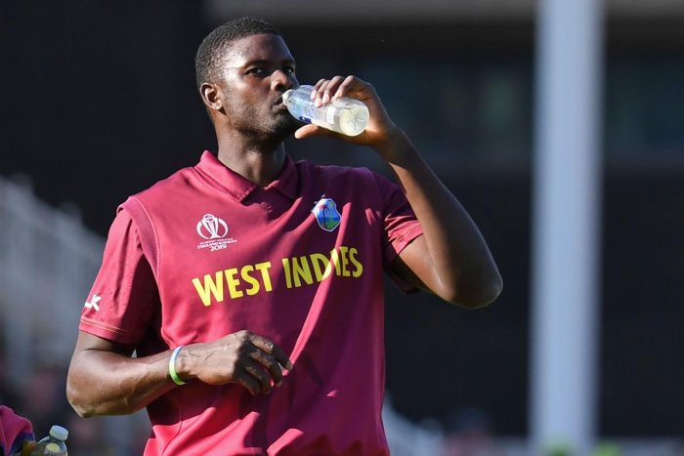
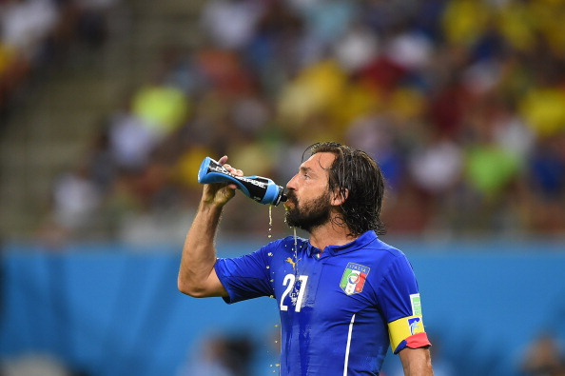
Nutrition in Sport
LO2
Good Progress | Outstanding Progress
Be able to explain the impact of exercise before, during, after exercise | Be able to explain the impact on a sporting performance
Over a range of examples to support | Offer a wide range of examples.

Slide 2
Nutrition is important
Before exercises
During exercises
After exercise

Slide 3
Before event
You should always eat before exercising so your body has enough fuel and energy for the activity/sport you are going to do.
Your body needs a certain amount of carbohydrates for fuel /energy when training.. So you need enough carbohydrates for energyWhen you start exercising your body burns the carbohydrates then fats then muscle stores to be used up .
You also would need to drink plenty of water and stay hydrated. An athlete would have an increased carbohydrates intake 3-4 days before he exercised and he would have a high level of energy stores to keep him performing at a high level. Some athletes would eat food such as noodles, rice and potatoes as carbohydrate sources.

Slide 4
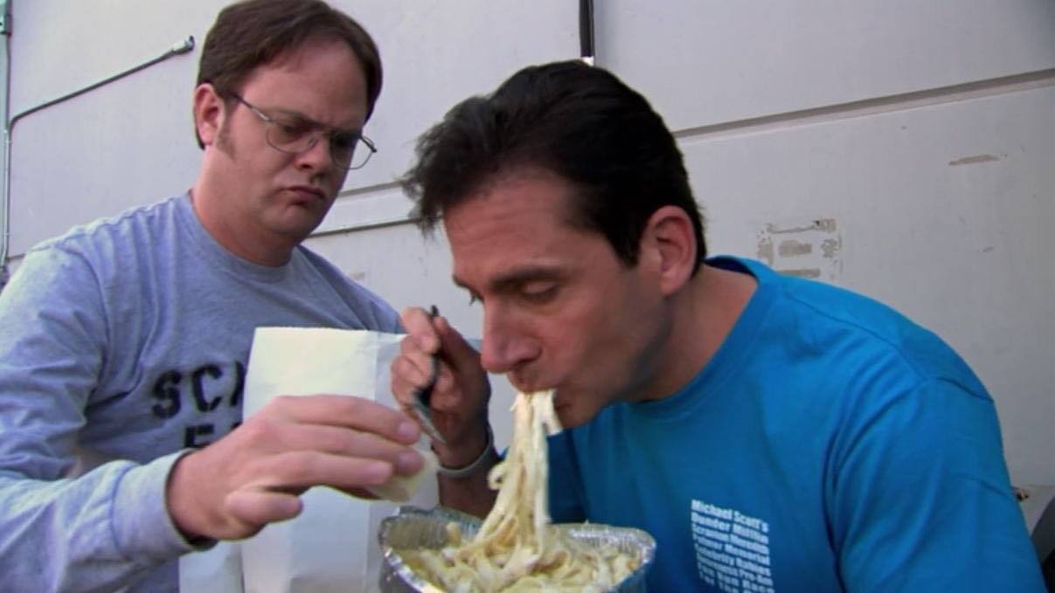
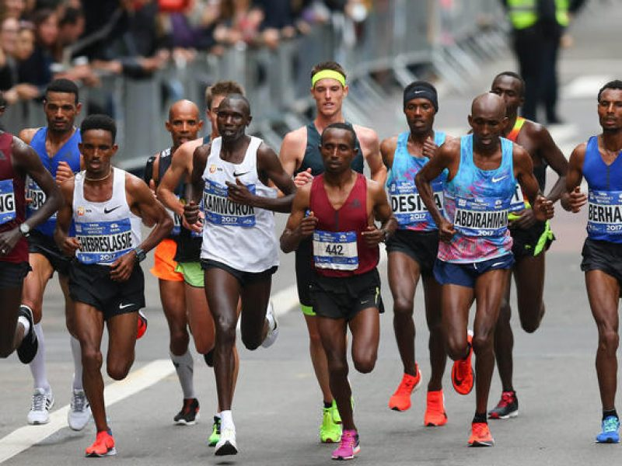
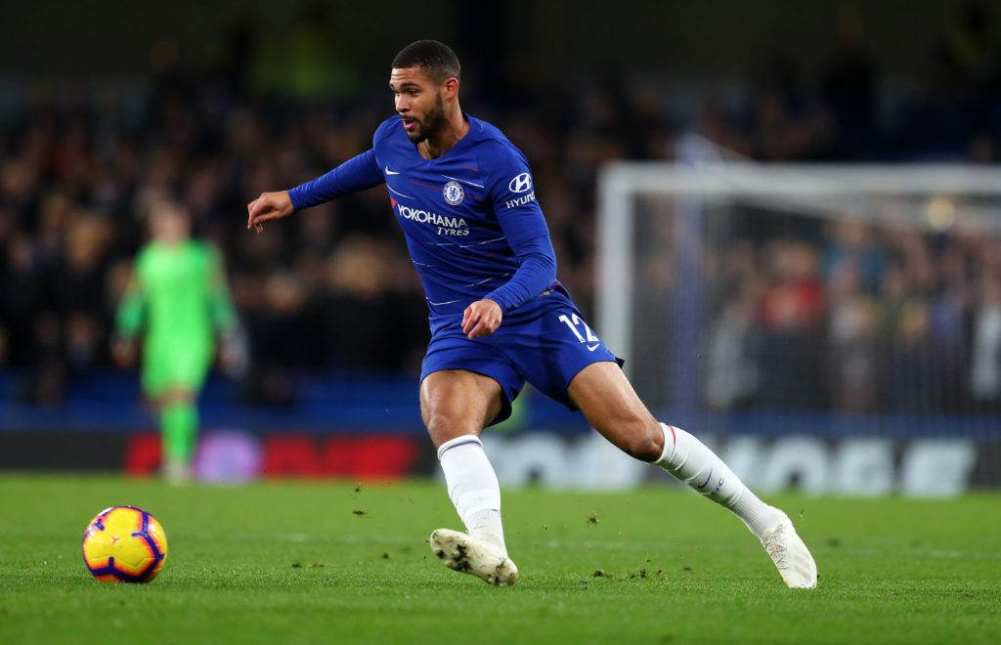
Before event

Slide 5
During event
Some sports last a long period of time
You may need to eat/drink during the event to keep the body functioning
Marathon runners might need this as they have to run constantly for 26 miles. During this they will drink water at different mile markers and try and replenish stores of water that have been used up. This is needed otherwise the athlete could be dehydrated.
Being hydrated controls the body temperature and avoids dehydration. Body temp is controlled by your body sweating and releasing fluid onto the skins surface, this then cools the athlete down. If you are dehydrated you cannot sweat and therefor get too hot!
Energy gels – Energy gels are a supplement you can take during performance that immediately increases energy levels by replacing some carbohydrate stores. Used most in endurance sports.

Slide 6
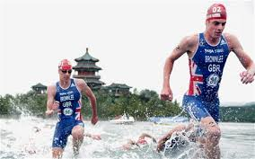
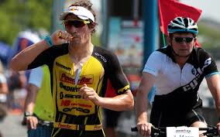
The importance of nutrients during exercise
https://www.telegraph.co.uk/sport/olympics/triathlon/9411439/London-2012-Olympics-Alistair-and-Jonathan-Brownlee-interview.html
https://guides.wiggle.co.uk/powerbar-triathlon-nutrition-guide

Slide 7
After event
After exercises an athlete should make sure he drinks a lot of fluids and has some carbohydrates because he will need to restore the stores he lost during the game. After hard exercise a footballer will have muscle fatigue. To recover quickly the player will eat protein as soon as they can after exercise stops. This could be protein shakes or protein foods like eggs, chicken and other routine high foods. This will help recovery and reduce muscle soreness.

Slide 8
Summary
Nutrition is important when:
Before exercises
During exercises
After exercise
Carbohydrates for energy
Hydration to stop dehydration
Hydration for temperature control
Energy gels
Protein to recover
Carbohydrates to restore energy stores
Fluids to replace water lost

Slide 9
Examples

Slide 10
The importance of nutrition during exercising
It is important to maintain good nutrition during exercise to make sure you remain hydrated to allow you to maintain the same pace and to make sure you are not dehydrated as your muscles may become tired and you could get heat stroke which could lead to injuries. It is also important to also have a quick energy boost to replenish you nutritional needs during exercise, for example if you were tired and thirsty in a football match you could have a quick drink of water or an energy drink at half time. It is important that if you are working really hard and for a long time like marathon runner they need to have a small snack that will provide them with energy.
EXAMPLE

Slide 11
EXAMPLE

Slide 12
EXAMPLE

Slide 13
End of P4 target
Explain why nutrition is important for performance
Explain why nutrition is important:
Before exercise
During exercise
After exercise
You must give a sporting example for each one

Slide 14
P5 LO2 Supplements

Slide 15
Supplements
Supplements are used in sport to enhancing performance and add nutrients to your system that perhaps you need more than normal or you do not get from your diet

Slide 16
Supplements
Creatine
Creatine mainly helps build muscle quicker and makes the athlete stronger. This has many benefits for example in football it means you could shoot with more power and tussle for the ball better with more strength. Creatine also helps speed up muscle repair and strengthening.
Protein Powders
Protein powders can be put with water and mixed and drank. These help muscles repair and grow muscle tissue and can be taken with low calories. After hard intense exercise people take these shakes so they can recover quick and train again like in football.
Multivitamins and Herbs
These herbs and vitamins can come in varying forms to fill gaps in a diet for nutrients that are not being used or eaten by foods in their diet to remain healthy and not get ill. Examples are vitamins A, B, C, D, E and can make bones stronger
Risks
The risks of supplements is that you don’t know what to take or how much of it, for example too much protein with high carbohydrate content can cause you to gain weight that you might not want to and mean you run slower/lower performance. Too much creatine can kidney problems.

Slide 17
EXAMPLE

Slide 18
EXAMPLE

Slide 19
LO2: CAU
When to eat nutrients for performance
Before
During
After
Supplements
Definition
Multivitamins, protein powders, herbs, spices
Why they are used
Issue with them

Slide 20
Next lesson
Diets tailored to performance

Slide 21
Diet with types of activity
Aerobic
When you do activities such as running and marathons (aerobic) you need to be hydrated and energized and eat foods with nutrients and foods that will give energy for a long period like carbohydrate loading. Carbohydrate loading is where you start low and gradually build up the carbohydrates up to the race for energy increase. This allows them to perform aerobically without fatiguing.
Endurance athletes need to be hydrated because they perform for a long time , they have to be hydrated all the time so they wont get dehydrated during the event. Dehydration could cause them to drop out of the race.
Anaerobic
Anaerobic exercise is short with a high intensity (100m sprint). Anaerobic Sprinting is hard but not for very long. They would need carbohydrates with low fat content for energy and explosive movements not carbohydrate loading as this would make them feel heavy and stodgy for their races.
For bodybuilding you should eat carbohydrates that will give energy and fast releasing energy for hard exercises and high intensity. You should also use proteins that will help muscles repair and get bigger. You will eat more calories little and often make your level of muscle growth big.

Slide 22
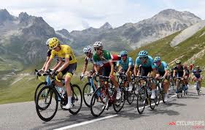
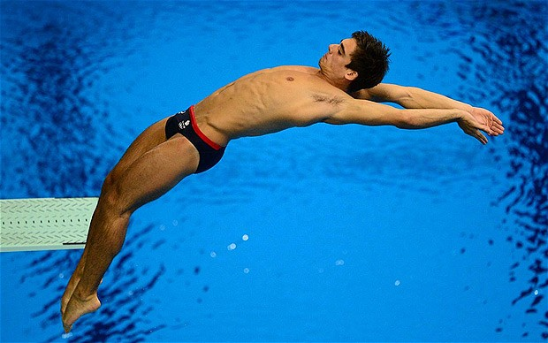
Sporting diets
EXAMPLE
Sports have different needs. Here are two examples of different sports that have different diets. The intensity and physical nature of the sport you do determines what type od diet you need.
Aerobic Sport
Tour de France cycler
This bike event last for a long time and burns a lot of calories and energy stores. Carbohydrate loading is where the athlete builds up their carbohydrate in the days/weeks up to the event so they have a maximum store of energy going into he event. They need to stay hydrated before and through the event and eat lots of slow releasing carbs.
Anaerobic Sport
Diver
A diver will need carbohydrates in smaller amounts as they need it for recovery and short energy sections. Low fat carbs are what's needed so they don’t put on extra weight. After a diving competition the carbs would help him recover ready fro training after.
Anaerobic Sport
Weight lifting
Weight lifts eat a lot of calories to build muscle and have high energy levels when working out. They will eat up to 7 meals a day and have cars and protein content to build an repair muscles. They will avoid fatty foods to stop saturated fats from making them overweight in the wrong weight.

Slide 23
EXAMPLE
Why change you diet
Endurance/aerobic athletes: Carbohydrate loading is a strategy used by endurance athletes, such as runners, to maximise the storage of glycogen (or energy) in the muscles and liver. This carbo loading builds up and increase the carbohydrates a sportsman is eating in as they get closer and closer to a event. If you were Mo Farah and running the 5000m you would increase the % of carbohydrate in your meals leading up to the Olympics. High levels of hydration is needed to sustain activity over long periods of time this is because you’ll become tired and distracted by anything.
Short intense/anaerobic activities: Not carbohydrate loading because you don’t need to maximise glycogen because of it being a short intense activity The need for long term energy has gone and now you need explosive short term energy form low fat sources as it wouldn't’t get burned off like aerobic exercise does. There's a lactic acid build up because of it being an anaerobic as the oxygen delivery cannot keep up.
Strength based activities: If your doing weightlifting your going to need a lot of protein to build muscle and burn fats. They would not need to carbo load, they need to eat high calorie diet to support muscle growth and high protein for the same reason. Their muscles are worked very hard and consistently so an extremely high protein diet is important. These athletes would aim for anywhere between 5-7 meals a day. You will need to build muscle mass so you can limit excess body fat in order to lift heavier weights.
https://www.google.co.uk/url?q=https://www.mensfitness.com/training/workout-routines/beginners-guide-weight-training&sa=U&ved=0ahUKEwiF-O6YiKjZAhUHB8AKHf1oDx0QwW4IFjAA&usg=AOvVaw2q-Ehs8DsKaodZxjyCLeGT

Slide 24
LO2: CAU
When to eat nutrients for performance
Before
During
After
Supplements
Definition
Multivitamins, protein powders, herbs, spices
Why they are used
Issue with them
Needs for a diet
Aerobic (explain and give sporting example)
Carbohydrate loading
Anaerobic (explain and give sporting example)
Increase protein and fast burning carbs/fats

