Slide 1
Do Now Activity
Computer Science has had a massive impact on the world we live in.
Using these images, can you work out the main areas of society which computers have had an effect on?
Challenge: Can you think of any others?
Notes:
Education, Sport, Agriculture, Travel / Transport, Media

Slide 2
Unit 7 - Ethical, Legal, Cultural and Environmental Concerns Lesson 1 - Growth and Stakeholders
Progress Indicators
GOOD | OUTSTANDING
Describe how the growth of computer systems and its effect on society (4-6) Identify key stakeholders of technologies (4-6) | Discuss in detail, the growth of computer systems and its effect on society (7-9) Explain how key stakeholders are affected by technologies (7-9)
Stakeholder = anyone with an interest in an issue

Slide 3
Sport and Computer Science – Video
Look out for the positive and negative impact of computing

Slide 4
Task - Growth of Computing (Transferable Skills) pg.2
TOP LEFT BOX
(Group of 4)
5 Minutes
Give details of positive and negative impacts
TOP RIGHT BOX (Shoulder Pairs)
5 Minutes
Give details of positive and negative impacts
AS A TABLE
Choose 4 categories from the list
BOTTOM LEFT BOX
(Face Pairs)
5 Minutes
Give details of positive and negative impacts
BOTTOM RIGHT BOX (Individual)
5 Minutes
Give details of positive and negative impacts

Slide 5
Unit 7 - Ethical, Legal, Cultural and Environmental Concerns Lesson 1 - Growth and Stakeholders
Progress Indicators
GOOD | OUTSTANDING
Describe how the growth of computer systems and its effect on society (4-6) Identify key stakeholders of technologies (4-6) | Discuss in detail, the growth of computer systems and its effect on society (7-9) Explain how key stakeholders are affected by technologies (7-9)
Stakeholder = anyone with an interest in an issue

Slide 6
Stakeholders
Stakeholder: A person(s) who may be involved either directly,
or indirectly with an issue/problem
Most issues and problems will have many stakeholders
Some may be obvious, some may be less obvious
For high-banded responses (marks) you should be able to identify more than just the ‘obvious’
“The idea of driverless cars on our roads is rapidly becoming a reality”

Slide 7
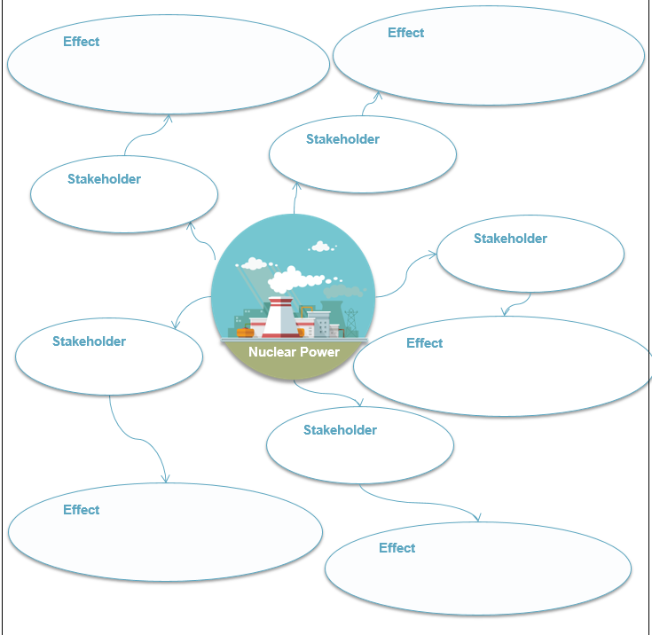
Task – Stakeholders pg.3

