Slide 1
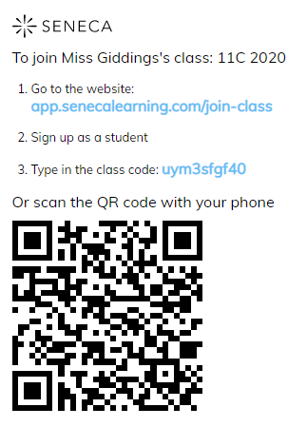
Seneca
Seneca is a free online website that you can use to revise all the topic that we need to cover for your written examination.
Simply
Go to website, sign up as a student
And enter the class code
This will take you to a revision page that I have set up from you to revise from.
Thank you

