Slide 1
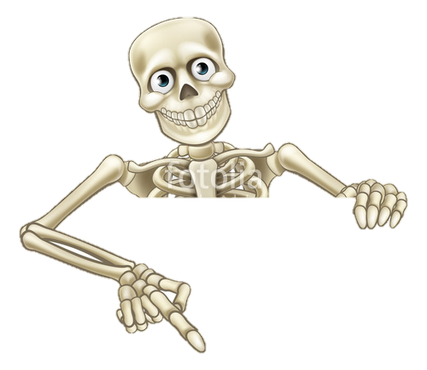

DO NOW ACTIVITY:
TASK: List as many KEY WORDS as you can remember within the MUSCULOSKELETAL system
Target:
3-4 = 15 or more = MERIT!
5-7= 20 or more = MERIT!
Learned throughout the lesson
8.
9.
10.
11.
12.
13.
14.
15.
16.
17.
18.
19.
20.

Slide 2
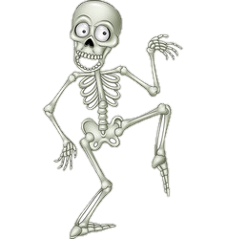
Date: 9 December, 2019
Musculoskeletal Revision
 | Good Progress | Outstanding Progress
3 - 4 | To state and identify key components that help the skeleton and muscles work together (AO1) | To begin to explain why they have an impact on performance, with some attempt to sporting examples (AO2/3)
5-7 | To be able to explain with examples how the skeleton and muscles help effect performance (AO2) | To be able to discus and analyse with clear sports examples how the skeleton and muscles help effect performance justifying the need for it (A03)
Identify your Progress Indictor

Slide 3
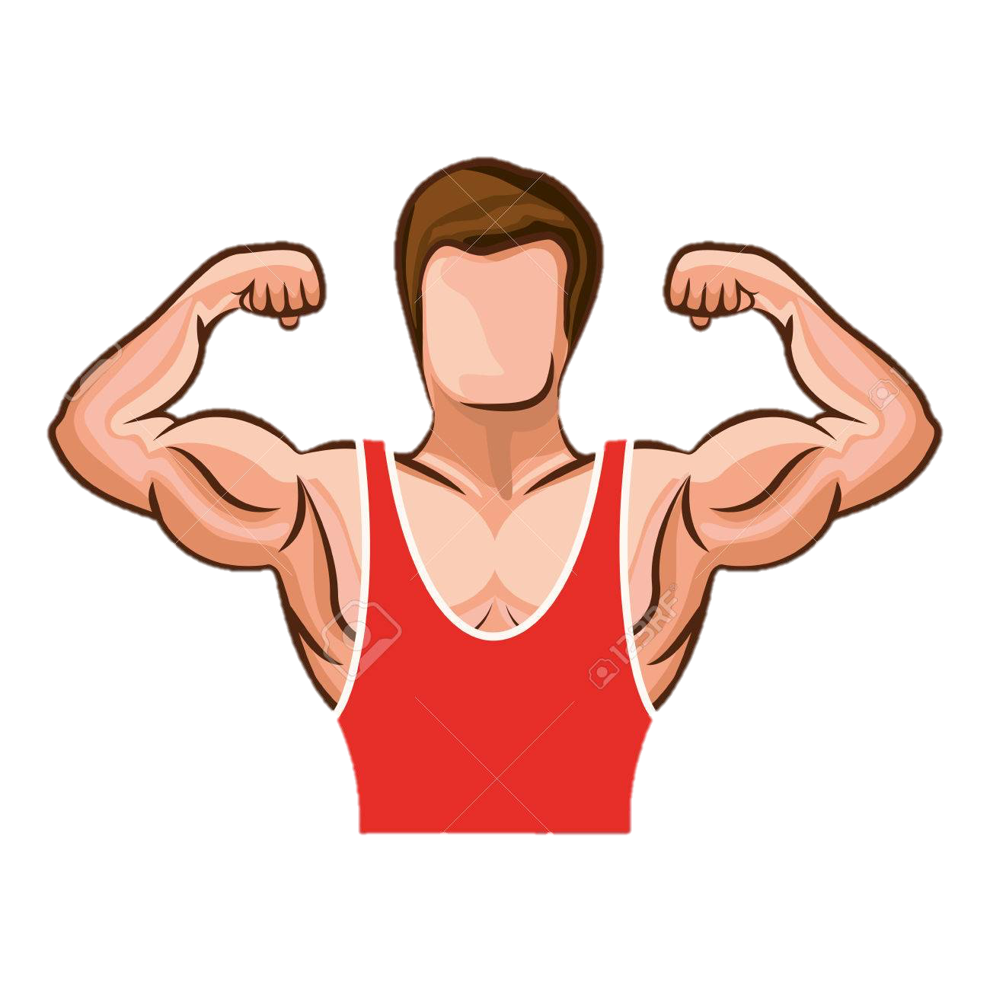
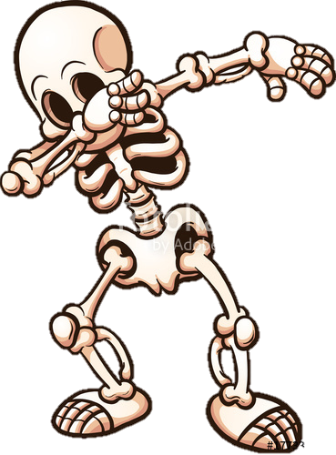
Highlight them
Date: 9 December, 2019
Musculoskeletal Revision
 | Good Progress | Outstanding Progress
3 - 4 | To state and identify key components that help the skeleton and muscles work together (AO1) | To begin to explain why they have an impact on performance, with some attempt to sporting examples (AO2/3)
5-7 | To be able to explain with examples how the skeleton and muscles help effect performance (AO2) | To be able to discus and analyse with clear sports examples how the skeleton and muscles help effect performance justifying the need for it (A03)
YOU HAVE 15 min to complete your revision booklet…
Target = 3-5
Skeleton Pathway
If you want a go at the 5-7…you can!
Target = 6-9
Muscular Pathway

Slide 4
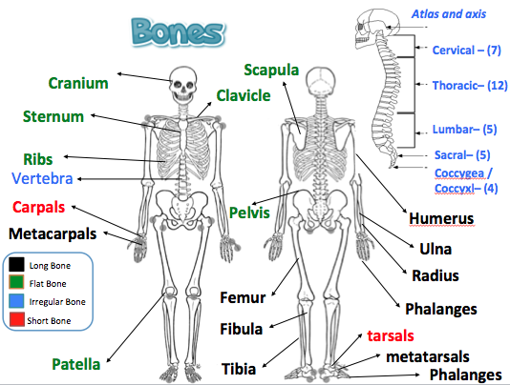
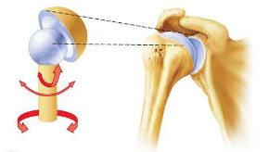
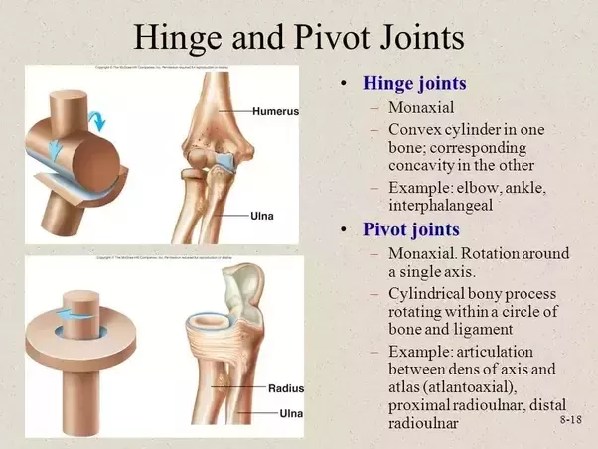
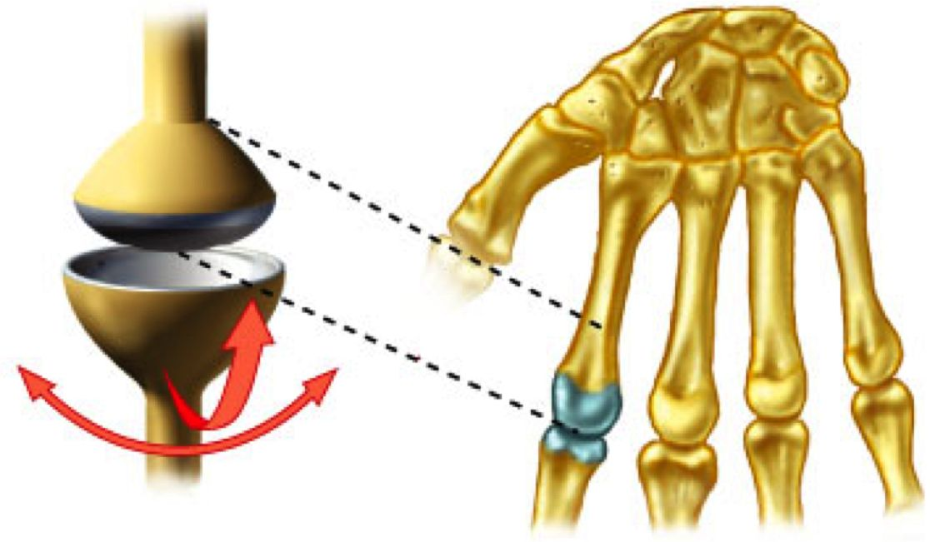


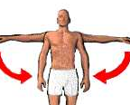
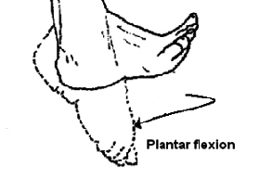
Synovial Joints
TYPES OF BONES:
1) LONG
Type | Example | Movements
Ball and Socket | Hip Shoulder | Flexion and Extension Adduction and Abduction Rotation Circumduction
Hinge | Knee, ankle, elbow | Flexion and Extension
Condyloid | Wrist | Flexion and Extension Adduction and Abduction Circumduction
Pivot | Neck (atlas and axis) | Rotation
Leverage , movement
2) SHORT
Weight baring
3) IRREGULAR
Protection, muscle attachment
You will USE these handouts to complete your own revision booklet independently
20 min….
4) FLAT
Protection, broad surface for muscle attachment ,
Functions:
Type of Movement:
Ligaments
A ligament is an elastic band of tissue that connects bone to bone and provides stability to the joint
Protection of vital organs
Flexion
Extension
The skeleton protects the vital organs by using FLAT BONES (e.g. the ribs protect the heart and lungs).
Closing a joint
Muscle Attachment
Opening a joint
Tendons
Adduction
Abduction
Muscles only PULL, they are attached to the joints by Tendons.
As a muscle contracts it pulls the bone and flexes or extends the joint. E.g when the bicep contracts the elbow flexes
A tendon is a band of tissue that connects muscle to bone to help movement happen when the muscles contract
Moving towards the center line
Moving away the center line
Joints for movement
Where 2 bones meet a joint is formed. This joint is where movement takes place
Circumduction
Rotation
Platelets, red and white blood cell production
Movement of a circular motion
Cartilage
Blood is formed in some of the long bones therefore more o2 can be sent to the working muscles red blood cells. These are produced in the bone marrow of some bones. (e.g. femur)
Clockwise or
anticlockwise movement
Cartilage is a soft, gel-like padding between bones that protects joints and facilitates movement.
Plantar-Flexion
Dorsi-flexion
Storage of calcium and phosphorus
Calcium and phosphorus are minerals gives the skeletal structure strength to support your body and withstand powerful stresses particularly during sport. Less prone to injury
Extension of the ankle
P = pointing
Flexion of the ankle

Slide 5

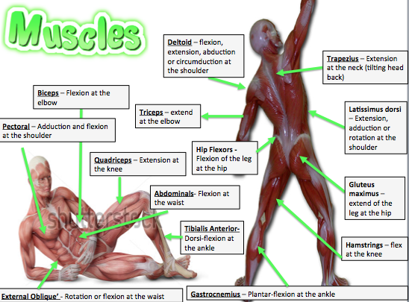
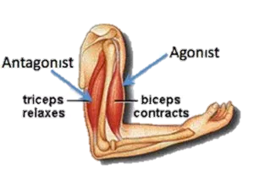


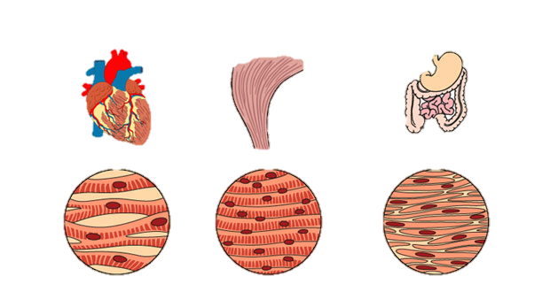
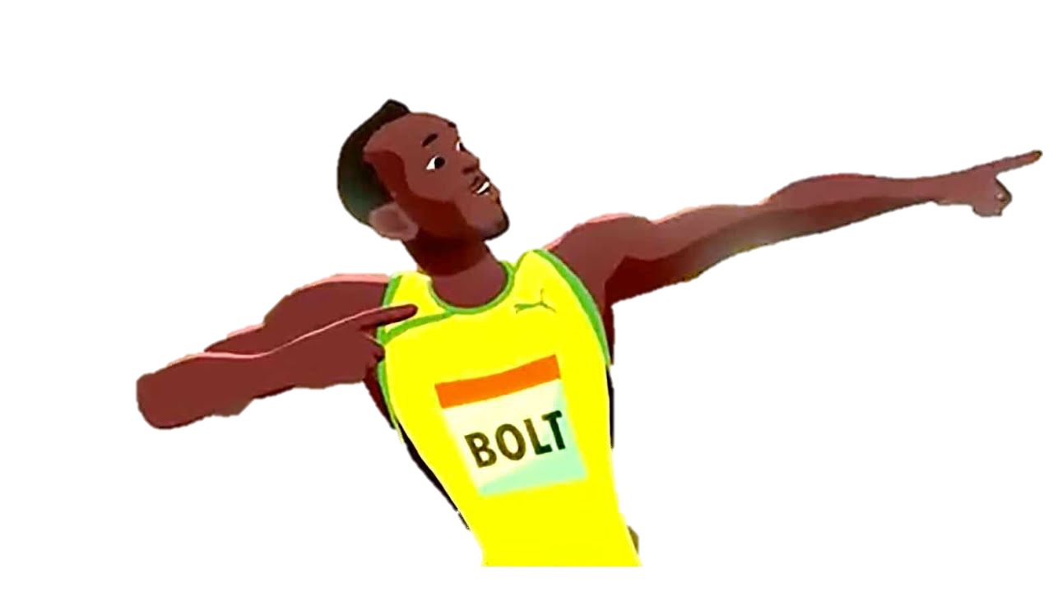
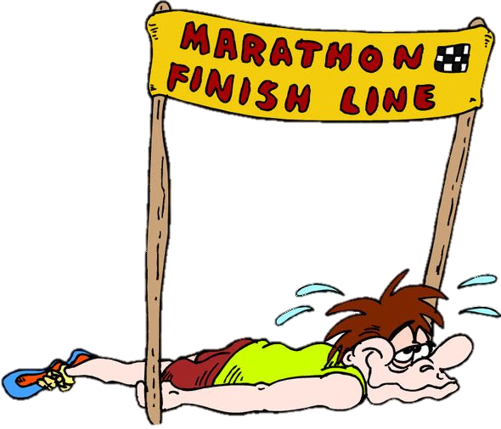
Muscles can only pull, therefore they need to work antagonistically.
When one muscle contracts (this is called the agonist/ prime mover) the other muscle must relax (this is called the antagonist).
Qastrocnemius and tibialis anterior acting at the ankle -plantar flexion to dorsi flexion
Quadriceps and hamstrings acting at the knee,
Biceps and triceps acting at the elbow
Hip flexors and gluteus maximus acting at the hip
Slow Twitch
Type I
Voluntary muscles
Suited to LOW intensity aerobic work.
Marathon running
Long distance running / swimming (they go slow = slow twitch)
Good supply of oxygen.
Darker in colour as contain myoglobin
Can be used for a long period of time without fatiguing
The skeletal Muscles
Used ANAEROBIC work
Dynamic and relatively fast paced 30-2min e. 800m & games players who use both
Can be improved through endurance training to increase their resistance to fatigue,
Lighter in colour as not much oxygen
striated muscles due to their appearance
this is voluntary
are under our conscious control
Involuntary muscles
Type IIA
Muscles in the blood vessels
Fast Twitch
not under our conscious control
Type IIX
Sometimes known as smooth muscle
Cardiac muscle
Used ANAEROBIC work
Can generate a much greater force then other Fibre type but fatigue quickly.
Useful in short bursts of exercise e.g. 100 m sprint, shot put, long jump….explosive sports
Muscles in the heart
This is involuntary
highly resistant to fatigue due to the presence of a large number of mitochondria

Slide 6
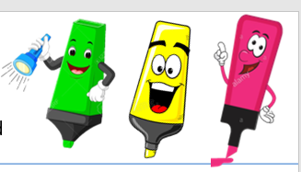
15 minutes
Write this in BIG across your page
Demonstrate:
How does the skeletal and muscular system work together to allow participation in physical activity and sport (9)
LAST LESSON….
Lets break it down….
(Use your books to help you)
AO1
Appropriate technical language (key words)
Impact on performance
Complete
Define
Select
Identify
Label
State
AO2
Which – using an example
Application of knowledge on how it effects performance
Clarify
Describe
Give
Linked
Applied
AO3
Analyse how it effects performance
Detailed E.G justifying
Discuss
Assess
Analyse
Examine
Explain
Justify

Slide 7
Question: How does the skeleton and muscular system work together to allow participation any athletics events (9)
AO1
Appropriate technical language (key words)
Complete
Define
Select
Identify
Label
State
AO2
Which – using an example
Application of knowledge on how it effects performance
Clarify
Describe
Give
Linked
Applied
Write ideas for each section on your page…
AO3
Analyse how it effects performance
Detailed E.G justifying
Discuss
Assess
Analyse – positives and negatives
Examine
Explain
Justify
 | Good Progress | Outstanding Progress
3 - 4 | To state and identify key components that help the skeleton and muscles work together (AO1) | To begin to explain why they have an impact on performance, with some attempt to sporting examples (AO2/3)
5-7 | To be able to explain with examples how the skeleton and muscles help effect performance (AO2) | To be able to discus and analyse with clear sports examples how the skeleton and muscles help effect performance justifying the need for it (A03)

Slide 8
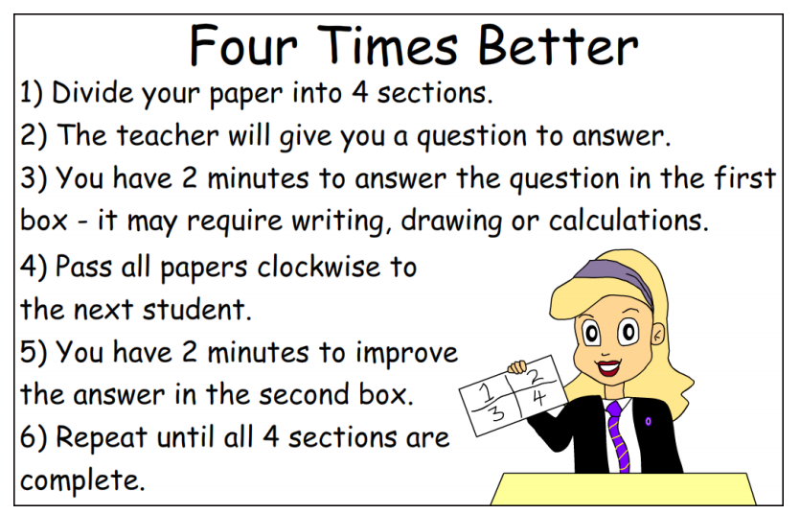
1. Me:
2. Name_______
My target grade _______
Question:
How does the skeleton and muscular system work together to allow participation any athletics events (9)
3. Name_______
4. Name_______
Lets help each other with ideas
 | Good Progress | Outstanding Progress
3 - 4 | To state and identify key components that help the skeleton and muscles work together (AO1) | To begin to explain why they have an impact on performance, with some attempt to sporting examples (AO2/3)
5-7 | To be able to explain with examples how the skeleton and muscles help effect performance (AO2) | To be able to discus and analyse with clear sports examples how the skeleton and muscles help effect performance justifying the need for it (A03)

Slide 9
Question: How does the skeleton and muscular system work together to allow participation any athletics events (9)
AO1
Appropriate technical language (key words)
Complete
Define
Select
Identify
Label
State
AO2
Which – using an example
Application of knowledge on how it effects performance
Clarify
Describe
Give
Linked
Applied
ADD TO YOUR PLAN
AO3
Analyse how it effects performance
Detailed E.G justifying
Discuss
Assess
Analyse – positives and negatives
Examine
Explain
Justify
 | Good Progress | Outstanding Progress
3 - 4 | To state and identify key components that help the skeleton and muscles work together (AO1) | To begin to explain why they have an impact on performance, with some attempt to sporting examples (AO2/3)
5-7 | To be able to explain with examples how the skeleton and muscles help effect performance (AO2) | To be able to discus and analyse with clear sports examples how the skeleton and muscles help effect performance justifying the need for it (A03)

Slide 10
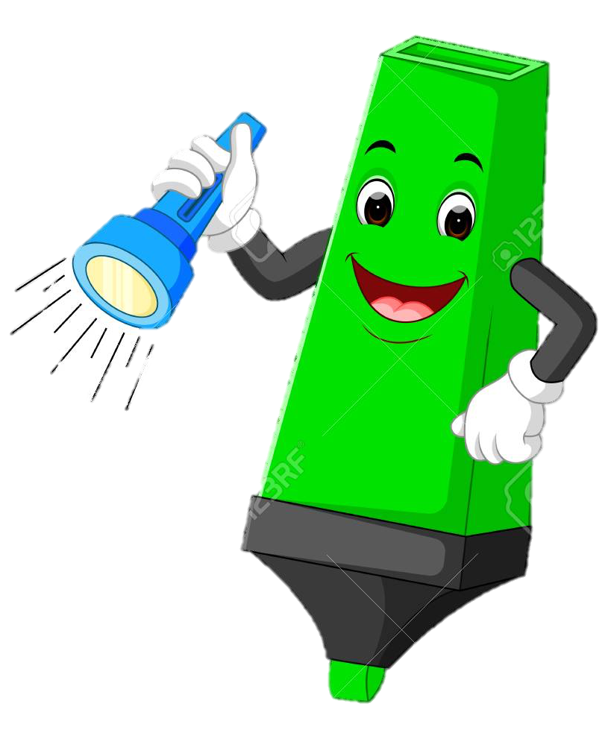
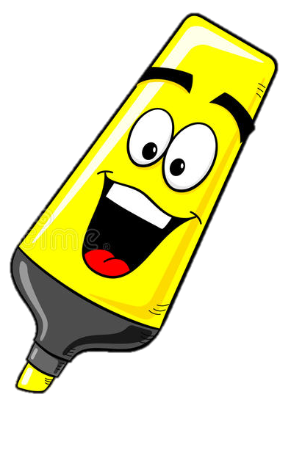
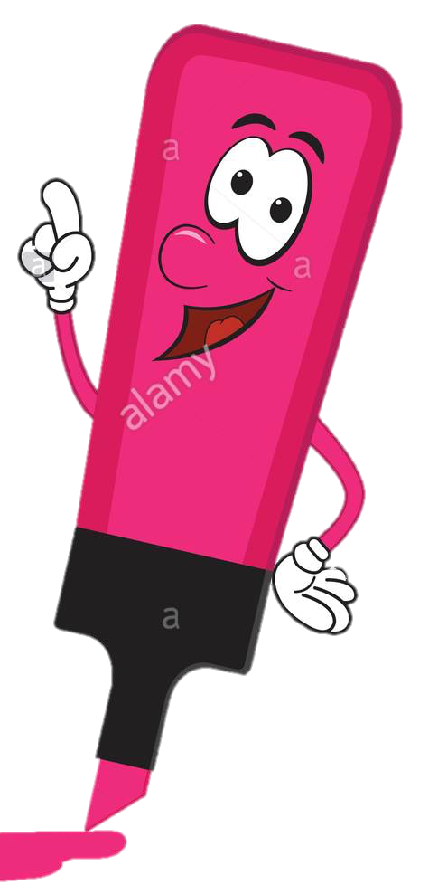
Connect
State what synovial joints and types of movement are involved in a basketball chest pass.
Describe with a sporting example, how muscles and bones work together to create sporting movement.
Analyse a penalty shot in football, explain how the skeletal system (bones) work with the musculoskeletal (muscles) to create the necessary movement/action.
Challenge
Explain everything you know about the heart and lungs

Slide 11
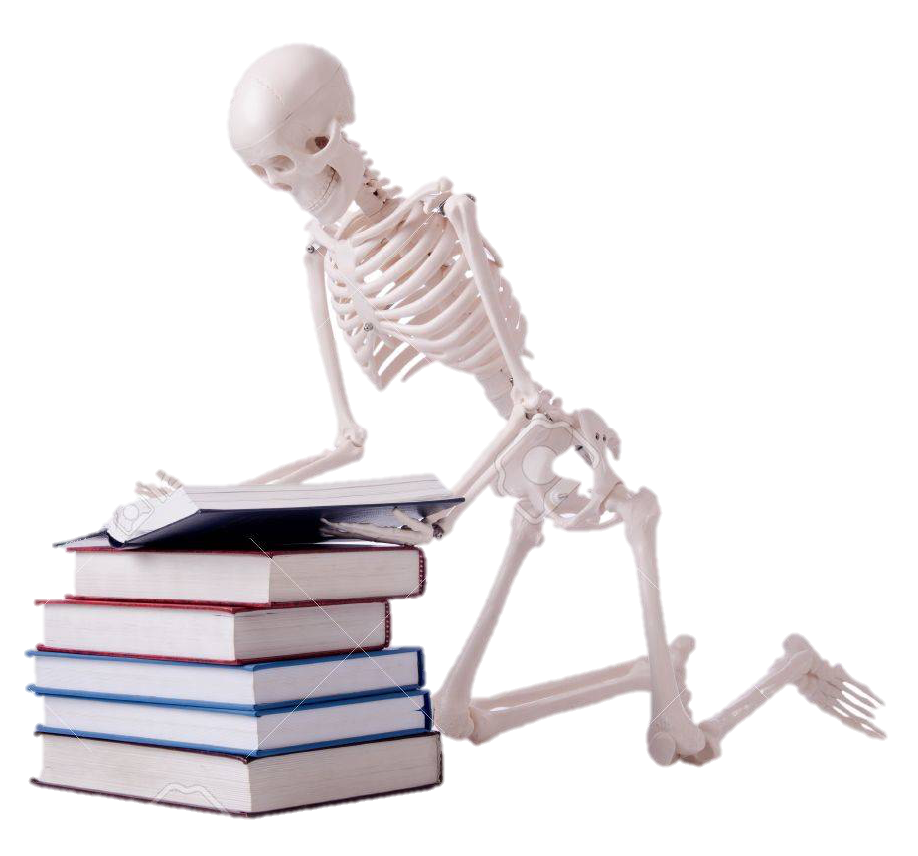
HOME LEARNING:
1) Finish your exam question
2) Revise, Revise, Revise

Slide 12
Date: 9 December, 2019
Musculoskeletal Revision
 | Good Progress | Outstanding Progress
3 - 4 | To state and identify key components that help the skeleton and muscles work together (AO1) | To begin to explain why they have an impact on performance, with some attempt to sporting examples (AO2/3)
5-7 | To be able to explain with examples how the skeleton and muscles help effect performance (AO2) | To be able to discus and analyse with clear sports examples how the skeleton and muscles help effect performance justifying the need for it (A03)
Identify the progress you have made….

Slide 13


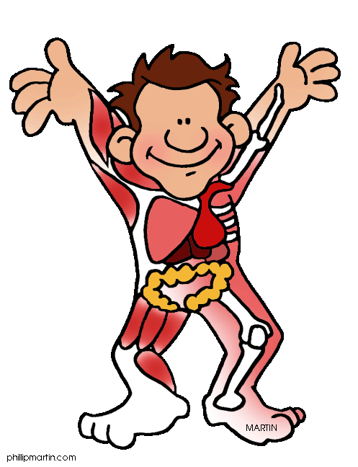
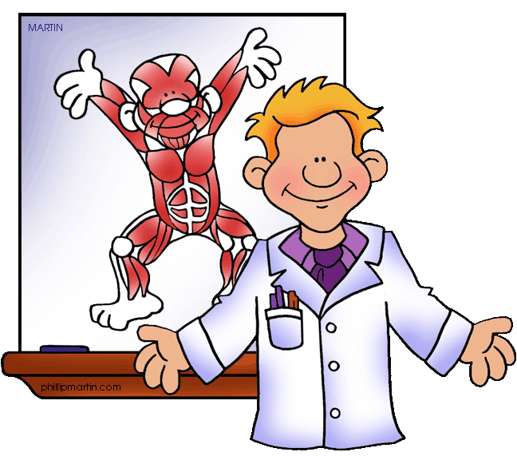

TARGET:
_______
GCSE PE
Name: ………………………………………………
Muscle Pathway
 | Good Progress | Outstanding Progress
3 - 4 | To state and identify key components that help the skeleton and muscles work together (AO1) | To begin to explain why they have an impact on performance, with some attempt to sporting examples (AO2/3)
5-7 | To be able to explain with examples how the skeleton and muscles help effect performance (AO2) | To be able to discus and analyse with clear sports examples how the skeleton and muscles help effect performance justifying the need for it (A03)
School: ……………………………………………..
Teacher: …………………………………………..

Slide 14
DO NOW ACTIVITY:
TASK: List as many KEY WORDS as you can remember within the MUSCULOSKELETAL system
Target:
3-4 = 15 or more = MERIT!
5-7= 20 or more = MERIT!
Learned throughout the lesson
8.
9.
10.
11.
12.
13.
14.
15.
16.
17.
18.
19.
20.

Slide 15
Type of Movement:
Must know
Definition of each
Sporting examples x 2
Flexion
Extension
Adduction
Abduction
Circumduction
Rotation
Plantar-Flexion
Dorsi-flexion

Slide 17

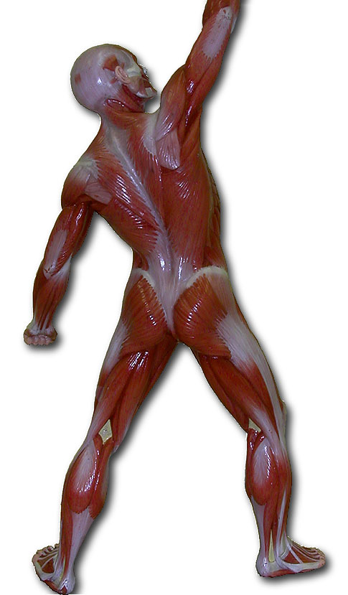
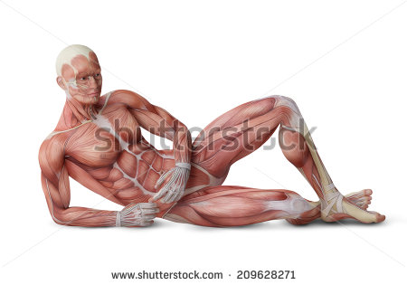
Need to know ALL LOCATIONS & MOEVEMENT
Deltoid –
Trapezius –
__________
– Flexion at the elbow
Latissimus dorsi
Pectoral –
Quadriceps – Extension at the knee
Abdominals-
Tibialis Anterior-
External Oblique’ -

Slide 18
 | Type of Movement | Sporting Example
Biceps
Triceps
Quadriceps
Hamstrings
Gastrocnemius
Tibialis Anterior
Hip Flexors
Gluteus maximus

Slide 19
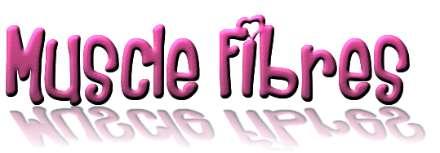
Slow Twitch Fibres | Fast Twitch Fibres

Slide 20


Slide 21
HOME LEARNING:
1) Finish your exam question
2) Revise, Revise, Revise

Slide 22
Date: 9 December, 2019
Musculoskeletal Revision
 | Good Progress | Outstanding Progress
3 - 4 | To state and identify key components that help the skeleton and muscles work together (AO1) | To begin to explain why they have an impact on performance, with some attempt to sporting examples (AO2/3)
5-7 | To be able to explain with examples how the skeleton and muscles help effect performance (AO2) | To be able to discus and analyse with clear sports examples how the skeleton and muscles help effect performance justifying the need for it (A03)
Identify the progress you have made….
I have made …………………….. Progress because…

Slide 23
Question: How does the skeleton and muscular system work together to allow participation any athletics events (9)
AO1
Appropriate technical language (key words)
Complete
Define
Select
Identify
Label
State
AO2
Which – using an example
Application of knowledge on how it effects performance
Clarify
Describe
Give
Linked
Applied
AO3
Analyse how it effects performance
Detailed E.G justifying
Discuss
Assess
Analyse – positives and negatives
Examine
Explain
Justify
 | Good Progress | Outstanding Progress
3 - 4 | To state and identify key components that help the skeleton and muscles work together (AO1) | To begin to explain why they have an impact on performance, with some attempt to sporting examples (AO2/3)
5-7 | To be able to explain with examples how the skeleton and muscles help effect performance (AO2) | To be able to discus and analyse with clear sports examples how the skeleton and muscles help effect performance justifying the need for it (A03)

Slide 24
1. Me:
2. Name_______
My target grade _______
Question:
How does the skeleton and muscular system work together to allow participation any athletics events (9)
3. Name_______
4. Name_______
 | Good Progress | Outstanding Progress
3 - 4 | To state and identify key components that help the skeleton and muscles work together (AO1) | To begin to explain why they have an impact on performance, with some attempt to sporting examples (AO2/3)
5-7 | To be able to explain with examples how the skeleton and muscles help effect performance (AO2) | To be able to discus and analyse with clear sports examples how the skeleton and muscles help effect performance justifying the need for it (A03)

Slide 25
TARGET:
_______
GCSE PE
Name: ………………………………………………
Skeleton Pathway
 | Good Progress | Outstanding Progress
3 - 4 | To state and identify key components that help the skeleton and muscles work together (AO1) | To begin to explain why they have an impact on performance, with some attempt to sporting examples (AO2/3)
5-7 | To be able to explain with examples how the skeleton and muscles help effect performance (AO2) | To be able to discus and analyse with clear sports examples how the skeleton and muscles help effect performance justifying the need for it (A03)
School: ……………………………………………..
Teacher: …………………………………………..

Slide 26
DO NOW ACTIVITY:
TASK: List as many KEY WORDS as you can remember within the MUSCULOSKELETAL system
Target:
3-4 = 15 or more = MERIT!
5-7= 20 or more = MERIT!
Learned throughout the lesson
8.
9.
10.
11.
12.
13.
14.
15.
16.
17.
18.
19.
20.

Slide 27
Type of Movement:
Flexion
Extension
Definition =
Sporting example =
Definition =
Sporting example =
Adduction
Abduction
Definition =
Sporting example =
Definition =
Sporting example =
Circumduction
Rotation
Definition =
Sporting example =
Definition =
Sporting example =
Plantar-Flexion
Dorsi-flexion
Definition =
Sporting example =
Definition =
Sporting example =

Slide 28
 | Works with | Sporting example…
Biceps
Quadriceps
Gastrocnemius
Hip Flexors
Antagonistic pairs are….

Slide 29
Need to know ALL LOCATIONS & MOEVEMENT
Deltoid –
Trapezius –
__________
– Flexion at the elbow
Latissimus dorsi
Pectoral –
Quadriceps – Extension at the knee
Abdominals-
Tibialis Anterior-
External Oblique’ -

Slide 30
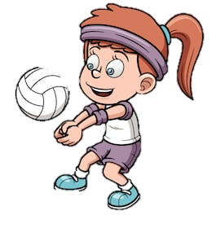
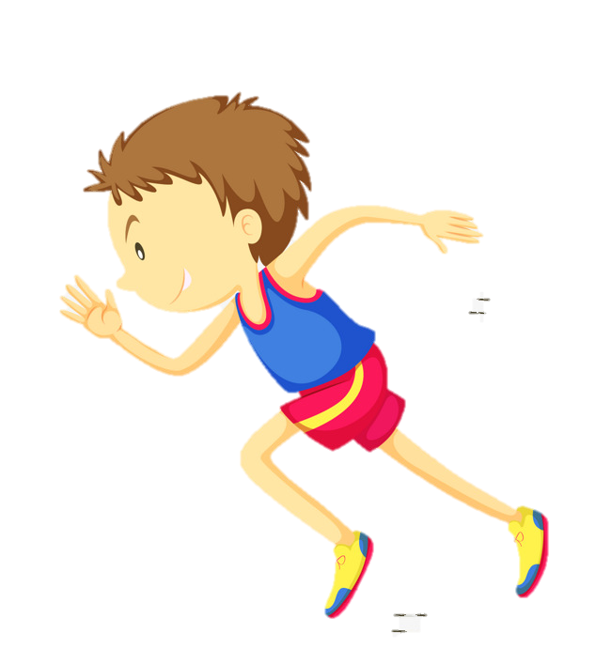
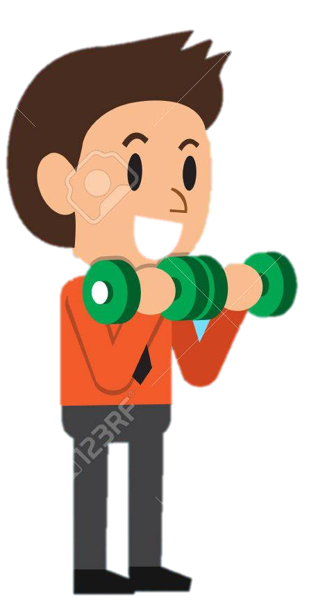
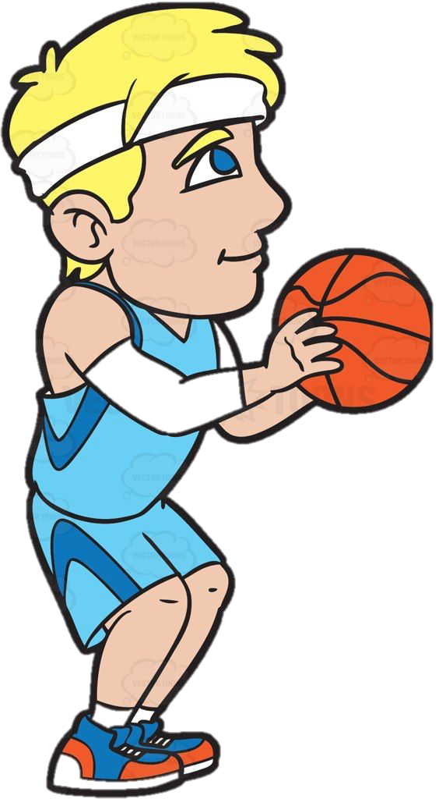
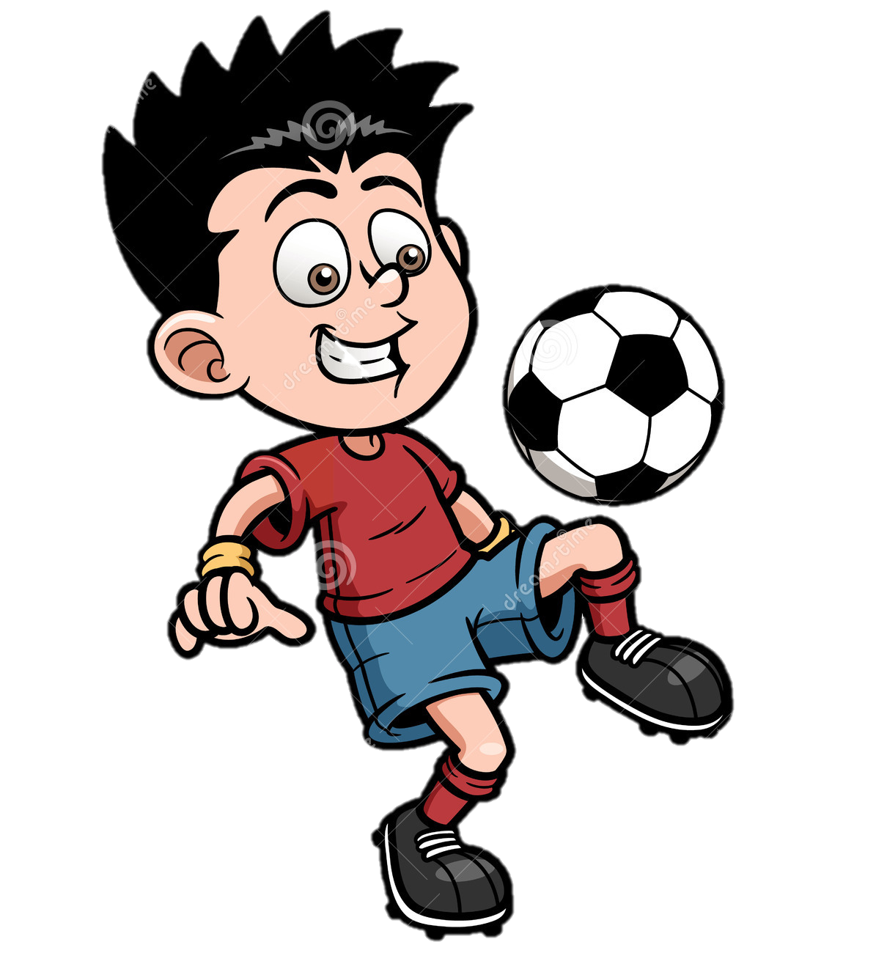
 | Type of Movement | Sporting Example
Biceps
Triceps
Quadriceps
Hamstrings

Slide 31
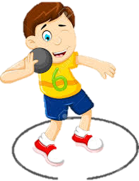
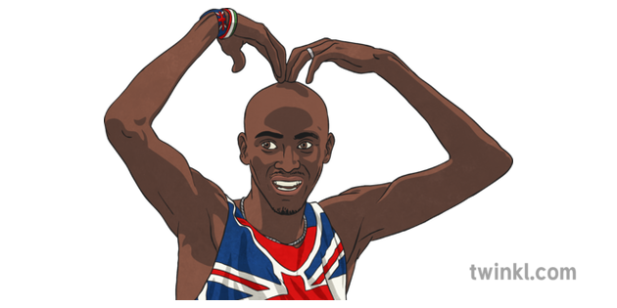
Slow Twitch Fibres | Fast Twitch Fibres
Type _____ | Type _____ | Type _____
Time they last = Intensity level = Use Oxygen = Sporting example = | Time they last = Intensity level = Use Oxygen = Sporting example = | Time they last = Intensity level = Use Oxygen = Sporting example =

Slide 32
Voluntary muscles
Involuntary muscles
Cardiac muscle
Example =
Example =
Example =
Appearance =
Appearance =
Appearance =

Slide 33
HOME LEARNING:
1) Finish your exam question
2) Revise, Revise, Revise

Slide 34
Date: 9 December, 2019
Musculoskeletal Revision
 | Good Progress | Outstanding Progress
3 - 4 | To state and identify key components that help the skeleton and muscles work together (AO1) | To begin to explain why they have an impact on performance, with some attempt to sporting examples (AO2/3)
5-7 | To be able to explain with examples how the skeleton and muscles help effect performance (AO2) | To be able to discus and analyse with clear sports examples how the skeleton and muscles help effect performance justifying the need for it (A03)
Identify the progress you have made….
I have made …………………….. Progress because…

Slide 35
Question: How does the skeleton and muscular system work together to allow participation any athletics events (9)
AO1
Appropriate technical language (key words)
Complete
Define
Select
Identify
Label
State
AO2
Which – using an example
Application of knowledge on how it effects performance
Clarify
Describe
Give
Linked
Applied
AO3
Analyse how it effects performance
Detailed E.G justifying
Discuss
Assess
Analyse – positives and negatives
Examine
Explain
Justify
 | Good Progress | Outstanding Progress
3 - 4 | To state and identify key components that help the skeleton and muscles work together (AO1) | To begin to explain why they have an impact on performance, with some attempt to sporting examples (AO2/3)
5-7 | To be able to explain with examples how the skeleton and muscles help effect performance (AO2) | To be able to discus and analyse with clear sports examples how the skeleton and muscles help effect performance justifying the need for it (A03)

Slide 36
1. Me:
2. Name_______
My target grade _______
Question:
How does the skeleton and muscular system work together to allow participation any athletics events (9)
3. Name_______
4. Name_______
 | Good Progress | Outstanding Progress
3 - 4 | To state and identify key components that help the skeleton and muscles work together (AO1) | To begin to explain why they have an impact on performance, with some attempt to sporting examples (AO2/3)
5-7 | To be able to explain with examples how the skeleton and muscles help effect performance (AO2) | To be able to discus and analyse with clear sports examples how the skeleton and muscles help effect performance justifying the need for it (A03)

Slide 37
Synovial Joints
TYPES OF BONES:
1) LONG
Type | Example | Movements
Ball and Socket | Hip Shoulder | Flexion and Extension Adduction and Abduction Rotation Circumduction
Hinge | Knee, ankle, elbow | Flexion and Extension
Condyloid | Wrist | Flexion and Extension Adduction and Abduction Circumduction
Pivot | Neck (atlas and axis) | Rotation
Leverage , movement
2) SHORT
Weight baring
3) IRREGULAR
Protection, muscle attachment
4) FLAT
Protection, broad surface for muscle attachment ,
Functions:
Type of Movement:
Ligaments
A ligament is an elastic band of tissue that connects bone to bone and provides stability to the joint
Protection of vital organs
Flexion
Extension
The skeleton protects the vital organs by using FLAT BONES (e.g. the ribs protect the heart and lungs).
Closing a joint
Muscle Attachment
Opening a joint
Tendons
Adduction
Abduction
Muscles only PULL, they are attached to the joints by Tendons.
As a muscle contracts it pulls the bone and flexes or extends the joint. E.g when the bicep contracts the elbow flexes
A tendon is a band of tissue that connects muscle to bone to help movement happen when the muscles contract
Moving towards the center line
Moving away the center line
Joints for movement
Where 2 bones meet a joint is formed. This joint is where movement takes place
Circumduction
Rotation
Platelets, red and white blood cell production
Movement of a circular motion
Cartilage
Blood is formed in some of the long bones therefore more o2 can be sent to the working muscles red blood cells. These are produced in the bone marrow of some bones. (e.g. femur)
Clockwise or
anticlockwise movement
Cartilage is a soft, gel-like padding between bones that protects joints and facilitates movement.
Plantar-Flexion
Dorsi-flexion
Storage of calcium and phosphorus
Calcium and phosphorus are minerals gives the skeletal structure strength to support your body and withstand powerful stresses particularly during sport. Less prone to injury
Extension of the ankle
P = pointing
Flexion of the ankle

Slide 38
Muscles can only pull, therefore they need to work antagonistically.
When one muscle contracts (this is called the agonist/ prime mover) the other muscle must relax (this is called the antagonist).
Qastrocnemius and tibialis anterior acting at the ankle -plantar flexion to dorsi flexion
Quadriceps and hamstrings acting at the knee,
Biceps and triceps acting at the elbow
Hip flexors and gluteus maximus acting at the hip
Slow Twitch
Type I
Voluntary muscles
Suited to LOW intensity aerobic work.
Marathon running
Long distance running / swimming (they go slow = slow twitch)
Good supply of oxygen.
Darker in colour as contain myoglobin
Can be used for a long period of time without fatiguing
The skeletal Muscles
Used ANAEROBIC work
Dynamic and relatively fast paced 30-2min e. 800m & games players who use both
Can be improved through endurance training to increase their resistance to fatigue,
Lighter in colour as not much oxygen
striated muscles due to their appearance
this is voluntary
are under our conscious control
Involuntary muscles
Type IIA
Muscles in the blood vessels
Fast Twitch
not under our conscious control
Type IIX
Sometimes known as smooth muscle
Cardiac muscle
Used ANAEROBIC work
Can generate a much greater force then other Fibre type but fatigue quickly.
Useful in short bursts of exercise e.g. 100 m sprint, shot put, long jump….explosive sports
Muscles in the heart
This is involuntary
highly resistant to fatigue due to the presence of a large number of mitochondria

