Slide 1
Do Now Activity
Principles of training
Components of fitness
Health
Skill
___________ _________
A_______________
___________ _________
B_______________
___________ _________
C_______________
___________ _________
P_______________
_______________
R_______________
S_______________

Slide 2
Do Now Activity
Principles of training
Components of fitness
Health
Skill
___________ _________
A_______________
___________ _________
B_______________
___________ _________
C_______________
___________ _________
P_______________
_______________
R_______________
S_______________

Slide 3
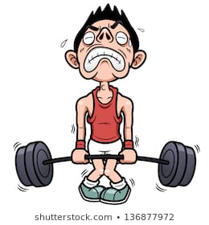
Principles of training
Components of fitness
Frequency
Intensity
Time
Type
Health
Skill
Specificity
Progressive Overload
Overtraining
Reversibility
Threshold Training
Individual needs
Cardiovascular endurance
Muscular Endurance
Muscular Strength
Body Composition
Flexibility
Agility
Balance
Coordination
Power
Reaction Time
Speed
Anaerobic = 80-90%
Aerobic = 60-80%

Slide 4
Content recall
Principles of Training
Specificity
Progressive Overload
Individual differences/needs
Overtraining
Reversibility
Training thresholds
Definitions
When an injury occurs and you stop training, you lose any fitness gains
60-80% MHR aerobic exercise 80-90% MHR anaerobic exercise
Making the method of training right for your aims
Training with an injury, planning so to not aggravate it
Training too often, not allowing your body to recover and grow
Increase the intensity gradually over time
These are mixed up, work it out and write them up in your book

Slide 5
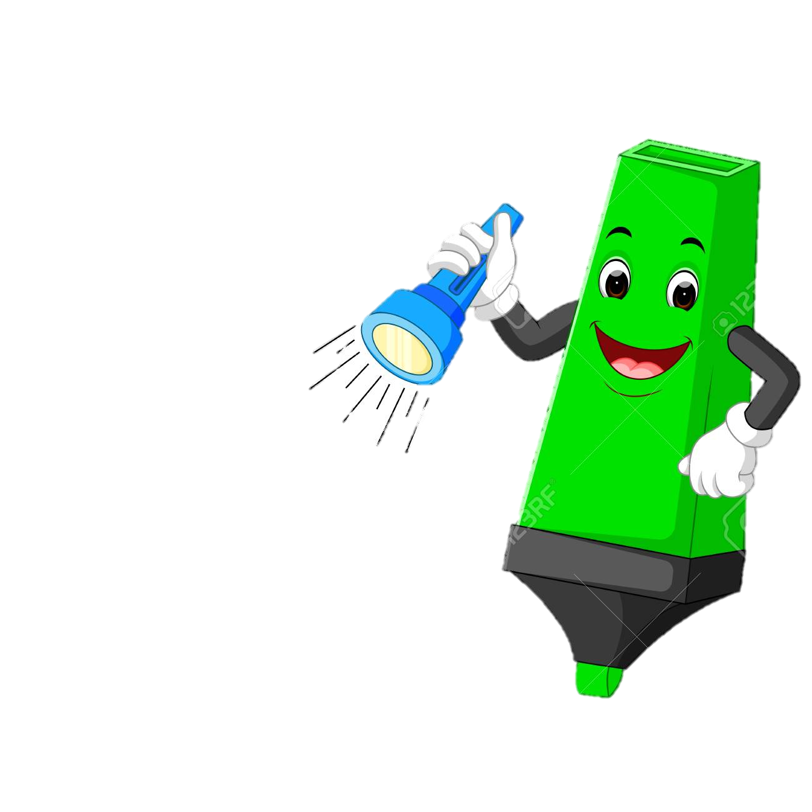



Demonstrate
Question: Discuss, using examples, how the principles of training can improve the fitness of a group of GCSE PE students. (6)
LETS MARK THIS
___/ 6

Slide 6
1-2
3-4
5-6

Slide 7
Help
Cardiovascular Endurance:
Spinning
Muscular endurance:
Body Pump
Aerobics
Weight/resistance training
Circuit training
Interval training
Body Pump
Fartlek training
Continuous training
Spinning
Circuit training
Flexibility:
Speed
Interval training
Flexibility training
Weight/resistance training
Yoga / pilates
Muscular strength:
Power:
Interval training
Weight/resistance training
Weight/resistance training
Body Pump
Plyometric training

Slide 8
Connect
Identify all the Principles of training
Give a definition of each
Give simple examples of how most the PoT will help improve fitness
*choosing your own fitness to improve
Detail of how each PoT will be applied in a PEP to improve Muscular Strength
Challenge
Describe how this would be different for a 21 year old male athlete trying to improve his strength and a 40 year old female who wants to improve her cardiovascular fitness

Slide 9
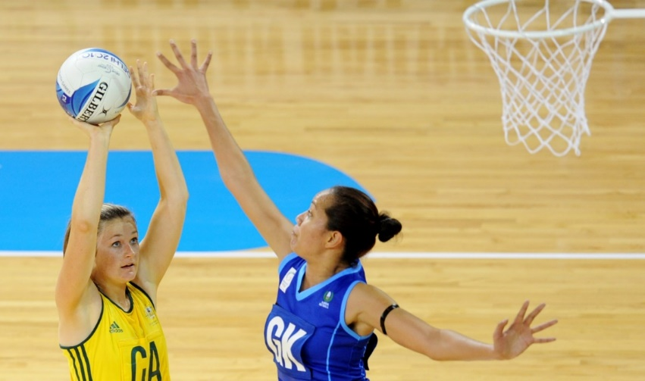
Methods of Training
 | Good | Outstanding
3-5 | To know 3 methods of training and what they look like | TBAT link a explanation of a method of training with at least 1 practical example
6-9 | TBAT Link a explanation of a method of training with at least 1 practical example | Explain in detail 4 different training methods and who would use it and why

Slide 10
Circuit
training
Interval
Training
Weight
Training
Methods of training
Fitness
Classes
Plyometric
Training
Fartlek
Training

Slide 11
Circuit Training
A series of exercise stations completed one after the other in a circuit. Rest after one circuit and then repeat.
Benefits
Easy to adapt the circuit specific to your sport & needs, little equipment needed
QUESTION TIME:
Good: List some exercises that might be in a circuit for someone who wants to improve MUSCULAR ENDURANCE
Outstanding: Explain the difference in the stations you would use for someone who wants to improve flexibility and someone who wanted to improve power

Slide 12
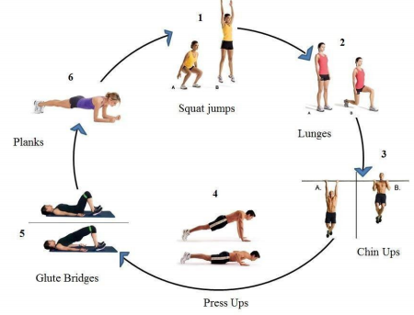

Slide 13
Interval Training
Varying levels of intensity. Often anaerobic exercise. Example – sprint for 30sec, walk for 10 sec.
Benefits
Suitable for games players, simulates a live environment (football, netball match) where you are sprinting/walking.
QUESTION TIME:
Good: name a famous athlete and their sport that would do interval training
Outstanding: discuss is Mo Farah would use this type of training giving reasons why you have said your answer

Slide 14
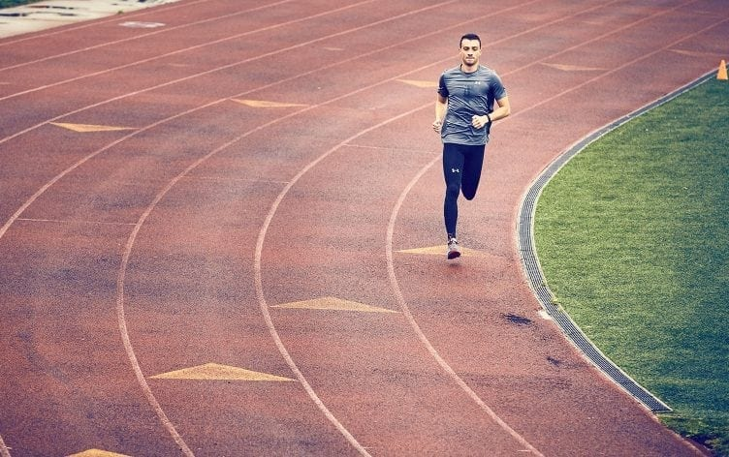
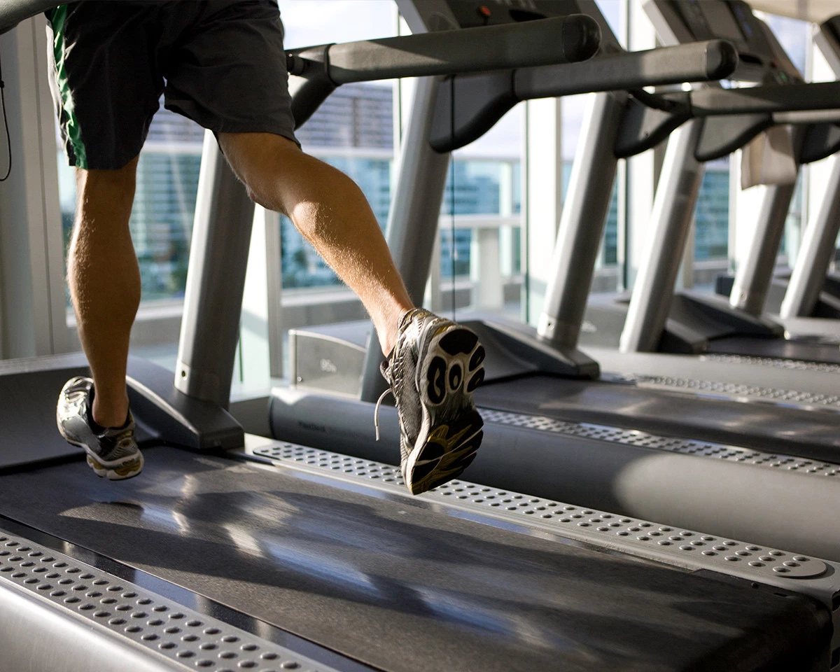
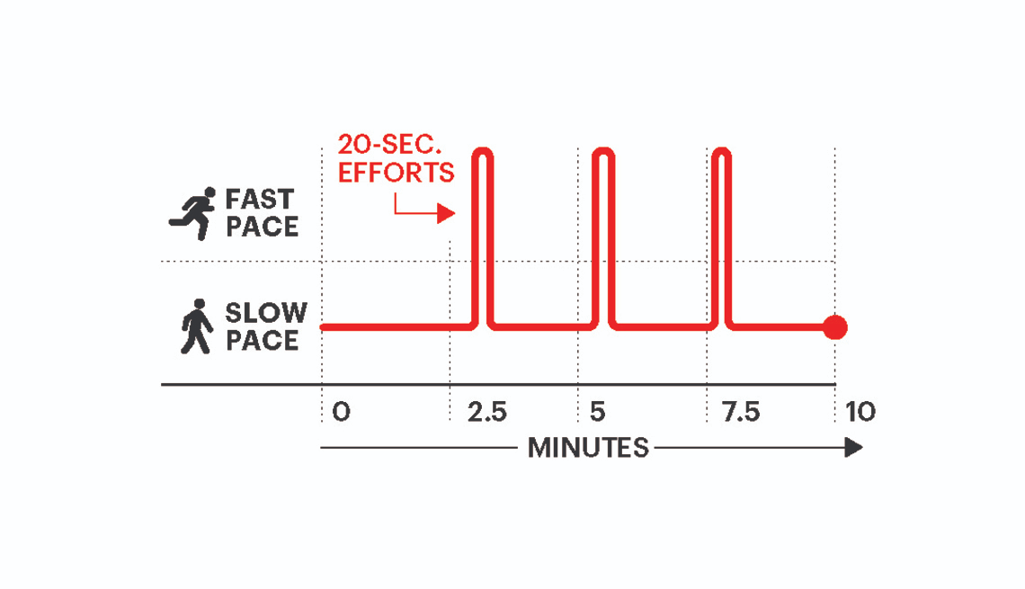

Slide 15
Continuous Training
Moderate level of exercise, maintaining a consistent heart rate between 60-80% MHR (target zone)
This training is aerobic.
Benefits
Suitiable for long distance endurance athletes. E.g marathon runners, 5,000 metre runners.
QUESTION TIME:
Good: Name the test that is similar to this type of training, what does it test
Outstanding: discus if you feel this is good type of training for a rugby player

Slide 16
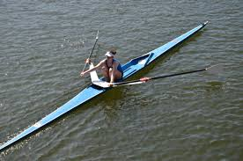
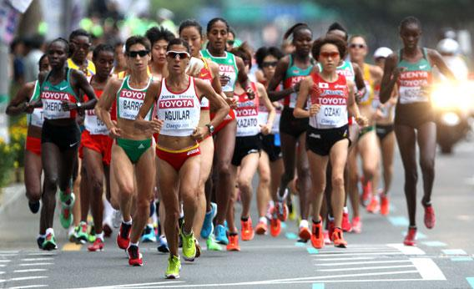
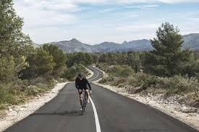

Slide 17
RECAP PI’s – where are you at?
WHY?
 | Good | Outstanding
3-5 | To know 3 methods of training and what they look like | TBAT link a explanation of a method of training with at least 1 practical example
6-9 | TBAT Link a explanation of a method of training with at least 1 practical example | Explain in detail 4 different training methods and who would use it and why

Slide 18
Weight / Resistance Training
Using resistance and weights can develop muscular strength/endurance & power in isolation and large muscle groups.
Develops muscle size and mass.
Low repetitions & heavy weight = Increase power
High repetitions & lower weight = Increase muscular endurance
QUESTION TIME:
Good: Give a sport that would do this type of training?
Outstanding: discus the weight that a basketball player would use to get a better jump to get rebounds

Slide 19
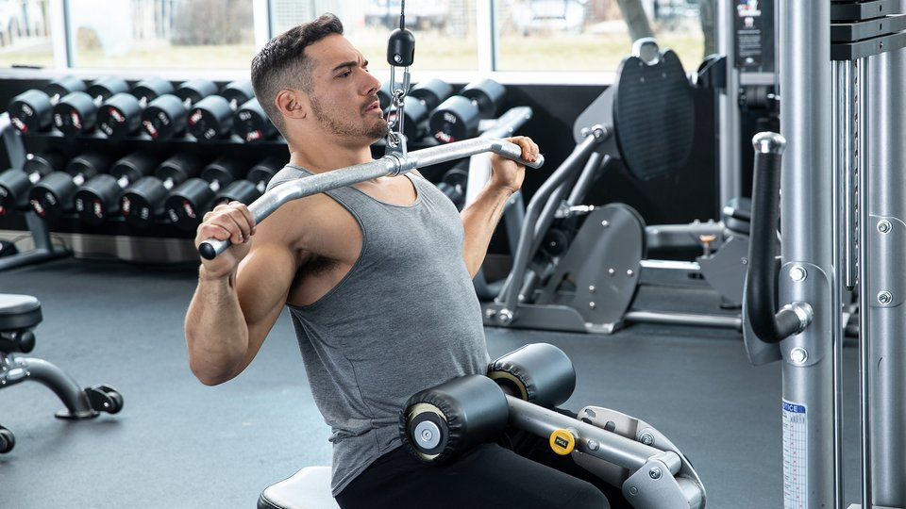


Slide 20
Fartlek Training
Running, using different terrains.
Examples - Completing a circuit of 400m including up & down a hill/bank causing more resistance. This develops aerobic & anaerobic fitness.
Cross country runners can use this training method. It is similar to interval training.
QUESTION TIME:
Good: Where could you do this type of training near you? Explain why
Outstanding: discus the difference between this and INTERVAL TRAINING

Slide 21



Slide 22
Plyometric Training
Explosive movements mainly jumping movements. This method increases explosive power: box jumps, squat jumps
(focus on leg movements when giving examples)
Also known as JUMP training
QUESTION TIME:
Good: list 2 sports that would do this and and example why
Outstanding: Discus what might happen if you do not warm up on this type of training and why

Slide 23
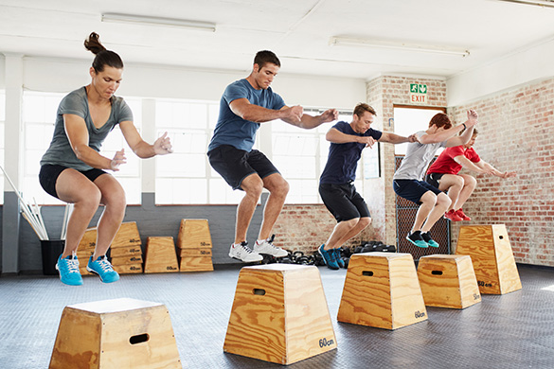
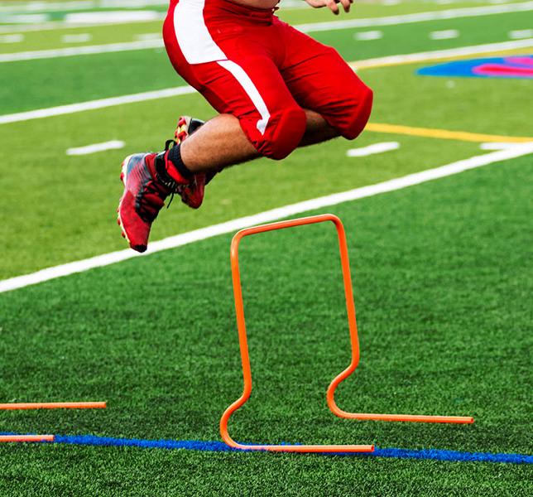

Slide 24
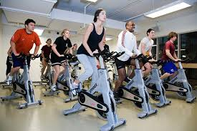

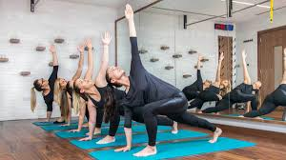
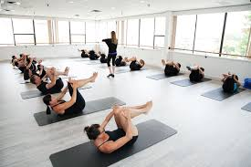
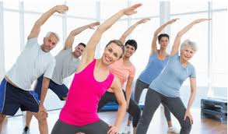
Fitness Classes
Body Pump
Aerobics
Spinning
Yoga
Pilates

Slide 25
Homework
Due in next MONDAY
Complete your principles of training worksheet from last weeks lesosn

