Slide 1
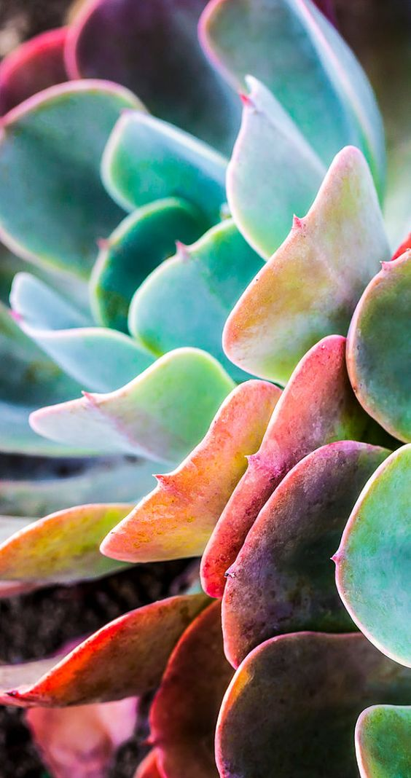
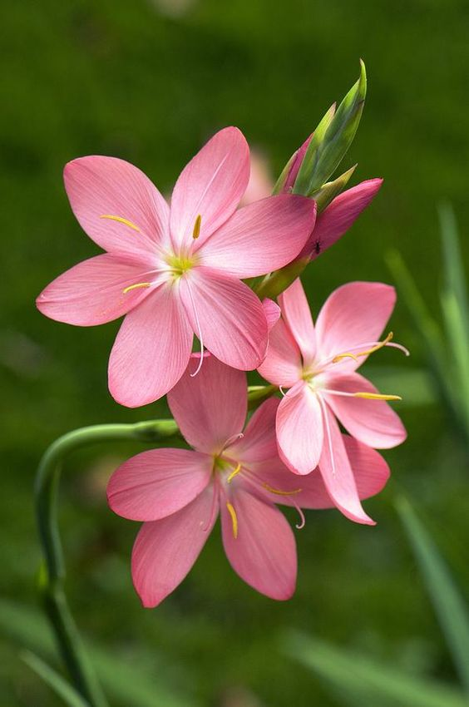
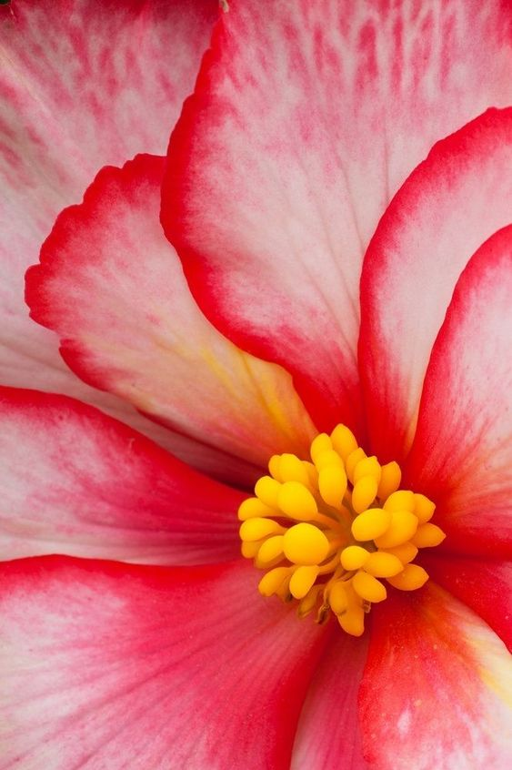
Task 1 - Observational drawing of a flower
With a flower or a clear image of a flower in front of you – observe, draw and shade.
Once you have completed the outline, add shading to give the drawing a more realistic look and 3D
Make sure your drawing is large (A4) to be able to add finer details

Slide 2
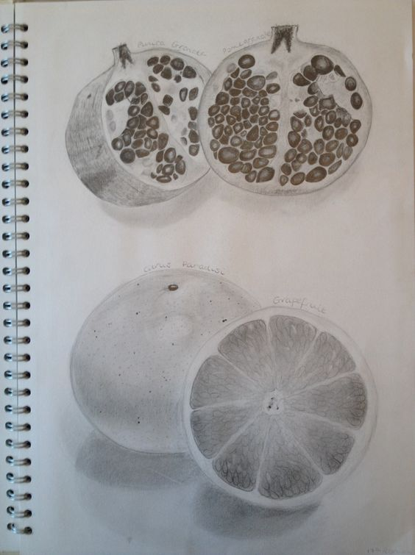
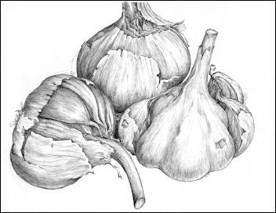
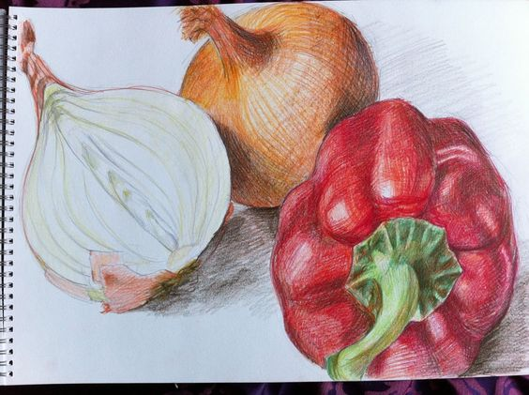
Task 2 - Observational drawing of a piece of fruit or vegetable cut in half
With the fruit or vegetable in front of you– observe the inside and the outside, then and draw and shade them in.
Once you have completed the outline add shading to give the drawing a more realistic look and 3D
Make sure your drawing is large (A4) to be able to add finer details

Slide 3
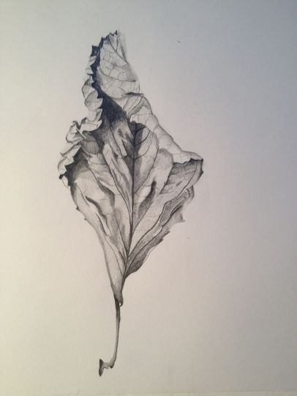
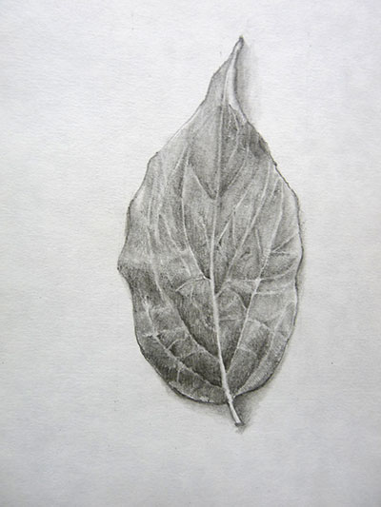
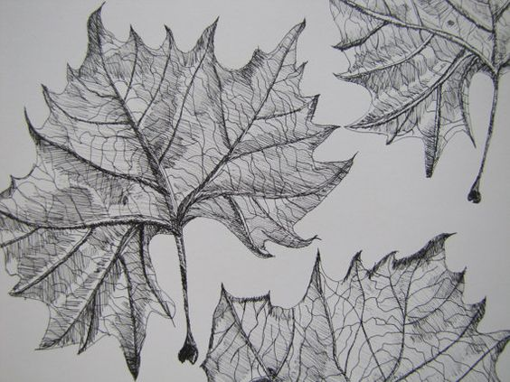
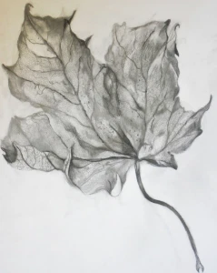
Task 3 - Observational drawing of a leaf in detail (close up)
With the leaf in front of you – observe and draw and shade it in(or colour if you have)
Once you have completed the outline add shading to give the drawing a more realistic look and 3D
Make sure your drawing is large (A4) to be able to add finer details

Slide 4
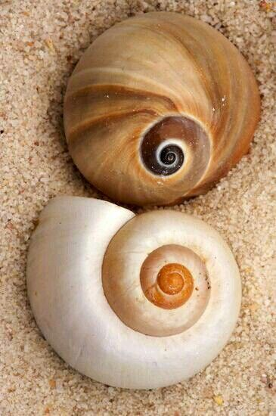
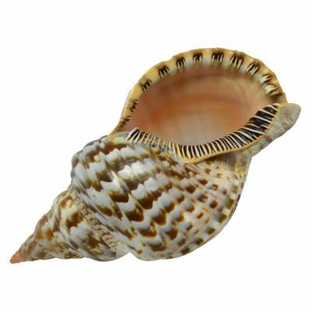
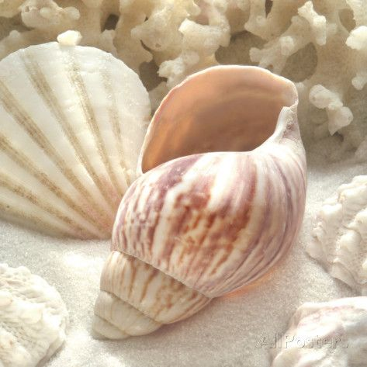
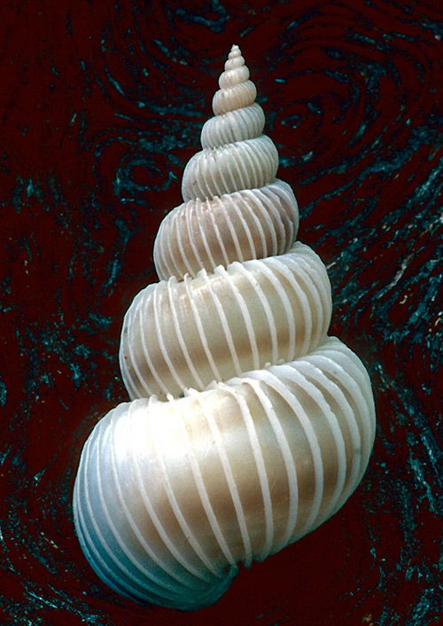
Task 4 - Observational drawing of a shell from a clear image
With the image of a shell in front of you – observe and draw and shade it in(or colour if you have)
Once you have completed the outline add shading to give the drawing a more realistic look and 3D
Make sure your drawing is large (A4) to be able to add finer details.
Accurate tone is needed to show the 3D effect of the twists/folds of the shell.

