Slide 1
YOUR TASK – QUESTION 4
Focus this part of your answer on the lines 22 to the end.
A student, having read this section of the text said: “The writer contrasts the normal actions of Nat with the strange actions of the birds to create tension and a sense of foreboding.’
To what extent do you agree?
In your response, you could:
write about your own impressions of Nat and the birds.
evaluate how the writer has created these impressions.
support your opinions with quotations from the text. (20 marks)

Slide 2

The key skill for Question 4 is evaluation, both of the ideas in the source in relation to the given statement, and also the methods used by the writer to convey these ideas. However, the biggest error made by students was that many of them failed to address methods; they dealt with the ‘what’ but not the ‘how’, which limited how far they could move into a given level.
TO CONSIDER
said…
Question 4 is a synoptic question. That means it is testing all of your reading abilities, including your inference skills, your ability to analyse language and comment on structure.
You must think of questions 1, 2 and 3 as preparing you to answer this question.

Slide 3
WHAT IS EVALUATION?
Judge the statement:
Is it right or wrong?
Evaluation
Assess the statement:
Is the statement a good statement to make? Why? Why not?
To judge or determine the significance, worth, or quality of; assess.
Determine why the statement has been made:
Make inferences, analyse language and structure.

Slide 4
YOUR TASK: EVALUATE THE STATEMENT
Focus this part of your answer on the lines 22 to the end.
A student, having read this section of the text said: “The writer contrasts the normal actions of Nat with the strange actions of the birds to create tension and a sense of foreboding.’
Determine why the statement has been made:
Gather evidence and make inferences, analyse language and structure.
Judge the statement:
Is it right or wrong?
Assess the statement:
Is the statement a good statement to make? Why? Why not?
Notes:
You may want a visualiser at this point to work through collecting ‘evidence’ with students together.

Slide 5
WHAT THE EXAMINER WILL SEE
SIMPLE/LIMITED (L1)
Simple evaluative statement (L1)
Limited method (L1)
Simple references (L1)
Simple response to statement (L1)
SOME/ATTEMPTS (L2)
Some evaluative comment (L2)
Some method (L2)
Some appropriate references (L2)
Some response to statement (L2)
CLEAR/RELEVANT (L3)
Clearly evaluates effect on reader (L3)
Clear understanding of method (L3)
Range of references (L3)
Clear and relevant response to statement (L3)
PERCEPTIVE/JUDICIOUS (L4)
Critically evaluates the effect on the reader (L4)
Perceptive understanding of method (L4)
Judicious range of references (L4)
Convincing and critical response to statement (L4)
Candidate’s answer will appear here on the examiner’s marking screen.

Slide 6
WHAT THE EXAMINER WILL SEE
SIMPLE/LIMITED (L1)
Simple evaluative statement (L1)
Limited method (L1)
Simple references (L1)
Simple response to statement (L1)
SOME/ATTEMPTS (L2)
Some evaluative comment (L2)
Some method (L2)
Some appropriate references (L2)
Some response to statement (L2)
CLEAR/RELEVANT (L3)
Clearly evaluates effect on reader (L3)
Clear understanding of method (L3)
Range of references (L3)
Clear and relevant response to statement (L3)
PERCEPTIVE/JUDICIOUS (L4)
Critically evaluates the effect on the reader (L4)
Perceptive understanding of method (L4)
Judicious range of references (L4)
Convincing and critical response to statement (L4)
The examiner will see the candidate’s answer to the right of these comments.
The examiner will then click and drag these comments onto your answer to show where you have met the criteria.
This means that part of your answer could contain a L1 comment but also a L4 comment. This means that if part of your answer is L4 but the rest is L1, you will receive a mark in the L4 section of the mark scheme.

Slide 7
YOUR TASK: BE THE EXAMINER. MARK THE FOLLOWING ANSWERS
SIMPLE/LIMITED (L1)
Simple evaluative statement (L1)
Limited method (L1)
Simple references (L1)
Simple response to statement (L1)
SOME/ATTEMPTS (L2)
Some evaluative comment (L2)
Some method (L2)
Some appropriate references (L2)
Some response to statement (L2)
CLEAR/RELEVANT (L3)
Clearly evaluates effect on reader (L3)
Clear understanding of method (L3)
Range of references (L3)
Clear and relevant response to statement (L3)
PERCEPTIVE/JUDICIOUS (L4)
Critically evaluates the effect on the reader (L4)
Perceptive understanding of method (L4)
Judicious range of references (L4)
Convincing and critical response to statement (L4)
Annotate the following answers with the comments on the left. See if you can identify the highest level the answer achieves and where it achieves it.

Slide 8
YOUR TASK: BE THE EXAMINER (CANDIDATE ONE)
SIMPLE/LIMITED (L1)
Simple evaluative statement (L1)
Limited method (L1)
Simple references (L1)
Simple response to statement (L1)
SOME/ATTEMPTS (L2)
Some evaluative comment (L2)
Some method (L2)
Some appropriate references (L2)
Some response to statement (L2)
CLEAR/RELEVANT (L3)
Clearly evaluates effect on reader (L3)
Clear understanding of method (L3)
Range of references (L3)
Clear and relevant response to statement (L3)
PERCEPTIVE/JUDICIOUS (L4)
Critically evaluates the effect on the reader (L4)
Perceptive understanding of method (L4)
Judicious range of references (L4)
Convincing and critical response to statement (L4)
I agree and disagree with the statement because I think there are times when Nat’s life is normal and the birds are acting strangely and there are also times when I think maybe Nat’s life isn’t normal. Nat likes to watch the birds from the quotation, ‘Nat watched them’ which shows how he has a routine but his routine is ruined when he notices that there were more birds than usual. They are ‘restless’. This is an adjective which could show how the birds are not their usual selves. This creates tension because we don’t know what the birds may try and do next. I also disagree with the statement because Nat’s life isn’t normal at the end of the extract because a bird attacks him. The quotation ‘what kind of bird he could not tell’ creates tension because we don’t know what kind of bird has attacked him but this is why I agree and disagree.
Notes:
LEVEL 2 ANSWER

Slide 9
YOUR TASK: BE THE EXAMINER (CANDIDATE TWO)
SIMPLE/LIMITED (L1)
Simple evaluative statement (L1)
Limited method (L1)
Simple references (L1)
Simple response to statement (L1)
SOME/ATTEMPTS (L2)
Some evaluative comment (L2)
Some method (L2)
Some appropriate references (L2)
Some response to statement (L2)
CLEAR/RELEVANT (L3)
Clearly evaluates effect on reader (L3)
Clear understanding of method (L3)
Range of references (L3)
Clear and relevant response to statement (L3)
PERCEPTIVE/JUDICIOUS (L4)
Critically evaluates the effect on the reader (L4)
Perceptive understanding of method (L4)
Judicious range of references (L4)
Convincing and critical response to statement (L4)
I agree with the statement. In the extract Nat watches the seabirds because he likes birds. He watches them every day and it is normal for him to watch the birds. The birds are acting strangely while Nat is eating a pasty. Nat starts speaking to show his thoughts and feelings. The writer uses description to show what Nat and the others at the farm usually do. They so this in the quotation, ‘there are more birds about that usual’ which shows Nat knows what normal is and the birds aren’t normal. Nat then goes home and goes to sleep but in the middle of the night he can hear a tapping at the window and so he goes to have a look but a bird pecks at him before flying away. This shows the statement is correct because it would be normal for someone to check what was knocking at the window but not normal for it to be a bird.
Notes:
LEVEL 1 ANSWER

Slide 10
YOUR TASK: BE THE EXAMINER (CANDIDATE THREE)
SIMPLE/LIMITED (L1)
Simple evaluative statement (L1)
Limited method (L1)
Simple references (L1)
Simple response to statement (L1)
SOME/ATTEMPTS (L2)
Some evaluative comment (L2)
Some method (L2)
Some appropriate references (L2)
Some response to statement (L2)
CLEAR/RELEVANT (L3)
Clearly evaluates effect on reader (L3)
Clear understanding of method (L3)
Range of references (L3)
Clear and relevant response to statement (L3)
PERCEPTIVE/JUDICIOUS (L4)
Critically evaluates the effect on the reader (L4)
Perceptive understanding of method (L4)
Judicious range of references (L4)
Convincing and critical response to statement (L4)
I agree with the student. We can clearly determine why the statement has been made because of the writer’s prominent use of juxtaposition, contrasting the mundane tasks of Nat’s everyday life with the ‘restless’ agitation of the birds he is seemingly familiar with. Du Maurier structures her text around Nat’s familiarity with the birds, a familiarity soon shattered when he watches them fly away, ‘to what purpose?’. The use of a rhetorical question is interesting here and highlights the contrast which in turn creates tension. Nat, in his cyclical routine, clearly knows his purpose: to look after his family and work at the farm. The purpose of the birds, however, is more obscure, creating tension as an unclear purpose equates to unpredictability, making the birds seem threatening and creating a sense of foreboding. The reader’s inability to understand the birds and their movements compared to the relatable actions of Nat create a sense of uncertainty.
Notes:
LEVEL 4 ANSWER

Slide 11
YOUR TASK: BE THE EXAMINER (CANDIDATE FOUR)
SIMPLE/LIMITED (L1)
Simple evaluative statement (L1)
Limited method (L1)
Simple references (L1)
Simple response to statement (L1)
SOME/ATTEMPTS (L2)
Some evaluative comment (L2)
Some method (L2)
Some appropriate references (L2)
Some response to statement (L2)
CLEAR/RELEVANT (L3)
Clearly evaluates effect on reader (L3)
Clear understanding of method (L3)
Range of references (L3)
Clear and relevant response to statement (L3)
PERCEPTIVE/JUDICIOUS (L4)
Critically evaluates the effect on the reader (L4)
Perceptive understanding of method (L4)
Judicious range of references (L4)
Convincing and critical response to statement (L4)
The statement is correct and I agree with it. It is clear the writer is juxtaposing the normality of Nat’s life, zooming in on everyday, somewhat mundane tasks like, ‘munching his pasty’ and the way he ‘watched the sea birds’, perhaps to create the sense that life for him is cyclical; there is never anything different. This, then, has a greater impact on the reader when du Maurier shifts our attention to the fact that the birds ‘were more restless than ever this fall of year.’ The adjective ‘restless’ begins to create a dark and ominous tone. The adjective implies that something is not quite right which would contrast Nat’s routine of working at the farm , eating lunch and going home, a routine seemingly established from years of doing the same thing. ‘Restless’ as an adjective connotes agitation which is most likely why the student voices the idea that something that goes against the norm creates tension; change can be unexpected and can create suspense.
Notes:
LEVEL 3 ANSWER

Slide 12

YOUR TASK: BE THE EXAMINER (CANDIDATE ONE)
SIMPLE/LIMITED (L1)
Simple evaluative statement (L1)
Limited method (L1)
Simple references (L1)
Simple response to statement (L1)
SOME/ATTEMPTS (L2)
Some evaluative comment (L2)
Some method (L2)
Some appropriate references (L2)
Some response to statement (L2)
CLEAR/RELEVANT (L3)
Clearly evaluates effect on reader (L3)
Clear understanding of method (L3)
Range of references (L3)
Clear and relevant response to statement (L3)
PERCEPTIVE/JUDICIOUS (L4)
Critically evaluates the effect on the reader (L4)
Perceptive understanding of method (L4)
Judicious range of references (L4)
Convincing and critical response to statement (L4)
I agree and disagree with the statement because I think there are times when Nat’s life is normal and the birds are acting strangely and there are also times when I think maybe Nat’s life isn’t normal. Nat likes to watch the birds from the quotation, ‘Nat watched them’ which shows how he has a routine but his routine is ruined when he notices that there were more birds than usual. They are ‘restless’. This is an adjective which could show how the birds are not their usual selves. This creates tension because we don’t know what the birds may try and do next. I also disagree with the statement because Nat’s life isn’t normal at the end of the extract because a bird attacks him. The quotation ‘what kind of bird he could not tell’ creates tension because we don’t know what kind of bird has attacked him but this is why I agree and disagree.
BAND
TWO
Some response to statement (L2)
Some method (L2)
Simple response to statement (L1)
Notes:
LEVEL 2 ANSWER

Slide 13
YOUR TASK: BE THE EXAMINER (CANDIDATE TWO)
SIMPLE/LIMITED (L1)
Simple evaluative statement (L1)
Limited method (L1)
Simple references (L1)
Simple response to statement (L1)
SOME/ATTEMPTS (L2)
Some evaluative comment (L2)
Some method (L2)
Some appropriate references (L2)
Some response to statement (L2)
CLEAR/RELEVANT (L3)
Clearly evaluates effect on reader (L3)
Clear understanding of method (L3)
Range of references (L3)
Clear and relevant response to statement (L3)
PERCEPTIVE/JUDICIOUS (L4)
Critically evaluates the effect on the reader (L4)
Perceptive understanding of method (L4)
Judicious range of references (L4)
Convincing and critical response to statement (L4)
I agree with the statement. In the extract Nat watches the seabirds because he likes birds. He watches them every day and it is normal for him to watch the birds. The birds are acting strangely while Nat is eating a pasty. Nat starts speaking to show his thoughts and feelings. The writer uses description to show what Nat and the others at the farm usually do. They so this in the quotation, ‘there are more birds about that usual’ which shows Nat knows what normal is and the birds aren’t normal. Nat then goes home and goes to sleep but in the middle of the night he can hear a tapping at the window and so he goes to have a look but a bird pecks at him before flying away. This shows the statement is correct because it would be normal for someone to check what was knocking at the window but not normal for it to be a bird.
BAND
ONE
Limited method (L1)
Simple references (L1)
Candidate is repeating the plot
Nothing to reward here
Notes:
LEVEL 1 ANSWER

Slide 14
YOUR TASK: BE THE EXAMINER (CANDIDATE THREE)
SIMPLE/LIMITED (L1)
Simple evaluative statement (L1)
Limited method (L1)
Simple references (L1)
Simple response to statement (L1)
SOME/ATTEMPTS (L2)
Some evaluative comment (L2)
Some method (L2)
Some appropriate references (L2)
Some response to statement (L2)
CLEAR/RELEVANT (L3)
Clearly evaluates effect on reader (L3)
Clear understanding of method (L3)
Range of references (L3)
Clear and relevant response to statement (L3)
PERCEPTIVE/JUDICIOUS (L4)
Critically evaluates the effect on the reader (L4)
Perceptive understanding of method (L4)
Judicious range of references (L4)
Convincing and critical response to statement (L4)
I agree with the student. We can clearly determine why the statement has been made because of the writer’s prominent use of juxtaposition, contrasting the mundane tasks of Nat’s everyday life with the ‘restless’ agitation of the birds he is seemingly familiar with. Du Maurier structures her text around Nat’s familiarity with the birds, a familiarity soon shattered when he watches them fly away, ‘to what purpose?’. The use of a rhetorical question is interesting here and highlights the contrast which in turn creates tension. Nat, in his cyclical routine, clearly knows his purpose: to look after his family and work at the farm. The purpose of the birds, however, is more obscure, creating tension as an unclear purpose equates to unpredictability, making the birds seem threatening and creating a sense of foreboding. The reader’s inability to understand the birds and their movements compared to the relatable actions of Nat create a sense of uncertainty.
BAND
FOUR
Judicious range of references (L4)
Perceptive understanding of method (L4)
Perceptive understanding of method(L4)
Notes:
LEVEL 4 ANSWER

Slide 15
YOUR TASK: BE THE EXAMINER (CANDIDATE FOUR)
SIMPLE/LIMITED (L1)
Simple evaluative statement (L1)
Limited method (L1)
Simple references (L1)
Simple response to statement (L1)
SOME/ATTEMPTS (L2)
Some evaluative comment (L2)
Some method (L2)
Some appropriate references (L2)
Some response to statement (L2)
CLEAR/RELEVANT (L3)
Clearly evaluates effect on reader (L3)
Clear understanding of method (L3)
Range of references (L3)
Clear and relevant response to statement (L3)
PERCEPTIVE/JUDICIOUS (L4)
Critically evaluates the effect on the reader (L4)
Perceptive understanding of method (L4)
Judicious range of references (L4)
Convincing and critical response to statement (L4)
The statement is correct and I agree with it. It is clear the writer is juxtaposing the normality of Nat’s life, zooming in on everyday, somewhat mundane tasks like, ‘munching his pasty’ and the way he ‘watched the sea birds’, perhaps to create the sense that life for him is cyclical; there is never anything different. This, then, has a greater impact on the reader when du Maurier shifts our attention to the fact that the birds ‘were more restless than ever this fall of year.’ The adjective ‘restless’ begins to create a dark and ominous tone. The adjective implies that something is not quite right which would contrast Nat’s routine of working at the farm , eating lunch and going home, a routine seemingly established from years of doing the same thing. ‘Restless’ as an adjective connotes agitation which is most likely why the student voices the idea that something that goes against the norm creates tension; change can be unexpected and can create suspense.
Clear and relevant response to statement (L3)
BAND
THREE
Clear understanding of method (L3)
Comments on structure (L3)
Some evaluative comment (L2)
Notes:
LEVEL 3 ANSWER

Slide 16
QUICK TERMINOLOGY TEST!
What does ‘in medias res’
mean?
In the middle of things.
What do we call a
character that contrasts
another character?
A foil
What is an analeptic
reference?
A flashback

Slide 17





WHAT SHOULD MY ANSWER LOOK LIKE?
Watch as I model an example answer on the board. Do not copy anything down. No talking. Just watch me.
I will write one of the paragraphs to this answer. Throughout, I will explain my thought process, linking to the assessment objectives and key points of the question.
Let’s continue together as a class. As I write, contribute with your thoughts and ideas, using the notes we have made throughout today’s lesson to help you.

Slide 18
YOUR TASK: ANSWER THE QUESTION
Now it is over to you. Answer the following question:
A student, having read this section of the text said: “The writer contrasts the normal actions of Nat with the strange actions of the birds to create tension and a sense of foreboding.’
To what extent do you agree?
Remember to include analysis of quotations both inside and outside the extract.
In the real exam you would
have around 10/15 minutes to
answer this question. Today we are
going to spend as long as we
need for us to get this right!
No talking

Slide 19
YOUR TASK: WRITE YOUR ANSWER
SIMPLE/LIMITED (L1)
Simple evaluative statement (L1)
Limited method (L1)
Simple references (L1)
Simple response to statement (L1)
SOME/ATTEMPTS (L2)
Some evaluative comment (L2)
Some method (L2)
Some appropriate references (L2)
Some response to statement (L2)
CLEAR/RELEVANT (L3)
Clearly evaluates effect on reader (L3)
Clear understanding of method (L3)
Range of references (L3)
Clear and relevant response to statement (L3)
PERCEPTIVE/JUDICIOUS (L4)
Critically evaluates the effect on the reader (L4)
Perceptive understanding of method (L4)
Judicious range of references (L4)
Convincing and critical response to statement (L4)
Write your answer to the following question:
“The writer contrasts the normal actions of Nat with the strange actions of the birds to create tension and a sense of foreboding.’ To what extent do you agree?
Use the examiner’s comments on the left to help you consider what you are writing.
Remember, this question is worth 20 marks. Check your Horsforth grid to see where you placed the skills needed for this question.

Slide 20
YOUR TASK: MARK AN ANSWER
SIMPLE/LIMITED (L1)
Simple evaluative statement (L1)
Limited method (L1)
Simple references (L1)
Simple response to statement (L1)
SOME/ATTEMPTS (L2)
Some evaluative comment (L2)
Some method (L2)
Some appropriate references (L2)
Some response to statement (L2)
CLEAR/RELEVANT (L3)
Clearly evaluates effect on reader (L3)
Clear understanding of method (L3)
Range of references (L3)
Clear and relevant response to statement (L3)
PERCEPTIVE/JUDICIOUS (L4)
Critically evaluates the effect on the reader (L4)
Perceptive understanding of method (L4)
Judicious range of references (L4)
Convincing and critical response to statement (L4)
Just like with the examples, mark your answer using the examiner comments on your left.
Annotate in a different colour.
Swap your answer with a partner and check they agree. Feel free to make further annotations on your partner’s work and if you disagree, write a quick note to explain why!

Slide 21
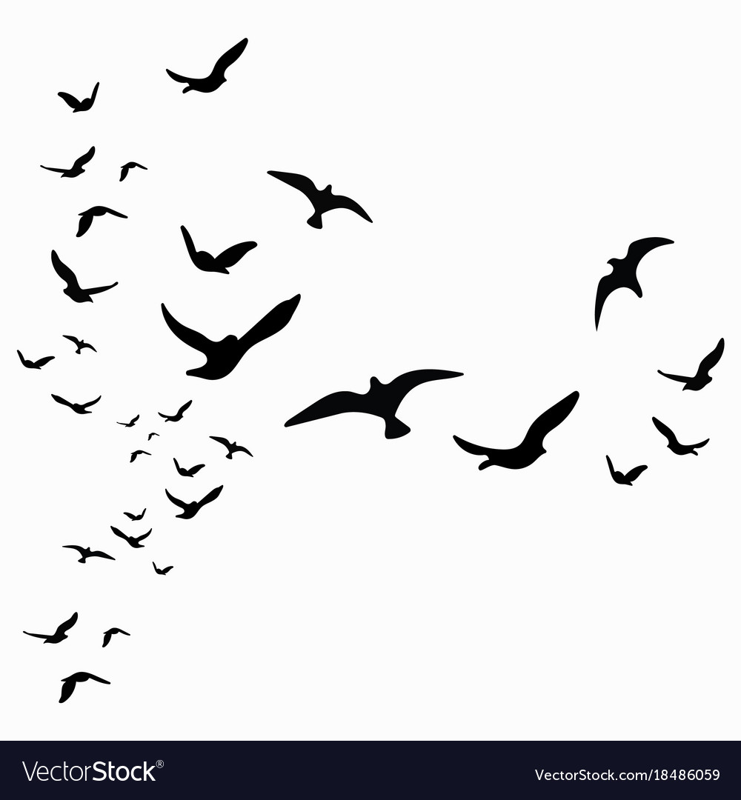

Slide 22
RESOURCES

Slide 23
Candidate 1: Level ______ Candidate 2: Level ______
I agree and disagree with the statement because I think there are times when Nat’s life is normal and the birds are acting strangely and there are also times when I think maybe Nat’s life isn’t normal. Nat likes to watch the birds from the quotation, ‘Nat watched them’ which shows how he has a routine but his routine is ruined when he notices that there were more birds than usual. They are ‘restless’. This is an adjective which could show how the birds are not their usual selves. This creates tension because we don’t know what the birds may try and do next. I also disagree with the statement because Nat’s life isn’t normal at the end of the extract because a bird attacks him. The quotation ‘what kind of bird he could not tell’ creates tension because we don’t know what kind of bird has attacked him but this is why I agree and disagree.
I agree with the statement. In the extract Nat watches the seabirds because he likes birds. He watches them every day and it is normal for him to watch the birds. The birds are acting strangely while Nat is eating a pasty. Nat starts speaking to show his thoughts and feelings. The writer uses description to show what Nat and the others at the farm usually do. They so this in the quotation, ‘there are more birds about that usual’ which shows Nat knows what normal is and the birds aren’t normal. Nat then goes home and goes to sleep but in the middle of the night he can hear a tapping at the window and so he goes to have a look but a bird pecks at him before flying away. This shows the statement is correct because it would be normal for someone to check what was knocking at the window but not normal for it to be a bird.
Notes:
Example answers to print

Slide 24
Candidate 3: Level ______ Candidate 4: Level ______
I agree with the student. We can clearly determine why the statement has been made because of the writer’s prominent use of juxtaposition, contrasting the mundane tasks of Nat’s everyday life with the ‘restless’ agitation of the birds he is seemingly familiar with. Du Maurier structures her text around Nat’s familiarity with the birds, a familiarity soon shattered when he watches them fly away, ‘to what purpose?’. The use of a rhetorical question is interesting here and highlights the contrast which in turn creates tension. Nat, in his cyclical routine, clearly knows his purpose: to look after his family and work at the farm. The purpose of the birds, however, is more obscure, creating tension as an unclear purpose equates to unpredictability, making the birds seem threatening and creating a sense of foreboding. The reader’s inability to understand the birds and their movements compared to the relatable actions of Nat create a sense of uncertainty.
The statement is correct and I agree with it. It is clear the writer is juxtaposing the normality of Nat’s life, zooming in on everyday, somewhat mundane tasks like, ‘munching his pasty’ and the way he ‘watched the sea birds’, perhaps to create the sense that life for him is cyclical; there is never anything different. This, then, has a greater impact on the reader when du Maurier shifts our attention to the fact that the birds ‘were more restless than ever this fall of year.’ The adjective ‘restless’ begins to create a dark and ominous tone. The adjective implies that something is not quite right which would contrast Nat’s routine of working at the farm , eating lunch and going home, a routine seemingly established from years of doing the same thing. ‘Restless’ as an adjective connotes agitation which is most likely why the student voices the idea that something that goes against the norm creates tension; change can be unexpected and can create suspense.
Notes:
Examples to print

