Slide 1
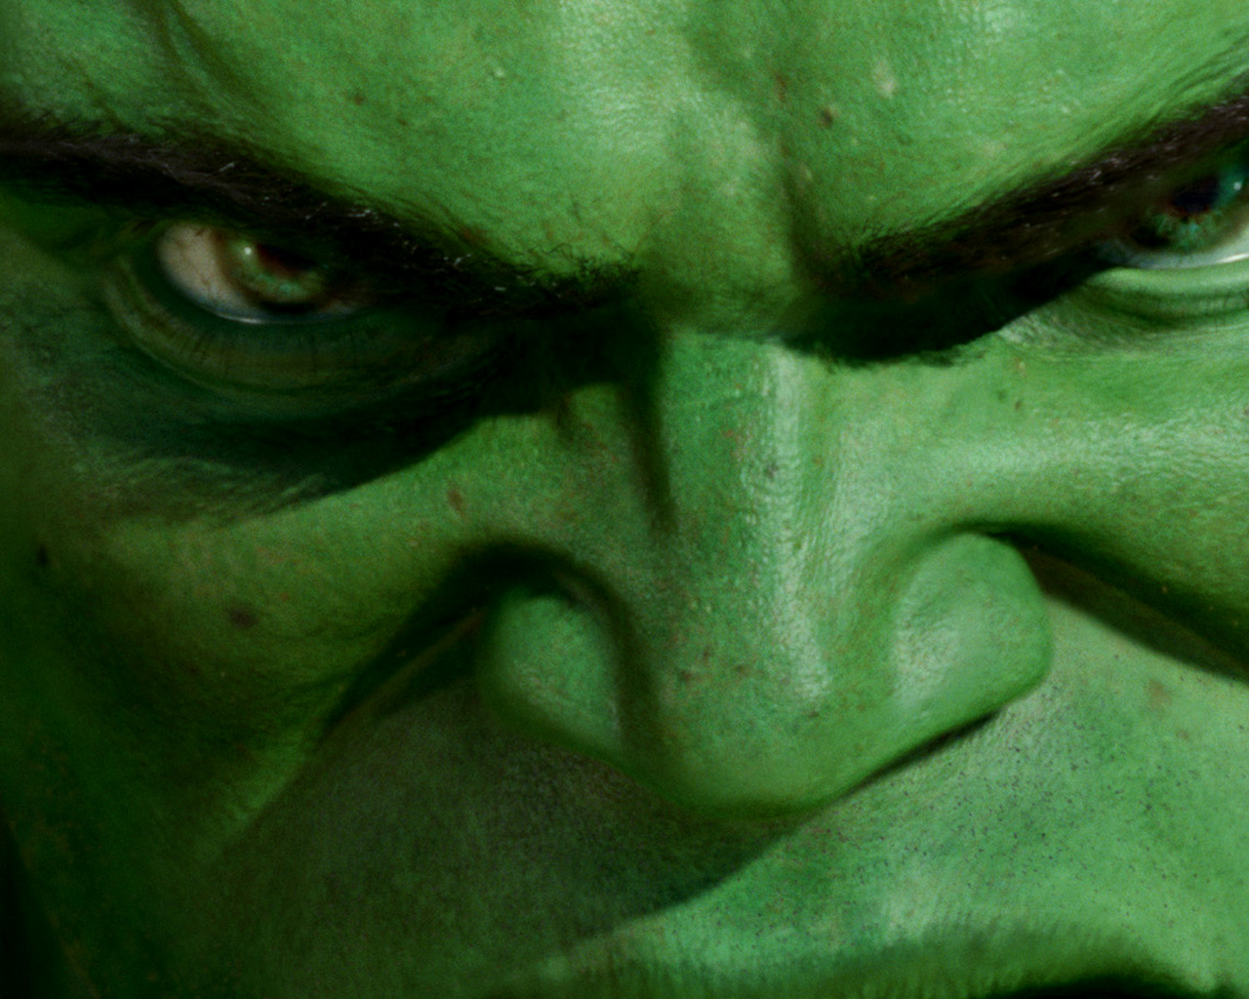
Film Music Assessment
DNA
Complete question 1 to 9
on the assessment paper

Slide 2
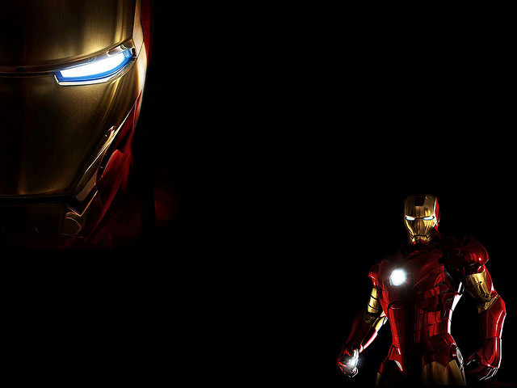
Progress Indicators
Good | Outstanding
You are able to recall most of the elements of music and describe what a leitmotif is You are able to play all of the motif (Superman or Stranger Things) accurately | You are also able to identify notes of Major and minor chords You are also able to play it fluently

Slide 3
Assessment Tasks
Listen to the following extract and complete the table (question 10) https://www.youtube.com/watch?v=egzfvjy6sqk
Perform your chose leitmotif to another pair and peer assess each other
Perform to Mrs Jones/class

Slide 4
Superman
G G C G G C G C G G C G G E D D
G G C G G C G C C C C D D D Ab G G

Slide 5
E G B C B G E
E G B C B G E
G /B
C E E
E G B C B G E
E G B C B G E
E G B C B G E
E G B C B G E
E E C C

Slide 6
Progress Indicators Review
Good | Outstanding
You are able to recall most of the elements of music and describe what a leitmotif is You are able to play all of the motif (Superman or Stranger Things) accurately | You are also able to identify notes of Major and minor chords You are also able to play it fluently

