Slide 1
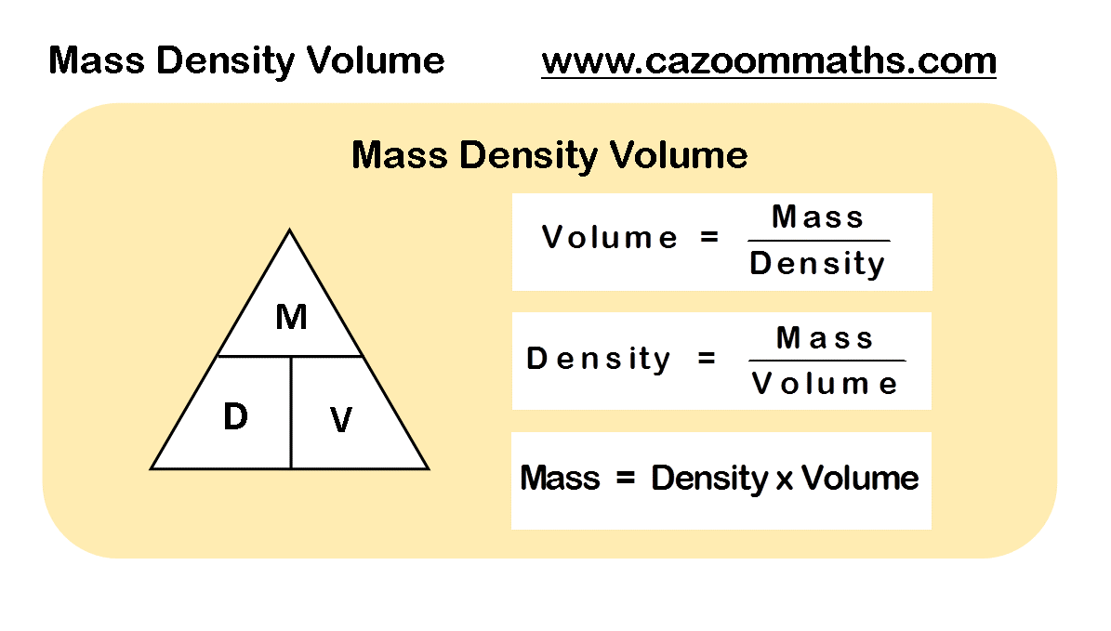
Use circuit diagrams to set up an appropriate circuit to investigate a factor/the factors that affect the resistance of an electrical component
Density Required Practical

Slide 2
Watch the video and make notes on the three different methods
https://www.youtube.com/watch?v=lvqu6JAbaKc

Slide 3
An investigation to determine the specific heat capacity of one or more materials. The investigation will involve linking the decrease of one energy store (or work done) to the increase in temperature and subsequent increase in thermal energy stored.
Reliability & Reproducibility
Reliability: the degree to which the result of a measurement, calculation, or specification can be depended on to be accurate.
Task
How do we know if results are reliable?
How do we know if results are reproducible?
How could we improve our method to make it more reliable & reproducible?
Reproducibility : The ability of an entire experiment or study to be duplicated, either by the same researcher or by someone else working independently. Reproducing an experiment is called replicating it.

Slide 4
Use appropriate apparatus to make and record the measurements needed to determine the densities of regular and irregular solid objects and liquids. Volume should be determined from the dimensions of regularly shaped objects and by a displacement technique for irregularly shaped objects.
Density Required Practical
Things to remember when answering 6 mark exam questions:
Try and remember everything you can about what the question is asking before you start answering it
Make at least 6 points
Write in full sentences starting with capital letters and ending with full stops
Try and answer the question in around five minutes
Check your answer to make sure you have not left anything out
Remember to use key words when appropriate

Slide 5
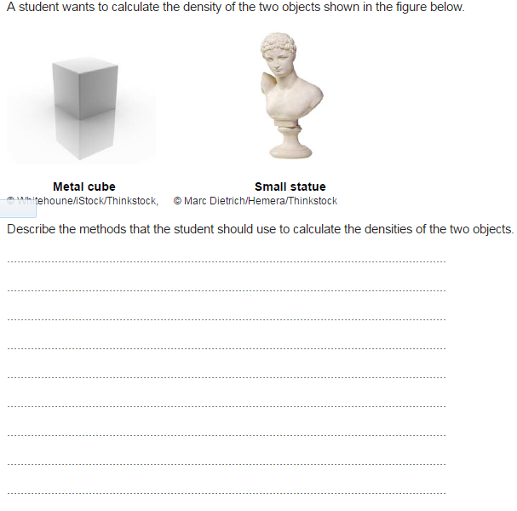
Task: Complete the past-paper question

Slide 6
