Slide 1
DNA:
Put the following fractions in descending order:
13
19
10
4
6
16
24
12
6
8
39
38
40
32
36
48
48
48
48
48
10
13
19
6
4
>
>
>
>
12
16
24
8
6

Slide 2
Fractions of an Amount
Unit 4G1

Slide 3
Progress Indicators:

Slide 4
Prior learning:
Place value.
Percentage as an amount out of 100.
Multiplication and division.
Ordering integers on a number line.
Unit 5 - Fractions, Decimals
and Percentages
Shading fractions of diagrams, equivalence and simplification of fractions.
57-59,61
Convert between improper fractions and mixed numbers.
63-64
65-66,
67-70
Four operations with mixed and improper fractions.
60
Order fractions.
Find fractions of an amount.
77
Calculate a percentage of an amount and percentage change.
84-90
73-76,
82-83
Convert between fractions, decimals and percentages and compare them.
Calculate simple and compound interest.
93-94
Next steps:
Calculating proportions of pie charts.
Using multipliers.
Reverse percentages.
Reverse fractions.

Slide 5
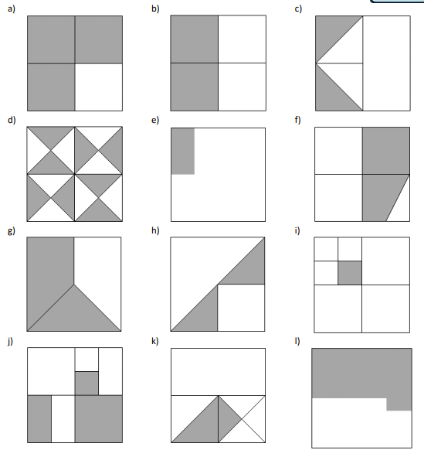

Slide 6
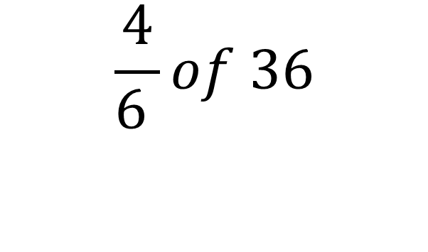
We Do:
Your Turn:
$$\frac{1}{5} of 20$$
Remember of means Multiply!

Slide 7
$Find \frac{1}{3 }$ of £12
$Find \frac{2}{3 }$ of £12
$Find \frac{2}{3 }$ of £24
$Find \frac{4}{3 }$ of £24
$Find \frac{3}{4 }$ of £24
6. $Find \frac{6}{8 }$ of £24
7. $Find \frac{5}{8 }$ of £24
$8. Find \frac{5}{8 }$ of £12
9. $Find \frac{8}{5 }$ of £12
$10. Find 1\frac{3}{5 }$ of £12

Slide 8
$Find \frac{1}{3 }$ of £12 £4
$Find \frac{2}{3 }$ of £12 £8
$Find \frac{2}{3 }$ of £24 £16
$Find \frac{4}{3 }$ of £24 £32
$Find \frac{3}{4 }$ of £24 £18
6. $Find \frac{6}{8 }$ of £24 £18
7. $Find \frac{5}{8 }$ of £24 £15
$8. Find \frac{5}{8 }$ of £12 £7.50
9. $Find \frac{8}{5 }$ of £12 £19.20
$10. Find 1\frac{3}{5 }$ of £12 £19.20

Slide 9
We Do:
James saves $\frac{5}{9}$ of his pocket money, he gets £45 per month. How much does he save each month?

Slide 10
Your Turn:
If Paul spends $\frac{7}{18}$ of his pocket money on sweets how much money will have left per month if he receives £36 per month?

Slide 11
Reverse Fraction of amounts:
We Do:
$\frac{3}{5}$ of the students in a class are girls. The rest are boys. There are 10 boys. How many girls are there?

Slide 12
Reverse Fraction of amounts:
You Do:
$\frac{7}{10}$ of your pocket money each week is spent on food. The rest is spent on activities. You spent £25 on food. How much pocket money do you receive each week?

Slide 13
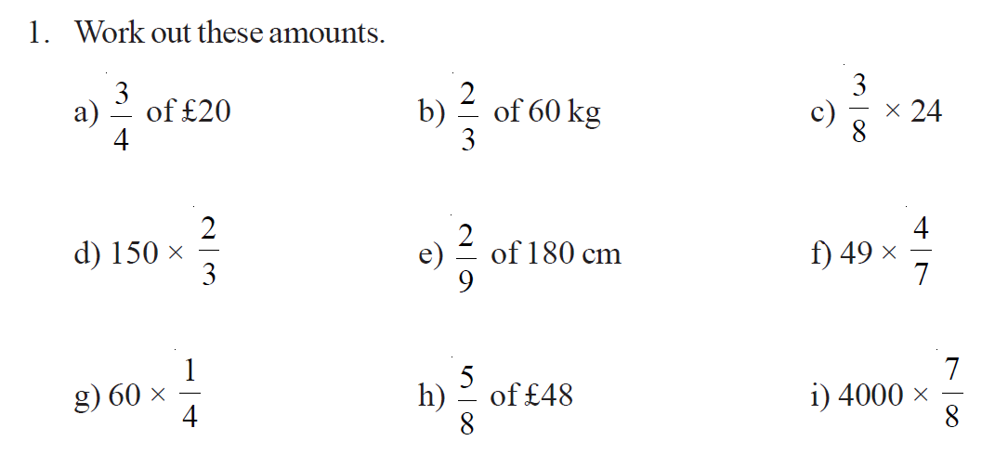
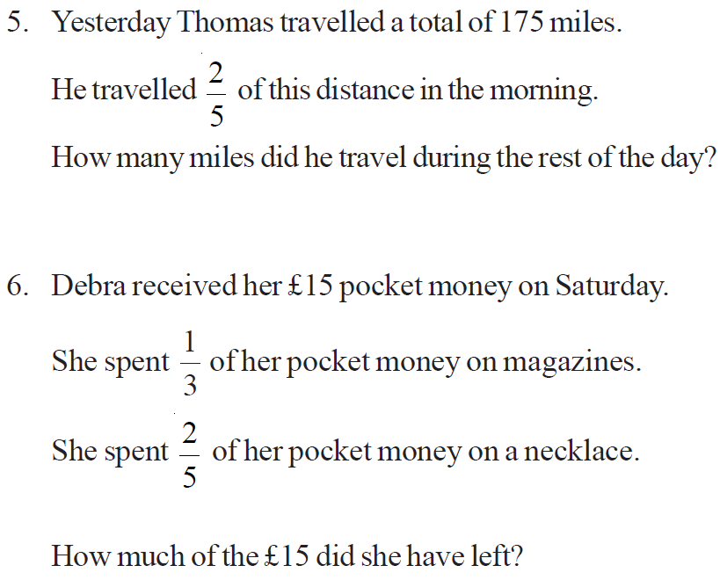
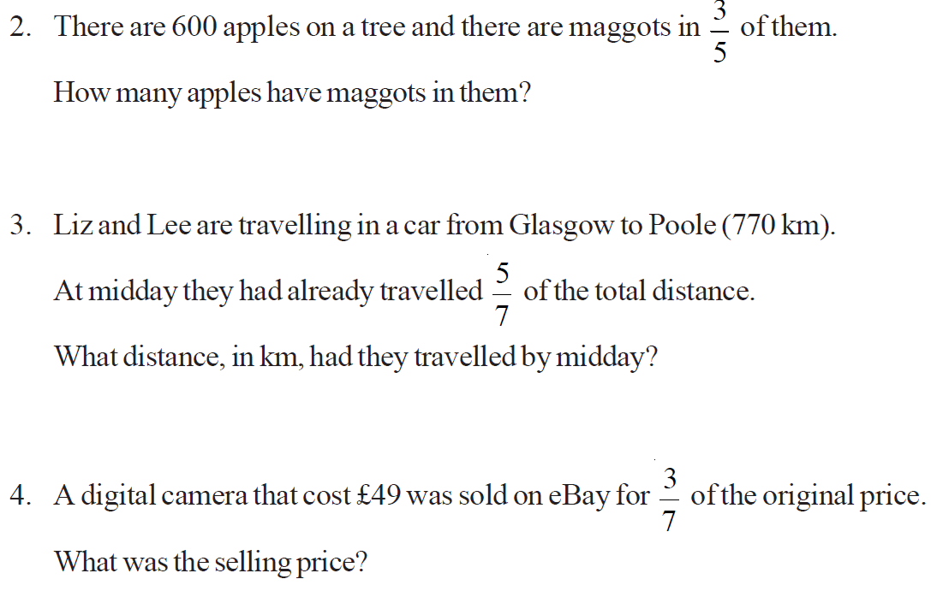
Worksheet Questions:

Slide 14
Worksheet Answers:
9
£15
40kg
100
40cm
28
15
£30
3500
175 – 70 = 105
360 Apples
£5
550 km
£6
£15 – £5 – £6 = £4
£21

Slide 15
Demonstrate:
3
5
of 20
3
8
x 40
2) Sam read 4/7 of a book on Friday. He has 42 more pages to read before he will reach the end of the book. How many pages did he read on Friday?
3) $\frac{8}{32}$ of your income each month is spent on guitar lessons. The rest is saved for a new guitar. You receive £40 monthly and the guitar you want is £240. How long will it take for you buy the guitar.

Slide 16
Connect
Solve the following: | Solve the following: 2) Some children were at summer school. 𝟓/𝟖 " of "them were girls. If there were 40 girls at summer school. How many boys were there? | 1) Amy had £240. 1/6 of her money was spent on a dress. 1/2 of her money was spent on a pair of shoes. How much money was left? 2) A School has 1200 pupils 575 of thee are girls. 2/5 of the girls like sport 3/5 of the boys like sport. Work out the total number of pupils in the school who like sport.
3
5
x 20
5
8
of 24
4
7
3
10
of 14
x 40
4
5
of 25

