Slide 1
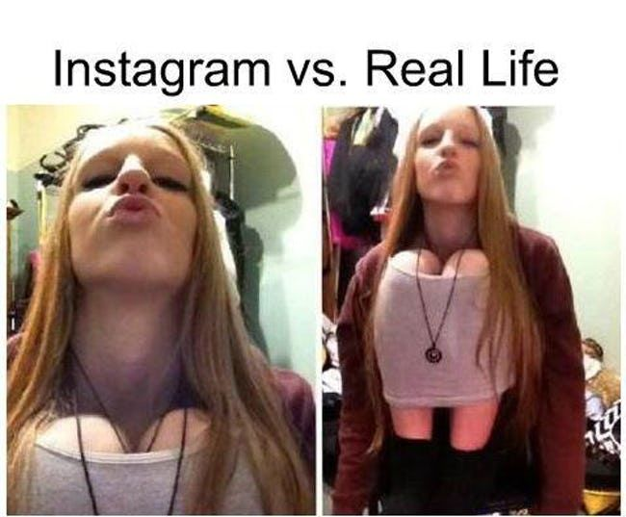
AO5 and AO6
DNA – 5 minute writing start
One line with an anecdote
A line using alliteration
One line using a rhetorical question
An ellipsis
Notes:
https://www.1001fonts.com/gooddog-plain-font.html

Slide 2
C/W Date
AO3 – Question 4
Notes:
https://www.1001fonts.com/earwig-factory-font.html

Slide 3
Word and definition | Your definition or synonyms
Viewpoint (noun)
Perspective (noun)
Notes:
https://www.1001fonts.com/earwig-factory-font.html

Slide 4
AO3
16 Marks
20 Minutes
For this question, you need to refer to the whole of Source A, together with the box whole of Source B.
Compare how the writers convey their different perspectives on surfing.
In your answer, you could:
• compare their different perspectives on surfing
• compare the methods the writers use to convey their perspectives
• support your response with references to both texts.
This is the most important word in the question as it is asking you to write about the effects of the language through the techniques that the writers have used.

Slide 5
AO3
1. Identify the viewpoints and attitudes in both texts – are they similar or different?
2. Identify and analyse the techniques the writers have used to present their views.
3. Link your ideas together in a PEEL paragraph – use connectives.
Useful sentences:
This metaphor/simile/personification is used to show...
The clever use of this adverb/verb/adjective/image represents...
The writer is trying to symbolise...
This image is effective because...
The use of the adjective/noun/verb evokes a sense of…
Similarly | Alternatively
Likewise | Whereas
As with | Unlike
Like | Instead of
Equally | In contrast
Remember to write a lot about a little!
Emotive language | Metaphor | Personification | Noun | (Dynamic) Verb
Semantic field | Simile | Asyndetic list | Adjective | Adverb

Slide 6
Differences
Similarities
Differences
Immediately wants to take up surfing.
Content to observe rather than participate.
Both admire the skill and bravery of the surfers.
TEXT A
TEXT B
TASK: complete a double bubble map to draw out some initial similarities and differences between the two texts.
THINK – PAIR – SHARE your ideas.
Notes:
Ideas:
Sense of hope and educational inspiration
Position and sense of responsibility
Levels of expectation
Educational priorities
Personal emotional response

Slide 7
Compare how the writers convey their different perspectives on surfing.
 | SOURCE A | Connective | SOURCE B
Views | The writer recalls how as a young boy he was “dazzled” by the spectacle of surfing and from the outset was desperate to join in and become a surfer. |  | The writer enjoys the spectacle of surfing but is content to remain a spectator.
Techniques
Create your own table.
Notes:
Methods:
Structural opening – both set the scene to create contrast or emphasis
Structural ending – emotive, either hopeful or despairing
Whole text structure – both chronological accounts
Narrative perspective – first person – impersonal or personal
Tone – cheerful, amused and objective or agonised, intimate and serious
Language features – superlatives, hyperbole, irony, adverbs
Figurative language – metaphors, similes, symbolism

