Slide 1
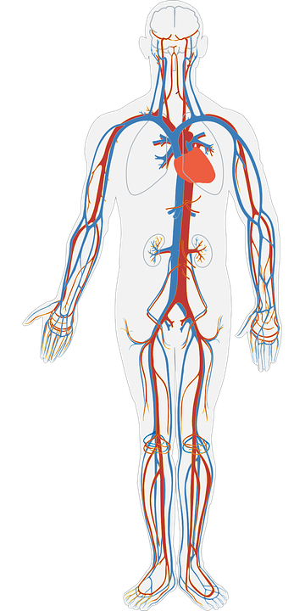
The Blood Vessels
Do Now activity:
What are the four main components of blood?
Describe the features of a red blood cell which aids it’s transportation of oxygen
Explain the journey an oxygen molecule takes from the alveoli to respiring tissues

Slide 2
Progress indicators
GOOD PROGRESS:
- Identify and label diagrams of the three main types of blood vessel
- Describe the structure of each of the types of blood vessels
OUTSTANDING PROGRESS:
- Explain how the structure of each of the blood vessels relates to it’s function in the circulatory system

Slide 3
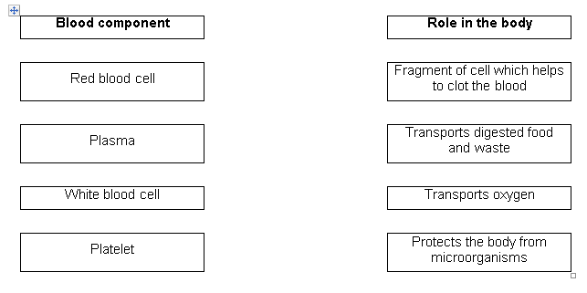
Quick reminder…
Task: Match the blood component to it’s role:

Slide 4
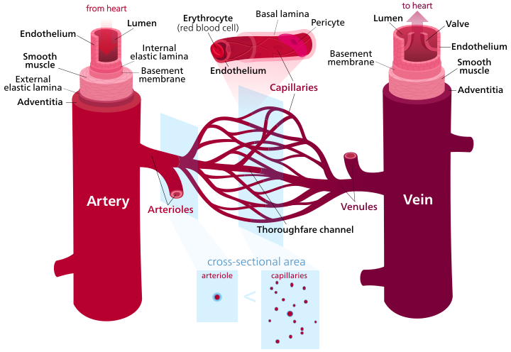
There are three main types of blood vessel in the human body:
Artery
Vein
Capillary
Notes:
Image: By File:Blood vessels-en.svg: Kelvinsongderivative work: Begoon - This file was derived from Blood vessels-en.svg:, CC BY-SA 3.0, https://commons.wikimedia.org/w/index.php?curid=65695195

Slide 5
Task: Answer the following questions on blood vessels whilst watching the video:
What does our blood flow through?
What are arteries and what do they do?
What structural feature do arteries have in order with stand high pressure?
What occurs at the capillaries?
What are endothelial cells?
http://study.com/academy/lesson/blood-vessels-arteries-capillaries-more.html

Slide 6
Self-assessment:
Blood vessels – arteries, veins, capillaries
Arteries are blood vessels which carry blood away from the heart to other tissues.
Arteries have thick elastic walls to withstand high blood pressure, these arteries expand when the pressure of the blood rises and then recoil when the heart relaxes between beats to provide a smooth flow of blood.
Capillaries are small, microscopic blood vessels where exchange of materials takes place between the blood and the body tissues
Endothelial cells are thin, flattened cells that line the inner wall of all blood vessels

Slide 7
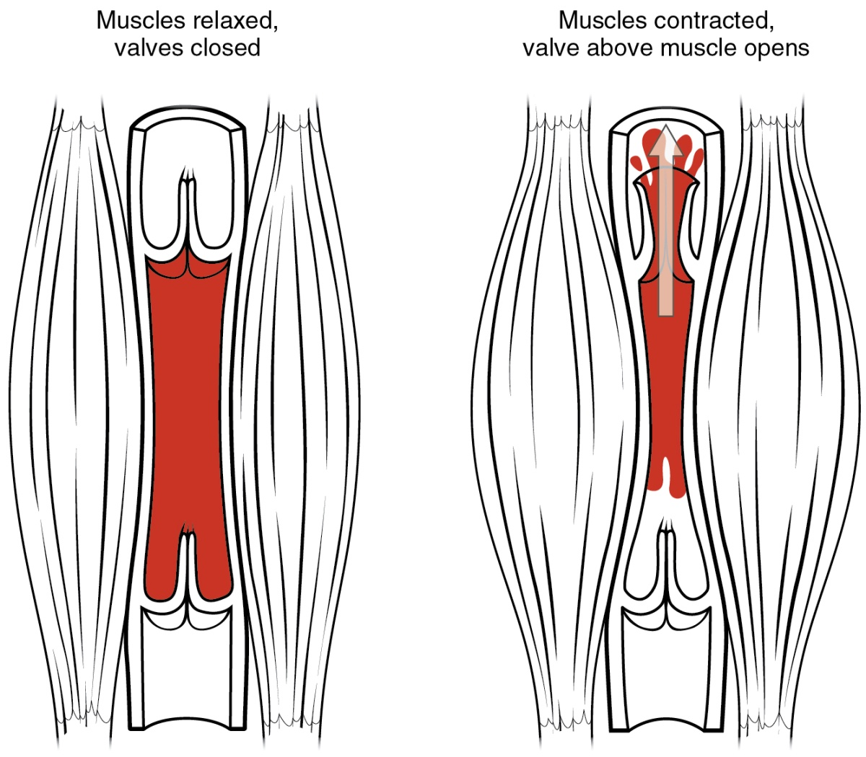
How does blood move through the veins?
Blood pushed forward towards the heart through open valves
Backward flow of blood prevented by the closing of the valves as they fill with blood
Backward prevented by valves closing
Blood is passed through the veins by moving our limbs and breathing.
Notes:
Image by OpenStax College [CC BY 3.0 (http://creativecommons.org/licenses/by/3.0)], via Wikimedia Commons

Slide 8
Vessel type | artery | vein | capillary
Diagram
Direction of blood flow
Blood pressure
Blood colour
Function
Structure
Valves?
Task: Memory game...how much can you get filled in with only 30 seconds to look at the information?

Slide 9
vessel type | artery | vein | capillary
Diagram
Direction of blood flow | blood moving away from the heart | blood moving towards the heart | in organs and tissues, link between arteries and veins
blood pressure | high (40-100 mmHg) | low (5-20 mmHg) | medium (20-30 mmHg)
Blood colour | oxygenated, bright red | deoxygenated, deep purply-red | both
Function | transport of oxygenated blood (except pulm. artery) | transport of deoxygenated blood (except pulm. Vein) | exchange of O2, CO2, nutrients and waste between cells + blood
structure | • thick muscular wall (elastic) • small lumen (internal space) | • thin wall • large lumen | • very thin wall (one layer of cells) • very small lumen (red blood cells travel single file)
valves | no | yes | no
Notes:
Images: Blood vessels-en.svg: Kelvinsongderivative work: Begoon - This file was derived from Blood vessels-en.svg:, CC BY-SA 3.0, https://commons.wikimedia.org/w/index.php?curid=65695195

Slide 10
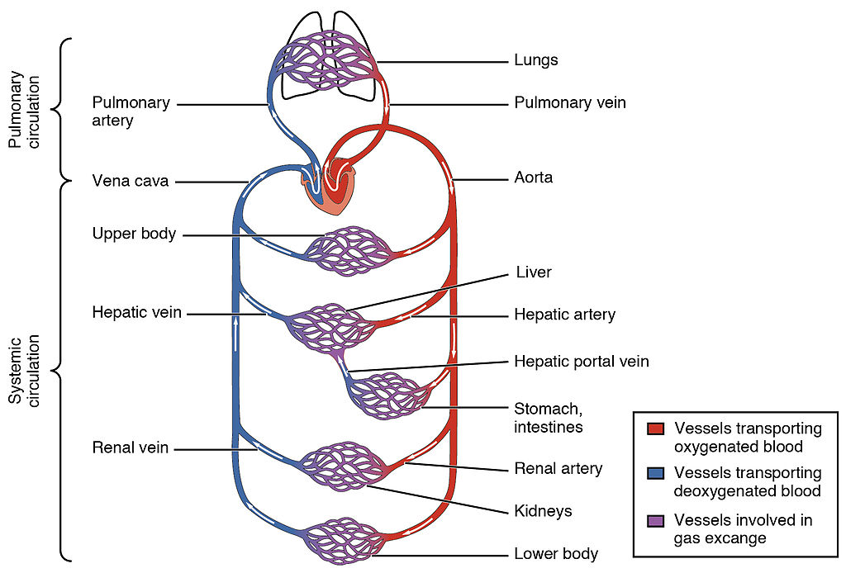
Double-circulation
In humans and other mammals the blood vessels are arranged into a double-circulatory system.
One transport system carries blood from your heart to your lungs and back again.
The other transports blood from your heart to all other organs of your body and back again.
The pulmonary circulation carries deoxygenated blood to the lungs to exchange carbon dioxide for oxygen
The systemic circulation carries the newly oxygenated blood from the heart to deliver oxygen to respiring tissues in the rest of the body
Q. What is the main job of the:
Pulmonary circulation
Systemic circulation
Notes:
Image by OpenStax College - Anatomy & Physiology, Connexions Web site. http://cnx.org/content/col11496/1.6/, Jun 19, 2013., CC BY 3.0, https://commons.wikimedia.org/w/index.php?curid=30148241

Slide 11
Plenary: Quick Check
Task: Choose one of the following questions to answer:
Describe one feature of a capillary, artery and a vein
Explain how the feature relates to the function of
the blood vessel
Explain why veins do have valves whereas arteries do
not

Slide 12
Resources

Slide 15
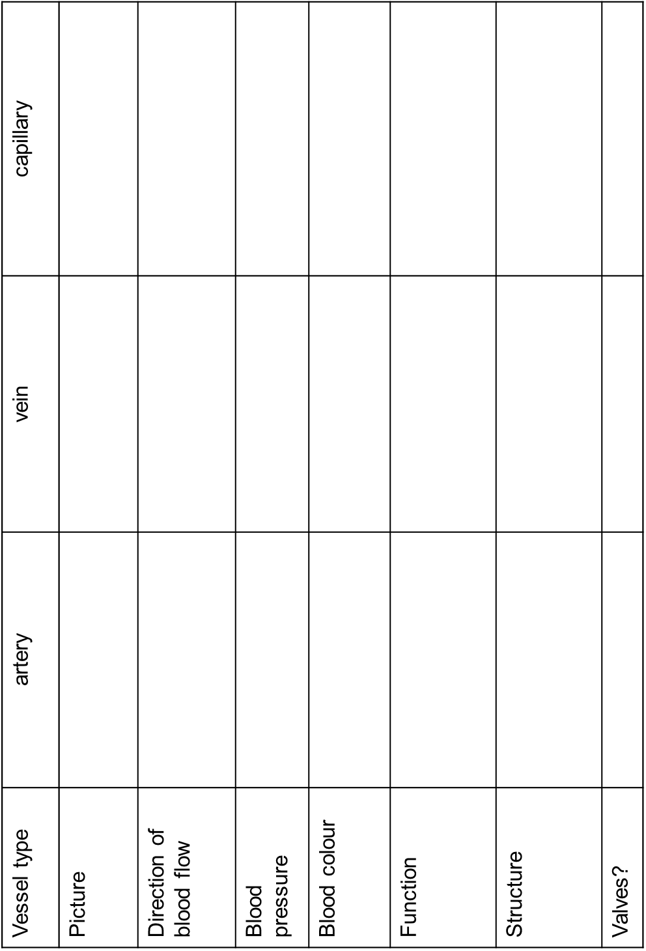

Slide 16
