Slide 1
Accident and injury
Good progress: to be able to explain the impact of an accident
Excellent progress: To explain the impact of an accident and clearly explain how it would impact the next life stage as well as the current one.

Slide 2
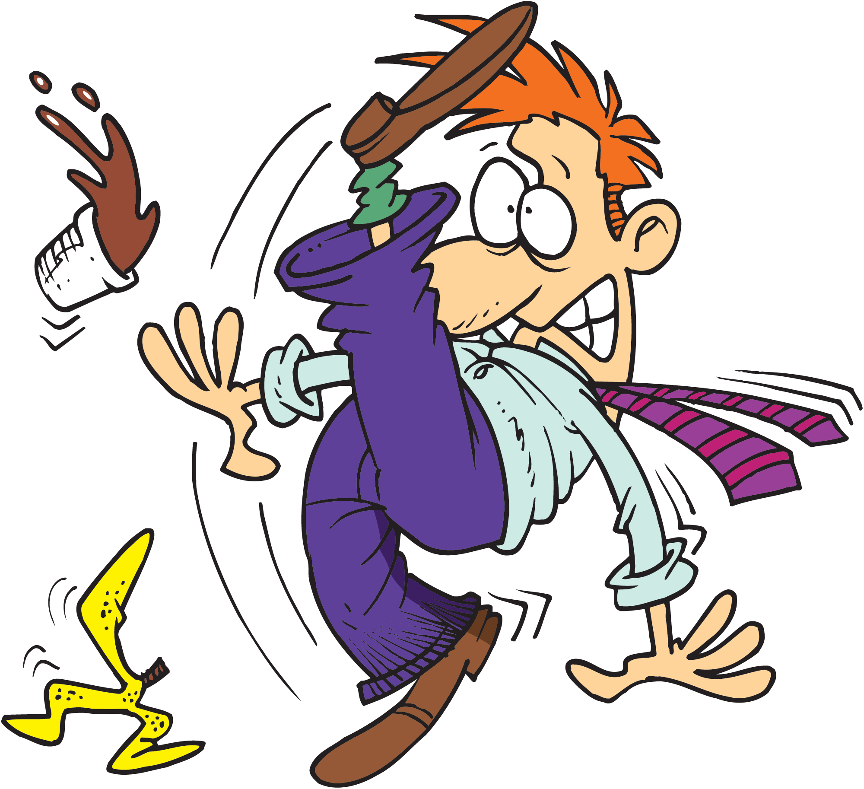
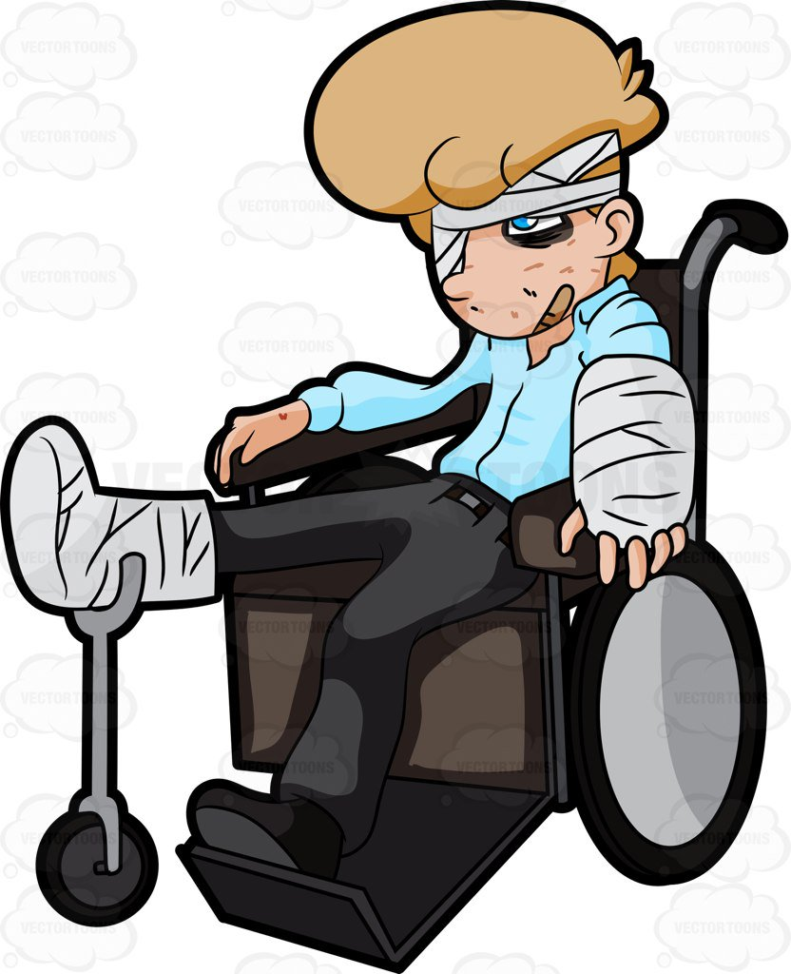
What is an accident?
An accident is an incident that happens unexpectedly and unintentionally, which results in damage or injury.
You need to list as many examples of accidents that you can…
What is an injury?
An injury is when there is physical harm or damage to someone's body caused by an accident or an attack.
You need to list as many examples of injuries that you can…

Slide 3
Hollyoaks train crash…
The McQueen family are celebrating a wedding, when a car travelling over the train tracks breaks down and the train unexpectedly derails and crashes. This is then followed by a leak of gas and an explosion. There many injured including two deaths. You need to watch the video…
https://www.youtube.com/watch?v=cZiCirTBqmw

Slide 4
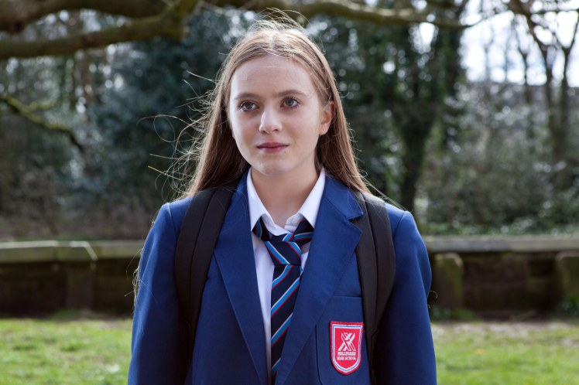
Who is Nico…
Nico is the long lost daughter of Sienna Blake. She is 15 years of age.
Nico’s personality…
She is an "intelligent, funny, but with quite a dark streak", as well as being quite mature for her age, as a result from going to care home to care home. It also mentions that although Nico has a tendency to push people away, this is down to a fear of rejection and in reality she just wants "to be loved and to be a part of a real family" and that she is "looking for a place in the world.
Nico sustained severe injuries in the train crash, resulting in her needing a kidney, which she later received from a family friend.

Slide 5
Nico’s pies (1)…
Task 1
You need to write Nico’s PIES as they should be. What is expected of Nico as an adolescent? You need to refer back to book 1 and create a pies chart/mind map for Nico..
Physical
Intellectual
Emotional
Social

Slide 6
Nico’s pies (2)…
Task 2a
You now need to write Nico’s PIES for after the accident. How have her PIES changed? You can write on your current PIES chart but will need to complete this task in a different colour…
Physical
Intellectual
Emotional
Social
Task 2b
Using the following key words, what other ways might Nico be affected? You also need to comment on the words below…
Diet
Relationships
Mobility
Self image
Self esteem
Independence

