Slide 1
DNA:
How do the British Royal Family impact on the United Kingdom’s tourist industry?
Explain your ideas.

Slide 2
Year 9: Transactional Writing
Lesson Title: Using Leaflets to Persuade
Lesson Focus: shape and craft language within individual paragraphs, and structure ideas between them, to achieve particular effects.
Progress indicators:
 | Good | Outstanding
Assessment reminder: The paparazzi have a damaging impact on society. Write an article in which you explain your
point of view on this statement.

Slide 3
Word Consciousness – Please record on the back page of your exercise books
Word and definition | Your definition
Hereditary (adjective) when you inherit an aspect of something from your parents e.g. eye colour, blood type etc
Psychological (adjective) related to the mental and emotional state of a person
Commercial (adjective) making or intended to make a profit.

Slide 4
Learning Journey
Considered the benefits and drawbacks of the British Royal Family
Develop your understanding of hat makes an effective persuasive leaflet
Explore a persuasive leaflet and assess its use of persuasive features.

Slide 5
What are the features of a leaflet?
On the next slide is an example of a leaflet that aims to educate people about the impact of poor breeding practices and how they can support dogs who have been affected by this.
Task:
Who is the intended audience of this particular leaflet?
How many features of an article can you identify?
How does the leaflet present the information?

Slide 6
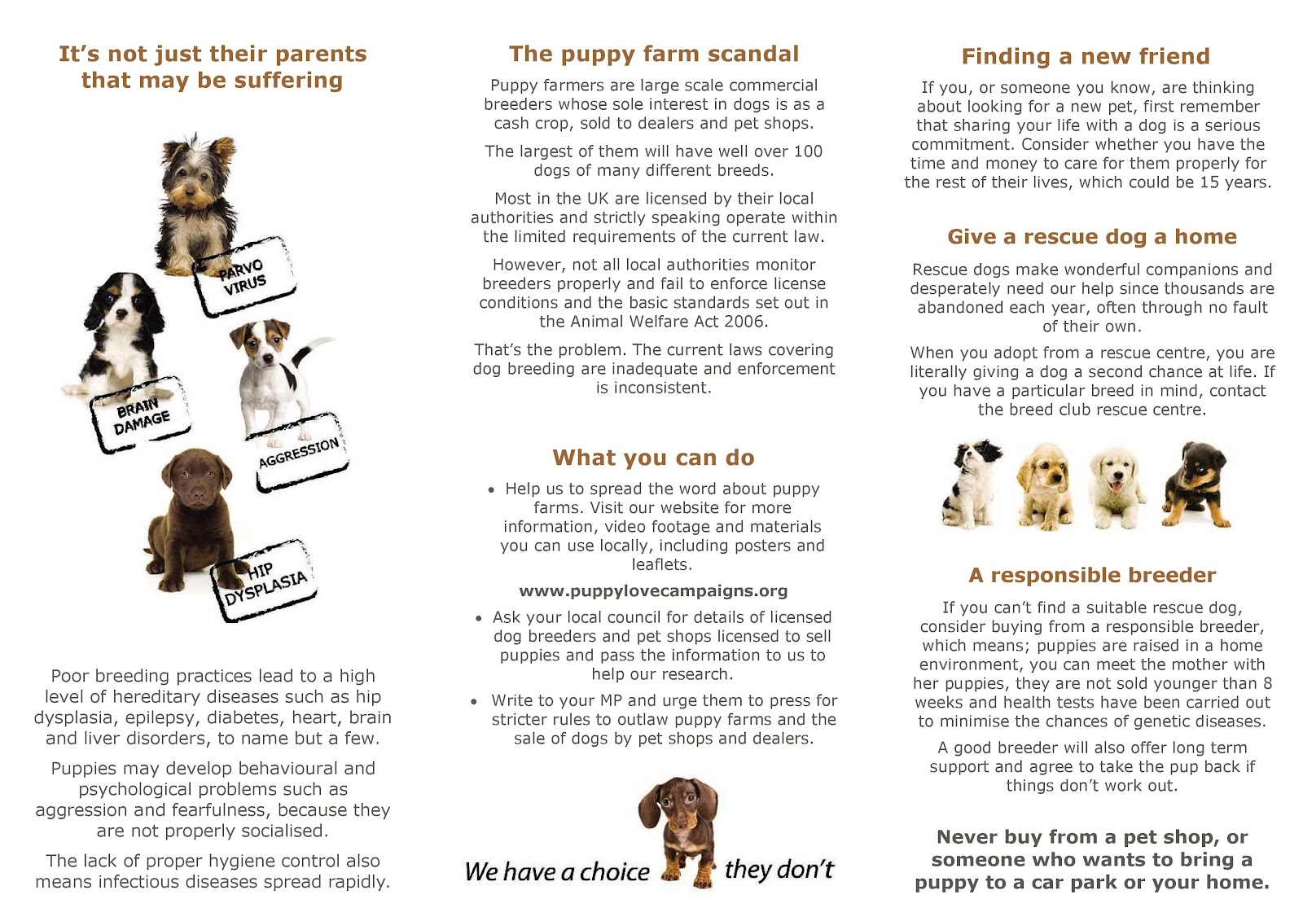
This and more examples in resources folder – lesson 22

Slide 7
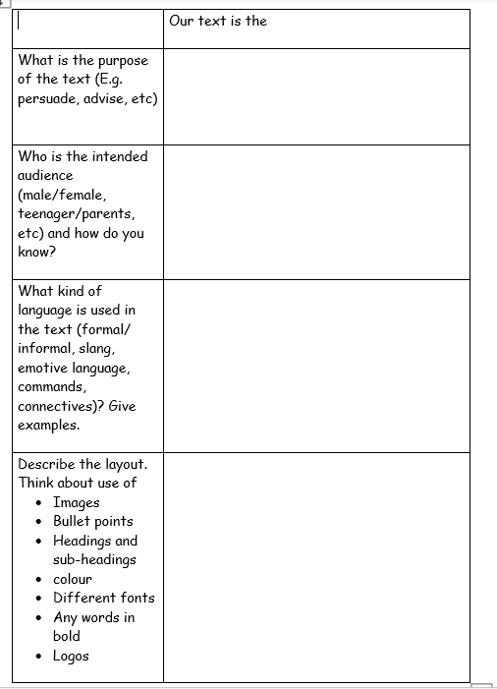
Teacher note – copy in resources folder – lesson 22
Pupils to use the leaflet to complete the following table then feedback on their ideas.

Slide 8
Mind-map ideas as a whole class for feedback
Features of a leaflet

Slide 9
How many of the persuasive techniques can you identify in the example leaflet?
 | TECHNIQUE
D | Direct address (you/your)
A | Alliteration/Anecdotes
F | Facts
O | Opinions
R | Repetition/rhetorical questions
E | Emotive language
S | Statistics
T | Triple emphasis (rule of three)
Pupils to annotate their copy of the leaflet and consider the effects of the persuasive features.

Slide 10
Persuasive Technique | Example from the leaflet | What effect does this have on the reader?

