Slide 1
Year 10 Art / 3D
Build up more of your folder work by accurately drawing these images or any others that you find more appropriate to your work.
Remember you can use a grid to help you.

Slide 2
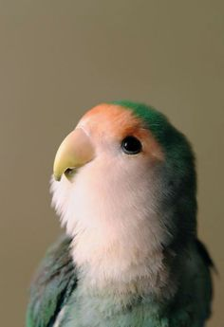
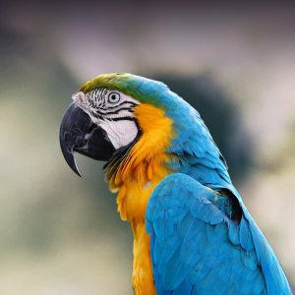

Slide 3
