Slide 1
DNA: Ask a question make a statement

Slide 2
Express a Number as a Percentage of another number.
22.9.20
Unit 4H

Slide 3
Prior learning:
Place value.
Percentage as an amount out of 100.
Multiplication and division.
Ordering integers on a number line.
Unit 5 - Fractions, Decimals
and Percentages
Shading fractions of diagrams, equivalence and simplification of fractions.
57-59,61
Convert between improper fractions and mixed numbers.
63-64
65-66,
67-70
Four operations with mixed and improper fractions.
60
Order fractions.
Find fractions of an amount.
77
Calculate a percentage of an amount and percentage change.
84-90
73-76,
82-83
Convert between fractions, decimals and percentages and compare them.
Calculate simple and compound interest.
93-94
Next steps:
Calculating proportions of pie charts.
Using multipliers.
Reverse percentages.
Reverse fractions.

Slide 4
Progress Indicators:
Good Progress: Pupils can find the Percentage of an amount by using Fractions and Decimals
Outstanding Progress: Pupils can use Multipliers with a Calculator to solve percentage Increase and Decrease.

Slide 5
Worked Example
Your Turn
Write $15$ as a percentage of $30$
Write $30$ as a percentage of $60$
Write $10$ as a percentage of $25$
Write $20$ as a percentage of $50$
Write $15$ as a percentage of $150$
Write $3$ as a percentage of $30$
Write $10$ as a percentage of $80$
Write $5$ as a percentage of $40$

Slide 6
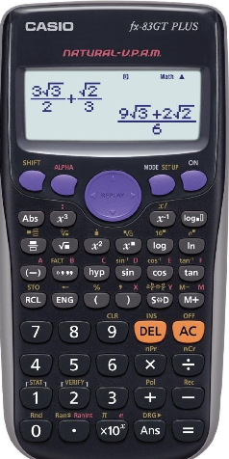
CASIO fx-83GT PLUS CALCULATOR
These calculators are brilliant, if
you know how to use them correctly!
The % button works on this version – here is how to use it

Slide 7
FIND THE PERCENTAGE OF A NUMBER
eg C$alculate$14% of 1250
= 14% x 1250 = 175
eg C$alculate$22.5$\frac{1}{2}$% of £64
= 22.5% x 64 = 14.4
= £14.40
14% x 1250
175

Slide 8
Write 5 as a percentage of 20.
Write 50 as a percentage of 200.
Write 150 as a percentage of 200.
Write 15 as a percentage of 20.
Write 5 as a percentage of 40.
Write 50 as a percentage of 400.
Write 150 as a percentage of 400.
Write 15 as a percentage of 40.
Write 150 as a percentage of 40
Intelligent Practice

Slide 9
Write 5 as a percentage of 20.
Write 50 as a percentage of 200.
Write 150 as a percentage of 200.
Write 15 as a percentage of 20.
Write 5 as a percentage of 40.
Write 50 as a percentage of 400.
Write 150 as a percentage of 400.
Write 15 as a percentage of 40.
Write 150 as a percentage of 40
25%
25%
75%
75%
12.5%
12.5%
37.5%
37.5%
375%

Slide 10
Task:
Calculate the percentage of the amount
66% of 99 (b) 84% of 84 (c) 17.5% of 130
(d) 20.3% of 190 (e) 23.8% of 70
1.5% of 68 (g) 1.9% of 95 (h) 99.9% of 16
(i) 104% of 65 (h) 117.5% of 49

Slide 11
Answers
65.34 (b) 70.56 (c) 22.75
(d) 38.57 (e) 16.66
1.02 (g) 1.805 (h) 15.984
(i) 67.6 (h) 57.575

Slide 12
BINGO
Draw a 3 x 3 grid as shown below:
Place any nine numbers below into the grid (repeats forbidden)
68.16 188.83 99.12 169.47
216.45 39.6 530.4 649.8
56.7 364 253.4 326.4
236.16 497.8 120.4 1.21
Notes:
12

Slide 13
MERIT TIME:

Slide 14
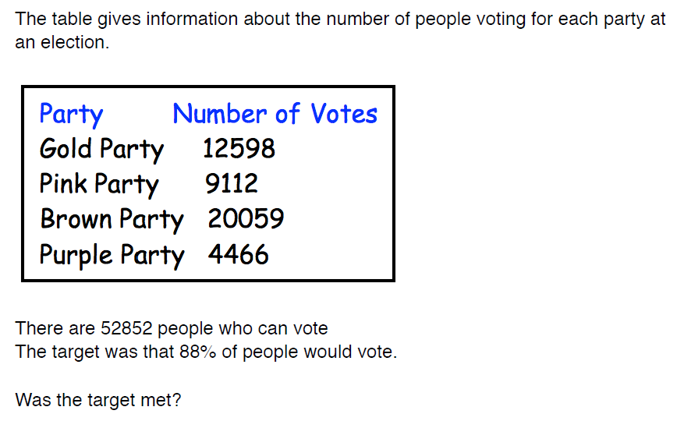
Demonstrate

Slide 15
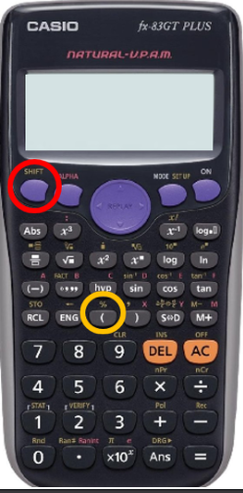
On these calculators we can if we want to simply divide by the % rather than the decimal multiplier
Note: 20% increase = 120% = 1.2 (Multiplier)

Slide 16
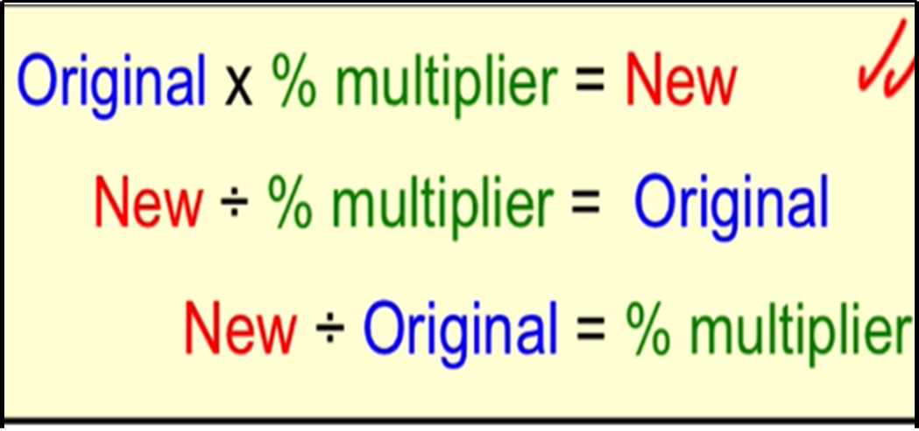
We Do:
In a sale, the all items are reduced by 20%. If the sale price of a jacket is £40, what was its original price prior to the sale?
Initial Amount
Percentage Change
Final Amount
?
× 80%
= £40
The jacket was £50 prior to the sale
Rearranging our equation…
$$\frac{£40}{80\%} = ?$$
Notes:
Remind about the calculators and the fact you can divide by 80% in this example

Slide 17
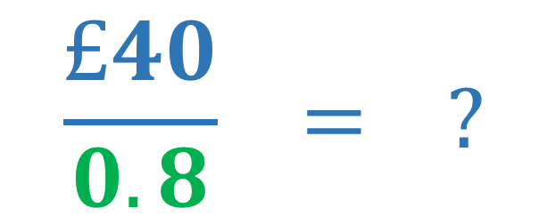
We Do:
In a sale, the all items are reduced by 20%. If the sale price of a jacket is £40, what was its original price prior to the sale?
Initial Amount
Percentage Change
Final Amount
?
× 0.8
= £40
The jacket was £50 prior to the sale
Rearranging our equation…
$$\frac{£40}{0.8} = ?$$
Notes:
Remind about the calculators and the fact you can divide by 80% in this example

Slide 18
We Do:
In a sale, a smartphone costs £350 after a 30% discount has been applied. What was the original price of the smartphone?
Original Price
Percentage Change
Sale Price
?
× 70%
= £350
$$\frac{£350}{70\%} = ?$$
The smartphone was £500 prior to the sale

Slide 19
We Do:
In a sale, a smartphone costs £350 after a 30% discount has been applied. What was the original price of the smartphone?
Original Price
Percentage Change
Sale Price
?
× 0.70
= £350
$$\frac{£350}{0.7} = ?$$
The smartphone was £500 prior to the sale

Slide 20
You Do:
In a sale, I paid £60 for a pair of trainers. I received a 20% discount using my student card. How much would the trainers normally cost?
$$\frac{£60}{0.8} = ?$$
The trainers normally cost £75
× 0.80
Price before discount
Price after discount
÷ 0.80

Slide 21
You Do:
In a sale, I paid £60 for a pair of trainers. I received a 20% discount using my student card. How much would the trainers normally cost?
$$\frac{£60}{80\%} = ?$$
The trainers normally cost £75
× 80%
Price before discount
Price after discount
÷ 80%

Slide 23
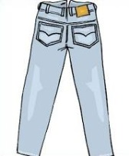
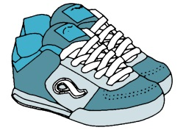
20% off!
30% off!
15% off!
Sale Price £40
Sale Price £60
Sale Price £25.50
60% off!
40% off!
Sale Price £1.40
Sale Price £54

Slide 24
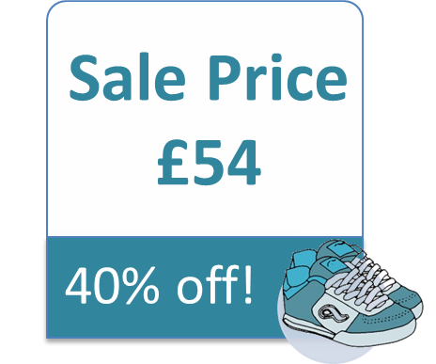
Answers
$$\frac{£40}{0.8}=£50$$
$$\frac{£1.40}{0.4}=£3.50$$
$$\frac{£60}{0.7}=£85.71$$
$$\frac{£54}{0.6}=£90$$
$$\frac{£25.50}{0.85}=£30$$

Slide 25
Answers
$$\frac{£40}{80\%}=£50$$
$$\frac{£1.40}{40\%}=£3.50$$
$$\frac{£60}{70\%}=£85.71$$
$$\frac{£54}{60\%}=£90$$
$$\frac{£25.50}{85\%}=£30$$

Slide 26
Challenge:

Slide 27
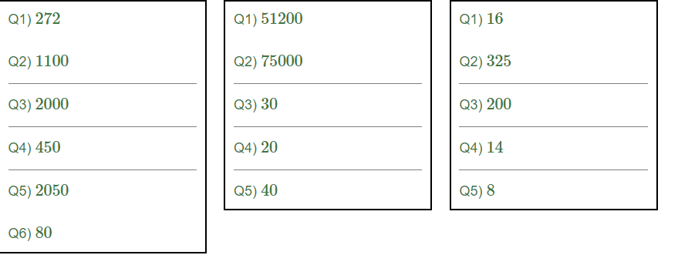
Answers

Slide 28
Demonstrate
a) 20% off everything”, screamed the sale posters. I paid £60. What should I have paid before the sale?
b) Yesterday evening, my 25 mile journey home took 25% longer than usual. By what percentage was my average speed reduced compared to normal?
c) The price of a hamster is reduced by 20% to £640. What was the original cost?

Slide 29
Answers
a) 20% off everything”, screamed the sale posters. I paid £60. What should I have paid before the sale?
£75
b) Yesterday evening, my 25 mile journey home took 25% longer than usual. By what percentage was my average speed reduced compared to normal?
20%
c) The price of a hamster is reduced by 20% to £640. What was the original cost?
£800.

Slide 30
Connect
Solve the following: | Solve the following: 1) A SUV is reduced by 10% to £3600. What was the original cost? 2) Mike drank 60% of his glass of milk. Afterwards, 80 ml of milk remained in the glass. What volume of milk was initially in the glass? 3) Patrick invested money into a special savers bank account. Each year money in the account earns 4% interest. After one year, the total amount of money in the account was £291.20. How much did Patrick invest? | Solve the following: 1) The kettle in Keith’s kitchen is 80% full after 20% of the water in it has been poured out, there are 1152ml of water left. What volume of water does Keith’s kitchen kettle hold when it is full? A 1440ml B 1600ml C 1700ml D 1800ml E 2000ml 2) When a barrel is 30% empty it contains 30 litres more than when it is 30% full. How many litres does the barrel hold when full?
1) If 60% of a number is £420. What is the number?
2) A car is reduced by 30% to £3500. What was the original cost?
3) If 22% of a number is 66, what is the number?

Slide 31
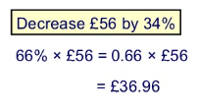
DNA
Make a statement / ask a question

Slide 32
Understanding Percentages greater than 100%
23.9.20
Unit 4M

Slide 33
Prior learning:
Place value.
Percentage as an amount out of 100.
Multiplication and division.
Ordering integers on a number line.
Unit 5 - Fractions, Decimals
and Percentages
Shading fractions of diagrams, equivalence and simplification of fractions.
57-59,61
Convert between improper fractions and mixed numbers.
63-64
65-66,
67-70
Four operations with mixed and improper fractions.
60
Order fractions.
Find fractions of an amount.
77
Calculate a percentage of an amount and percentage change.
84-90
73-76,
82-83
Convert between fractions, decimals and percentages and compare them.
Calculate simple and compound interest.
93-94
Next steps:
Calculating proportions of pie charts.
Using multipliers.
Reverse percentages.
Reverse fractions.

Slide 34
Progress Indicators:
Good Progress: Pupils can find the Percentage of an amount by using Fractions and Decimals
Outstanding Progress: Pupils can use Multipliers with a Calculator to solve percentage Increase and Decrease.

Slide 35
Percentage Increase
The value of Frank’s house has gone up by 20% in the last year. If the house was worth £150 000 1 year ago, how much is it worth now?
Find the result in a single calculation.
The original amount is 100%:
100%
20%
Now we add 20%
We now have 120%
Notes:
Remind pupils that 100% of the original amount is like one times the original amount: it remains unchanged. 100% means ‘all of it’.
When we add on 20% we are adding on 20% to the original amount, 100%, to make 120% of the original amount.
Ask pupils why might it be better to find 120% than to find 20% and add it on.
Establish that it’s quicker because we can do the calculation in one step.
Discuss how 120% can be written as a decimal.

Slide 36
120%
=
120
=
1.20
100
So multiply by 1.2

Slide 37
So……………..
120% of £150 000 = 1.2 × £150 000
So house is worth= £180 000

Slide 38
Percentage increase | Multiplier for percentage increase
Remember:
If you have the Casio FX-83GT plus you can use the % button instead of a decimal multiplier
10%
1.1
25%
1.25
17%
1.17
1%
1.01
5%
1.05
33.5%
1.335
7%
1.07
24.3%
1.243

Slide 39
Percentage increase
Here are some more examples using this method
Increase £50 by 60%.
160% × £50 OR
1.6 × £50
= £80
Increase £86 by 7%.
107% × £86 OR
1.07 × £86
= £92.02
Notes:
Talk through each example as it appears. Explain the significance of finding a 17.5% increase in relation to VAT.

Slide 40
Try these
Increase £66 by 22%
Increase £134 by 36%
Increase £246 by 150%
*Challenge
Jack had lunch in a restaurant. The food he ordered cost £56. He also had to pay 4% service charge. How much was the total cost of his meal?

Slide 41
Percentage Decrease
A CD walkman originally costing £75 is reduced by 30% in a sale. What is the sale price?
The original amount is 100% like this:
70%
100%
30%
Now we subtract 30%
We now have 70% of the original amount.
Notes:
Remind pupils again that 100% of the original amount is like one times the original amount, it remains unchanged. 100% is ‘all of it’.
Explain that when we subtract 30% we are subtracting 30% from the original amount, 100%, to make 70% of the original amount.
Ask pupils why might it be better to find 70% than to find 30% and take it away.
Again, establish that it’s quicker. We can do the calculation in one step.
Discuss how 70% can be written as a decimal.
Conclude that to decrease an amount by 30% we multiply it by 0.7.
Give more verbal examples as necessary.

Slide 42
70%
=
70
=
0.70
100
So multiply by 0.7

Slide 43
So……………..
70% of £75 = 0.7 × £75
So sale price is = £52.50

Slide 44
Percentage decrease | Multiplier for percentage increase
Remember:
If you have the Casio FX-83GT plus you can use the % button instead of a decimal multiplier
10%
0.9
25%
0.75
17%
0.83
1%
0.99
5%
0.95
33.5%
0.665
7%
0.93
24%
0.76

Slide 45
Percentage Decrease
Here are some more examples using this method:
Decrease £65 by 20%.
80% × £65 OR
0.8 × £65
= £52
Decrease £320 by 3%.
97% × £320 OR
0.97× £320
= £310.40
Notes:
Talk through each example as it appears. Pupils should be able to confidently subtract any given amount from 100 in their heads.

Slide 46
Try these
Decrease £34 by 25%
Decrease £120 by 8%
Decrease £46 by 18%
*Challenge
In a sale a DVD player that originally cost £130 was reduced by 20%. John bought the DVD player at the sale price – how much did he pay?

Slide 47
Holidays ☺
I need some help to book my summer holiday.
There are four possible destinations to choose from but I want to find the cheapest deal.
I want to go away for 2 weeks. The holiday is for 2 adults and 2 children.
In pairs/fours work out the cost of each holiday and decide which is the best value.

Slide 48
*Table Challenge
What is the best holiday for 2 adults and 2 children for 2 weeks?
Thailand
Adult Price: £455 per week.
Child Price: 32% off adult price.
Special Offer
2nd week: 35% off the price of the first week.
New York
Adult Price: £520 per week.
Child Price: 55% off adult price.
Special Offer
2nd week: 30% off the price of the first week.
Hawaii
Adult Price: £687 per week.
Child Price: 15% off adult price.
Special Offer
2nd week: Free.
Australia
Adult Price: £805 per week.
Child Price: 84% off adult price.
Special Offer
2nd week: 65% off the price of the first week.

Slide 49
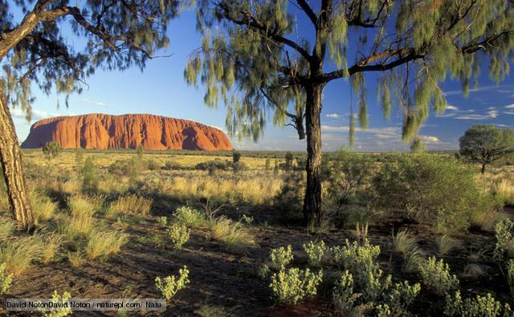
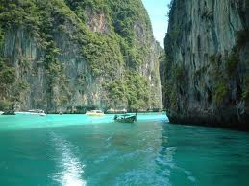
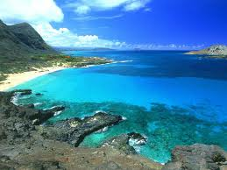
Which holiday?
Thailand - £2522.52
New York - £2563.60
Hawaii - £2541.90
Australia - £2521.26
Cheapest holiday is Australia at £2521.26 for 2 adults and 2 children for 2 weeks.

Slide 50
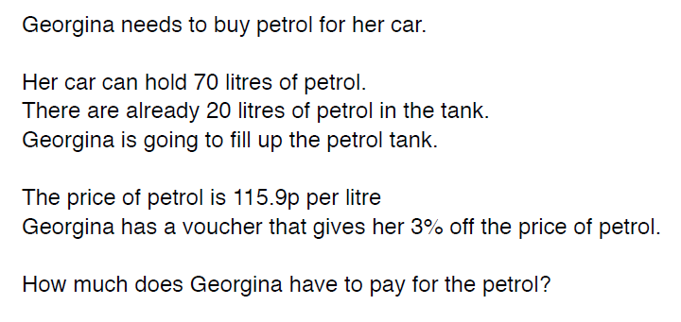
Demonstrate

Slide 51
Connect
Calculate 7% of 340 Calculate 83% of 9000 Calculate 3.5% of 140g | Find 18.2% of £25,000 b) Oliverʼs salary is £18,000 and he is due to get an increase of 4%. How much will this increase be? | Joanne sees this special offer in a shop. Joanne buys both items. How much discount does she get? *How much does she pay?

