Slide 1
Name three digestive enzymes. | 2. Name an organ where all three enzymes are produced.
3. Which organ produces bile and where is it stored? | 4. Where is food absorbed into the bloodstream?
Amylase
Protease
Lipids
Pancreas
Liver produces bile
Bile is stored in the gall bladder
Small intestines

Slide 2
BACTERIA AND ENZYMES IN DIGESTION
GOOD PROGRESS
Describe the role of bacteria in digestion
Describe the role of enzymes in digestion
Describe the adaptations of the small intestine
OUTSTANDING PROGRESS
Explain how peristalsis helps digestion
WORD CONSCIOUSNESS
Soluble – able to be dissolved
Insoluble – incapable of being dissolved

Slide 3
context
LAST LESSON
FOOD TESTS REQUIRED PRACTICAL
THIS LESSON
DIGESTION
NEXT LESSON
ENZYMES REQUIRED PRACTICAL
WHY ARE WE STUDYING DIGESTION?
Digestion is the process that turns chunks of food into small sugars, amino acids, fatty acids and nucleotide components. These small molecules are used by all the cells in the body to make new proteins, nucleic acids, fats, sugars and hence the energy needed to run all the activities of the cell. Digestive enzymes are crucial for breaking down food, so it can be absorbed by the body. Once food is broken down into smaller molecules that can be absorbed into the bloodstream, the nutrients can be distributed to all the cells in the body and used to fuel all the cells’ activities.

Slide 4
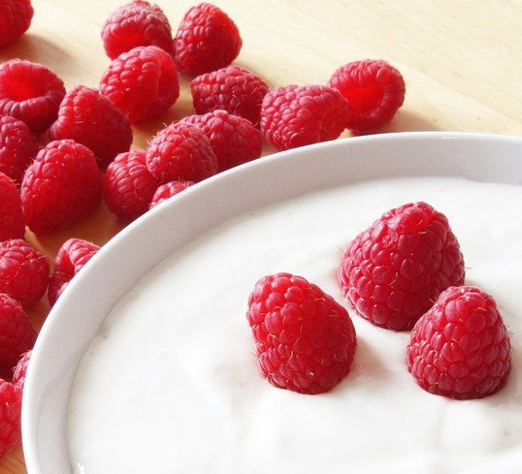
Bacteria in digestion
You are encouraged to eat foods such a probiotic yoghurt, because it contains bacteria which is good for your digestive system.
You have millions of bacterial cells which live in your gut, these are known as ‘good’ bacteria because they release certain vitamins which can then be absorbed by your body.
One example is vitamin K, which is needed to help heal wounds.

Slide 5
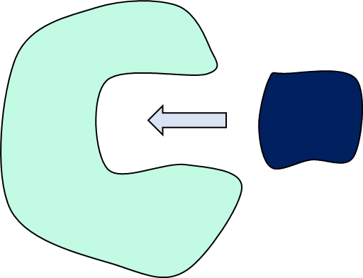
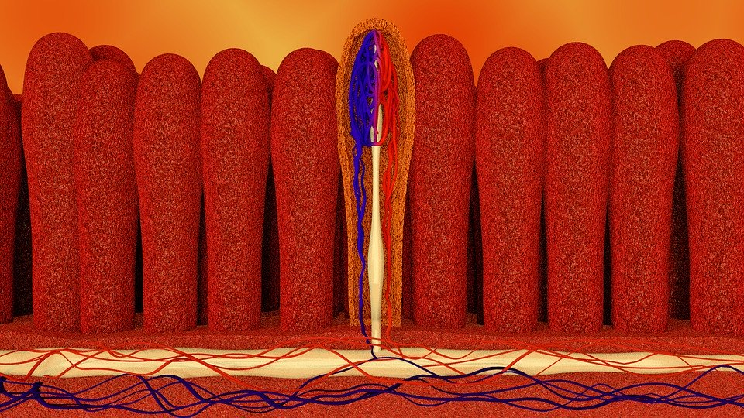
Task: Watch the video and answer the following questions:
https://www.youtube.com/watch?v=32gNePkj1_4
What is the main purpose of digestion?
What are enzymes?
Why are they needed during digestion?
What are the three food groups that enzymes work on?
What is peristalsis?
What are some of the adaptations of the small intestine that speed up digestion?

Slide 6

Self-assessment:
The purpose of digestion is break down large food molecules into small, soluble molecules that can be absorbed by the blood.
Enzymes are biological catalysts.
Enzymes are needed to speed up a reaction or the break down of a substance. In digestion they speed up the break down of large food molecules in the mouth, stomach and small intestine.
The three main food groups that are digested are carbohydrates, proteins and fats.
Peristalsis is the movement of food along the digestive tract by contractions of muscles in the lining of the organs
The small intestine has Villi which increases the surface area, a thin layer of cells and very good blood supply which allows for quick absorption of food molecules.

Slide 7
ACTIVITY - Put the chemicals into the correct space on the Venn diagram.

Slide 8
ANSWERS
Enzymes
amylase
lipase
protease
pepsin
reductase
ligase
Not enzymes
glucose
pyruvate
maltose
glycerol
lactose

Slide 9
Digestive Enzyme | Where released? | Breakdown what?
Amylase | Salivary glands and pancreas | Carbohydrates into simple sugars
Protease | Stomach and pancreas | Proteins into amino acids
Lipase | Pancreas | Fats and oils (lipids) into fatty acids and glycerol
Notes:
http://www.bbc.co.uk/education/clips/z6nwmp3
Activity
http://www.bbc.co.uk/education/guides/zwqycdm/activity

Slide 10
Copy and complete the table using the boxes at the bottom.
Digestive Enzyme | Where released? | Substrate | Product
Amylase
Protease
Lipase
Glycerol
Lipids
Protein
Fatty acids
Amino acids
Salivary glands and pancreas
Stomach and pancreas
Stomach and pancreas
Carbohydrate
Simple sugars

Slide 11
ACTIVITY
What does each enzyme do? Complete the sentences about specific enzymes.
Lipase breaks down lipids (fats) to form fatty acids and glycerol.
b. Amylase breaks down starch to form maltose or simple sugars .
c. Protease breaks down proteins to form amino acids.

Slide 12
Exam-style question
Complete the following sentences using the key words:
amino acids, fats, proteins, starch, fatty acids, sugar
Amylase speeds up the digestion of ____________. The product of this digestion is ____________. Protease speeds the up the digestion of ____________, the product of this digestion is _____________. (4 marks)
Why is it important that molecules of starch, protein & fat be digested? (2 marks)
What do we call substances, such as protease, which speed up chemical reactions? (1 mark)

Slide 13
Self-assessment:
Complete the following sentences using the key words:
amino acids, fats, proteins, starch, fatty acids, sugar
Amylase speeds up the digestion of starch. The product of this digestion is sugar. Protease speeds the up the digestion of proteins, the product of this digestion is amino acids. (4 marks)
So they are broken down into small soluble molecules which can be absorbed into the blood stream more readily (2 marks)
Biological catalysts/enzymes (1 mark)

Slide 14
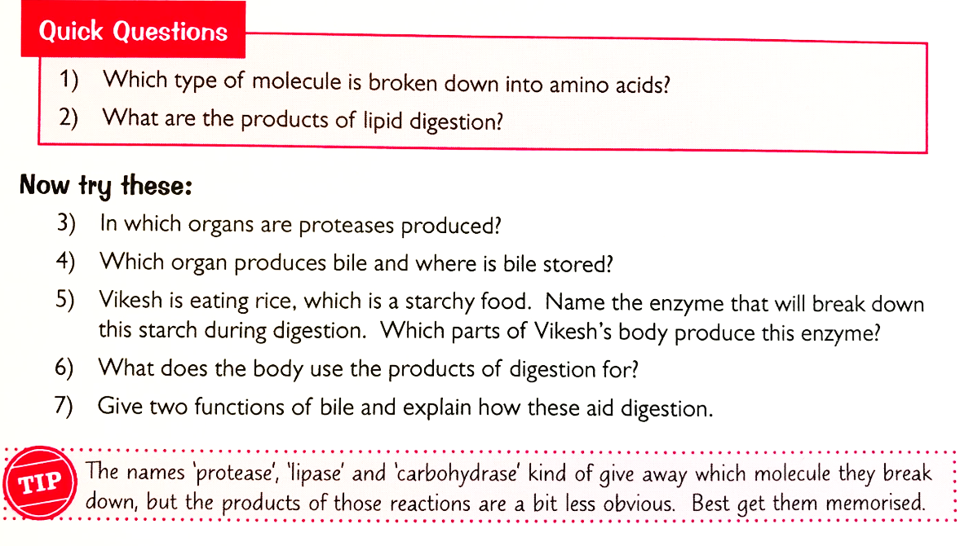
HOMEWORK

