Slide 1
Atom Economy
DNA:

Slide 3
Progress indicators
Good progress:
State what is meant by atom economy
Calculate the atom economy of a reaction
Outstanding progress:
-Explain why atom economy is important to industrial processes

Slide 4
Task: Watch the video and answer the following question:
What is atom economy?
What is the calculation for atom economy?
What would the atom economy be for a reaction where only one product forms.
What is the atom economy for the second example question?
Why is it important that industries work towards the most efficient industrial processes?
Efficient processes conserve more _______ ________ and produce _____ ________.
https://www.youtube.com/watch?v=Zuyk4hfbjSA

Slide 5
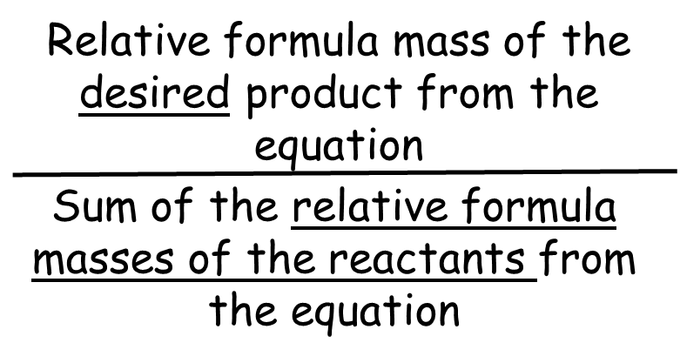
Self-assessment:
Atom economy tell us the amount of product that was useful as a percentage of all the products formed.
Percentage atom economy =
The atom economy would be 100% if only one product formed.
Atom economy for the second example question would be 29.5%
It is important to ensure high atom economy as this ensures sustainable development.
Efficient processes conserve more natural resources and produce less waste.
x 100%

Slide 6
Worked example:
The following shows a reaction for making hydrogen from methane:
CH₄ + H₂O → CO + 3H₂
Calculate the atom economy for making hydrogen in this reaction
Remember:
The first thing to figure out is what is the desired product?
Next, calculate the M_{r} of the desired product and of each of the reactants (for this calculation you multiply the M_{r} by the no. of moles)
Then, calculate the atom economy using the equation

Slide 7
CH₄ + H₂O → CO + 3H₂
The desired product is hydrogen
Mr of desired product = 2, multiplied by number of moles = 2 x 3 = 6
Mr of reactants =
- CH4 = 12 + (4 x 1) = 16
- H2O = (1 x 2) + 16 = 18
- Total = 16 + 18 = 34
Atom economy = 6 / 34 = 0.18 x 100 = 18%

Slide 8
Task: Using the worked example, write down a step-by-step checklist of tasks you will need to complete in order to calculate atom economy of a reaction

Slide 9
To work you atom economy you must:
Write out the balanced symbol equation if it has not been provided for you
Decide what the desired product is
Calculate the M_{r} of the desired product
Calculate the M_{r} of each of the reactants
Add together so that you have the total M_{r} of all of the reactants
Calculate the atom economy by dividing the relative formula mass of the desired product by the sum of the relative formula mass of the reactants, then multiplying by 100%.

Slide 10
Task: Complete the questions on atom economy

Slide 11
Self-assessment:
What is the atom economy of extracting iron from its ore?
Fe₂O₂ + 3CO → 2Fe + 3CO₂
Desired product: Fe
Mr of 2Fe = 56 x 2 = 112
Mr of reactants:
- Fe₂O₂ = 144
- 3CO = 84
- Total = 144 + 84 = 228
4. Atom economy = 112 / 228 x 100 = 0.49 x 100 = 49%

Slide 12
Calculate the atom economy for the production of copper sulphate:
CuO + H₂SO₄ → CuSO₄ + H₂O
Desired product: CuSO₄
Mr of CuSO₄: 160
Mr of reactants:
- CuO = 80
- H₂SO₄ = 98
- Total = 80 = 98 = 178
4. Atom economy = 160 / 178 x 100 = 0.90 x 100 = 90%

Slide 13
3. Calculate the atom economy for the production of ammonia from the thermal decomposition of ammonium sulphate:
(NH₄)₂SO₄ → H₂SO₄ + 2NH₃
Desired product: H₂SO₄
Mr of H₂SO₄ : 98
Mr of reactants:
- (NH₄)₂SO₄ = 132
4. Atom economy = 98 / 132 x 100 = 0.74 x 100 = 74%

Slide 14
Calculate the atom economy for the thermal decomposition of calcium carbonate
Write out the balanced symbol equation –
CaCO₃ → CaO + CO₂
2. Desired product: CaO
3. Mr of desired product 56
4. Mr of reactants:
- CaCO₃ = 100
5. Atom economy = 56 / 100 x 100 = 0.56 x 100 = 56%

Slide 15
Calculate the atom economy for the production of
magnesium chloride during the reaction between magnesium and hydrochloric acid.
Write out the balanced symbol equation –
Mg + 2HCl → MgCl₂ + H₂
2. Desired product: MgCl₂
3. Mr of desired product: 95
4. Mr of reactants:
- Mg = 24
- 2HCl = 36.5 x 2 = 73
- Total = 97
5. Atom economy = 95 / 97 x 100 = 0.98 x 100 = 98%

Slide 16
Sodium nitrate decomposes on heating to produce sodium nitrite and oxygen gas. What is the atom economy of this reaction?
Write out the balanced symbol equation:
NaNO₃ → NaNO₂ + O₂
Desired product: NaNO₂
Mr of desired product: 69
Mr of reactants:
- NaNO3 = 85
5. Atom economy = 69 / 85 = 0.81 x 100 = 81%

Slide 17
Exam-style question
Titanium can be extracted from its ore by two different methods.
One uses a more reactive metal to displace the titanium:
TiO₂ + 2Mg → Ti + 2MgO
The second method is electrolysis of the ore. The overall reaction for this method is:
TiO₂ → Ti + O₂
Calculate the atom economy for each reaction. (4)
b) Which method could be described as more sustainable? Explain your answer.
(2)
c) Oxygen is a useful product and can be sold. What is the atom economy of the electrolysis if the oxygen is collected and sold? (2)

Slide 18
Mark Scheme
First reaction Second reaction
Mr of desired product: 48 Mr of desired product: 48
Mr of reactants: Mr of reactants:
- TiO₂ = 80 - TiO₂ = 80
- 2Mg = 48 Atom economy = 48/80
- Total = 128 = 0.6 x 100
Atom economy = 48/128 = 60%
= 0.375 x 100
= 37.5% (4)
b) The second reaction has a higher atom economy which means that the chemical reaction produces less waste which means that the process is more sustainable as it will conserve more natural resources and also save the industry more money. (2)
c) Mr of oxygen = 32
Mr of reactants = TiO₂ = 80
Atom economy = 32 / 80 = 0.40 x 100
= 40%
Atom economy of titanium = 60%, therefore 40% + 60% = overall 100% (2)

Slide 19
Task: Come up with 5 exam-style questions on the topic of atom economy. Make sure you include a range of questions and provide a mark scheme for each one.

Slide 20
Plenary ~ Complete one of the following sentences in your book:
Today I have learnt that …
One thing I must remember from today’s lesson is…
I still don’t understand ….
Before this lesson I already knew how to …

Slide 21
