Slide 1
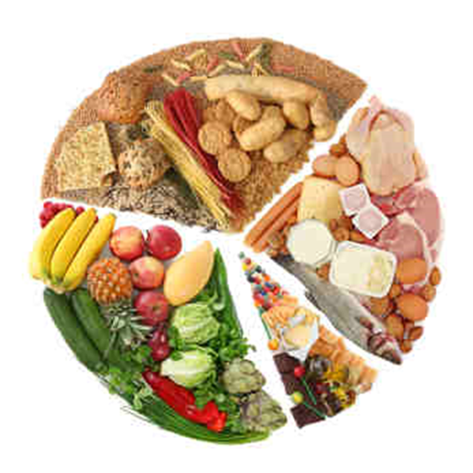
Tuesday 21st January 2020
LO1 Know about the nutrients needed for a healthy, balanced diet
DO NOW: write your own definition of a balanced diet.
Good Progress | Outstanding Progress
Identify some characteristics of a balanced diet. | Describe in detail the characteristics of a balanced diet.
Identify what nutrients are briefly describing some. | Comprehensively describes what nutrients are and their role within a healthy balanced diet

Slide 2
Quality of Work
MB1 1-3 Marks Identifies some of the characteristics of a balanced diet. Provides a limited description of what nutrients are and their role within a healthy balanced diet, giving a limited range of examples of food sources of nutrients. | MB2 4-6 Marks Briefly describes most of the characteristics of a balanced diet. Describes in detail what nutrients are and their role within a healthy balanced diet, giving a range of examples of food sources of nutrients. | MB3 7-9 Marks Describes in detail all of the characteristics of a balanced diet. Comprehensively describes what nutrients are and their role within a healthy balanced diet, giving a wide range of examples of food sources of nutrients.

Slide 3
LO1 Know about the nutrients needed for a healthy, balanced diet
Balanced Diet
Nutrients
Nutrients and their roles
Food sources of nutrients
Sub-headings

Slide 4
Balanced Diet
Nutrients

Slide 5
Nutrients and their roles
Food sources of nutrients

Slide 6
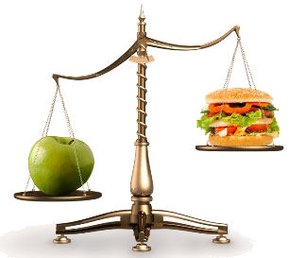
Balanced Diet
= A diet which contains an optimal ration of nutrients
Eating a healthy, balanced diet is an important part of maintaining good health, and can help you feel your best.
Consider:
Would this diet be the same for all of us? Think about age, gender, amount of exercise – give an example of each
For a balanced diet, calories in = calories out
Those more active need more calories. Excess calories = weight gain, too few calories = weight loss

Slide 7
Individual requirements:
A teenager will need more calories each day, compared to a 60 year old. Boys need around 2,800 calories a day compared to girls 2,200 calories. Teenagers need higher intake of calcium to support bone growth. Iron is also important males need it as they start to gain lean body mass and girls when they start their monthly period. A 60 year old will need fewer calories between 1,600 and 2000 depending on their activity levels. Elderly also need calcium as their body stores reduce with age extra serves of low fat milk, yogurt and cheese will help them avoid osteoporosis.
Compare a teenager to a 60 year old
Men compared to women
Active individual compared to a person who is sedentary.
Allergies/intolerances
Some religious beliefs restrict specific food types for example the Jewish & Islamic society do not eat pork so they would get this protein source from other food types.

Slide 8
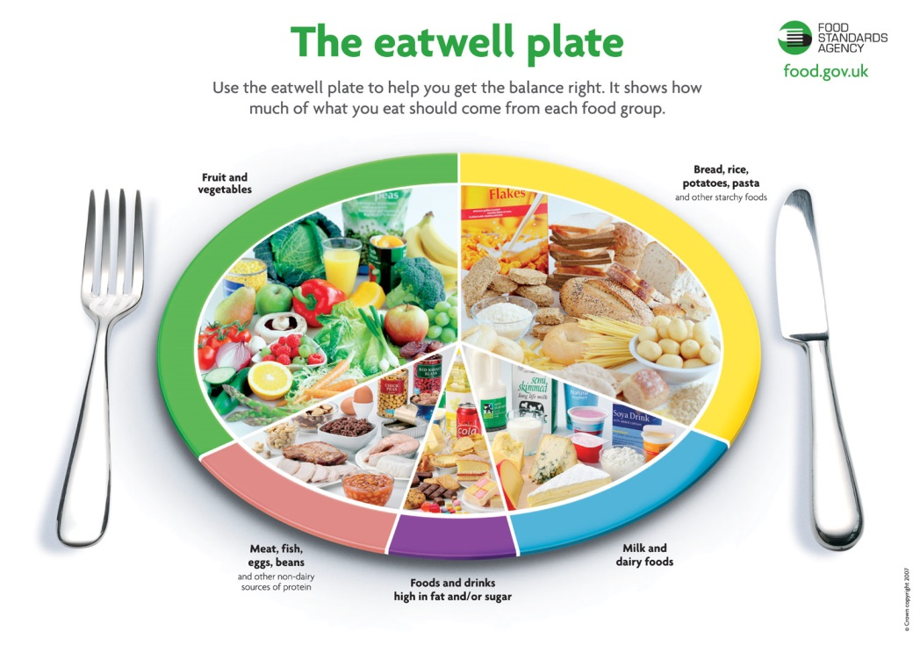
Balanced Diet
You need to at least discuss each of these points in 1 or 2 sentences
Characteristics of a balanced diet:
Meets the nutritional requirements of the individual
Includes foods from all food groups – including the recommended 5 per day
Contains a variety of foods – on a day-day/ weekly basis
Consuming the right amount of food and drink to achieve and maintain a healthy body weight
Suits the needs / tastes of the individual (including taking into account allergies / food intolerance) – include examples
You’ve 15 minutes to explain the 5 points opposite MB3 Comprehensively describes.

Slide 9
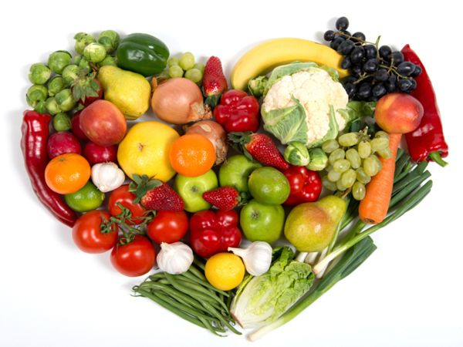
Nutrients
Aspects to cover…
Definition of a nutrient/ nutrients
Groupings/ categories: Macro & micronutrients
What the 7 nutrients are – in the form of a list

Slide 10
Definitions
With your face partner, discuss what you think is the meaning of the two words below…
Macro
Nutrients
Micro
Nutrients

Slide 11
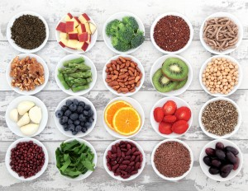
Key Definition
Macro – Large
Micro – Small
Nutrient – a substance that provides nourishment / Chemicals a living organism needs to live and to grow
Macronutrients:
‘The nutrients that we need to have in our diet in large quantities’
Micronutrients:
‘The nutrients that we need to have in our diet in small quantities’

Slide 12
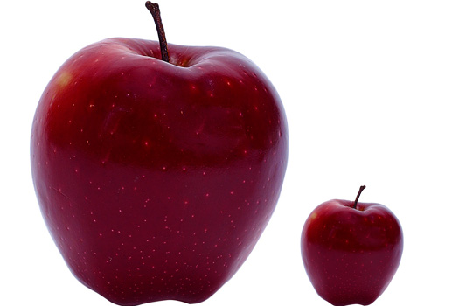
Groupings…
Macronutrients:
Carbohydrates, Proteins, Fats
Micronutrients:
Vitamins, Minerals, Fibre and Water

Slide 13
Role of nutrients
For example a marathon runner would need carbohydrates to maintain performance and energy during a race.
A footballer would need a high level of protein to recover after a football match and make sure he does not have sore muscles.
A triathlete would need to eat vitamins and minerals so they could train consistently over time and not get sick and ruin their training.
Carbohydrates – Energy
Fats – Energy (fast use)
Proteins – Recovery
Fibre – Healthy digestive system
Water - Hydration
Vitamins & minerals – Healthy immune system & cell replenish
Link each one to at least two sporting examples

Slide 14
Nutrients and their roles
Carbohydrates: ...
Fats: …
Proteins: …
Water: …
Fibre: …
Vitamins: …
Minerals: …

Slide 15
Do now: what are the differences between macro and micro nutrients?
TUESDAY 28TH JANUARY 2020
Nutrients And Their Roles
MB2
MB3

Slide 16
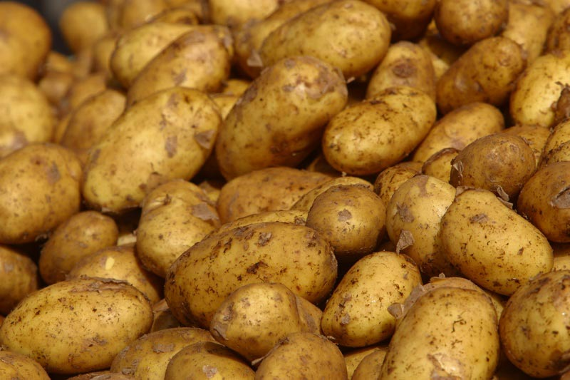
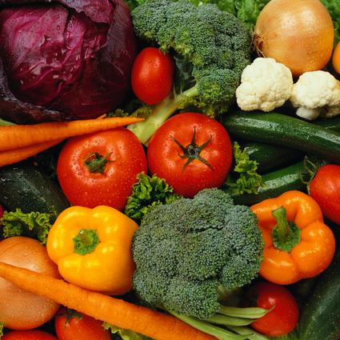
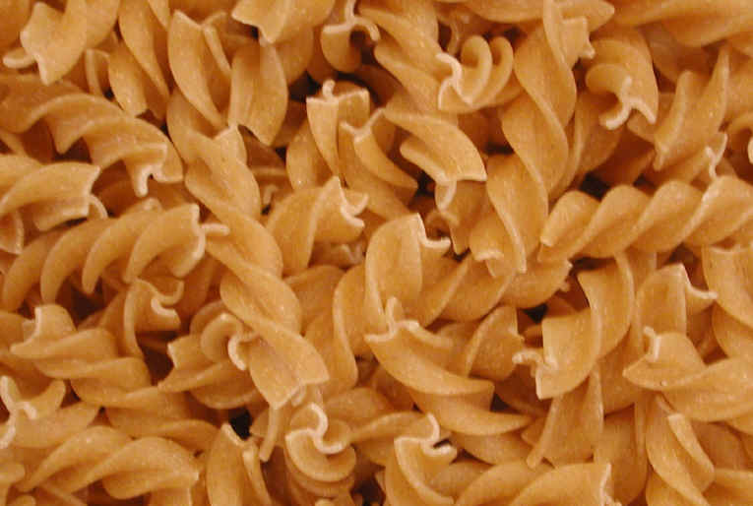
Carbohydrates
Most of our energy should come from carbohydrates
Two types: complex and simple
Stored in the muscles and the liver as glycogen
During exercise, glycogen is converted to glucose and used as energy

Slide 17
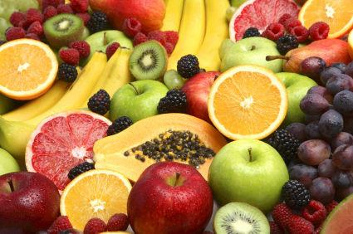
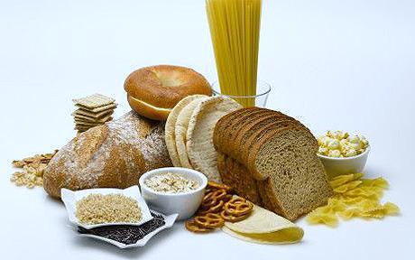
Carbohydrates
Complex –
Otherwise known as starch; provide us with energy
Examples: rice, pasta, bread
Simple –
Otherwise known as our sugars (natural vs refined)
Natural – fruit / vegetables
Refined – cakes / biscuits

Slide 18
Carbohydrates
1– how quickly these are broken down – is energy provided instantly or over time?
3 – which are better for you in terms of sport/ general population – simple or complex

Slide 19
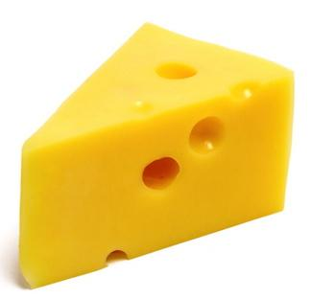
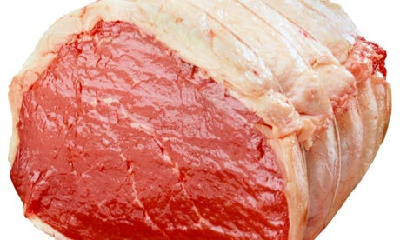
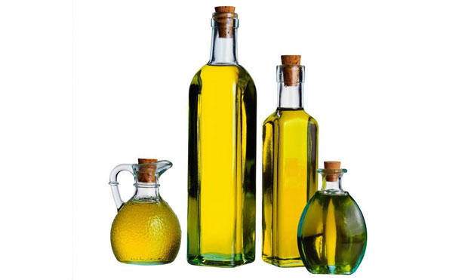
Fats
Fats also provide us with energy – to harvest this energy, it is recommended to exercise over long periods at low intensity
Must only be eaten in moderation – as they can lead to us gaining weight
Fats help the body to absorb vitamins A, D and E
Sources include: milk, cheese, butter, margarine, fatty meats, chocolate, and cooking oils

Slide 20
Fats
Note:
A gram of fat, provides 9kcal (37kJ) of energy compared with 4kcal (17kJ) for carbohydrate and protein
Other aspects you ‘could’ discuss…
Saturated vs Unsaturated Fats
Recommended percentages of each and total percentage in a balanced diet

Slide 21
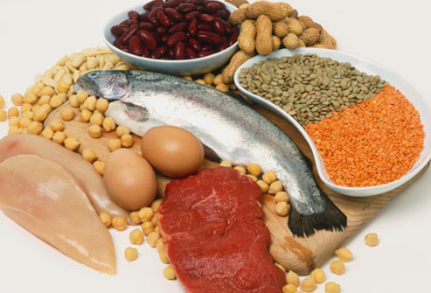
Proteins
Types:
Animal protein- e.g. milk, cheese, meat, eggs
Plant protein – e.g. nuts, beans
Three functions:
Growth of muscles – otherwise known as muscle hypertrophy
2. Repair – damaged tissues / muscles
3. Provide us with energy during extended periods of exercise when our carbohydrate sources have depleted

Slide 22
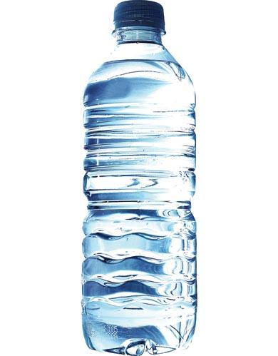
Water
Water holds oxygen and is the main component of many cells
Transports nutrients, waste and hormones around the body
Essential in the control of body temperature
During exercise, the body sweats, so water needs to be taken in for replenishment
Prevents dehydration
Recommended intake…
6-8 cups/ glasses or approximately 2 Litres (per day)

Slide 23
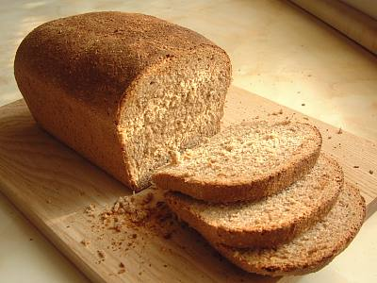
Fibre
Two types:
Insoluble – adds bulk to our food helping it to keep moving through the digestive system/ gut, preventing constipation. Sources include: wholegrain cereals and breads
Soluble – helps to reduce cholesterol, keeping the heart healthy. Sources include fruit and vegetables

Slide 24
Know about the nutrients needed for a healthy, balanced diet
Characteristics of a balanced diet, i.e.
meets the nutritional requirements of an individual
includes foods from all of the food groups (e.g. meat and dairy, fruit and vegetables, fats and sugars)
contains a variety of foods
suits the needs/tastes of the individual (e.g. accounting for allergies/intolerance to some ingredients)
what nutrients are (e.g. chemicals a living organism needs in order to live and grow) (you need a definition)
The role of nutrients in a healthy, balanced diet, i.e.
carbohydrates (e.g. quick supply of energy) MB3:Comprehensively describe what
fats (e.g. slower supply of energy, transport some vitamins around the body) these are giving at least 8 food examples
proteins (e.g. repair muscle damage)
fibre (e.g. helps maintain healthy bowels)
water (e.g. keeps the body hydrated)
vitamins and minerals (e.g. help strengthen bones, maintain a healthy immune system)
Food sources of nutrients, i.e.
carbohydrates (e.g. pasta, potatoes)
fats (e.g. dairy products, fish)
proteins (e.g. meat, pulses)
fibre (e.g. cereals, wholemeal bread)
Vitamins and minerals (e.g. fresh fruit and vegetables).
MB3: describes in detail (give sporting examples to why these are important/needed.

Slide 25
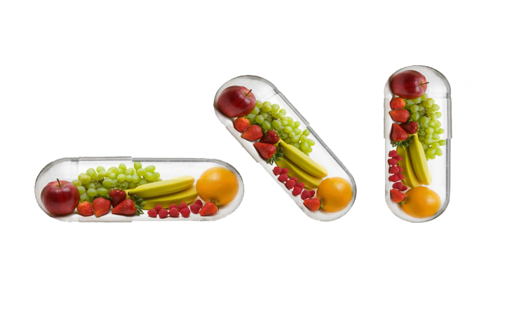
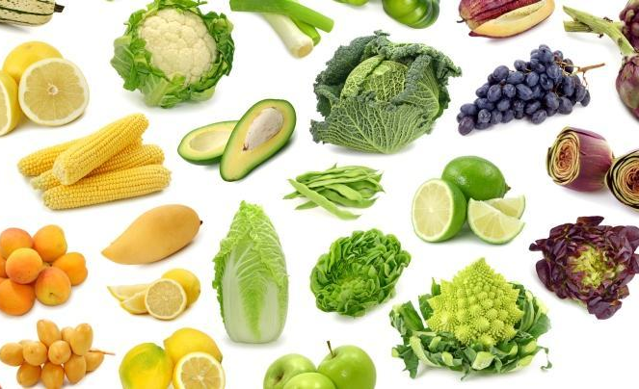
Vitamins / Minerals
It is important to remember that most of us will actually get our recommended daily doses of vitamins and minerals through our diet – if it is balanced, varied and contains the right amount/ percentages
You are able to boost or add to your vitamin & mineral levels through supplementation (tablets/ pills)
Excess levels will be stored for the body to re-use as and when necessary

Slide 26
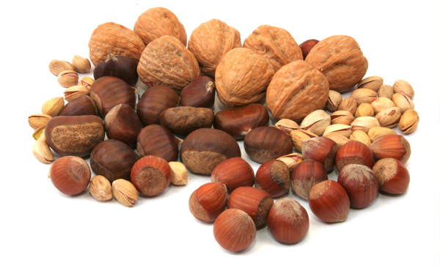
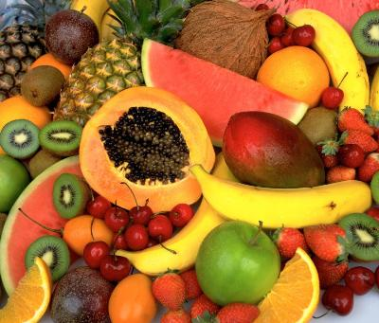
Vitamins
Vitamins are compounds which are necessary for our normal growth and function, which we cannot make within our bodies, and so we must obtain them from our foods
Macronutrient → essential in our diet, but only needed in small amounts
Many different types such as…A, E, D and K and can either be ‘water soluble’ or ‘fat soluble’
Can be found in many different foods such as: fruit, meat, cereals, nuts, and oils

Slide 27
Fat Soluble
Vitamin E
This helps to maintain healthy skin, eyes and strengthens the immune system.
Richest sources are plant oils (soya, corn and olive oil). Other sources include: nuts and seeds, cereals…
4mg a day for men, 3mg a day for women
Vitamin K
Needed for blood clotting (healing of wounds)
Found in: Green leafy vegetables – such as: broccoli…
Adults need approximately 0.001mg a day of vitamin K for each kilogram of their body weight. (e.g. 65kg = 0.065mg per day – give your own example)
Vitamin D
Needed to keep bones, teeth and muscles healthy → lack of it lead to bone deformities in children, and bone pain and tenderness in adults
Good sources of vitamin D include: Oily fish – such as salmon, sardines, herring and mackerel, Red meat
Vitamin A
Helping your immune system to work as it should against infections
0.7mg (men) and 0.6mg a day (women)
Good sources of vitamin A include: Cheese, Eggs, Oily fish, Milk and Yoghurt
Fat Soluble – not easily excreted from the body, stored for some time

Slide 28
Water Soluble
Vitamin C
Vitamin C helps to hold your body's cells together, aids with the healing process, helps with tooth and bone development, strengthens the walls of your blood vessels, improves iron absorption
Vitamin C also acts as an antioxidant, and may decrease the risk of heart disease and some cancers.
The best sources of vitamin C are citrus fruits including grapefruits, oranges and kiwis. Red and green peppers are also healthy sources of vitamin C.
Vitamin B complex (B1, B2, B3, B5, B6, B7, B9, B12)
Essential for converting the food we eat into fuel that we can use
B6 (Pyridoxine): Helps the body turn food into energy. Vitamin B6 also helps the body fight infection.
B7 (Biotin): Involved in the production of hormones.
B9 (Folic acid): This B vitamin helps cells make and maintain DNA and promotes the growth of red blood cells. It also helps to reduce the risk of birth defects.
B12 (Cobalamin): Vitamin B12 helps regulate the nervous system and plays a role in red blood cell formation.
Vitamin B complex (B1, B2, B3, B5, B6, B7, B9, B12)
Essential for converting the food we eat into fuel that we can use
B1 (Thiamine): Helps the body make new cells.
B2 (Riboflavin): Important for red blood cell production.
B3 (Niacin): Helps regulate the nervous and digestive systems and aids in the conversion of food into energy.
B5 (Pantothenic acid): Breaks down fats and carbohydrates for energy and is responsible for the production of hormones.
Water Soluble –easily excreted from the body (i.e. urination, sweating, vomiting…)

Slide 29
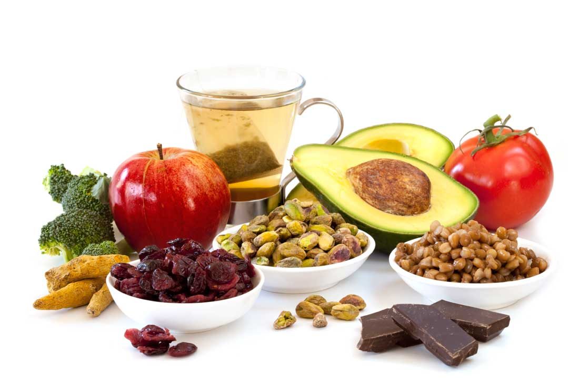
Minerals
Different minerals are required in different amounts but they are all essential. Minerals are grouped depending on how much they are needed on a daily basis
Definition: Minerals are inorganic substances, which occur naturally in non-living things
Benefits: They are important for building strong bones and teeth, blood, skin, hair, nerve function, muscle and for metabolic processes such as those that turn the food we eat into energy.
Needed for the body to work properly, for growth and development, and overall, for maintaining normal health
Sources: Meat, cereals (including cereal products such as bread), fish, milk and dairy foods, vegetables, fruit (especially dried fruit) and nuts
Examples include: Iron and Calcium – two of the most important minerals

Slide 30
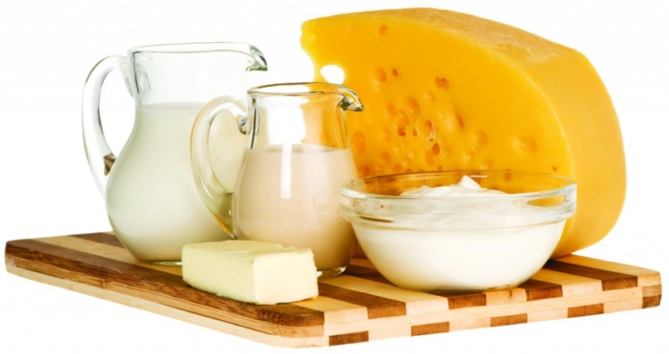
Minerals
Good sources of calcium include: Milk, cheese and other dairy foods, green leafy vegetables – such as broccoli, cabbage, Soya beans, tofu, nuts, fish (where you eat the bones – sardines)
Adults need around 700mg of calcium a day – however, over 1500mg can result in stomach pain/ diarrhoea
Calcium
Important in the formation of bones and teeth, helping to make bones strong
Important for older people as it helps to maintain bone density
Help with the clotting of your blood (healing wounds and preventing infections)
Lack of calcium could result in rickets (children) or osteoporosis (adults)

Slide 31
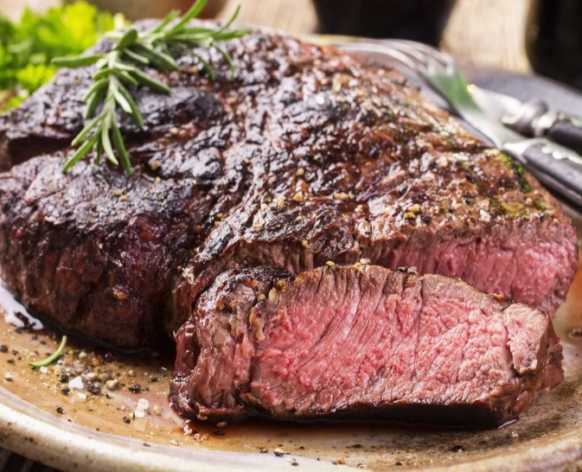
Minerals
Iron
Important in the formation of red blood cells (RBCs) so without iron the blood would not be able to carry oxygen around the body
Lack of iron can lead to anaemia (iron deficiency)
Essential for long distance athletes – who need strong blood supply and significant levels of RBCs
Good sources of iron include:
Liver, Meat (especially red meat), Beans/ Nuts, Dried fruit – such as dried apricots and Whole grains – such as brown rice
How much?
8.7mg a day for men, 14.8mg a day for women
Over 20mg of iron per day can result in: constipation, nausea, vomiting and stomach pain

Slide 32
Food sources of nutrients
For each of the nutrients, you must provide several examples/ food sources (as a minimum, try to think of at least 8-10)
e.g.
Carbohydrates – bread, rice, potatoes…
Proteins – nuts, beans, chicken…

