Slide 1
80/20 – THINK! What do you NEED to cover with your set
Grade | Objective | Outcomes
1-3 | To be able to describe the structure of an atom | Recall the different charges of the particles that make up an atom
 |  | Be able to use the periodic table to identify the number of protons in different elements
4-6
 |  | Explain why atoms have no overall charge
7-9
Specification reference: 5.1.1.4 and 5.1.1.5

Slide 2
Atomic structure
CWK
DO IT NOW – Classify the substances as elements or compounds
ELEMENT
COMPOUND
COMPOUND
ELEMENT
ELEMENT
COMPOUND
Challenge- Can you name any substances the different diagrams could show?

Slide 3
Progress indicators
GOOD PROGRESS:
OUTSTANDING PROGRESS:

Slide 4
Word consciousness
Sub-atomic particle – part of an atom
Neutral – no charge

Slide 5
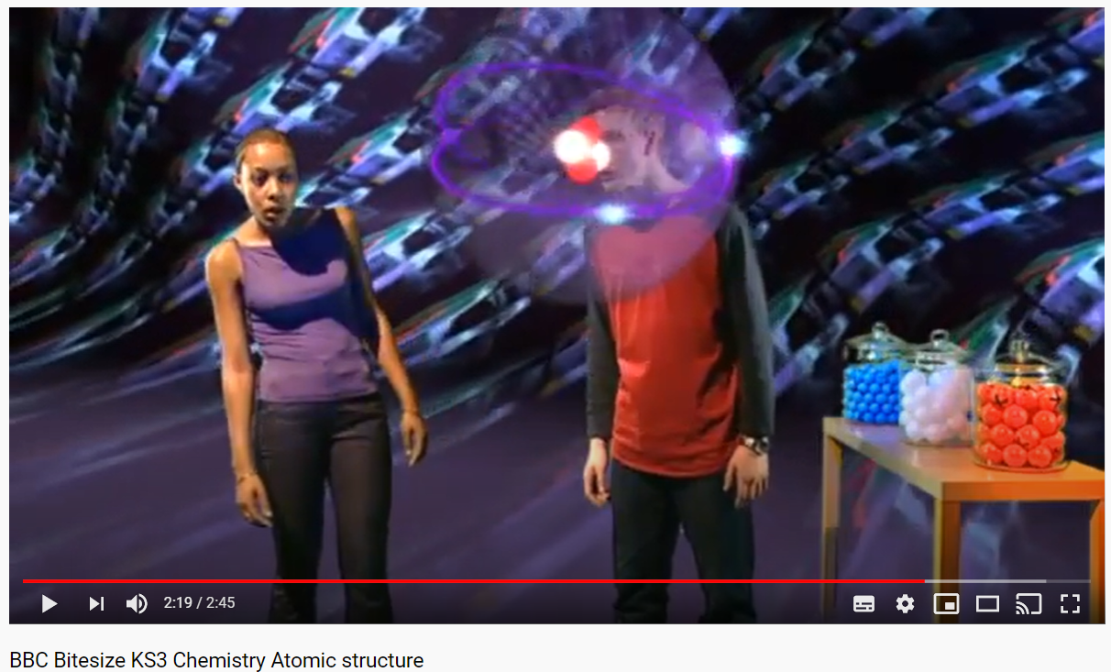
https://www.youtube.com/watch?v=4sl-E_l_1pk
Task – watch the video and when asked to record write down the key information about the 3 parts of the atom
Notes:
Could have pupils draw a blank table before the video so they know what information they are focusing on

Slide 6
Sub-atomic particles
Sub-atomic particle | Location | Charge | Mass
P
E
N
PROTON
NUCLEUS
+1
1
ELECTRON
SHELLS
-1
1/2000
Very small
NEUTRON
NUCLEUS
1
0

Slide 7
Mini-plenary: True or false?
An atom contains four sub-atomic particles
A neutron is positively charged
The nucleus contains protons and neutrons
Electrons are found in the nucleus of an atom
Electrons are negatively charged

Slide 8
True or false?
An atom contains four sub-atomic particles

Slide 9
True or false?
A neutron is positively charged

Slide 10
True or false?
The nucleus contains protons and neutrons

Slide 11
True or false?
Electrons are found in the nucleus of an atom

Slide 12
True or false?
Electrons are negatively charged

Slide 13
How do you calculate protons, electrons and neutrons?
19
F
9
Mass number
Symbol
Atomic number

Slide 14
How many protons?
Mass number
19
F
9
Symbol
Atomic number
24
Mg
12
35.5
Cl
17
39
K
19
65
Zn
30
27
Al
13
12
17
19
30
13
The number of electrons is equal to the number of protons so an atom has no overall charge

Slide 15
How many neutrons?
Number of neutrons = mass number – atomic number
Atom | Mass number | Atomic Number | Number of Neutrons
Helium | 4 | 2
Fluorine | 19 | 9
Lead | 207 | 82
Sodium | 23 | 11
Iodine | 127 | 53
2
10
125
12
74

Slide 17
Write out how many protons, neutrons and electrons for the following.
Element | P | E | N
Sodium | 11 | 11 | 12
Potassium | 19 | 19 | 20
Iron | 26 | 26 | 30
Gold | 79 | 79 | 118
Radon | 86 | 86 | 136
Challenge: Draw an atom diagram to illustrate an oxygen atom
Notes:
Explain that dealing with protons and neutrons is easy because they exist in the nucleus but the electrons are scattered in energy levels.

Slide 18
Calculating atomic and mass number
e.g. An atom has 7 protons, 7 electrons and 7 neutrons, what are the atomic and mass numbers?
Atomic number = number of protons = 7
Mass number = protons and neutrons = 7+7 = 14

Slide 19
Application
Calculate the atomic and mass numbers for:
Atom X has 15 protons, 15 electrons and 16 neutrons.
Atom Y has 45 protons, 45 electrons and 52 neutrons.
Atom Z has 123 protons, 123 electrons and 125 neutrons.

Slide 20
Application
Calculate the atomic and mass numbers for:
Atom X has 15 protons, 15 electrons and 16 neutrons.
Atom Y has 45 protons, 45 electrons and 52 neutrons.
Atom Z has 123 protons, 123 electrons and 125 neutrons.
Atomic number = 15, mass number = 31
Atomic number = 45, mass number = 97
Atomic number = 123, mass number = 248

Slide 21
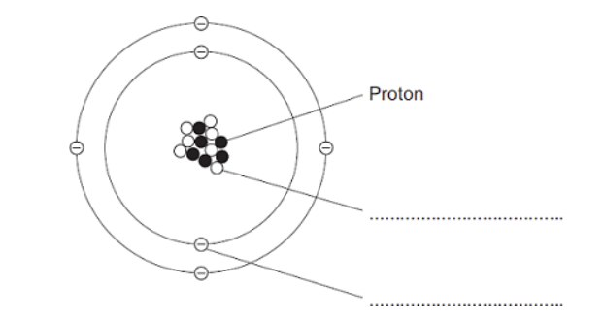
Plenary
Label the sub-atomic particles in the diagram:
A = ________________
B = ________________ (2)
A
B
2. a) Which sub-atomic particle has a positive charge? (1)
b) Which sub-atomic particle is NOT found in the nucleus? (1)
3.Use the periodic table to find the number of protons, neutrons and electrons in:
a) Neon b) Phosphorus (6)

Slide 22
SELF-ASSESS IN RED
Label the sub-atomic particles in the diagram:
A = ________________
B = ________________ (2)
A
Neutron
B
Electron
2. a) Which sub-atomic particle has a positive charge? (1)
b) Which sub-atomic particle is NOT found in the nucleus? (1)
3.Use the periodic table to find the number of protons, neutrons and electrons in:
Neon
Phosphorus (6)
Proton
Electron
P = 10, E = 10 and N = 10
P = 15, E = 15 and N = 16

