Slide 1
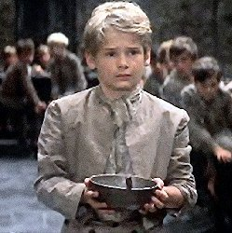
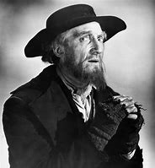
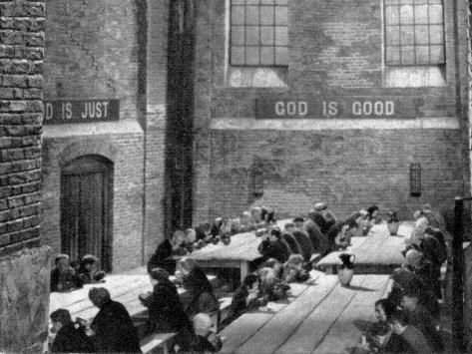
Lesson 15 Oliver
Title: Transactional writing – writing a letter to advise.
Lesson focus: link ideas and planning choices explicitly to a clear sense of task, audience and purpose
Notes:
Learners respond independently

Slide 2
DNA
Answer the following questions;
What was the last piece of advice you gave? How effective was it?
What language devices or word classes would be most effective when giving advice or guidance?

Slide 3
Word Consciousness
New word and DD | Your definition | Synonym
Blasphemed - speak irreverently about God or sacred things.
Incoherent - (of spoken or written language) expressed in an incomprehensible or confusing way; unclear.

Slide 4
Learning Journey
Last lesson we looked Dicken’s presentation of Scrooge and wrote our own description of a villain.
We were able to explain, comment on and analyse the way that Dickens uses language
Today we use our contiguous reading and summary skills for Chapter 14 & 15. Then we are going to use different skills of ‘writing to advise’ and apply to our own letter from Oliver’s character perspective.
Notes:
Learners respond independently

Slide 5
Contiguous read
Now read Chapter 14 & 15
These are pages 86-94 on the copy of the text your teacher has uploaded for you
Notes:
Learners respond independently

Slide 6
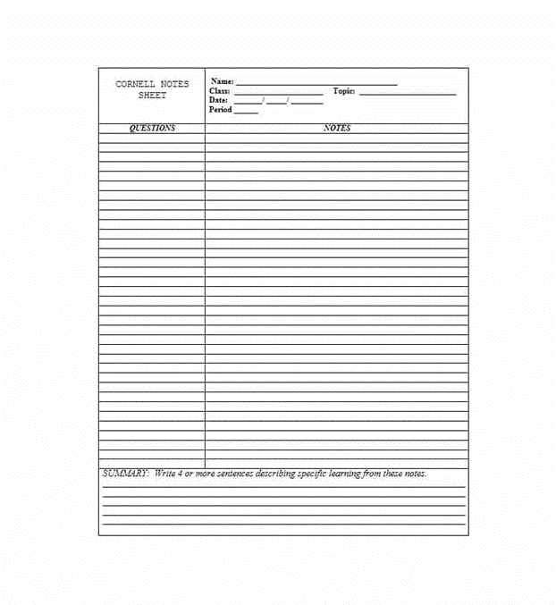
Cornell Notes
Complete the notes summary for Chapter 14 & 15

Slide 7
Chapter 14 summary - When Oliver next enters the housekeeper’s room, he notices that the portrait of the lady whom he resembles is gone. Mrs. Bedwin says that Brownlow removed it because it seemed to worry Oliver. One day, Brownlow sends for Oliver to meet him in his study. Assuming that Brownlow means to send him away, Oliver begs to remain as a servant. Brownlow assures Oliver that he wishes to be Oliver’s friend. He asks Oliver to tell him his history. Before Oliver can begin, Brownlow’s friend, Mr. Grimwig, arrives to visit.
Grimwig, a crotchety old man, hints that Oliver might be a boy of bad habits. Brownlow bears his friend’s eccentricity with good humor. Mrs. Bedwin brings in a parcel of books delivered by the bookstall keeper’s boy. Brownlow wishes to send his payment and some returns back with the boy, but he has already gone. Grimwig suggests that Brownlow send Oliver but hints that Oliver might steal the payment and the books. Wishing to prove Grimwig wrong, Brownlow sends Oliver on the errand. It grows dark and Oliver does not return.
What do you think about the section of the text that is underlined? Can you link this to previous lessons?
Notes:
Learners respond independently

Slide 8
Chapter 15 summary
Oliver takes a wrong turn on the way to the bookstall. Suddenly, Nancy appears. She tells everyone on the street that Oliver is her runaway brother who joined a band of thieves, and that she is taking him back home to their parents. Everyone ignores Oliver’s protests. Bill Sikes runs out of a beer shop, and he and Nancy drag Oliver through the dark backstreets.
What do you think about the section of the text that is underlined? What has happened? How must Oliver be feeling?
Notes:
Learners respond independently

Slide 9
Oliver has been captured by Bill and Nancy Sikes!!! He needs help!
Write the advice you would give Oliver in this situation.
Notes:
Learners respond independently

Slide 10
Big question: How can I confidently write a letter to advise?
TASK: Plan and write a letter to Oliver advising him what to do after being captured by Nancy and Mr Sikes.
Success criteria:
Address
Long date
Formal mode of address
Opening line
Connectives between paragraphs
Formal signing off

Slide 11
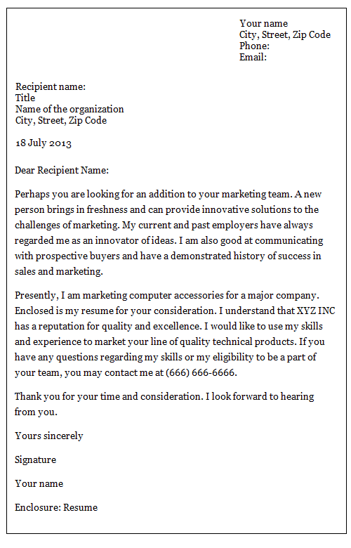
Layout example
Features of a letter:
Address
Long date
Formal mode of address
Opening line
Connectives between paragraphs
Formal signing off

Slide 12
Self assessment
Self assess in green pen, using the success criteria below.
Give yourself a WWW and an EBI.
Success criteria:
Address
Long date
Formal mode of address
Opening line
Connectives between paragraphs
Formal signing off

Slide 13
Plenary
Which words did you use that were most effective and why?
Do you feel the letter advised what to do well?
Is there anything you would change?

