Slide 1
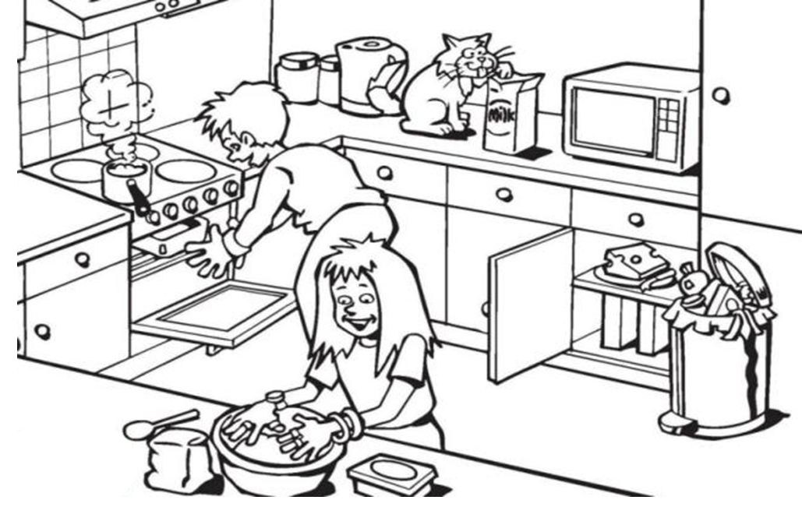
Introduction to food technology
Learning Objectives:
Completed
Will be able to list health and safety rules in the food room.
Good Will be able to recognise the hygiene and safety errors throughout the demonstration.
Outstanding Will be able to recommend measures to stop bad hygiene.
Task: Look at the picture and circle the hazards in the kitchen area.
What is a hazard?
How can you prevent hazards?
What is cross contamination?

Slide 2
Introduction to food technology
Extension: The 4 C’S of Food Hygiene. These four rules will help you and others stay safe from food poisoning.
C
C
C
C
Keyword term definition.
Hygiene– practices that maintain health and prevent diseases.
Task: List ways you can be food safe in a kitchen
.________________________________________________________________________________
.________________________________________________________________________________
.________________________________________________________________________________
.________________________________________________________________________________
.________________________________________________________________________________
.________________________________________________________________________________
.________________________________________________________________________________
.________________________________________________________________________________
.________________________________________________________________________________
.________________________________________________________________________________
Extension Task: Fill in the blanks
B…………………………..……… are the main cause of food poisoning. The symptoms of food poisoning include ……..……………., …………………………, ……………………………… and …………………..………….. Food that is ……..………………. with bacteria often doesn’t ……………..……, ……………..…….. or smell any different, so it is hard to know they are there. Bacteria like ……………………………… where they can multiply quickly, these include moisture, …………..…………. and time.
Word Bank: Contaminated, Stomach Cramps, Sickness, Warmth, Look, Bacteria, Taste, Conditions, Diarrhea, Fever.
Extension Task: Describe the words you have learned today.
Hygiene
______________________________
Cross Contamination
______________________________
Food poisoning
______________________________
Teacher checked: Sign: Date:

Slide 3
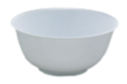
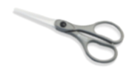
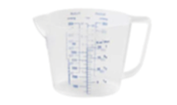
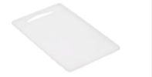
Weighing & Measuring
Success Criteria:
Completed
Will be able to identify equipment used in the food room.
Good Will be able to recognize the correct way to weigh and measuring using equipment
Oustanding Will be able to describe the use of the equipment used during the practical activity.
Settling Task: Using your previous knowledge, can you name the equipment?
Starter Task:
What colour chopping board do you use to cut raw meat?
What colour chopping board do you use to grate cheese?
What is a saucepan used for
Where will you find clean towels?
Where do you put dirty cloths and towels?
How do you carry a knife correctly
What do you do after you handle raw meat?
Where would you put your apron after a practical?
What would you do with a towel if you dropped it on the floor?
Extension task: Hygiene
Why do we use HOT water?__________________________
What is the correct word for germs?___________________
What utensil do we use to wash up?___________________
Which cloth do you use to dry the dishes?_______________
Use colour coded _______________to prevent cross contamination.

Slide 4
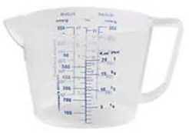
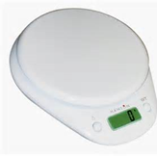
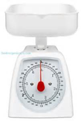
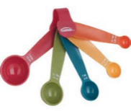
Weighing & Measuring
Task 1- Weighing and measuring equipment-
Some of the weighing and measuring equipment that you will be using during this project are illustrated on this sheet. Write the correct name for each and explain when, how and why they are used.
Name
What it is used for
Task two- Weighting and measuring task, using weight scales, measuring jugs and measuring cups. Measure out some of the following ingredients.
Rice
Flour
Water
Pasta
Sugar
Extension Task:
Question: What do you need to remember to check before you use the weighing scales?_________________________________________________
______________________________________________________

Slide 5
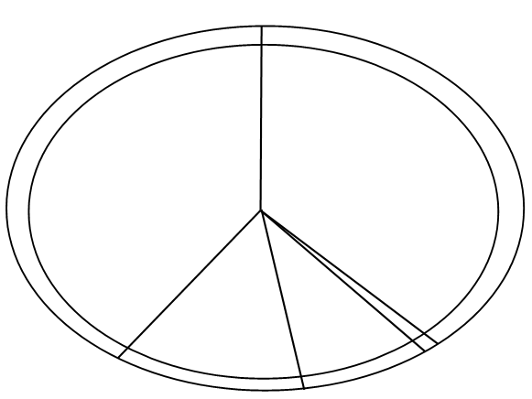
Carbohydrates
Nutrients_______________________________________________________________________________
Function_______________________________________________________________________________
Portions a day___________________________________________________________________________
Protein
Nutrients_______________________________________________________________________________
Function_______________________________________________________________________________
Portions a day___________________________________________________________________________
Dairy and alternative
Nutrients_______________________________________________________________________________
Function_______________________________________________________________________________
Portions a day__________________________________________________________________________
Fats & Oils
Nutrients_______________________________________________________________________________
Function_______________________________________________________________________________
Portions a day__________________________________________________________________________
Fruit and Vegetables
Nutrients_______________________________________________________________________________
Function_______________________________________________________________________________
Portions a day__________________________________________________________________________

Slide 6
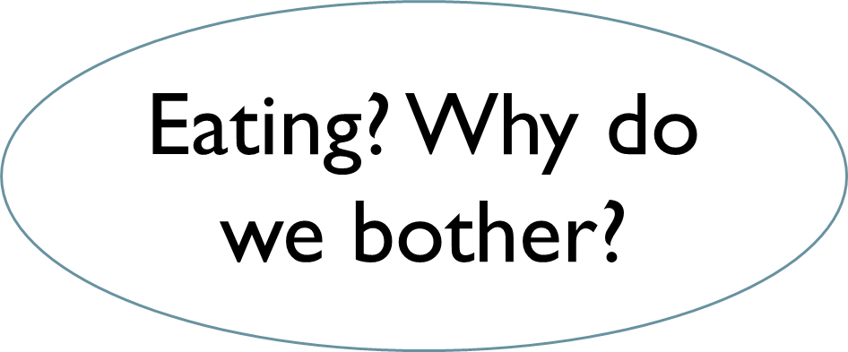
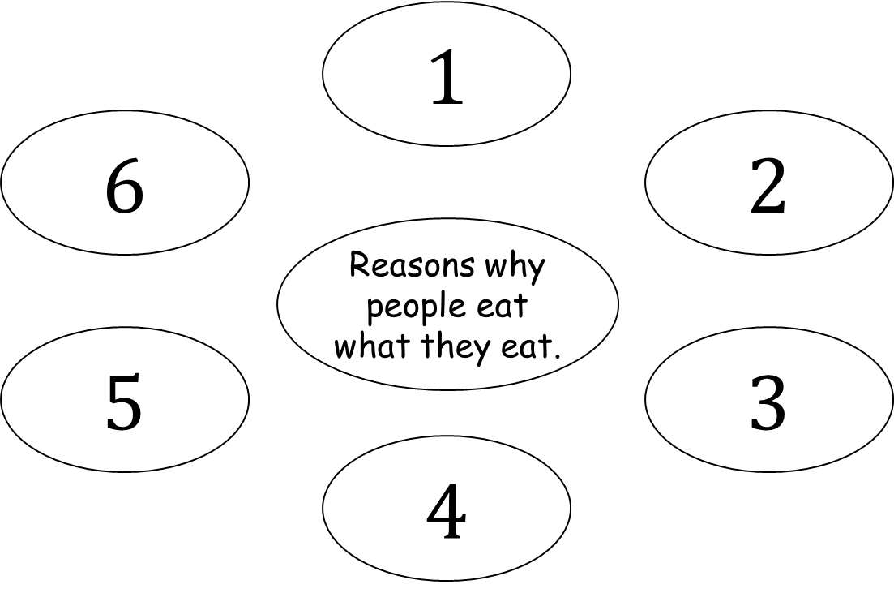
SMSC
Success Criteria:
Completed
Will be able to explain the reasoning behind specific food choices.
Good Will be able to adapt a recipe to met specific dietary requirements.
Outstanding Will be able to create a adapted recipe to met a specific dietary requirement.
Starter Task: Why do we eat? Complete the mind map below.
Task: Explore the reasons why people choose to eat the food that they do.
Questions: What effects your families choice of food?
Peer checked: Sign: Date:

Slide 7
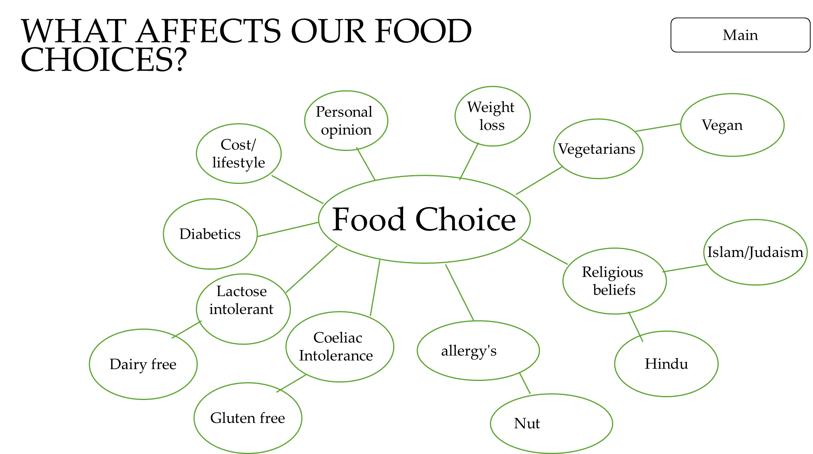
Research what these food choices are and why people have to follow these diets or lifestyles
Jewish
Hindu
Sikhs
Islam
Buddhist
Christians
Catholics
Diabetics
Lactose Intolerant
Coeliac Disease
Nut allergies
Vegans
Vegetarians

Slide 8
Specification
Success Criteria:
Completed
Will be able to design a successful pizza product.
Good Will be able to design and annotate a successful pizza design.
Outstanding Will be able to explain your designs with detailed annotation; commenting on ingredients, their function and nutrition.
Main
I have designed my pizza for a person who’s specific food choice is________________________________
Peer checked: Sign: Date:

