Slide 1
80/20 – THINK! What do you NEED to cover with your set
Grade | Learning Objective | Learning Outcome
1 | Describe how substances diffuse in and out of cells | Recall some substances that move into and out of cells Describe the process of diffusion Describe some factors which may effect the rate of diffusion
2
3

Slide 2
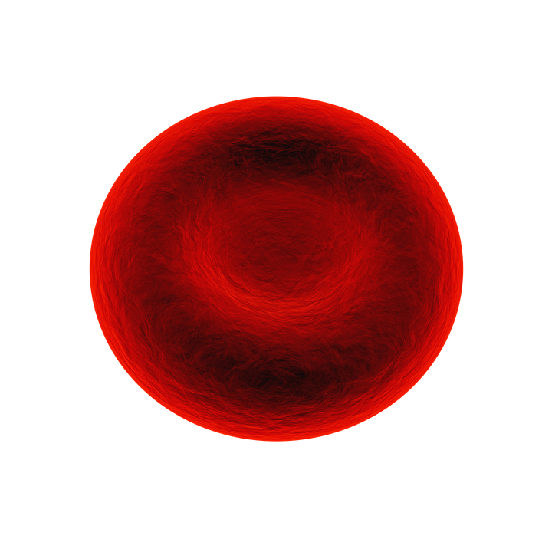
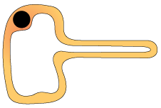
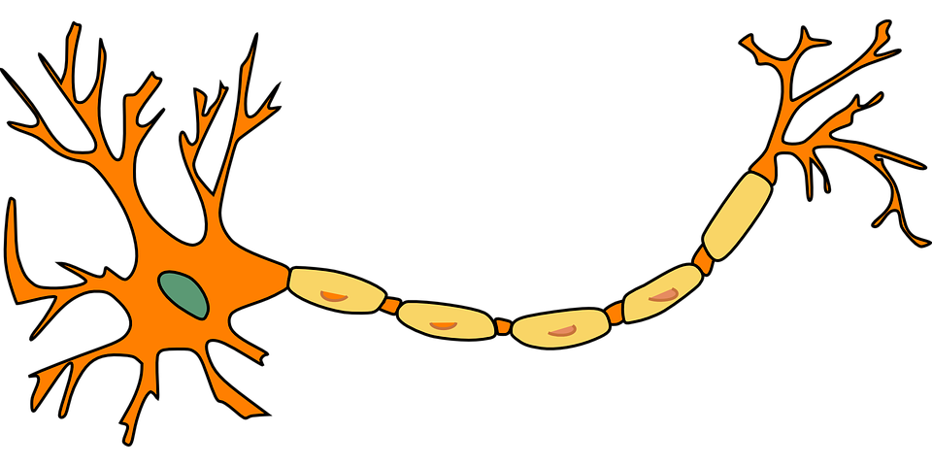
Movement of Substances
Do now activity: Look at the diagrams of specialized cells, for each one identify how its structure is related to its function

Slide 3
Progress indicators
GOOD PROGRESS:
Recall some substances that move into and out of cells
Describe the process of diffusion
OUTSTANDING PROGRESS:
Describe some factors which may effect the rate of diffusion

Slide 4
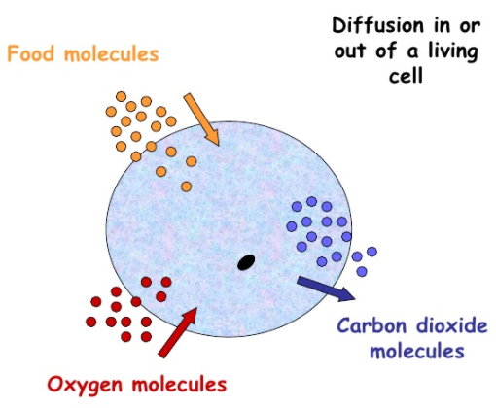
Your cells need to take in substances such as glucose and oxygen for respiration.
They also need to get rid of waste products and chemicals that are produced in your body, e.g. carbon dioxide
Dissolved substances and gases can move in and out of cells, across the cell membrane, by diffusion.

Slide 5
Task: Sketch the diagram of the cell, label the arrows to identify:
Two substances needed by the cell
One waste product of the cell
Carbon Dioxide
Oxygen
Glucose

Slide 6
When you have just sprayed perfume, the concentration of perfume particles in that area is very high.
Diffusion is the movement of the ‘smelly’ particles, through particles of air, to an area where they are at a LOWER concentration.
Air particle
Perfume particle

Slide 7
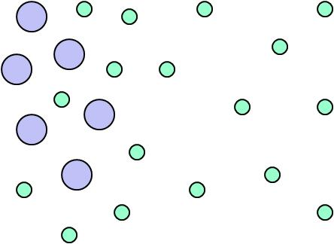
Definition of diffusion:
The spreading out of particles of a gas, or any substance in solution, resulting in the net movement of particles from an area of high concentration to an area of low concentration.

Slide 8
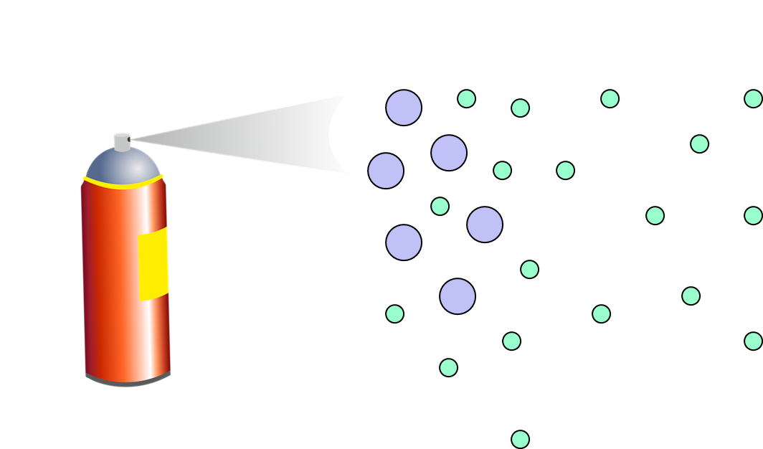
Diffusion
Task: Copy and complete the following sentences:
Diffusion is the _____________ of particles from any area where they are in a ____ __________ to an area where they are in a ______ ___________.

Slide 9
Self-assessment:
Diffusion is the movement of particles from any area where they are in a high concentration to an area where they are in a low concentration.

Slide 10
1
2
3
4
Task: Draw the diagrams above and match the correct statements to the correct diagram to demonstrate the sequence of diffusion
The particles are now nearly diffuse
The particles are separate when first put together
The particles are fully diffuse
They slowly start to mix due to their random motion

Slide 11
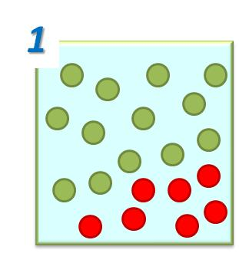
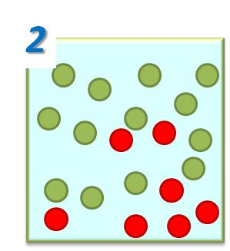
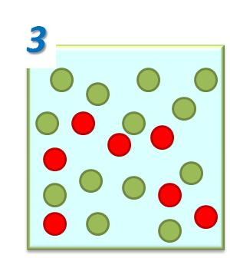
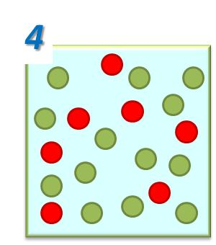
The particles are separate when first put together
They slowly start to mix due to their random motion
The particles are now nearly diffuse
The particles are fully diffuse

Slide 12
Think > Pair > Share!
Size of particles
What factors might affect the rate of diffusion?
Concentration of particles
Temperature

Slide 13
Think > Pair > Share: How do you think temperature might affect the rate of diffusion?
http://lab.concord.org/embeddable.html#interactives/sam/diffusion/2-temperature.json
Key Words: thermal, collide, higher, diffusion, move
In summary, the _________ the temperature the quicker the rate of _________.
This is due to the fact the an increase temperature means the particles are supplied with more _______ energy. The more energy the particles have, the more they _______ around and will _______ more often.
This means diffusion will happen much more rapidly.

Slide 14
Self-assessment:
higher
In summary, the _________ the temperature the quicker the rate of _________.
This is due to the fact the an increase temperature means the particles are supplied with more _______ energy. The more energy the particles have, the more they _______ around and will _______ more often.
This means diffusion will happen much more rapidly.
diffusion
thermal
move
collide

Slide 15
Why do plants wilt?
If plants are not watered regularly, they will wilt and eventually die.
Inside the cells, the water fills the vacuole and pushes outwards on the cell wall to make it rigid. If the plant does not have enough water, the vacuole shrinks. The cell becomes floppy and the plant wilts.
Cell from a leaf with enough water
Cell from a leaf with no water
Healthy Plant
Wilted Plant

Slide 16
Plenary: Create 3 quiz questions to test your peers knowledge of diffusion!!
Notes:
Ciliated cell: By Esaah6 (Own work) [CC BY-SA 3.0 (https://creativecommons.org/licenses/by-sa/3.0)], via Wikimedia Commons

