Slide 1
Extraction of aluminium
Spec 5.4.3.3
Do Now: Mr Wrong has got some things muddled up! Correct his statements.
Cation = negative ion Anion = positive ion
The electrolyte needs to be molten or dissolved in water so the ions are in a fixed position.
Electrolysis is the breakdown of a compound using heat
The anode is the negative electrode
The anion moves towards the cathode
Notes:
Green are correct statements, they’re animated to appear over the top of the incorrect

Slide 2
Extraction of aluminium
Spec 5.4.3.3
Do Now: Mr Wrong has got some things muddled up! Correct his statements.
Cation = negative ion Anion = positive ion
Cation = positive ion Anion = negative ion
The electrolyte needs to be molten or dissolved in water so the ions are free to move.
The electrolyte needs to be molten or dissolved in water so the ions are in a fixed position.
Electrolysis is the breakdown of a compound using electricity
Electrolysis is the breakdown of a compound using heat
The anode is the positive electrode
The anode is the negative electrode
The anion moves towards the cathode
The anion moves towards the anode
Notes:
Green are correct statements, they’re animated to appear over the top of the incorrect

Slide 3
PROGRESS INDICATORS
 | Good progress | Outstanding progress
Grade 1-3 | State that aluminium can be extracted from aluminium oxide using electrolysis. | Explain why electrolysis of aluminium is an expensive metal extraction method.
Grade 4-6 | Write a word equation to describe the electrolysis of aluminium oxide. | Write a balanced symbol equation to describe the electrolysis of aluminium oxide.
Grade 7-9 | Distinguish which elements are oxidised and reduced in the electrolysis of aluminium oxide. | Describe electrolysis with half equations at the electrodes.

Slide 4
Word Consciousness
Ore – A compound containing a useful element, usually found as rocks
Extracted – remove/ take out
Blast Furnace – A process where metals are extracted by heating to high temperatures in the presence of carbon

Slide 5
ACTIVITY 1- Describe why electrolysis is used to extract metals.
Using the diagram of the reactivity series from a previous lesson to describe why we use electrolysis to extract aluminium
Key words to include
Reactive, ore, more, extracted, carbon, electrolysis
Model Answer
Electrolysis is used to extract aluminium from its ore as aluminium is more reactive than carbon therefore cannot be extracted by carbon. Any metal in the reactivity series above carbon must be extracted using electrolysis as it to too reactive.

Slide 6
Progress Check
State which method of extraction we could use for each metal
Iron
Aluminium
Silver
Potassium
Lead
Reduction/ Blast Furnace
Electrolysis
Found naturally
Electrolysis
Reduction/ Blast Furnace

Slide 7
ACTIVITY 2
Watch the video clip and answer the questions below.
How to extract aluminium by electrolysis
Why must aluminium be made molten before electrolysis?
What is cryolite?
Why do we use cryolite?
What is the electrodes made out of?
Which electrode does aluminium ion move to?
Which electrode does carbon dioxide get formed
Why must the anode constantly be replaced?
Why is electrolysis expensive?
Challenge – Write the balanced equation for the electrolysis of aluminium.

Slide 8
ACTIVITY 2- Answers
So the ions can move
Cryolite is an aluminium compound with a much lower melting point
We use it to reduce the costs
Graphite
Cathode (negative electrode)
Anode (positive electrode)
Because the carbon in the graphite reacts with oxygen to form carbon dioxide.
Because it uses a lot of energy to heat AND constantly replacing anode
SA
In red pens please

Slide 9
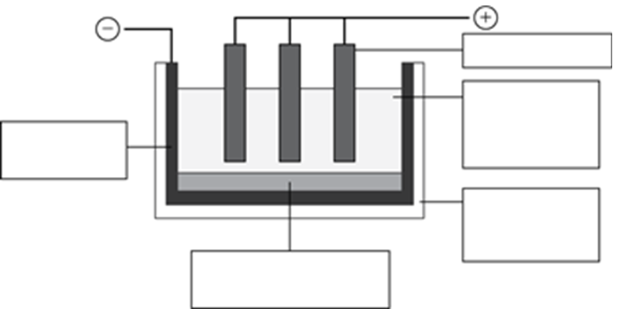
Demonstrate – part one
Answer the following questions
1) Explain why aluminium cannot be extracted from its oxide by reduction with carbon. (1 mark)
2) Label the diagram of electrolysis equipment (5 marks)
3) Describe the electrolysis in terms of the ions moving (2 marks)
4) Explain why cryolite is added (1 mark)

Slide 10
Demonstrate – part two
Answer the following questions
5) Give two reasons why the electrolysis of aluminium is expensive (2 marks)
6) Give 3 uses of aluminium and explain why it is used for each purpose (3 marks)
7) Write an equation to summarise the overall process (2 marks)
8) HT ONLY Write the half equations at the anode and the cathode and determine whether each reaction is oxidation or reduction (4 marks)

Slide 11
Demonstrate – Mark Scheme
1) Aluminium cannot be extracted from its oxide by reduction with carbon because aluminium is more reactive than carbon
2) On next slide
3) The positive ions are attracted to the negative electrode (cathode)
The negative ions are attracted to the positive electrode (anode)
4) Lowers the melting point so less energy is needed
5) The oxygen reacts with the carbon anode to produce carbon dioxide so the carbon anode gradually burns away. Large amounts of energy are used in the extraction process
6) Air craft = Strong / Low density Drinks Cans = Easy to shape / Corrosion resistant Saucepans/cookers/ Boilers = Good conductor of heat Overhead electricity cables = Good conductor of electricity
Mirrors = Highly reflective
7) 2Al₂O₃ → 4Al + 3O₂
8) Cathode Al³⁺ + 3e⁻ → Al REDUCTION
Anode 2O²⁻ → O₂ + 4e⁻ OXIDATION
SA
In red pens please

Slide 12
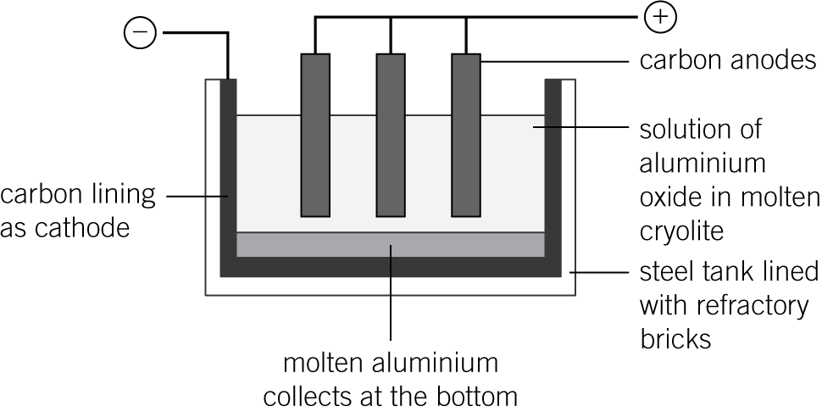
Demonstrate – Mark Scheme
2)
SA
In red pens please

Slide 13
Connect
Complete your connect task in green pens
Mark | Colour | Task
0-6 | Pink | Define electrolysis Draw a diagram of electrolysis equipment Suggest why cryolite is added Suggest one reason why electrolysis is expensive
7-14 | Yellow | 1. Suggest one reason why electrolysis is expensive 2. Write the balanced equation for the electrolysis of aluminium 3. Describe why the anode must be constantly replaced.
15-20 | Green | Write the half equation for what is happening at the cathode Write the half equation for what is happening at the anode State which reaction is reduction and which is oxidation

Slide 14
Plenary
TRUE OR FALSE?
Aluminium is manufactured by reduction using carbon
Aluminium extraction involves a molten mixture of aluminium oxide and cryolite
Carbon is used for the electrodes.
FALSE
TRUE
TRUE

