Slide 1
Do Now Activity
State 3 functions of the cardiovascular system. 1 2 3 | State the long term effects of exercise on the cardiovascular system..
Can you remember the composition of inspired versus expired air? | State the long term effects of exercise on the respiratory system
Inspired (breathed in) | Expired (breathed out)
Nitrogen: Oxygen: Carbon dioxide: | Nitrogen: Oxygen: Carbon dioxide:
Challenge: How does the cardio and respiratory system work together?

Slide 2
Do Now Activity
State 3 functions of the cardiovascular system. 1 2 3 | State the long term effects of exercise on the cardiovascular system..
Can you remember the composition of inspired versus expired air? | State the long term effects of exercise on the respiratory system
Inspired (breathed in) | Expired (breathed out)
Nitrogen: Oxygen: Carbon dioxide: | Nitrogen: Oxygen: Carbon dioxide:
Challenge: How does the cardio and respiratory system work together?

Slide 3
State 3 functions of the cardiovascular system. | State the long term effects of exercise on the cardiovascular system..
Can you remember the composition of inspired versus expired air? | State the long term effects of exercise on the respiratory system
Decreased resting HR
Hypertrophy of the heart
Increased Heart recovery rate
Increased SV (mention hypertrophy of heart muscle)
CO increase
Blood Pressure reduces
Healthy veins and arteries
(link to a decrease risk of heart decrease)
1 Transportation
2 Protection
3 Regulate temperature
Increased number of alveoli – you can take in more air and extract oxygen more effectively
Increased strength of intercostal muscles - respiratory system is stronger so it can contract more forcefully when needed
Increased strength of diaphragm – respiratory system is stronger so it can contract more forcefully when needed
Increase lung volume – due to increased tidal volume and vital capacity
Inspired (breathed in) | Expired (breathed out)
Nitrogen: 79% Oxygen: 21% Carbon dioxide: 0.4 | Nitrogen: 79% Oxygen: 16% Carbon dioxide: 4%

Slide 4
Discuss the immediate effects and long-term training effects in physical activity on the respiratory system, and explain why those effects are beneficial to an athlete. (6 Marks)
From last week…
There are many effects which take place on the respiratory system………
Immediate effects are………….
Long term effects on the respiratory system………
To conclude……….

Slide 5
Mark Scheme – peer assessment
Short term benefits
Increase in breathing rate (faster breathing) (ss) therefore increases the oxygen intake and aids with the removal of carbon dioxide (ds)
Increase in depth of breathing/tidal volume (more air taken in with each breath) (ss) which means an increases in the amount of oxygen taken to the lungs in each breath(ds)
More effective gas exchange in the alveoli (ss) which means oxygen and carbon dioxide is exchanged quicker (ds)
Long term effects:
Increased number of alveoli (ss) therefore you can take in more air and extract oxygen more effectively (ds)
Increased strength of intercostal muscles (ss) therefore respiratory system is stronger (ds)
Increased strength of diaphragm (ss) therefore respiratory system is stronger (ds)
Increase lung volume (ss) therefore due to increased tidal volume and vital capacity (ds)
Due to all of the above you can provide more oxygen for transport to the working muscles (ss) which means the athlete will be able to work for longer (ds)
Conclusion:
Summing up key points from above relating to the athlete and why it benefits them
Remember you do not get a point for each statement for these questions, you get marks for the quality of your overall answer

Slide 6
Mark Scheme
1-2:
A number of simple statements that discuss the benefit short term and long term training on the respiratory system and why these effects are important to an athlete
1-2 Developed statements linked to long term effects linked to the above
No conclusion
3-4:
Minimum of 3 developed statements that discuss benefit of short term and long term training on the respiratory system and explain why these effects are important to an athlete (no balance)
Short conclusion
5-6:
At least 4 developed statements that discuss the benefit of short term and long term training on the respiratory system and explain why these effects are important to an athlete (balanced and succinct responses)
Conclusion

Slide 7
Monday 9th March 2020
Cardiorespiratory system
Good Progress: | Outstanding Progress:
Will be able to assess showing some accuracy the short and long term effects of exercise on the respiratory system. | Will show accuracy when assessing the short and long term effects of exercises on the respiratory system.
Will be able to state two ways in how both systems work together in sporting activity. | Will be able to explain how both systems need to work together to allow sporting performance.

Slide 8
Tidal Volume
During one breath the amount of air you breathe in or out is known as your Tidal Volume.
When you take part in sport your tidal volume increases, you breathe more deeply
Bringing more oxygen. This helps to release extra energy in the muscles for aerobic activity, and remove lactic acid from them (produced during anaerobic activity)
To breathe out the extra carbon dioxide produced during aerobic activity.

Slide 9
Vital Capacity
The most air you can breathe in after breathing out the largest volume of air you can.
Q how does having a larger vital capacity help in sporting performance?
The larger your vital capacity, the more oxygen you can take in, the more oxygen you can supply to your muscles.

Slide 10
What this looks like on a graph then…

Slide 11
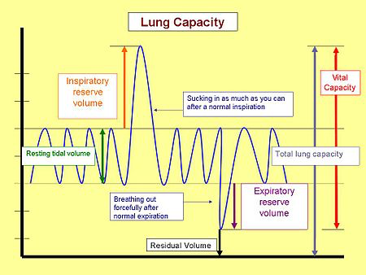
NEED TO KNOW
Lets break it down….

Slide 12
This is your title!
Draw this from margin line – margin line
Draw these 2 lines between each
A total of 7

Slide 13
Draw this
TOTAL LUNG CAPACITY:
The total lung capacity (TLC) is the most air that you can inspire into your lungs
Write this under the graph…

Slide 14
Draw this
VITAL CAPACITY:
Vital capacity is the maximum amount of air a person can expel from the lungs after a maximum inhalation

Slide 15
Draw this
RESIDUAL VOLUME:
Residual volume (RV) is a lung volume representing the amount of air left in the lungs after a forced exhalation; this volume cannot be measured, only calculated.

Slide 16
TIDAL VOLUME:
The amount of air breathed in or out during normal breathing
This increases during exercise – why?
Draw this

Slide 18
QUICKLY TALKING THROUGH THIS….. We will come back to this a lot next BUT will touch on it quickly now
Energy
The muscles and liver store glucose (main source of energy from food)
Aerobic Respiration -
Glucose + oxygen -----Energy + CO2 + water
Is toxic!, causes muscle ache, cramps eventually stopping them from working!
Anaerobic Respiration -
Glucose -----Energy + lactic acid
Carbohydrates:
Fuel source for anaerobic and aerobic activity
Fats:
Fuel source for aerobic activity
Oxygen debt
The amount of oxygen needed at the end of a physical activity to break down lactic acid. Often after a 400m race lactic acid is build up as oxygen is not being used. Oxygen is repaid through deep gasping breaths at the end of exercise

Slide 19
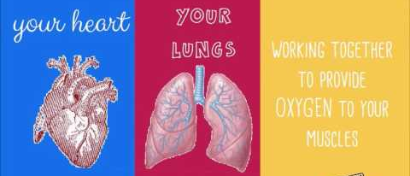
How both cardiovascular and respiratory system work together.
During exercise more oxygen is delivered to the muscles than normal, extra carbon dioxide is taken away to be breathed out. Both systems work together to make this happen.

Slide 20
Cardiovascular system
Cardiac Output: is the amount of blood pumped from the heart in 1 minute.
Respiratory system
More O2 delivered
Breathing rate and depth increases, to allow more oxygen to be delivered to the alveoli in the lungs.
Cardiac output increases so blood passes through the lungs at a faster rate collecting extra O2 from the alveoli. This is taken to the muscles.
More CO2 is removed
Increased CO output means that the blood can transport CO2 from the muscles to the lungs more quickly
Moving back into the alveoli, the higher breathing rate and depth allow it to be breathed out quickly.

Slide 21
PRINTING THE REVISION BOOKLET
Steps …
K Drive – PE – GCSE PE – Revision Pack

