Slide 1
Check your list in front of black folder
Check your list that you have sat down with Miss Bates and discussed
The next slide will help you along with the help sheet (your booklet) that are on the website too. Use them

Slide 2
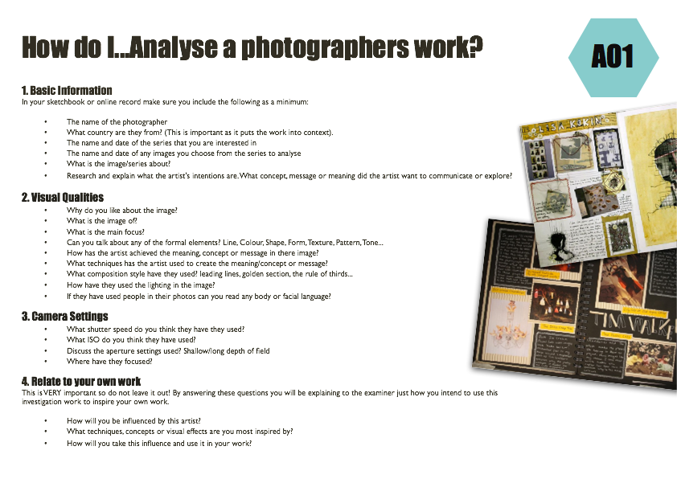
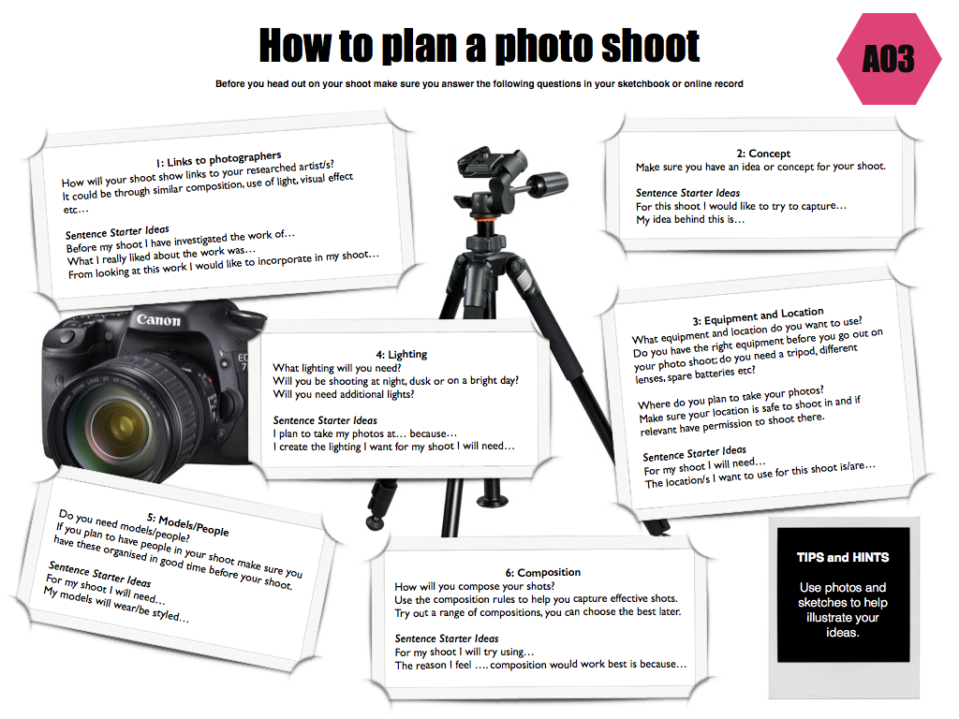
To gain an understanding of the work of a chosen photographer/artist/style that links to your project and develop ideas
GCSE photography Progress Indicators
Good | Answered some questions from each heading on the ‘help sheet pages’ A range of neatly cut out and presented images by the photographer/artist/style that link to your development of ideas Ideas are based on your chosen photographer/artist/style
Outstanding | Answered most questions from each heading on the ‘help sheet pages’ Writing uses detailed and in-depth sentences Creative layout/design for the pages used A range of ideas that reflect the style of your chosen photographer/artist/style Camera setting have been discussed and used in various ways Various compositions and lighting have been experimented with
Titles on each page should link
1) Reference Page
Research your own photographer/art style/artist/crafts person. Get information and a minimum of 6 photos of their work. Must include:- Title /Images /Information /Possible ideas
Use the ‘How do I….analyse a photographers work’
2) Plan of Photo Shoot
Using the ‘How to plan a photo shoot’ handout plan your photo shoot – must include Sketches/ location/ equipment/links to reference page
3) Contact Sheet
Using the ‘Contact Sheet’ handout print out contact sheet and annotate. Relate work to reference page. Discuss (TICK and CROSS) photos.
4) Best Photos
Using the ‘How do I ….Present my work’ handout and enlarge/edit your final idea for your chosen photographer/artist/style.
REMEMBER TO LINK BACK TO YOUR PREVIOUS REFERENCE PAGES

