Slide 1
DNA
Ask a question, make a statement
π
Radius
Diameter
Notes:
Option 1

Slide 2
Connect
Notes:
Reliant on knowledge of types of number on a dice. Green introduces idea of “or” to stretch students understanding.

Slide 3
Identify key circle properties
Unit 9 Objective A

Slide 4
Progress Indicators

Slide 5
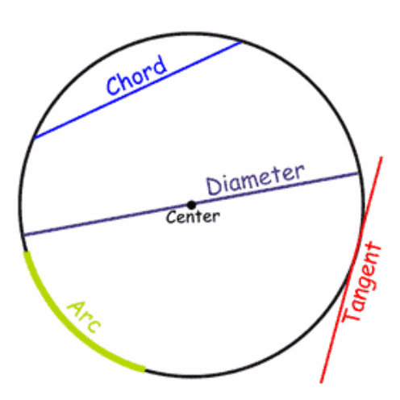
Collaborative Learning
How many of these coloured lines/curves can you name?

Slide 6
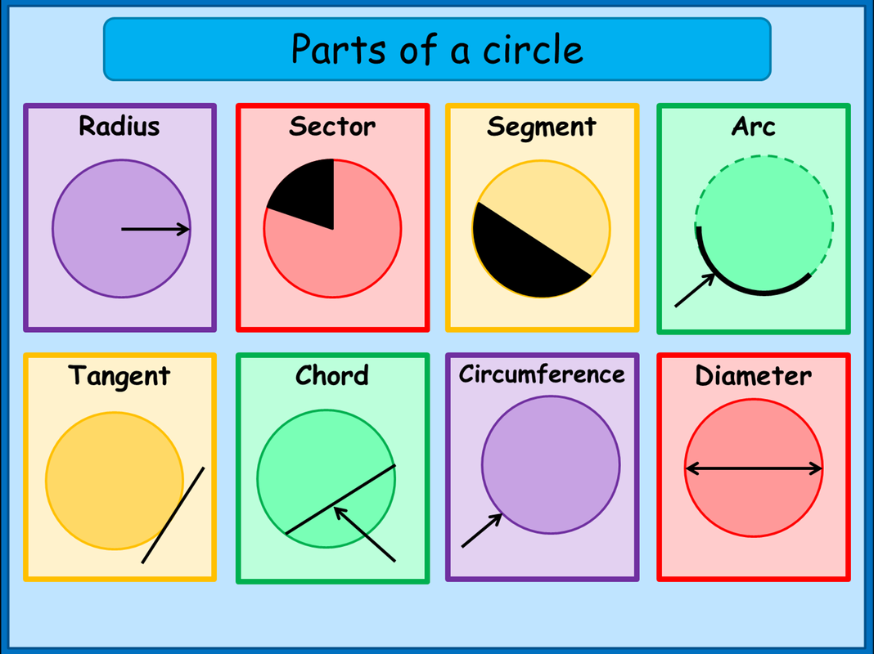
Circumference
The distance around the outside of the circle.

Slide 7
Radius
A line from the centre of the circle to a point on the circumference.

Slide 8
Diameter
A line that crosses a circle, passing through the centre.

Slide 9
Sector
A part of a circle formed by two radii and an arc.

Slide 10
Segment
A part of a circle formed by a chord and an arc.

Slide 11
Arc
A part of the circumference of the circle

Slide 12
Tangent
A line that touches the circumference at one point only. It meets the radius at right angles.

Slide 13
Chord
A line that joins two points on the circumference of a circle.

Slide 14
Intelligent Practice

Slide 15
Answers

Slide 16
Key Elements (must be included)
DNA
Connect to previous lesson
Main body – including worked examples, intelligent practice and collaborative learning.
Demonstrate

Slide 17
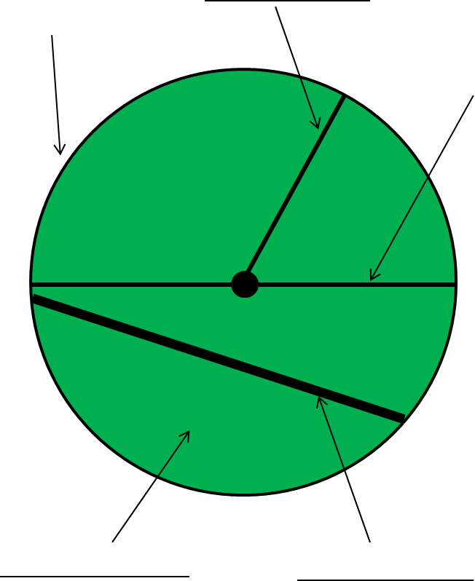
Demonstrate
Label the parts of the circle

