Slide 1
KI : Food, water and energy are fundamental to human development
GCSE The Challenge of Resource Management Knowledge Organiser
Key terms | Definitions
Resource management | The control and monitoring of resources so they don’t become depleted or exhausted
The significance of food, water and energy to economic and social well being
Key for human wellbeing. All lead to social and economic benefits which all increase the standard of living
Food | Calories provide energy Availability depends on climate, soil and level of technology Malnourishment means disease and death. Can also lead to underperforming at school which decreases economic wellbeing in life More than 1 billion people are malnourished 2 billion are undernourished (poor diet) Obesity is an issue in some areas
Water | Used for survival, washing, food production, industry We need clean safe water otherwise we can get stuck in a cycle of poverty
Energy | Traditionally we get energy from oil, coal and wood Many different sources Used for production, heating, transport and for water supply (e.g. wells)
Water
Changing demand for water | Increasing wealth Hygiene Demand for out of season food Increasing industrial use Increased domestic use Increasing population Increased use in domestic properties since 1975 by 70%
Water quality and pollution management | Water quality is managed by legislation, education campaigns, waste eater treatment, building better treatment plants, investing in infrastructure, pollution traps, green roofs and walls Key pollutants are fertilisers, pesticides, heavy metals and acid rain
Matching supply and demand – areas of deficit and surplus | Highest population is in the South East (area of deficit) and highest rainfall is in the north and west (water surplus) 80% of Southern England relies on groundwater. 50% are affected by water quality
Need for transfer to maintain supply | Kielder Water - transfers water from the Kielder Dam in Northumberland (surplus) eastwards towards Newcastle-Upon-Tyne (deficit). Built in order to cope with the high industrial output in the north-east Still used but not as widely due to the decline in industrial activity in Newcastle-Upon-Tyne
KI : The changing demand and provision of resources in the UK create opportunities and challenges
An overview of global inequalities in the supply and consumption of resources
Key terms | Definitions
Agribusiness | Application of business skills to agriculture
Carbon footprint | A measurement of all the greenhouse gases we individually produce
Energy mix | The range of energy sources of a region or country
Food miles | The distance covered supplying food to consumers
Fossil fuels | A natural fuel formed in the geological past from the remains of living organisms
Local food sourcing | A method of food production and distribution that is local
Organic produce | Food produced using environmentally and animal friendly farming methods on organic farms
Food | UK consume 3200 calories per person per day Somalia 1580 calories per person per day Areas of greatest population growth have highest levels of undernourishment Demand depends on changing diets and increasing population Supply depends on climate, soil and level of technology
Water | Fresh water is unequally distributed Water footprint is the amount of water used per day Global average is 1240 l per day Bangladesh is 896 l per day USA is 2483 l per day Water scarcity can be physical or economic 1 in 5 (more than 1.2 billion people) live in areas of water scarcity 1 in 3 (2.4 billion people) have no access to clean drinking water
Energy | Richest billion people use 50% of the energy Poorest billion people use 4% of the energy Countries import and export energy Some countries do not have their own sources of energy
Food
Energy
The growing demand for high value food exports from LICs and all year demands for seasonal food and organic produce | Used to be seasonally and locally sourced. Now eat globally sourced foods all year In 2013 47% of UK food was imported More disposable income and increased demand for greater choice Can’t grow all foods in the UK and foods can only be grown at certain times High value products are five times the price of similar products e.g. Madagascan vanilla, gourmet coffee Positive impacts : Jobs and wages for those in LICs, more tax income leads to a better quality of life Negative impacts – less land for locals, high water use and exposure to chemicals Organic – no pesticides or fertilisers used. Since the 1990s there has been an increase in demand. Worth £2 billion a year
Larger carbon footprints due to the increased number of food miles travelled | Grown more cheaply elsewhere Production and transport lead to carbon footprint 17% of the UK’s carbon footprint is due to food Tomatoes have less of a carbon footprint being grown in Spain and imported to the UK than if we grew them in the UK Food miles travelled by UK food imports is 18.8 billion. 68% of food imported is from within the EU, 32% from the rest of the world Push now for buying local and having an allotment
A trend towards agribusiness | Agribusiness is a farm run as a business with the main aim being profit Big impacts on the environment as often heavy use of pesticides and fertilizers East Anglia has a lot of agribusinesses
The changing energy mix – reliance on fossil fuels and the growing significance of renewable energy | UK Energy mix in 2015 : Coal 31% Gas 25% Nuclear 19% Renewable sources 22% In 1970 91% was from coal and oil UK investing in renewable energy e.g. solar energy and subsidies given by the government Shale gas most recent focus
Decreasing domestic supply of oil, coal and gas | In 1980 North Sea oil and gas was discovered Now have decreasing reserves of fossil fuels EU regulations on emissions has meant decrease in fossil fuel use 12% less energy being used in homes since 1970 and 60% less in industry due to energy efficiency, public awareness and increasing costs
Economic and environmental issues associated with the exploitation of resources | Cheaper to import coal into the UK than to mine it Nuclear sites being decommissioned and all current plants will close by 2023 – issues of contamination and disposal of nuclear waste Economic issues – coasts, jobs, set up costs, research, reliability Environmental costs – ecosystems, waste, noise, aesthetics, emissions, pollution, radiation leaks

Slide 2
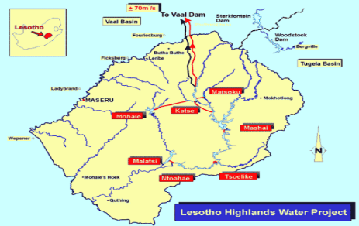
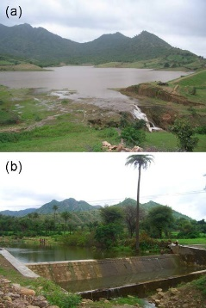
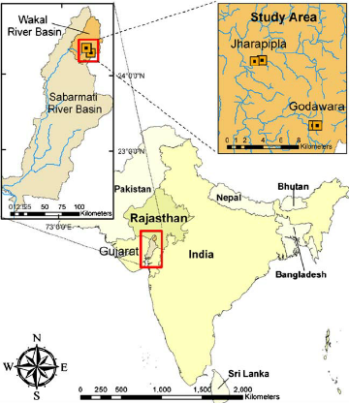
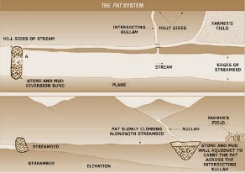
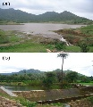
KI : Demand for water resources is rising globally but supply can be insecure, which may lead to conflict
GCSE The Challenge of Resource Management – Water Management Knowledge Organiser
Example of a large scale water transfer scheme to show how it’s development has advantages and disadvantages
Lesotho Highland Water Project -A huge water transfer scheme aimed to help solve the water shortage in South Africa. 40% of the surplus water in Lesotho is transferred to South Africa. It involves the construction of dams and reservoirs as well as pipelines and roads.
Key terms | Definitions
Over abstraction | When water is being used more quickly than it is being replaced
Waterborne diseases | Diseases caused by microorganisms that are transmitted in contaminated water
Water conflict | Disputes between different regions or countries about the distribution and use of fresh water
Water deficit | Where water demand is greater than supply
Water insecurity | Where water availability is not enough to ensure the population enjoys good health, livelihood and earnings
Water quality | Measured in terms of the chemical, physical and biological content of water
Water security | Reliable availability of an acceptable quality and quantity of water
Water stress | Demand for water exceeds the available amount during a certain period or when poor quality restricts its use
Water surpluses | Water supply is greater than demand
Advantages for Lesotho | Disadvantages for Lesotho
Provides income. 75% of Lesotho’s GDP Supplies renewable energy to Lesotho (Hydro-Electric Power, HEP) | Building the first two dams meant 30,000 people were moved homes (displaced) Destruction of a unique wetland ecosystem (habitats) A corrupt government has meant money has been prevented from reaching people affected
Advantages for South Africa | Disadvantages for South Africa
Provides water to an area with regular droughts Provides safe water to an extra 10% of the population | The cost of building and buying the water is at $4bn 40% of water is lost through leakages Corrupt government has plagued the project
Impacts of water insecurity
Waterborne diseases and pollution | Chemicals, sewage, waste, ashes, dead animals etc lead to cholera, dysentery, malaria and polio 11% of the world’s population is water insecure 2.6 billion lack access to sanitation Often have to queue or walk miles for water
Food production | Reliant on water Decrease in quality of livestock if not enough water Agriculture is the biggest polluter of water e.g. fertilisers and pesticides
Industrial output | Increase in product price if water cost is too high e.g. chemicals and textiles LICs and NEEs – 70% of industrial waste is untreated Without water there would be no industry meaning less wages and a failing economy
Moving towards a sustainable resource future
Water conservation | Minimise water footprint Lots of different ways : artificial grass, push taps, mend leaks, hydroponics, drip agriculture, education, water meters Nevada has decreased water use by 23% in 10 years despite population increase by ½ million
Groundwater management | Decrease the amount of permitted pumping Can recharge with reclaimed / grey water Need to decrease the amount of fertilisers and pesticides used in the area and monitor the water levels
Recycling | Can use reclaimed water - sewage water that has been treated and is suitable for irrigation, industry and power plants Coca Cola use 25% of harvested water in bottling plants, washing vehicles and flushing toilets
Grey water | Flushing toilets, irrigation and washing cars Expensive system to put in
Areas of surplus (security) and deficit (insecurity)
Global patterns of water surplus and deficit | Water stress – Africa, South Asia, Australia, Middle East Water surplus – Northern hemisphere Supply and demand balanced in North America and Europe 94% of fresh water is stored in aquifers
Reasons for increasing water consumption – economic development and rising populations | World population increase d to nearly 7.5 billion which has led to an increase in consumption. Mostly in LICs. Led to an increased demand for food To produce 1kg of beef it needs 9500 l of water compared to 1800 l for a kg of wheat Economic development has led to an increase in commercial agriculture, manufacturing industries and living standards. More energy is needed (15% of water use is in the generation of energy) Higher the economic development the higher the standard of living and the more water consumption per capita
Potential for conflict where demand exceeds supply
e.g. India and Bangladesh share the Ganges River; Canada and the USA have the Great Lakes; USA and Mexico have the Colorado river; Israel, Jordan, Syria and Lebanon share the River Jordan.
Where this occurs there is the potential for water wars – physical fighting over the use of the water from the rivers especially if those countries nearer the source use all the water
An example of a local scheme in a LIC or NEE to increase the sustainable supply of water
KI : Different strategies can be used to increase water supply
The Wakel River Basin Project, Rajasthan, India.
Little rainfall in the area has led to food and water shortages
Over use of water for irrigation has led to waterlogging and running out of water
Water supply has been increased by encouraging locals to make changes to their farming practice. Rainwater harvesting
Factors affecting water availability
Key terms | Definitions
Grey water | Wastewater from peoples’ homes that can be recycled and put to good use
Groundwater management | Regulation and control of water levels, pollution, ownership and use of groundwater
Sustainable development | Development that meets the needs of the present without limiting the ability of future generations to meet their own needs
Sustainable water supply | Meeting the present day need for safe, reliable and affordable water which minimises adverse effects on the environment whilst enabling future generations to meet their requirements
Water conservation | The preservation, control and development of water resources and prevention of pollution
Water transfer schemes | Systems of canals, pipes and dredging over long distances to transport water from one river basin to another
Climate | Most water in tropical, temperate humid or mountainous areas. Evaporation rates affect water availability Water can be stored as snow, and ice
Geology | Synclines in rocks often are porous Where porous rocks are between non porous rocks an aquifer forms Non porous rocks good for reservoirs to be created
Pollution of supply | Polluted water is unfit for human consumption Industrial waste has metals in it which people drink making them ill 200 children die a day from drinking polluted water
Overabstraction | Causes salt water from sea to be sucked up into ground water contaminating the supply Sinking water tables mean rivers dry up Mexico city has sunk 9m since 1910 Demand changes seasonally e.g. tourism
Limited infrastructure | Water lost from leaking pipes Rapid urbanisation can cause the contamination of water supplies as city can not install the infrastructure fast enough to keep up with the population growth
Poverty | Prevents access to safe water – economic scarcity. Need to pay for access to clean treated piped water
How? | Pos v Neg
Pats – Small irrigation channels that have been dug off the main river channel. They divert water from the river to the fields where water is needed to irrigate crops Taankas – Underground water storage systems. Collect surface water from roofs via drains Johed – Small earth and mud dams that trap water and allow it to soak back into the soil increasing the amount of groundwater | Positive Built using low cost materials such as mud and earth Can be maintained by the locals if anything isn’t working as well Has increased water supply to the area resulting in less food and water shortages. Negative Small scale
Overview of strategies to increase water supply
Diverting supply and increasing storage, dams and reservoirs, water transfers and desalination | Diverting supply is expensive, has environmental impacts and can encourage wastage. Often includes HEP scheme and leisure. Water can be stored in aquifers e.g. London and Oklahoma Dams have social, economic and environmental impacts. 50,000 large dams worldwide Desalination is very expensive. Starting to be more common. UAE, Kuwait and Saudi Arabia use it. 98% of Dubai’s water supply as more efficient plants than Europe. 1% population worldwide rely on it. £2 per m³ of water. Brine waste damages ecosystems.

