Slide 1
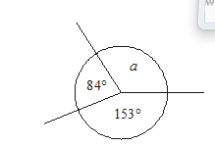
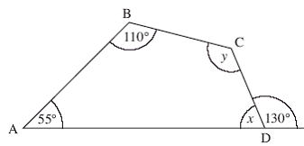
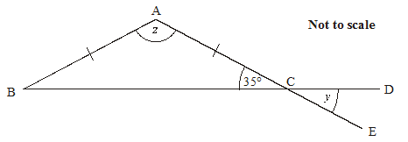
Connect
Orange
Pink
Green
*Challenge

Slide 2
Polygons
6i

Slide 3
On your white boards name these shapes.

Slide 4
On your white boards name these shapes.

Slide 5
On your white boards name these shapes.

Slide 6
On your white boards name these shapes.

Slide 7
On your white boards name these shapes.

Slide 8
On your white boards name these shapes.

Slide 9
On your white boards name these shapes.

Slide 10
Name these shapes
BRONZE
SILVER
GOLD

Slide 11
What are polygons?

Slide 12
Naming polygons
Polygons are named according to their number of sides.
Number of sides | Name of polygon
3
4
5
6
7
8
9
10
Triangle
Quadrilateral
Pentagon
Hexagon
Heptagon
Octagon
Nonagon
Decagon
Notes:
Pupils should learn any of the names that they do not know already.

Slide 13
What triangles do you know?
Tell me about each one
What are the properties?

Slide 14
Equilateral

Slide 15
Isosceles

Slide 16
Right angled

Slide 17
Scalene

Slide 18
Recap
1) What is a Quadrilateral?
→ A shape with 4 straight sides…
2) How many can you name?
Square
Equal sides
2 pairs of Parallel sides
All angles 90˚
Rectangle
2 pairs of Equal sides
2pairs of Parallel sides
All angles 90˚
Trapezium
1 pair of parallel sides
Kite
2 pairs of equal sides
No parallel sides
Rhombus
Equal sides
Opposite sides parallel
Opposite angles equal
Parallelogram
2 pairs of equal sides
Opposite sides parallel
Opposite angles equal
Arrowhead (Delta)
Contains a reflex angle
Adjacent sides are equal
Irregular
None of the other ones!

Slide 19
Lines of Symmetry
How many lines of symmetry does each quadrilateral have?
Kite
Square
Rectangle
Trapezium
0
2
1
4
1
Arrowhead (Delta)
Rhombus
Parallelogram
Irregular
2
0
1
0

Slide 20
Rotational Symmetry
How many times does the shape fit exactly on itself? Count as it spins
No rotational symmetry
No rotational symmetry
4
2
No rotational symmetry
2
2
No rotational symmetry
No rotational symmetry

Slide 21
Diagonals in Quadrilaterals
Bisect: Divide into two equal parts
Square
Bisect each other
Cross at 90°
Rectangle
Bisect
NOT at 90°
Trapezium
DO NOT Bisect
NOT at 90°
Kite
DO NOT Bisect
Cross at 90°
Rhombus
Bisect
Cross at 90°
Parallelogram
Bisect
NOT at 90°
Arrowhead (Delta)
DO NOT Bisect
Cross at 90° OUTSIDE the shape
Irregular
DO NOT Bisect
NOT at 90°

Slide 22
QUAD-RIDDLES: WHAT AM I ?
I am a quad. All my sides are equal, but all my angles aren’t.
I am a quad. I have no parallel sides.
I am a quad. My diagonals bisect each other at right angles.
I am a quad. My diagonals are not equal, but they cross each other at right angles.
I am a quad. I have only one line of symmetry.
I am a quad. Some refer to me as ‘regular quadrilateral’.
I am a quad with no lines of symmetry.
I am the only quad with four lines of symmetry.
Rhombus
Arrowhead or Kite
Square or Rhombus
Kite or Arrowhead
Kite or Arrowhead or Isosceles Trapezium
Square
Parallelogram
Square

