Slide 1
80/20 – THINK! What do you NEED to cover with your set
Grade | Learning Objective | Learning Outcome
1 | Describe levels of organisation within a living organisms | Recall examples of tissues, organs and organ systems Describe the components of tissues, organs and organ systems Explain the hierarchy of organization in a multicellular organisms
2
3

Slide 2
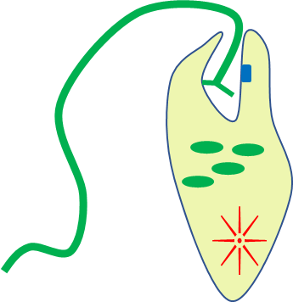
Levels of Organisation
Do now activity: What do we remember about the structural features of the following unicellular organisms?
Euglena
Amoeba

Slide 3
Progress indicators
GOOD PROGRESS:
Recall examples of tissues, organs and organ systems
Describe the components of tissues, organs and organ systems
OUTSTANDING PROGRESS:
Explain the hierarchy of organization in a multicellular organisms

Slide 4
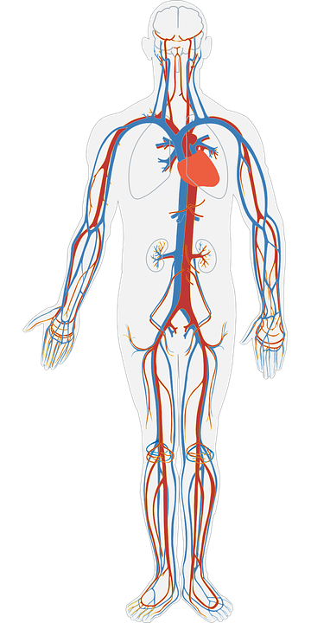
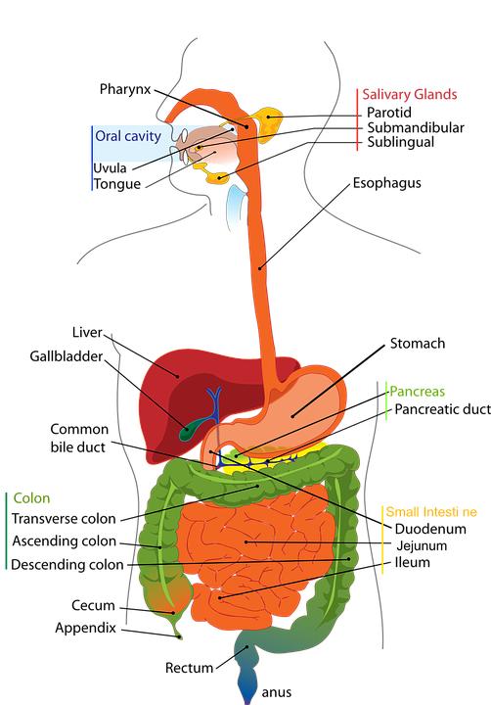
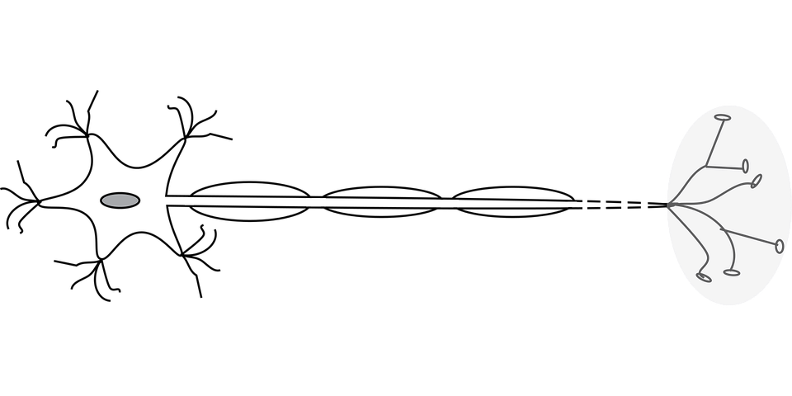
Multicellular organisms are made up of many cells.
They contain organ systems to perform their life processes.

Slide 5
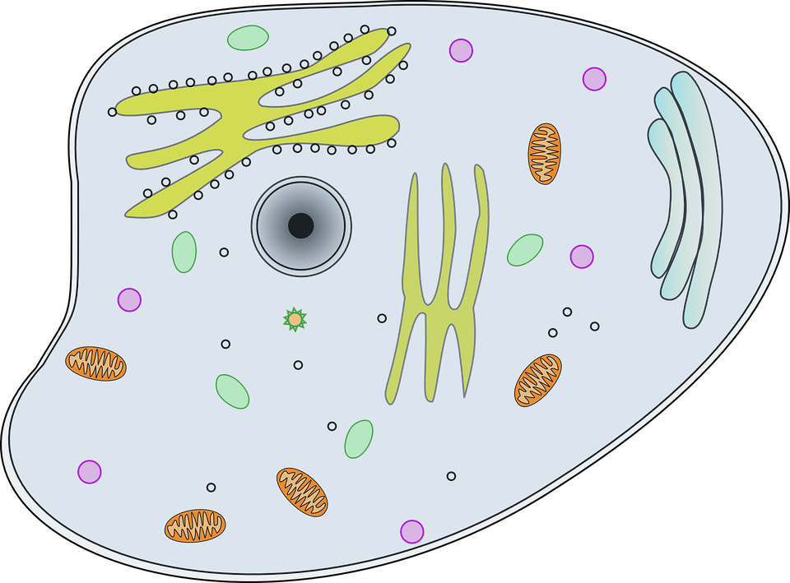
All Systems Go!
Put these in order of SIZE – smallest to largest
Organs
Cells
Organ systems
Tissues

Slide 6
Cells
Tissues
Organs
Organ systems

Slide 7
How is the body organized?
Each specific cell is grouped with other cells similar in structure and function to form tissues and ultimately organs:
Groups of tissues work together to form organs.
Cells are the basic units of life.
Groups of cells work together to form tissues.
organ
cell
Question
How is an organ formed?
What is the difference between a tissue and an organ?
tissue
Notes:
Images By Jill D.B. (Own work) [CC BY-SA 3.0 (https://creativecommons.org/licenses/by-sa/3.0)], via Wikimedia Commons

Slide 8
So what is an organ system?
An organ system is consists of many organs working together to carry out a common function
Examples of organ systems
Task: Brainstorm in your books different examples of organ systems in the human body

Slide 9
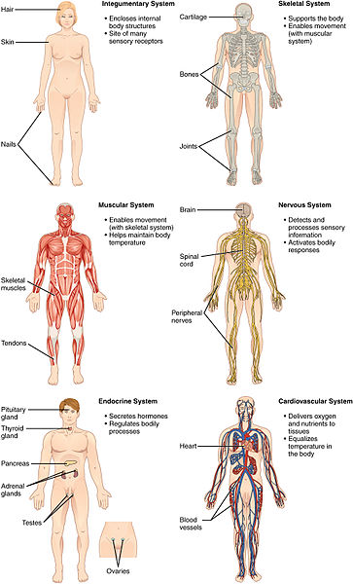
Self-assessment: How many did you think of?
Others include the reproductive system and the endocrine system

Slide 10
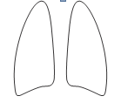
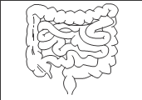
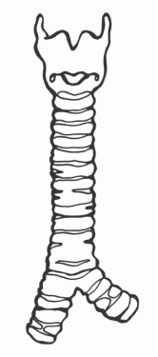
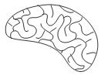
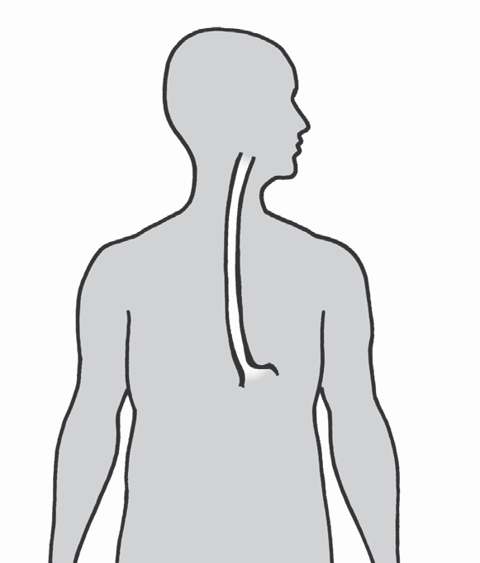
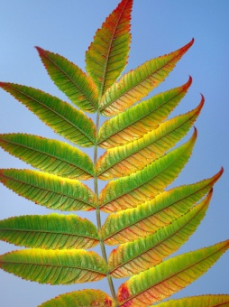
Task: From the selection of organs below select the ones you think make up the following organ systems:
Digestive system
Respiratory system
Water transport system
Lungs
Stem
Heart
Intestines
Roots
Windpipe
Brain
Petal
Liver
Leaf
Gullet
Stomach

Slide 11
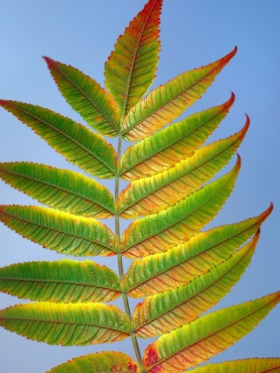
Self-assessment:
Digestive system:
Liver
Stomach
Intestines
Gullet
Respiratory system:
Lungs
Water transport system:

Slide 12
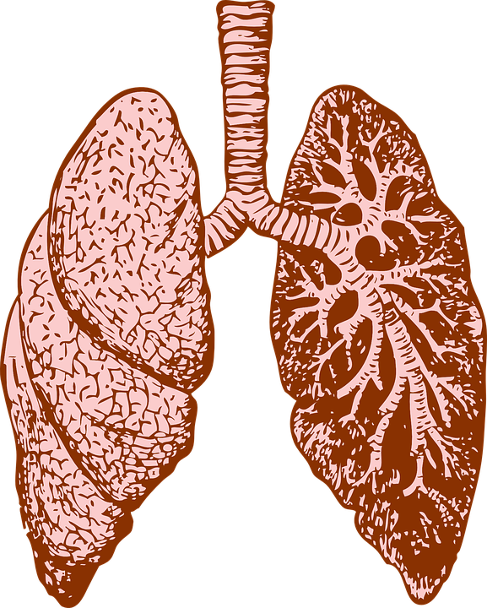
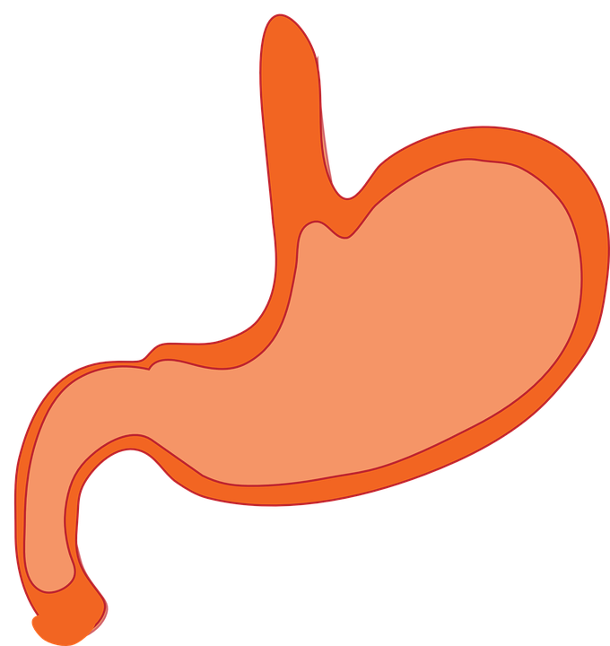
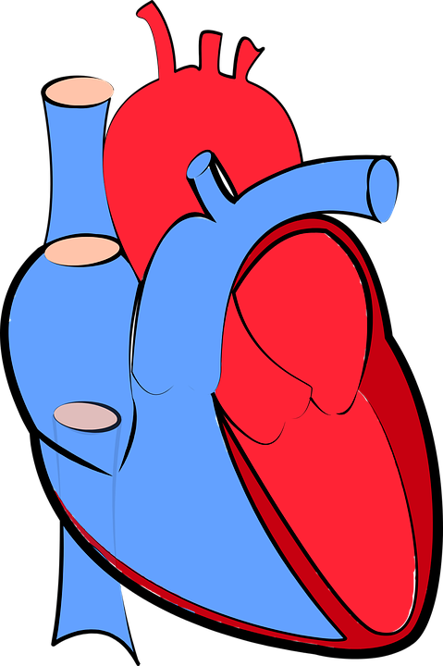
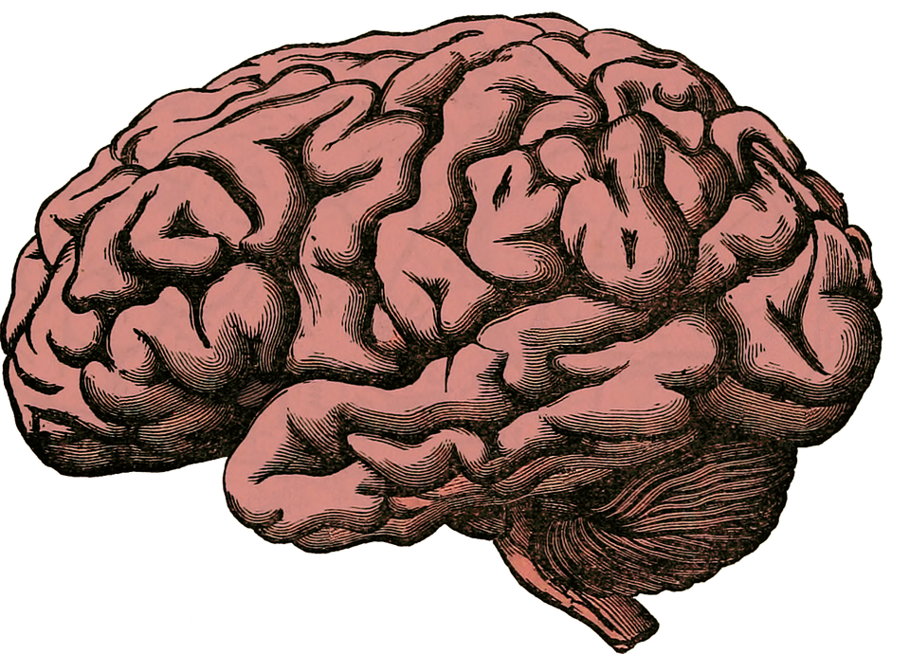
Task: Match each of the following organ systems to their function:
Respiratory system
Digestive system
Circulatory system
Nervous system
Regulates behaviour and responses to the environment
Transport nutrients, wastes, hormones and gases
Moves air into and out of the lungs to control gas exchange between blood & lungs
Extracts and absorbs nutrients from food, removes waste and maintains water balance

Slide 13
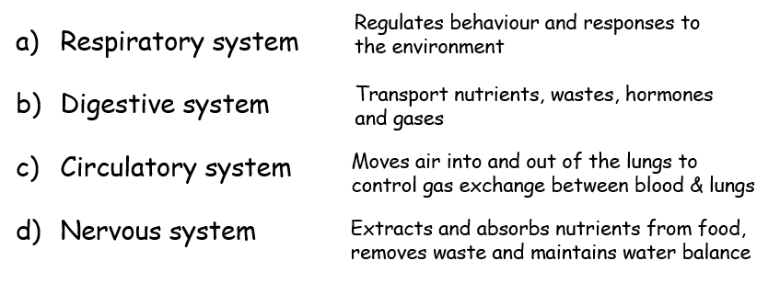
Self-assessment:

Slide 14
Task: 1. Fill in the blanks using the following key words:
Key words: organs, cells, organ systems, tissues
The human body is made up of several different ______________________ e.g. the digestive, immune and circulatory systems Organ Systems are made up of _________________
Organs are made up of ____________________ Tissues are made up of ____________________
Organ systems
Organs
Tissues
Cells
2. For each of the following, state whether they are a specialised cell, a tissue or an organ. Explain your answer:
a) sperm b) kidney c) stomach
Specialised cell
Organ
Organ

Slide 15
Task: You have been given some images and names of cells, tissues and organs.
Match the name of the cell/tissue/organ to the correct image
Place this structure into the correct column – is it a cell, tissue or organ?
Cell | Tissue | Organ

Slide 16
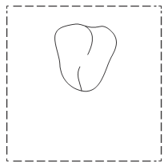
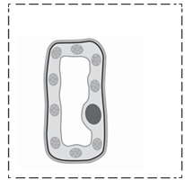
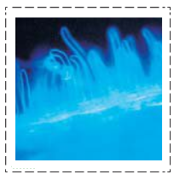
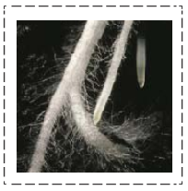
Self-assessment:
Cell | Tissue | Organ
Muscle Cell
Muscle Tissue
Heart
Palisade Cell
Palisade Tissue
Leaf
Root Hair Tissue
Root
Root Hair Cell

Slide 17
Organ systems ~ Team Challenge
Label all organs, organ systems AND include a description
Straight line behind the poster with a pen
One person fills in on box at a time
Quietly & Quickly
Winner: First team with completed poster sat quietly in their seats – will take in to assess all groups.

Slide 18
Plenary ~ Take a minute!
Spend a minute talking to the person next to you about what you have learnt today!

Slide 19
Resources

Slide 20
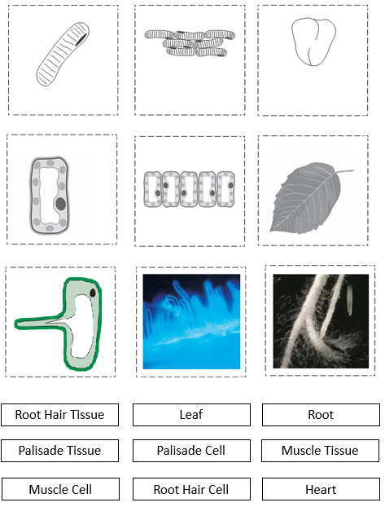

Slide 21
