Slide 1
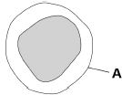
Describe the function of the cytoplasm. | 2. Name three parts found in a eukaryotic cell. C______ m________ C___________ N___________
3. The image shows one type of white blood cell. What is structure A? | 4. Describe the function of mitochondria.
Cell membrane, Cytoplasm, Nucleus
Where chemical reactions happen
Where aerobic respiration happens to release energy
Cell membrane

Slide 2
DIGESTION
GOOD PROGRESS
Describe the role of different organs in digestion
Explain how bile can speed up the digestion of lipids
OUTSTANDING PROGRESS
Explain why food molecules cannot be absorbed unless they are digested
WORD CONSCIOUSNESS
Soluble – able to be dissolved
Insoluble – incapable of being dissolved

Slide 3
context
LAST LESSON
FOOD TESTS REQUIRED PRACTICAL
THIS LESSON
DIGESTION
NEXT LESSON
ENZYMES REQUIRED PRACTICAL
WHY ARE WE STUDYING DIGESTION?
Digestion is the process that turns chunks of food into small sugars, amino acids, fatty acids and nucleotide components. These small molecules are used by all the cells in the body to make new proteins, nucleic acids, fats, sugars and hence the energy needed to run all the activities of the cell. Digestive enzymes are crucial for breaking down food, so it can be absorbed by the body. Once food is broken down into smaller molecules that can be absorbed into the bloodstream, the nutrients can be distributed to all the cells in the body and used to fuel all the cells’ activities.

Slide 4
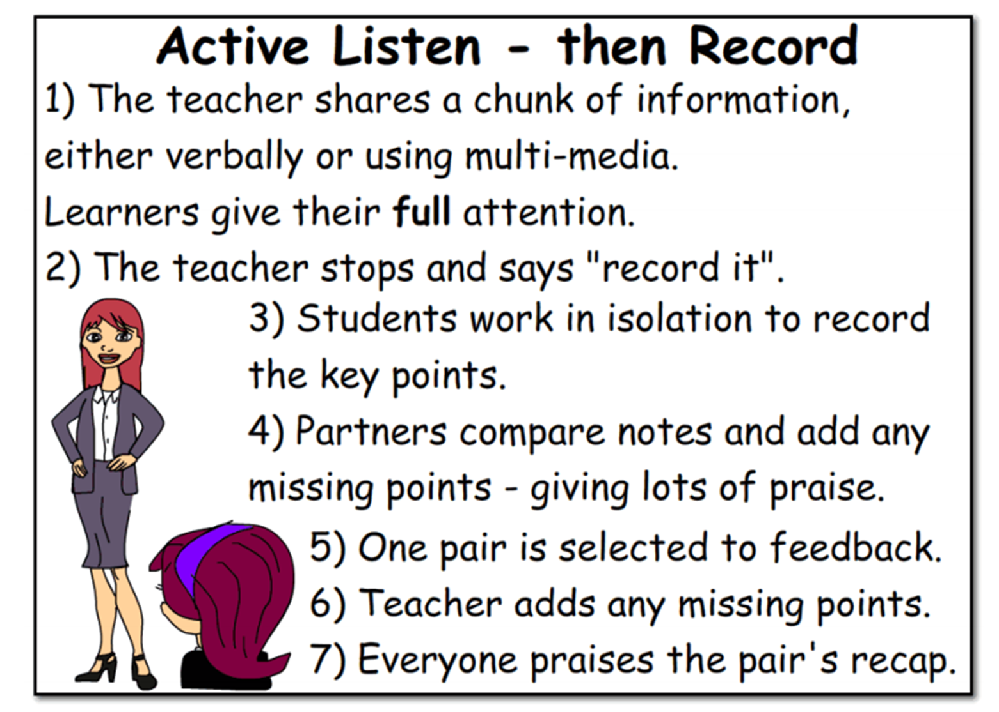
Click on the hyperlink below. Watch the video clip and make notes.
How the digestive system works

Slide 5

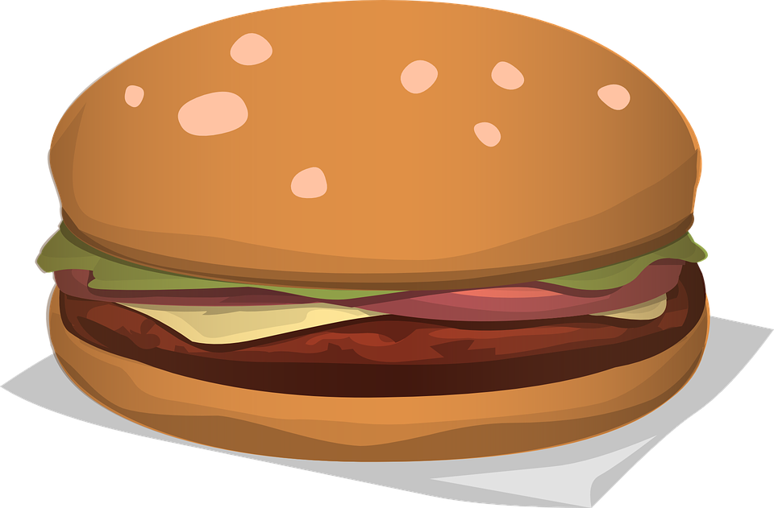
Digestion is where large insoluble molecules are broken down into smaller soluble ones that can be absorbed into the bloodstream. Digestion occurs in the GUT (tube from the mouth to the anus) and it relies on ENZYMES (biological catalysts).
Large, insoluble molecules
Small, soluble molecules
Blood stream
Notes:
http://www.bbc.co.uk/education/clips/z6nwmp3
Activity
http://www.bbc.co.uk/education/guides/zwqycdm/activity

Slide 6
The digestive system is an example of an organ system where different organs work together to digest and absorb food.
Notes:
http://www.bbc.co.uk/education/clips/z6nwmp3
Activity
http://www.bbc.co.uk/education/guides/zwqycdm/activity

Slide 7
Missing words
Pancreas
Liver
Oesophagus
Large intestine
Small intestine
Anus
Gall bladder
Mouth
Stomach
Q1. Label your diagram of the digestive system.
Notes:
http://www.bbc.co.uk/education/clips/z6nwmp3
Activity
http://www.bbc.co.uk/education/guides/zwqycdm/activity

Slide 8
Notes:
Print

Slide 9
1. Mouth
a. Where faeces is stored until it is ready to be excreted
b. Large insoluble pieces of food are broken down into small soluble pieces
2. Oesophagus
c. Food is passed down this tube
3. Stomach
d. Large insoluble pieces of food are broken down into small, soluble pieces which can then be absorbed into the bloodstream
4. Liver
5. Small intestine
Muscular ring which controls excretion of faeces
Water is absorbed from undigested food, what is left forms faeces
6. Large intestine
f. Food is chewed up into smaller pieces, salivary glands release enzymes to help with this process
7. Rectum
8. Anus
g. Produces bile to help with the digestion of fats

Slide 10
1. Mouth
a. Where faeces is stored until it is ready to be excreted
b. Large insoluble pieces of food are broken down into small soluble pieces
2. Oesophagus
c. Food is passed down this tube
3. Stomach
d. Large insoluble pieces of food are broken down into small, soluble pieces which can then be absorbed into the bloodstream
4. Liver
5. Small intestine
Muscular ring which controls excretion of faeces
Water is absorbed from undigested food, what is left forms faeces
6. Large intestine
f. Food is chewed up into smaller pieces, salivary glands release enzymes to help with this process
7. Rectum
8. Anus
g. Produces bile to help with the digestion of fats

Slide 11
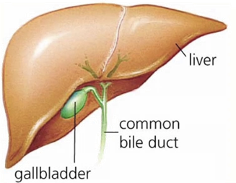
Bile is made in the liver and stored in
the gall bladder. It is alkaline to
neutralise hydrochloric acid from
the stomach. It also emulsifies fat
to form small droplets which
increases the surface area.
The alkaline conditions and large
surface area increase the rate of fat
breakdown by lipase.
Q2. Where is bile made?
Q3. Where is bile stored?
Q4. Why is bile alkaline?
Q5. How does bile emulsify fats?

Slide 12
ACTIVITY – Fill in the gaps
What role does bile have in digestion?
• It neutralises food, coming from the stomach , which is acidic .
• It provides an alkaline environment – which is the optimum pH for the enzymes which work in the small intestine.
• It emulsifies fat – increasing the surface area of the fat exposed to
lipase enzymes.

