Slide 1
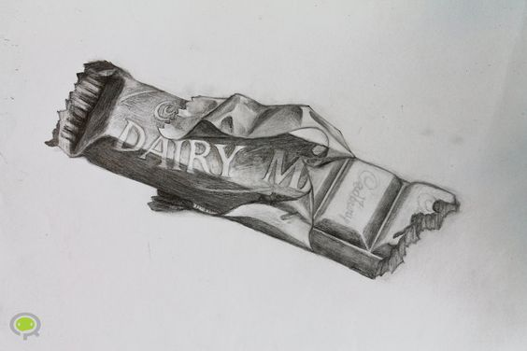
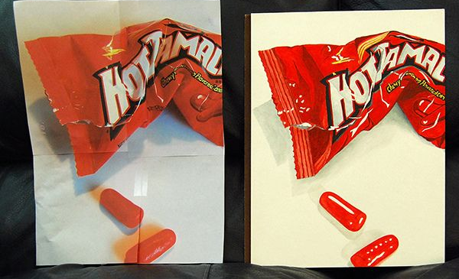
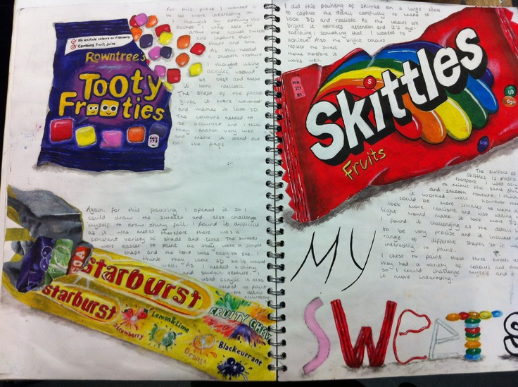
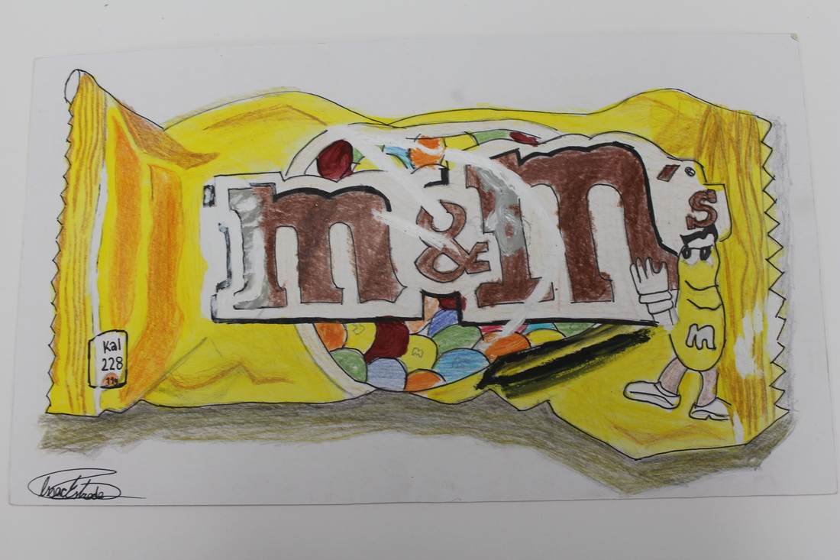
Task 1 – Observational Drawing – Sweet Wrapper
Place a sweet wrapper/chocolate/crisp packet in front of you on the table.
Observe the shape, form, sizes of the objects, draw what you see. ONLY DRAW WHAT YOU CAN SEE.
Add shading to make your drawing look 3D
Look at the examples on this page

Slide 2
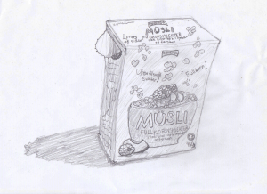
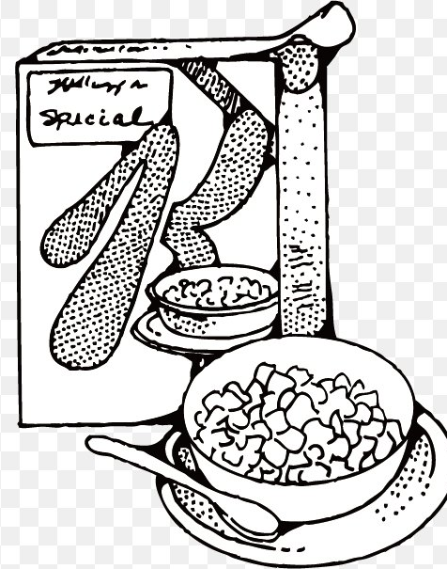
Task 2– Observational Drawing – Cereal Box
Place box of cereal in front of you on the table.
Observe the shape, form, sizes of the objects next to each other, draw what you see. ONLY DRAW WHAT YOU CAN SEE.
Add shading or colour to make your drawing look 3D
Look at the examples on this below to give you ideas and
inspiration

Slide 3
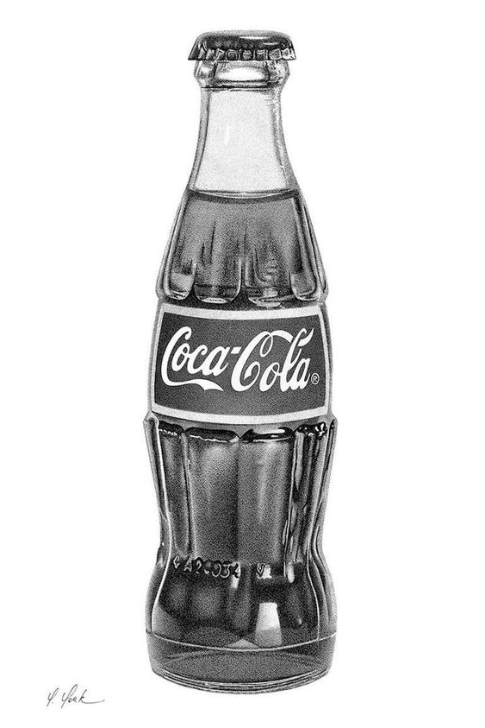
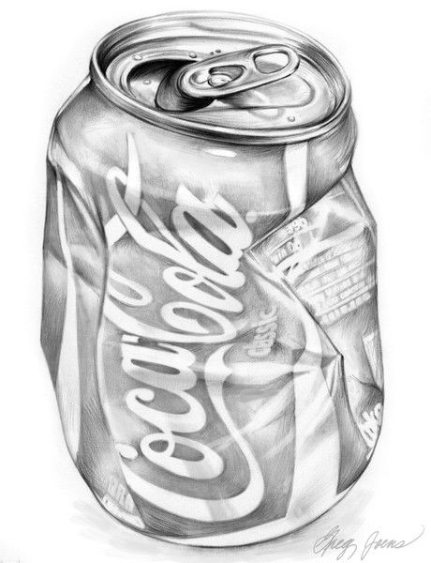
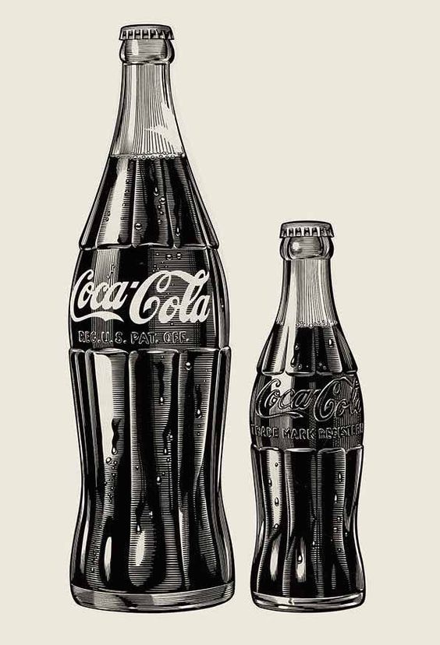
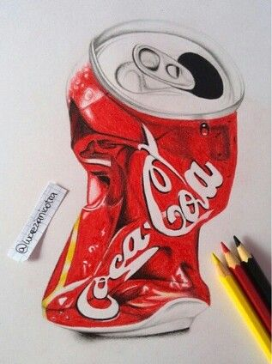
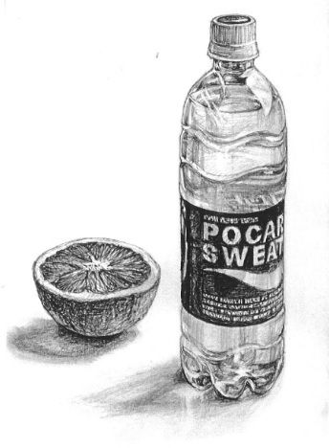
Task 3– Observational Drawing – Pop Bottle or Can
Place a bottle of pop or a can in front of you on the table.
Observe the shape, form, sizes of the objects next to each other, draw what you see. ONLY DRAW WHAT YOU CAN SEE.
Add shading or colour to make your drawing look 3D
Look at the examples on this below to give you ideas and
inspiration

Slide 4
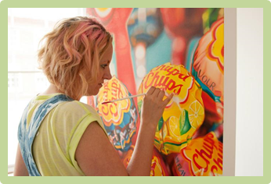
Task 4– Sarah Graham Copy
On the next slide there are 6 images of Sarah Graham work
Choose 1 and copy exactly as you see it.
Use colour or shading if you do not have coloured crayons (NO FELTS)

Slide 5
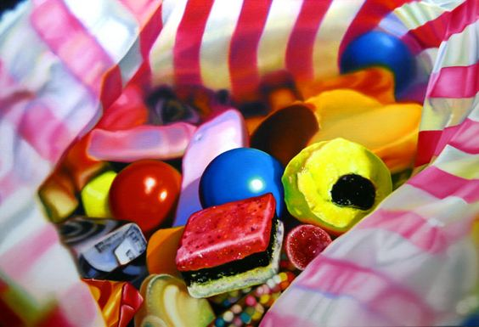
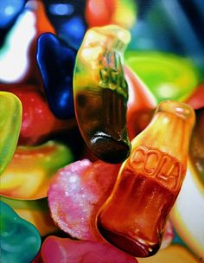
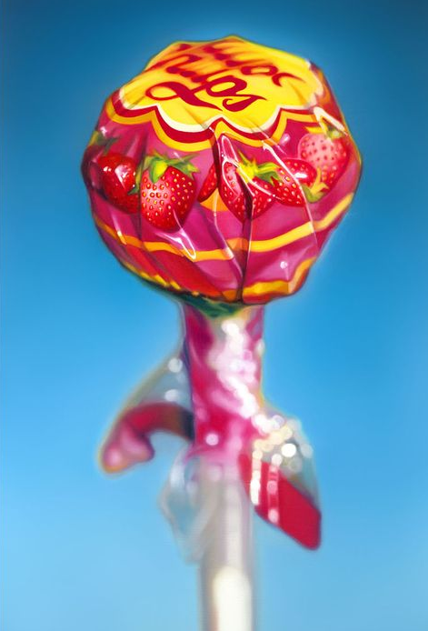
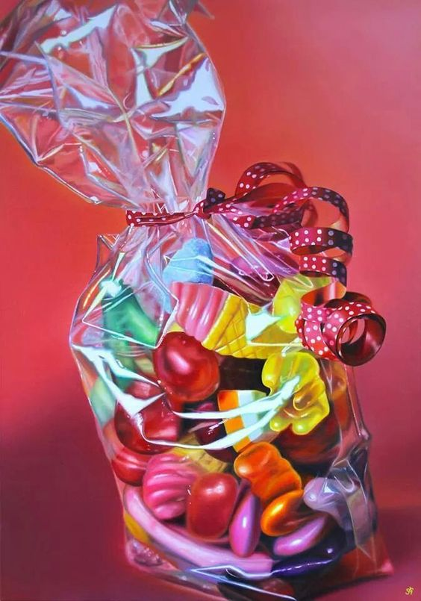
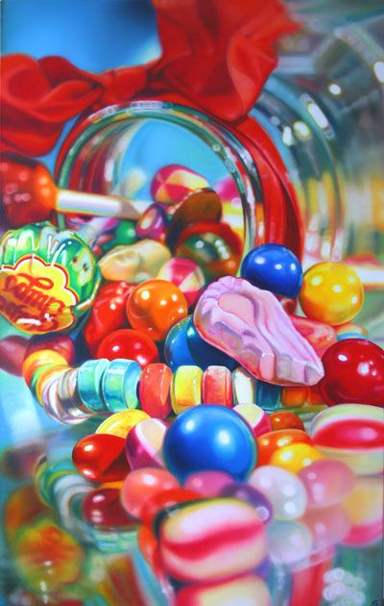
Oil Paintings

