Slide 1
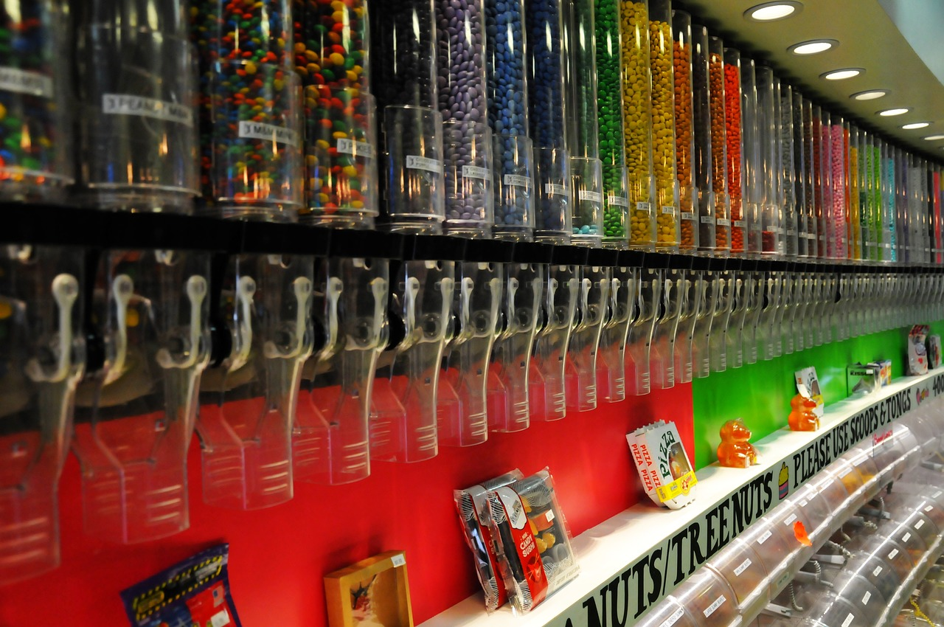
Descriptive Writing Practice
Write down all the different things you can see, hear, touch, taste and smell in this sweet shop.
Extension: Write five ‘wow’ words you could use to describe this shop.
Notes:
http://www.youtube.com/watch?v=aMICD3aMZpw

Slide 2
Learning Objectives
To describe the key features of a piece of descriptive writing.
To apply our understanding to our own descriptive writing.
To evaluate our descriptive writing so far based on clear success criteria

Slide 3
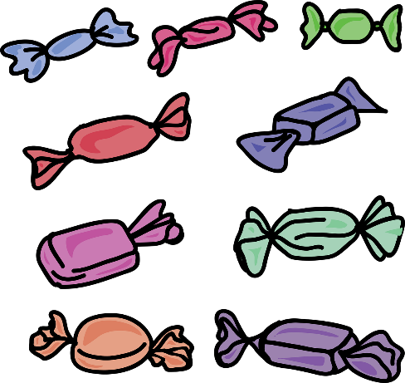
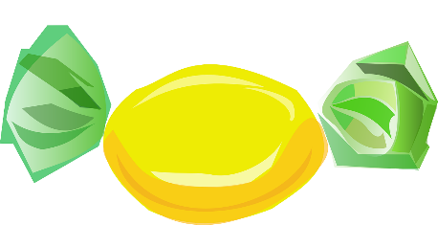
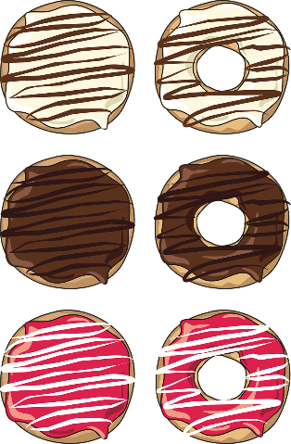
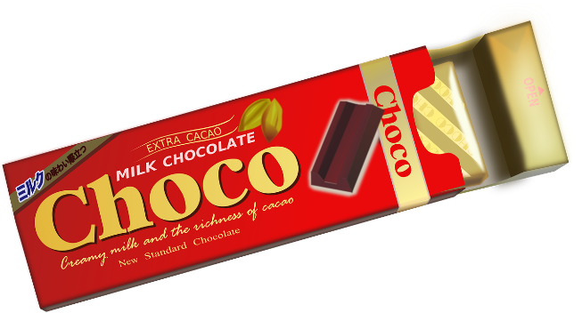
Choose one of the worksheets
Challenge
Extra Challenge
Mega Challenge

Slide 4
Challenge Worksheet
Not sure how to start? Use this to help you:
I would soon be inside. Amazingly, I could already smell the wonderful, delicious and powerful smells coming from the sweets. …
Paragraph One: Explain what it was like waiting outside the shop.
Paragraph Two: Explain how you felt and what you saw, heard, smelt, tasted and felt.
Paragraph Three: What did you do when you were in the shop? Describe it.
Ways you could start your sentences:
-ly words: Amazingly, Surprisingly, Shockingly, etc.
-ing words: Considering, Thinking, During, etc.
Connectives: Furthermore, On the other hand, Meanwhile, etc.
WOW words you could use:
delicious delightful wonderful amazing spectacular multi-coloured sweet mouth-watering sensational beautiful stunning shining enormous giant massive breath-taking
Punctuation Reminder
Remember: Full stops, capital letters, commas, speech marks, semi-colons, colons, etc.
Challenge Worksheet
Not sure how to start? Use this to help you:
I would soon be inside. Amazingly, I could already smell the wonderful, delicious and powerful smells coming from the sweets. …
Paragraph One: Explain what it was like waiting outside the shop.
Paragraph Two: Explain how you felt and what you saw, heard, smelt, tasted and felt.
Paragraph Three: What did you do when you were in the shop? Describe it.
Ways you could start your sentences:
-ly words: Amazingly, Surprisingly, Shockingly, etc.
-ing words: Considering, Thinking, During, etc.
Connectives: Furthermore, On the other hand, Meanwhile, etc.
WOW words you could use:
delicious delightful wonderful amazing spectacular multi-coloured sweet mouth-watering sensational beautiful stunning shining enormous giant massive breath-taking
Punctuation Reminder
Remember: Full stops, capital letters, commas, speech marks, semi-colons, colons, etc.

Slide 5
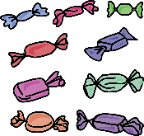
Extra Challenge Worksheet
Not sure how to start? Use this to help you:
I would soon be inside. Amazingly, I could already smell the wonderful, delicious and powerful smells coming from the sweets. …
Ways you could start your sentences:
-ly words: Amazingly, Surprisingly, Shockingly, etc.
-ing words: Considering, Thinking, During, etc.
Connectives: Furthermore, On the other hand, Meanwhile, etc.
Paragraphing Suggestion
Remember, you don’t have to organise you paragraphs like this, this is just to help you if you are stuck.
Paragraph One: Explain what it was like waiting outside the shop.
Paragraph Two: Explain how you felt and what you saw, heard, smelt, tasted and felt
Paragraph Three: What did you do when you were in the shop? Describe it.
Bonus Paragraphing: Think about how you could use a short paragraph for impact.
WOW words you could use:
delicious delightful wonderful amazing spectacular multi-coloured sweet mouth-watering sensational beautiful stunning shining enormous giant massive breath-taking
Punctuation Reminder
Remember: Full stops, capital letters, commas, speech marks, semi-colons, colons, etc. Do try and include semi-colons and colons.
Extra Challenge Worksheet
Not sure how to start? Use this to help you:
I would soon be inside. Amazingly, I could already smell the wonderful, delicious and powerful smells coming from the sweets. …
Ways you could start your sentences:
-ly words: Amazingly, Surprisingly, Shockingly, etc.
-ing words: Considering, Thinking, During, etc.
Connectives: Furthermore, On the other hand, Meanwhile, etc.
Paragraphing Suggestion
Remember, you don’t have to organise you paragraphs like this, this is just to help you if you are stuck.
Paragraph One: Explain what it was like waiting outside the shop.
Paragraph Two: Explain how you felt and what you saw, heard, smelt, tasted and felt
Paragraph Three: What did you do when you were in the shop? Describe it.
Bonus Paragraphing: Think about how you could use a short paragraph for impact.
WOW words you could use:
delicious delightful wonderful amazing spectacular multi-coloured sweet mouth-watering sensational beautiful stunning shining enormous giant massive breath-taking
Punctuation Reminder
Remember: Full stops, capital letters, commas, speech marks, semi-colons, colons, etc. Do try and include semi-colons and colons.

Slide 6
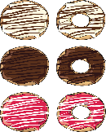
Mega Challenge Worksheet
Not sure how to start? Use this to help you:
I would soon be inside. Amazingly, I could already smell the wonderful, delicious and powerful smells coming from the sweets. …
Ways you could start your sentences:
-ly words: Amazingly, Surprisingly, Shockingly, etc.
-ing words: Considering, Thinking, During, etc.
Connectives: Furthermore, On the other hand, Meanwhile, etc.
Paragraphing Suggestion
Experiment with a variety of paragraph and sentence lengths to build up interest for your reader.
WOW words you could use:
delicious delightful wonderful amazing spectacular multi-coloured sweet mouth-watering sensational beautiful stunning shining enormous giant massive breath-taking
Sentences
Experiment with a variety of sentence lengths and types to keep the reader interested in what you are describing. When will you use short sentences? Could you include embedded clauses?
Mega Challenge Worksheet
Not sure how to start? Use this to help you:
I would soon be inside. Amazingly, I could already smell the wonderful, delicious and powerful smells coming from the sweets. …
Ways you could start your sentences:
-ly words: Amazingly, Surprisingly, Shockingly, etc.
-ing words: Considering, Thinking, During, etc.
Connectives: Furthermore, On the other hand, Meanwhile, etc.
Paragraphing Suggestion
Experiment with a variety of paragraph and sentence lengths to build up interest for your reader.
WOW words you could use:
delicious delightful wonderful amazing spectacular multi-coloured sweet mouth-watering sensational beautiful stunning shining enormous giant massive breath-taking
Sentences
Experiment with a variety of sentence lengths and types to keep the reader interested in what you are describing. When will you use short sentences? Could you include embedded clauses?

Slide 7
Choose one of the worksheets to help you write out your own description of a candy shop. Remember that you can add extra information to your description.
Remember to describe the five senses:

Slide 8
Peer assessment
WWW: Write down one thing the student has done well in their descriptive writing.
EBI: Write down one thing they will need to work on the next time.
Mega Challenge peer assessment:
WWW: Write down one aspect the student has done well on for each of the following: sentences, punctuation, punctuation and vocabulary.
EBI: Give them two targets that you think are the most important for them to concentrate on.
Banned targets:
Improve handwriting
Spell better
Write more
Write in pen
Improve punctuation (be specific!)

Slide 9
Plenary: Exit Targets
You may leave the room once you have told me one area you are good at and one area of descriptive writing you need to improve on.
To describe the key features of a piece of descriptive writing.
To apply our understanding to our own descriptive writing.
To evaluate our descriptive writing so far based on clear success criteria

