Slide 1
ENTRANCE DOOR
5+
5=
5=
7=
5-
5+
4+
5+
GCSE PE – YEAR 9 – Jan-Feb
6-
6=
6=
6+
5=
7-
5=
5+
5+
4+
4+

Slide 2
DO NOW ACTIVITY: Recall and Retrieval: Tick the statements that are true.
Can you get to the challenge?...MERIT
Cardiac Output is
…The amount of blood pumped out the heart per beat
…The amount of blood pumped out the heart per minute
The three main jobs of the cardiovascular system is …
…Transport
… Breathing
…Movement
…Protection (Clotting)
…Support
…Temperature regulation
Ligaments…
…Connect bone to bone
…Connect Muscle to bone
…Keep us stable
… help us move
Cardiac Output…
…Increases with exercise
…decreases with exercise
…stays the same with exercise
Challenge 1: Name 3 ways to reduce high blood pressure…
Challenge 2: How would you work out cardiac output?

Slide 3
Recall and Retrieval: Tick the statements that are true.
Cardiac Output is
…The amount of blood pumped out the heart per beat
…The amount of blood pumped out the heart per minute
The three main jobs of the cardiovascular system is …
…Transport
… Breathing
…Movement
…Protection (Clotting)
…Support
…Temperature regulation
Ligaments…
…Connect bone to bone
…Connect Muscle to bone
…Keep us stable
… help us move
Cardiac Output…
…Increases with exercise
…decreases with exercise
…stays the same with exercise
Challenge 1: Name 3 ways to reduce high blood pressure…
Decrease stress
avoid worrying situations
regular exercise
less salt and don’t smoke
decrease LDL in diet
Challenge: How would you work out cardiac output?
Cardiac Output =
Stroke Volume x Heart Rate

Slide 4
Date: 27 January, 2020
Components of blood
 | Good | Outstanding
6+ | TBAT explain the role of different components of blood during and after physical activity. | TBAT discuss the components of blood in maximising sports performance.
3- 5 | TBAT identify the different components of blood | TBAT describe the function of blood with some link to how some support physical activity

Slide 5
Demonstrate
LAST LESSON
Question:
How is cardiac output affected during exercise?
___/ 6

Slide 6
Mark Scheme
Question: How is cardiac output affected during exercise?
States (correct) formula and definition of all
Explains what happens during exercise
Explains and describes why it is important
0-2
3-4
5-6

Slide 7
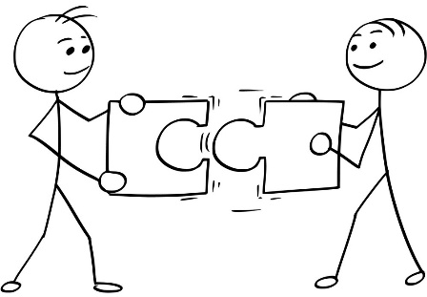
Connect
Explain what happens to Cardiac Output during am 800m run
(include information about HR and SV)
Explain and describe why Cardiac Output (include information about HR and SV) must change during an 800m run.
Discus how Cardiac Output may change throughout a football match (include information about HR and SV)
Challenge
Justify how Cardiac Output might differ with a more physically fit athlete doing a 400m Cycle to a less fit athlete

Slide 8
CARDIAC OUTPUT = INCREASES
This is because -
HEART RATE = INCREASES STROKE VOLUME = INCREASE
Cardiac Output = Stroke Volume x Heart Rate
QUESTION: Why is it so important that this increases?!?!
To get more blood to the working muscles!!!!
Why is this important? = Todays lesson!

Slide 9
Choose 1 style of homework to submit in TWO weeks time for the circulatory topic(s) you have covered so far!
6+
3
4 / 5
HOME LEARNING: 1 task every 2 weeks

Slide 10
Blood
R&R = A function of the CV system!
Blood is the body’s means of transporting substances around.
For GCSE PE – You need to:
Know the 4 different components of blood
The structure
The function / Job
How they help performance (Grade 5+)
Notes:
Now students will be presented with or introduced to the new information that they are required work with. Teachers need to consider what will be the best way to present the information so that it provides for maximum inclusion of the students.

Slide 11
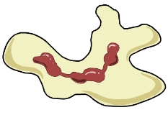
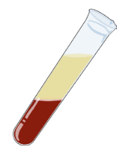
 | Good | Outstanding
6+ | TBAT explain the role of different components of blood during and after physical activity. | TBAT discuss the components of blood in maximising sports performance in specific sporting situations.
3- 5 | TBAT identify the different components of blood | TBAT describe the function of blood with some link to how some support physical activity
My Target =
White blood cells
Red blood cells
Structure (3):
Job (4/5):
Structure (3):
Job (4/5):
Role in physical activity (5+ See progress indicators) :
Role in physical activity (5+ See progress indicators) :
Platelets
Plasma
Structure (3):
Job (4/5):
Structure (3):
Job (4/5):
Role in physical activity (5+ See progress indicators) :
Role in physical activity (5+ See progress indicators) :

Slide 12
 | Good | Outstanding
6+ | TBAT explain the role of different components of blood during and after physical activity. | TBAT discuss the components of blood in maximising sports performance in specific sporting situations.
3- 5 | TBAT identify the different components of blood | TBAT describe the function of blood with some link to how some support physical activity
My Target =
White blood cells
Red blood cells
Structure (3):
Job (4/5):
Structure (3):
Job (4/5):
Information can be found here…
Role in physical activity (5+ See progress indicators) :
Role in physical activity (5+ See progress indicators) :
Task:
You will become a master of one of these components. Then…
Teach your shoulder partner (and Visa versa)
Teach your face partner (and Visa versa)
Teach your shoulder partner the final component
You need to use the information to formulate your own ideas…
(Check the PI’s for how much detail you need!)
Platelets
Plasma
Structure (3):
Job (4/5):
Structure (3):
Job (4/5):
Role in physical activity (5+ See progress indicators) :
Role in physical activity (5+ See progress indicators) :

Slide 13
Components of blood
 | Structure… (use 2 words maximum) | Function… (use one word) | Impact on sports performance within basketball
Red Blood Cells
White Blood Cells
Platelets
Plasma
LETS SEE WHAT YOU HAVE TAKEN AWAY FROM THE LAST TASK
YOU Do
During a game of basketball if you fall and start to bleed then platelets will form at the area and therefore you can continue to play for the rest of the game
WE Do
Irregular shapes
Clotting
Label the Components
In a game of basketball it must transport glucose to the muscles so that we can continue playing for the whole match and not run our of energy
I Do
Liquid
Transport
R&R CHALLENGE: Can we link to CO and add to our connect from earlier now? We need blood, now you know specifically what it carries and why. ADD…
Notes:
Students are given the time and opportunity to develop understanding of the new information and to practice using their developing skills. (I DO) Teacher to show them how to do so, then the class can do it together (we do) with teachers help and then the final two can be done one their own.
The students are actively engaged in exploring the content. At this time it would be common for them to be working in groups, talking with each other about, their work quite often making errors but most of all working towards building a personal understanding what they have been presented with.

Slide 14
Application: Exam Question
TARGET GRADE:
_______
Select and tick one examination questions from the choice below, please note the exam grade next to each one before you attempt it!
Challenge yourself – You can go above target grade but NOT below!!
Difficulty!
You are playing football and you have been tackled and cut your knee, discuss the role of the different components of blood during physical activity including getting injured. (6/7)
Explain what the job of Red Blood Cell is and compare how it differs from the white blood cells during a marathon (4/5)
Identify the main functions of all the different parts of blood and how sports might use each (2/3)
R&R CHALLENGE: Can you use information from previous lessons on CV – underline key words if you do. E.g. Cardiac Output, Functions such as transport
Notes:
Students are participating in a task or tasks that will allow them to demonstrate their developing understanding of the content that was presented. During this time teachers and students may be involved in assessing and evaluating the outcomes of the students’ learning. Over time there should be a variety of techniques and methods used to determine the levels of achievement

Slide 15
Progress Indicators:
 | Good | Outstanding
6+ | TBAT explain the role of different components of blood during and after physical activity. | TBAT discuss the components of blood in maximising sports performance.
3- 5 | TBAT identify the different components of blood | TBAT describe the function of blood with some link to how some support physical activity
Where am I at?
The role for sport ….
1)
2)
3)
4)
The 4 components are:
1)
2)
3)
4)
The functions of each is ….
1)
2)
3)
4)
I have made ________________ progress because….

Slide 16
HANDOUTS

Slide 17
DO NOW ACTIVITY: Recall and Retrieval: Tick the statements that are true.
Can you get to the challenge?...MERIT
Cardiac Output is
…The amount of blood pumped out the heart per beat
…The amount of blood pumped out the heart per minute
The three main jobs of the cardiovascular system is …
…Transport
… Breathing
…Movement
…Protection (Clotting)
…Support
…Temperature regulation
Ligaments…
…Connect bone to bone
…Connect Muscle to bone
…Keep us stable
… help us move
Cardiac Output…
…Increases with exercise
…decreases with exercise
…stays the same with exercise
Challenge 1: Name 3 ways to reduce high blood pressure…
Challenge 2: How would you work out cardiac output?

Slide 18
 | Good | Outstanding
6+ | TBAT explain the role of different components of blood during and after physical activity. | TBAT discuss the components of blood in maximising sports performance in specific sporting situations.
3- 5 | TBAT identify the different components of blood | TBAT describe the function of blood with some link to how some support physical activity
My Target =
White blood cells
Red blood cells
Structure (3):
Job (4/5):
Structure (3):
Job (4/5):
Role in physical activity (5+ See progress indicators) :
Role in physical activity (5+ See progress indicators) :
Platelets
Plasma
Structure (3):
Job (4/5):
Structure (3):
Job (4/5):
Role in physical activity (5+ See progress indicators) :
Role in physical activity (5+ See progress indicators) :

Slide 19
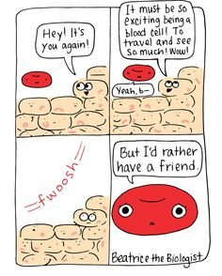
Red blood cells
Blood is made up of a number of different elements. The most common cell in blood is the red blood cell.
Also called erythrocytes.
Disc-shaped.
Made in the bone marrow.
Contain a red-coloured compound called haemoglobin which bonds with oxygen to form oxyhaemoglobin.
Transport oxygen around the body and to the tissues.
How important do you think red blood cells are to sports performance?
Notes:
low ability

Slide 20
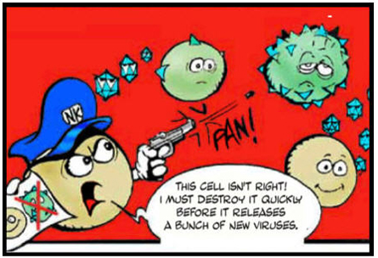
White blood cells
Blood also contains white blood cells.
Also called leucocytes.
They are bigger than red blood cells and have large nuclei.
Act as the body’s defence system and fight infection.
Some white blood cells surround and consume harmful microbes.
Some produce chemicals called antibodies that fight infection.
How important do you think white blood cells are to sports performance?
Notes:
Medium low ability

Slide 21
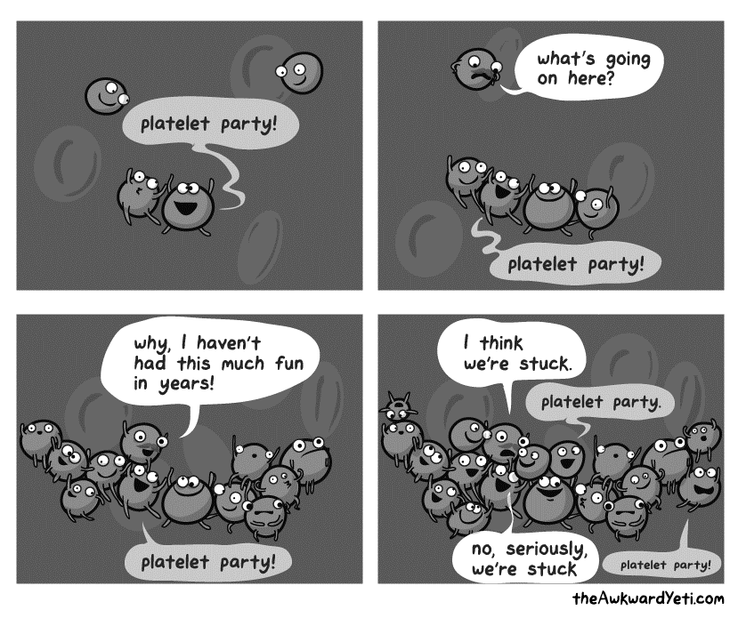
Platelets
Platelets are also carried in the blood.
Formed in red bone marrow.
Produce thrombokinase – a chemical needed for blood clotting.
Platelets help to repair tissues and close wounds both internally and externally.
When needed, they grow into irregular shapes and stick together to form a plug over the wound.
How important do you think platelets are to sports performance?
Notes:
Medium High ability

Slide 22
Plasma
The primary propose of Plasma is to transport. Plasma is the liquid/fluid part of blood that allows it to flow
The blood cells and platelets are suspended in a substance called plasma. Plasma is made up of:
90% water
inorganic salts
Glucose – energy
antibodies
urea and other waste products
plasma proteins.
How important do you think plasma is to sports performance?
plasma
Plasma can be separated from the other components of blood using a centrifuge.
Notes:
High ability

Slide 23
Components of blood
 | Structure… (use one word) | Function… (use one word) | Impact on sports performance within basketball
Red Blood Cells
White Blood Cells
Platelets
Plasma
Label the Components
Notes:
Students are given the time and opportunity to develop understanding of the new information and to practice using their developing skills also check with teacher through questioning. Teacher to show them how to do so, then the class can do it together with teachers help and then the final two can be done one their own.
The students are actively engaged in exploring the content. At this time it would be common for them to be working in groups, talking with each other about, their work quite often making errors but most of all working towards building a personal understanding what they have been presented with.

Slide 24
Application: Exam Question
TARGET GRADE:
_______
Select and tick one examination questions from the choice below, please note the exam grade next to each one before you attempt it!
Challenge yourself – You can go above target grade but NOT below!!
Difficulty!
You are playing football and you have been tackled and cut your knee, discuss the role of the different components of blood during physical activity including getting injured. (6/7)
Explain what the job of Red Blood Cell is and compare how it differs from the white blood cells during a marathon (4/5)
Identify the main functions of all the different parts of blood and how sports might use each (2/3)
Notes:
Students are participating in a task or tasks that will allow them to demonstrate their developing understanding of the content that was presented. During this time teachers and students may be involved in assessing and evaluating the outcomes of the students’ learning. Over time there should be a variety of techniques and methods used to determine the levels of achievement

Slide 25
Choose 1 style of homework to submit in TWO weeks time for the circulatory topic(s) you have covered so far!
6+
3
4 / 5
HOME LEARNING: 1 task every 2 weeks

