Slide 1
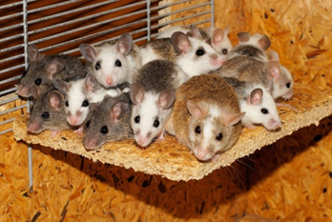
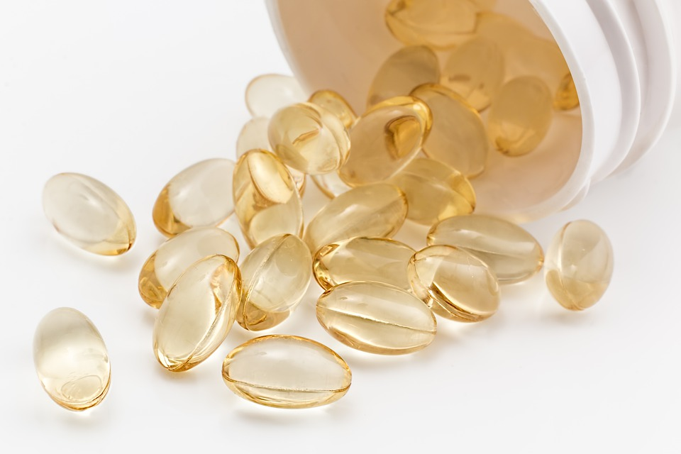
Discovering and developing drugs
Do now activity:
Can you name any examples of medical drugs?
What are the pros and cons of developing a new medicine?
What stages do you think are involved in a the drug trialling process?

Slide 2
Progress indicators
GOOD PROGRESS:
To identify the important factors of a good medicine
To give an overview of the development and discovery of drugs
OUTSTANDING PROGRESS:
To be able to explain the main steps in testing drugs

Slide 3
A good medicine is…
Think > Pair > Share: What makes a good medicine?
Effective – it prevents or cures the disease it is aimed at or at least makes you better.
Safe – it must not be toxic or have unacceptable side effects.
Stable – you need to be able to use the medicine under normal conditions and store it.
Successfully taken into and removed from the body – it needs to reach the target in your body. Then your body must be able to remove it.

Slide 4
Why don’t we have a drug for all diseases?
Every new medical treatment has to be extensively tested and trialled.
This process makes sure that it works well and is as safe as possible.
Some traditional drugs

Slide 5
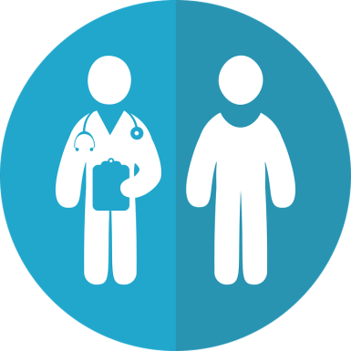
Testing
Drugs are tested for toxicity, efficacy and dose during two phases:
In the laboratory: Pre-clinical trials take place using cells, tissues and live animals to test for toxicity.
Clinical trial – Healthy human volunteers and patients – to identify any side effects.

Slide 6
Task: Active listen…

Slide 7
Clinical Trials
Phase 1: Very low doses are given to HEALTHY VOLUNTEERS to check the drug is safe in humans
Phase 2: If found to be safe, further trials are carried out on SICK VOLUNTEERS so that an optimum (best) dose can be found to treat the illness and side effects can be identified.
Phase 3: Double Blind Trials – some patients are given a placebo, which does not contain the drug. Patients are allocated to random groups so neither the doctor or the patient are aware if they have the drug or if they have taken the placebo.

Slide 8
Task: Watch the video and answer the questions
What is a placebo?
What is a double blind trial?
How do they maintain a fair test during a clinical trial?

Slide 9
Self-assessment:
What is a placebo?
What is a double blind trial?
How do they maintain a fair test during a clinical trial?
A placebo is a dummy/fake drug which will look and taste just like the real drug but contains no active ingredients.
A double-blind trial is when neither the patient or doctors knows whether the patient is taking the real drug or the placebo
Scientists ensure a fair test by checking each of the patients taking part in the study aren’t pregnant, aren’t taking medication and are generally healthy. Before the trial begins patients will have base-line checks, during the trial they will also eat and take their drugs at set times.

Slide 10
Task: Quick check…match the key word to the definition
A harmless substance that looks identical to the drug but has no effects.
Double-blind trial
Neither the doctor not the patient knows if they are receiving the drug.
Placebo
Only the doctor knows what the patient is receiving
Observer bias
The doctors might accidentally give away clues to the volunteers about the drug they are testing
Blind trial

Slide 11
Self-assessment:
A harmless substance that looks identical to the drug but has no effects.
Double-blind trial
Neither the doctor not the patient knows if they are receiving the drug.
Placebo
Only the doctor knows what the patient is receiving
Observer bias
The doctors might accidentally give away clues to the volunteers about the drug they are testing
Blind trial

Slide 12
Task: Order the following statements…
Drugs are tested on large numbers of patients. Half are given the new drug, half receive a placebo
Drugs are tested on patients to check that the drug works to treat the disease in people
Drugs are tested in test tubes and using computers to try to assess if they may be dangerous to humans
Drugs are tested on a few healthy young volunteers to ensure they are safe and to check for side effects
Drugs receive a license so doctors can prescribe them to patients
Drugs are tested in two animal species to check that they are not toxic and to find the best dosage
Notes:
Test Tubed
Animals
Health People
Patients
Randomised Trials
Market Release

Slide 13
Self-assessment:
Drugs are tested in test tubes and using computers to try to assess if they may be dangerous to humans.
Drugs are tested in two animal species to check that they are not toxic and to find the best dosage
Drugs are tested on a few healthy young volunteers to ensure they are safe and to check for side effects.
Drugs are tested on patients to check that the drug works to treat the disease in people.
Drugs are tested on large numbers of patients. Half are given the new drug, half receive a placebo.
Drugs receive a license so doctors can prescribe them to patients
Notes:
Test Tubed
Animals
Health People
Patients
Randomised Trials
Market Release

Slide 14
6 mark exam question
Tia is on work experience at a pharmaceutical company called PharmaQuest. PharmaQuest are in the process of developing a new drug to treat a new strain of influenza.
Describe and explain the steps that PharamQuest need to go through before the drug can be made available to the general public
Silent work

Slide 15
Peer-Assessment
1 mark for each step (max 3) and 1 mark for each reason (max 3):
S: Preclinical trials are carried out on cells, tissues and live animals
R: To check for toxicity, efficacy and that the drug is safe to be tested on humans
S: Clinical trials on humans with the disease
R: To see if the drug works, to test for any side-effects and to optimise the dose
S: Larger scale trials on human volunteers – using double blind trials and placebos
R: To prevent false claims and check efficacy once more
P = What did they do well/include?
I = What did they miss out?
N = What additional information could they add?

Slide 16
Plenary – Write a summary sentence about what you have learnt this lesson!

